Slide 1
What Makes People in a
Country Happy? 😆
Felix Zhu, Kevin Chen, Tommy Lin
CSE 351 Introduction to Data Science Project
Notes:
Project 4

Slide 2
Table of Contents
Data Preprocessing ⚙️
Exploratory Data Analysis 📊
Modeling 📈

Slide 3

Data Preprocessing

Slide 4
What Python Libraries Did We Use?
NumPy
Pandas
Matplotlib
Seaborn
Scikit-learn

Slide 5
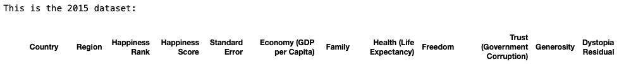
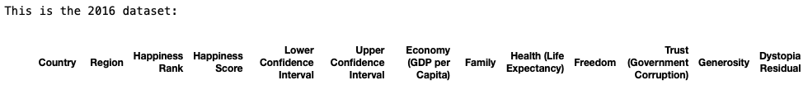

What Do the Data Sets Look Like?
Dystopia Residual?
Dystopia Residual?
Notes:
Explain observations on data:
Different columns
Names are different
2018 and 2019 missing Dystopia Residual

Slide 6
What Did We Do to Clean Our Data? (Part 1)
Removed all data we do not need
Standard Error, Region, Lower & Upper Confidence Interval, Whisker high and Whisker low
Added the ‘Year’ column to each data set
Renamed all the columns
'Year','Country', 'Happiness Rank', 'Happiness Score', 'GDP per Capita', 'Family or Social Support', 'Life Expectancy', 'Freedom', 'Trust', 'Generosity', 'Dystopia Residual'
Notes:
Explain that we do not need those data in our analysis. We only need the 6 key features.
Added the year column to each data set so that when we merge the data later, we know which row belongs to which year.
Note: The 2015, 2016, 2017 data have a column named Family and the 2018 and 2019 data have a column named Social support. Since they are similar features, we named the columns in the data set, 'Family or Social Support.'

Slide 7
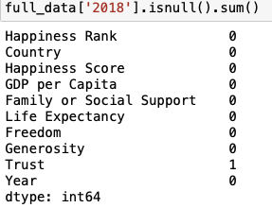
What Did We Do to Clean Our Data? (Part 2)
Dystopia Residual
Unexplained component or residual of happiness or life satisfaction that cannot be accounted for by the six key variables used in the World Happiness Report.
For the 2018 and 2019 data: Dystopia Residual = Happiness Score - Sum(6 key variables)
NULL data
Replaced with the mean of the feature.
Example: 2018
Replaced it with the mean of the Trust column.
Notes:
Dystopia Residual
Like to think of it as: Indicates whether the happiness level of a country is higher than what would be expected based on the outcomes of the 6 features
Believe: useful benchmark for comparing happiness levels across countries.
NULL data
2018 is the only one with NULL data
Why mean?:
We imputed missing values with the mean helps preserve the overall statistical properties of the data and can help reduce bias.

Slide 8
What Did We Do to Clean Our Data? (Part 3)
Renaming countries
'Somaliland region': 'Somaliland Region'
'North Cyprus': 'Northern Cyprus'
'Hong Kong S.A.R., China': 'Hong Kong'
'Taiwan Province of China': 'Taiwan'
'Trinidad & Tobago': 'Trinidad and Tobago'
'North Macedonia': 'Macedonia'
Removing countries that are not in all five data sets

Slide 9

Exploratory Data Analysis

Slide 10
Question 1
What are the central tendencies of happiness score over the years? Did they increase or decrease?

Slide 11
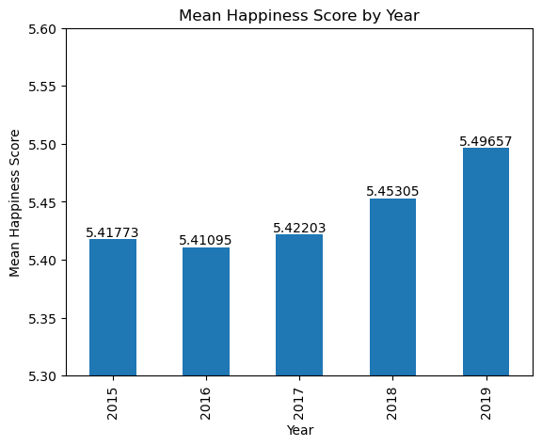
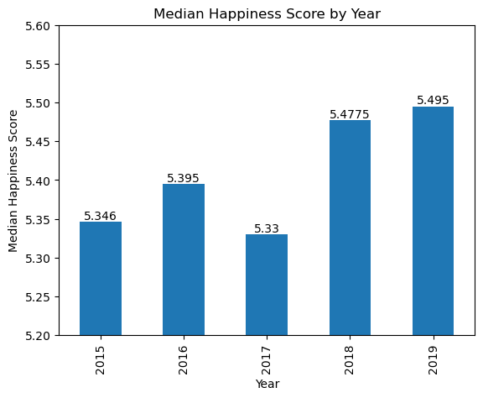
Analyzing Trends in Happiness Scores: Examining Central Tendencies Over Time

Slide 12
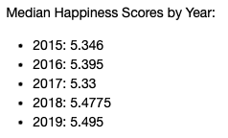
Analyzing Trends in Happiness Scores: Examining Central Tendencies Over Time
Merged all the happiness scores with the corresponding year.
Mean vs. Median
Data skewed to the right
We chose median because it gives a more precise representation of our sample set.
Notes:
Why skewed to the right?: The mean happiness score is higher than the median happiness score

Slide 13
Question 2
Which countries have stable rankings over the years? Which countries improved their rankings?

Slide 14
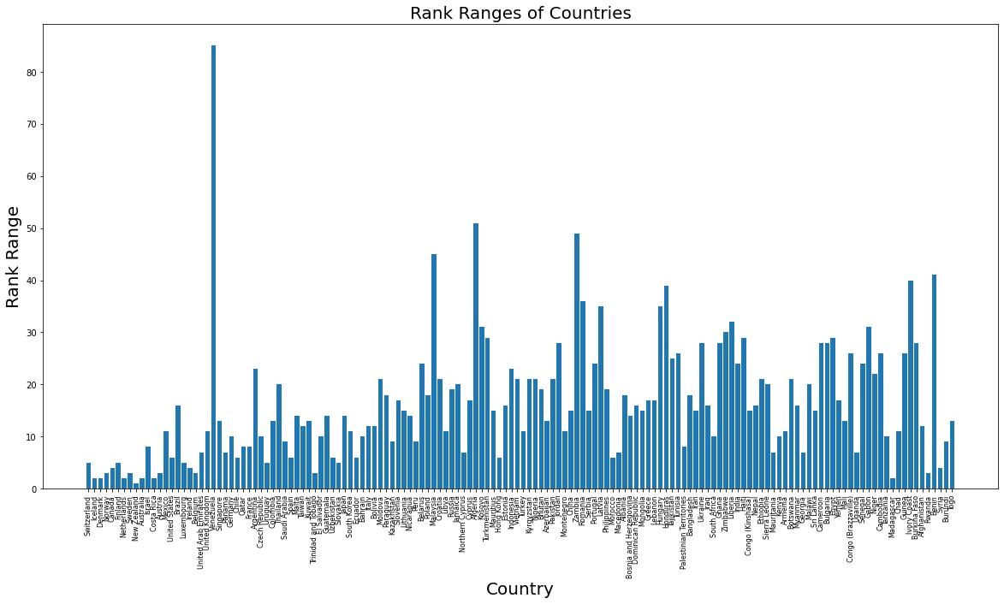
What Countries Have Stable Ranking Over the Years?
Calculated the range of a country’s happiness rank
Stable ranking is defined as range of rank being within 5 ranks, inclusive.
Only 21 countries fit this requirement, out of nearly 180+ countries.
Notes:
The countries that have stable rankings over the years are: ['Switzerland', 'Iceland', 'Denmark', 'Norway', 'Canada', 'Finland', 'Netherlands', 'Sweden', 'New Zealand', 'Australia', 'Costa Rica', 'Austria', 'Luxembourg', 'Ireland', 'Belgium', 'Uruguay', 'Trinidad and Tobago', 'Slovakia', 'Madagascar', 'Rwanda', 'Syria']

Slide 15
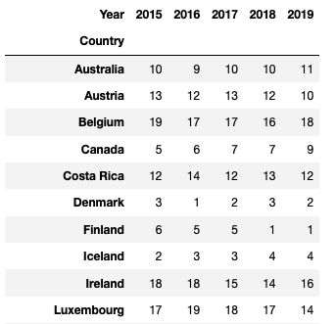
What Countries Have Stable Ranking Over the Years?
Here are 10 of the 21 stable ranking countries and their respective happiness ranks.
Notice how the range of each country’s rank is within 5 ranks.
Notes:
The countries that have stable rankings over the years are: ['Switzerland', 'Iceland', 'Denmark', 'Norway', 'Canada', 'Finland', 'Netherlands', 'Sweden', 'New Zealand', 'Australia', 'Costa Rica', 'Austria', 'Luxembourg', 'Ireland', 'Belgium', 'Uruguay', 'Trinidad and Tobago', 'Slovakia', 'Madagascar', 'Rwanda', 'Syria']

Slide 16
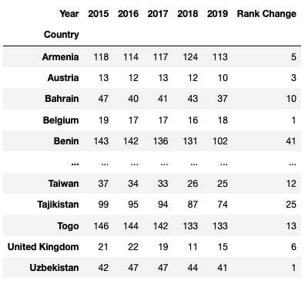
Which Countries Improved Their Rankings?
Calculated if rank(2015) - rank(2019) was negative, which would indicate rank improvement.
Any rank increase of 1 or more would signify rank improvement.
There were 70 countries that improved their ranking by 1+ ranks
Notes:
['Denmark', 'Norway', 'Finland', 'Netherlands', 'Sweden', 'New Zealand', 'Austria', 'Luxembourg', 'Ireland', 'Belgium', 'United Kingdom', 'Germany', 'France', 'Czech Republic', 'Saudi Arabia', 'Spain', 'Malta', 'Taiwan', 'El Salvador', 'Guatemala', 'Uzbekistan', 'Slovakia', 'Bahrain', 'Italy', 'Slovenia', 'Lithuania', 'Nicaragua', 'Poland', 'Jamaica', 'Cyprus', 'Kosovo', 'Mauritius', 'Estonia', 'Pakistan', 'Montenegro', 'Romania', 'Serbia', 'Portugal', 'Latvia', 'Philippines', 'Macedonia', 'Bosnia and Herzegovina', 'Dominican Republic', 'Mongolia', 'Greece', 'Lebanon', 'Hungary', 'Honduras', 'Tajikistan', 'South Africa', 'Ghana', 'Nepal', 'Armenia', 'Georgia', 'Cameroon', 'Bulgaria', 'Mali', 'Congo (Brazzaville)', 'Senegal', 'Gabon', 'Niger', 'Cambodia', 'Chad', 'Guinea', 'Ivory Coast', 'Burkina Faso', 'Benin', 'Syria', 'Burundi', 'Togo']

Slide 17
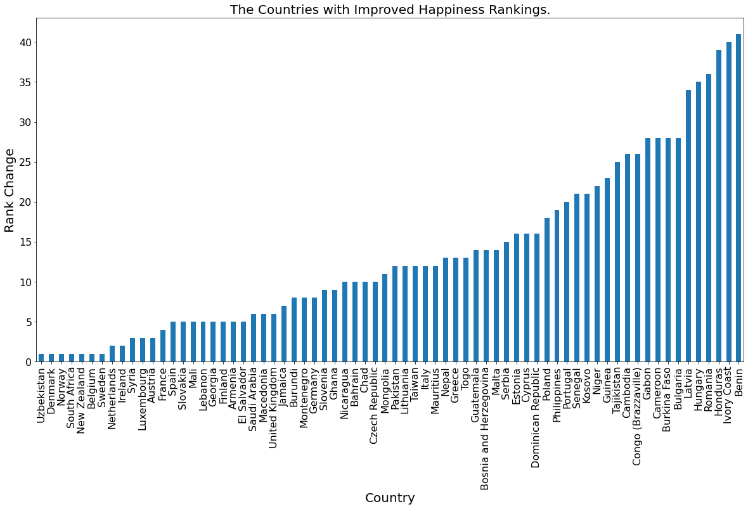
Which Countries Improved Their Rankings?
Sorted visualization of the countries and their respective rank increase.
Smallest increase of 1 rank (7), largest increase of 41 ranks (Benin).

Slide 18
Question 3
What is the relationship between happiness score and other features such as GDP, social support, freedom, etc.?

Slide 19
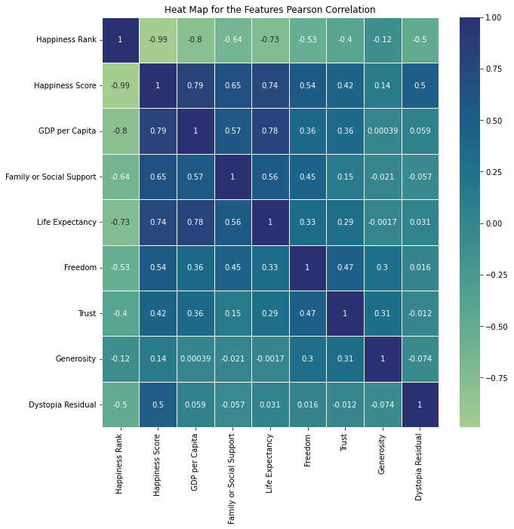
What is the Relationship Between Happiness Score and the Six Key Features of Happiness?
Pearson correlation between the features and presented as a heat map.
GDP per capita (0.79)
Family or Social Support (0.65)
Life Expectancy (0.74)
Freedom (0.54)
Trust (0.42)
Generosity (0.14)
Notes:
Happiness Rank (-0.99) - The correlation coefficient is practically -1.0, which indicates a negative correlation between happiness rank and the happiness score. The lower the numerical value is of the happiness rank, the higher the the happiness score the country has. This is obvious, there is an inverse relationship between these two values.
GDP per Capita (0.79) - The correlation coefficient is relatively close to 1.0, which indicates a moderately positive correlation between the happiness score and GDP per Capita of a country. This makes sense since a wealthier country has more people that are happy since there is less poverty among the general population.
Family or Social Support (0.65) - The correlation coefficient is closer to 1.0 than it is to 0. This indicates a relatively positive correlation between the happiness score and the family/social support. This means that if a country has families that are close with each other and/or able to befriend one another more easily, then they would generally be more happy. This makes sense since people with friends and/or a loving family are definitely not going to feel any signs of depression.
Life Expectancy (0.74) - The correlation coefficient is relatively close to 1.0, which indicates a moderately positive correlation between the happiness score and life expectancy of a country. This means that if a country has a greater life expectancy, they are more likely to be happy. This makes sense since happy people are less stressed, which leads to less health problems that arise from stress.
Freedom (0.54) - The correlation coefficient is relatively between the 0 and 1.0 mark, which indicates a moderately positive correlation between the happiness score and freedom of a country. This means that if a country has a greater perceived amount of freedom, then the people will be more happy. I expected the coefficient to be greater, but I guess with some countries like the USA, even though there is freedom, many people are unhappy whether it be poverty, inequality, politics, etc.
Trust (0.42) - The correlation coefficient is relatively between the 0 and 1.0 mark, which indicates some level of positive correlation between the happiness score and trust in government of the country. This means that if the people have a greater in the government, more generally they are happier. It is not closer to 1.0 because there could be some countries where the people don't trust the government as much, but are still relatively happy.
Generosity (0.14) - The correlation coefficient is relatively close to 0, which indicates a neutral correlation between the happiness score and generosity of a country. This means that the country's happiness doesn't necessarily depend on whether or not the people are nice to each other. They could be hesitant when people request donations, but this doesn't affect their happiness.
Dystopia Residual (0.5) - The correlation coefficient is between the 0 and 1.0 mark, which indicates a moderately positive correlation between the happiness score and dystopia residual of the features provided in the dataframe.

Slide 20
Question 4
Find out what features contribute to happiness. If you are the president of a country, what would you do to make citizens happier?

Slide 21
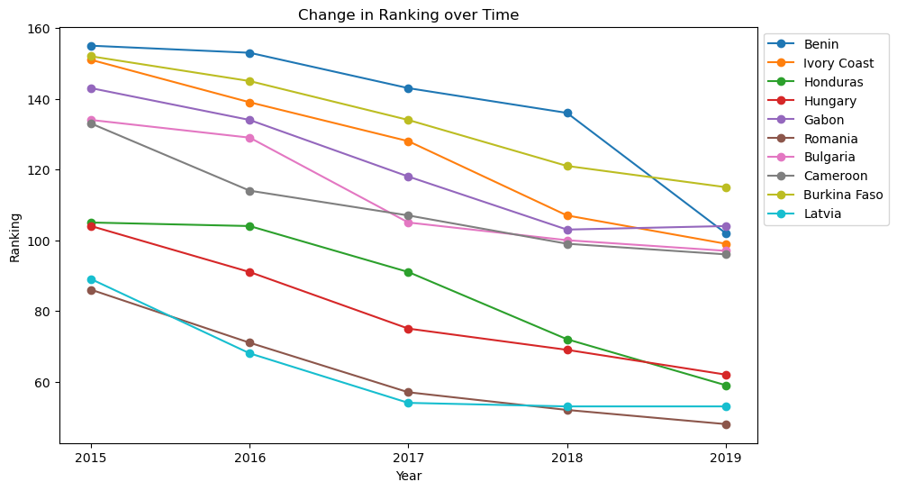
How to Make Citizens Happier as President of a Country? (Happiness Ranking)
Top 10 countries with the greatest change in their happiness rankings
Notes:
Say: These are the top 10 countries with the greatest change in their happiness rankings.
Best to stay that since we are talking about ranking, the graph looks like it is going down.

Slide 22
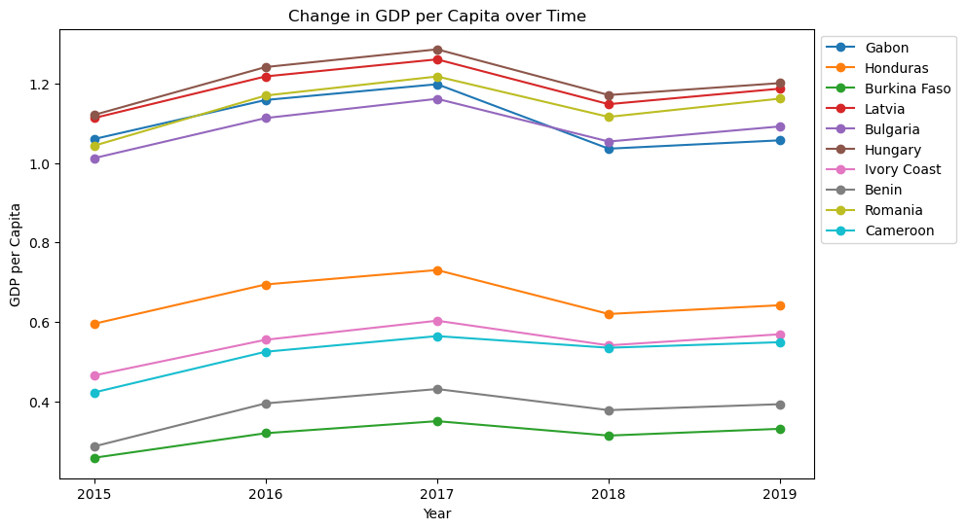
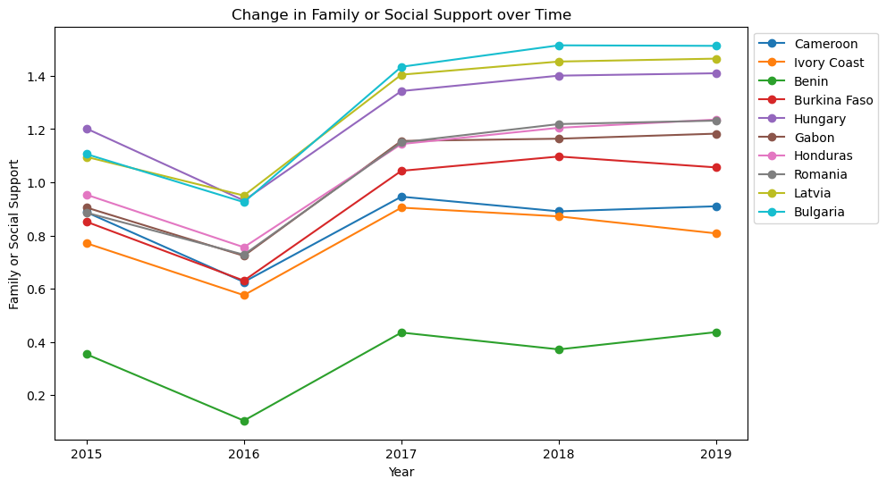
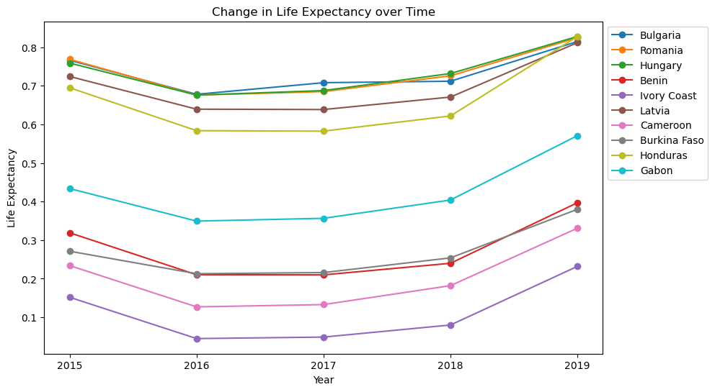
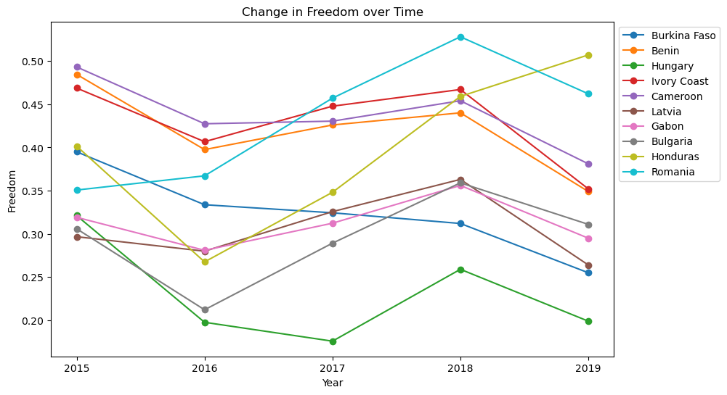
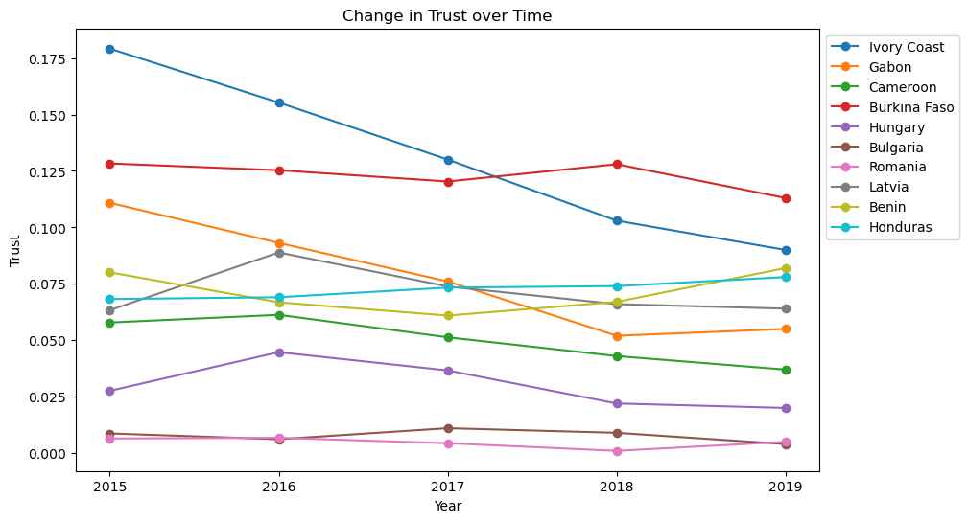
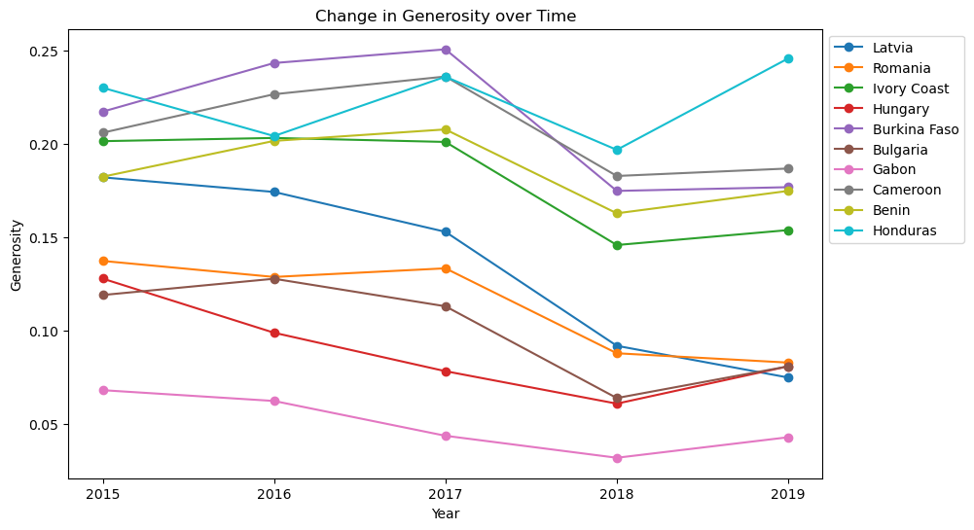
How to Make Citizens Happier as President of a Country?
Notes:
Explain that this is each features that we analyzed.

Slide 23
How to Make Citizens Happier as President of a Country?
Notes:
Explain that this is what we picked out and our answer to the question.

Slide 24

Modeling

Slide 25
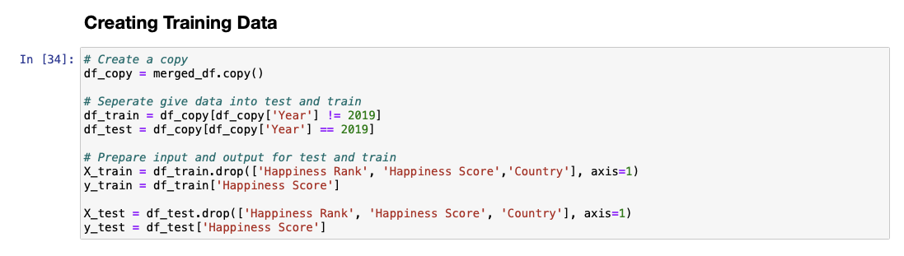
Model Setup
We set up our data by splitting it into training and testing data.
Training = 2015, 2016, 2017, 2018
Testing = 2019
We will be predicting the Happiness Rank and Score for 2019 through popular machine learning algorithms, such as, Linear Regression, Gradient Boosting, and Random Forest.

Slide 26
Model #1
Linear Regression

Slide 27
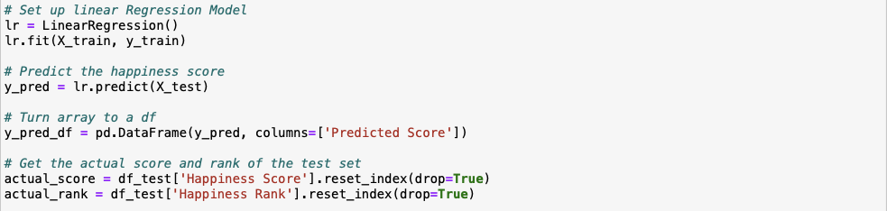
Linear Regression Purpose
This method is used to model the relationship between a dependent variable and one or more independent variables.
Goal:
Obtain the best fit line that describes the linear relationship between variables.
Predict the dependent variable based on the independent variable.

Slide 28
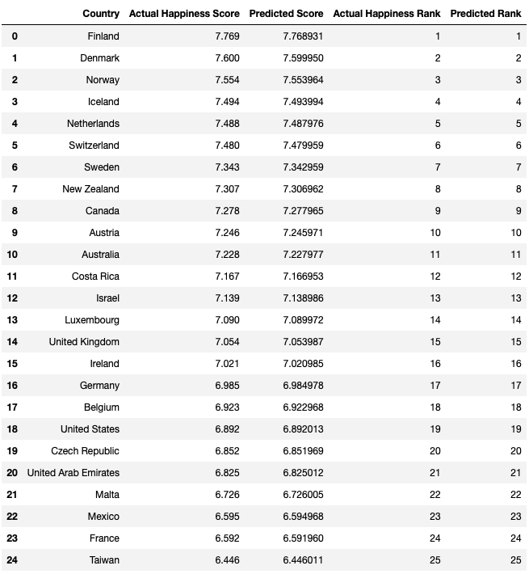
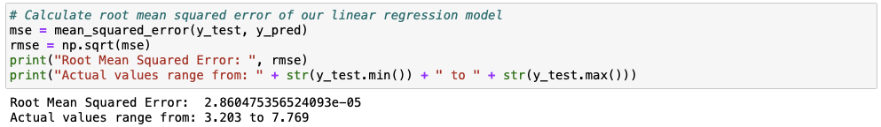
Linear Regression Outcome
Root Mean Squared Error: measure of the difference between predicted and actual observed values.
Notes:
More explanation for RMSE: Gives an idea of how close the predicted values are to the actual values, with lower values indicating a better fit between the model and the data.
Extremely low root mean squared error that we got from the linear regression model meaning that it is really good at predicting the happiness score and rank for 2019.

Slide 29
Model #2
Gradient Boosting

Slide 30
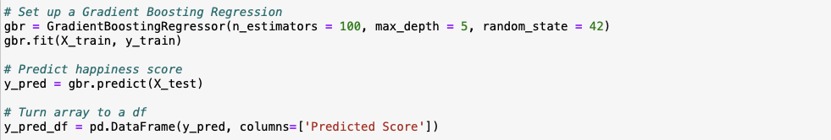
Gradient Boosting Purpose
This method works by combining multiple weak predictive models, such as decision trees, to create a more accurate and robust model.
Goal:
Iteratively adding new trees to the model and with each new tree attempting to correct errors made by previous trees.
Only limit to a certain number of decision trees and max depth of each tree to prevent any overfitting.

Slide 31
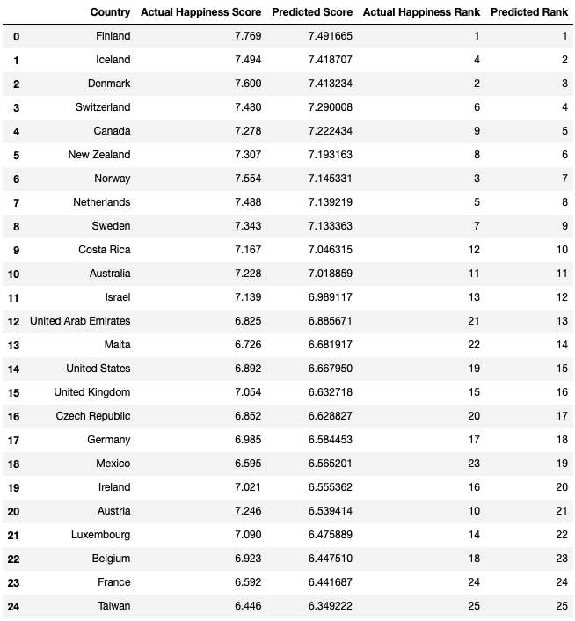
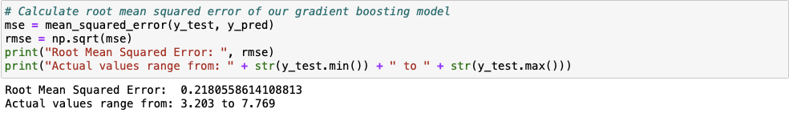
Gradient Boosting Outcome
Root Mean Squared Error: measure of the difference between predicted and actual observed values.
Notes:
More explanation for RMSE: Gives an idea of how close the predicted values are to the actual values, with lower values indicating a better fit between the model and the data.
Still pretty good root mean squared error however not as good as the linear regression model.
Point to the data

Slide 32
Model #3
Random Forest

Slide 33
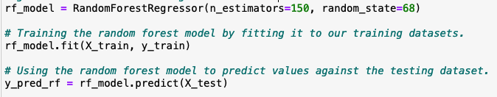
Random Forest Purpose
This ensemble learning model works by combining multiple decision trees to create a more accurate and robust model. A number of decision tree classifiers are fit on various sub-samples of the dataset and uses averaging to improve the accuracy and control over-fitting.
Goal:
Randomly selecting observations, builds decision trees, and takes the average result.
Each decision tree is created independently out of different data and features, which means not all features are considered while constructing and individual tree.
Notes:
# Setting up the Random Forest model with the parameter n_estimators equaling 150,
# which specify the number of decision trees that will be created in the random forest.
# The parameter random_state is used to set the seed for the random number generator
# used by the algorithm. Here it is 68, so the same sequence of random numbers will be
# generated each time the algorithm is run.

Slide 34
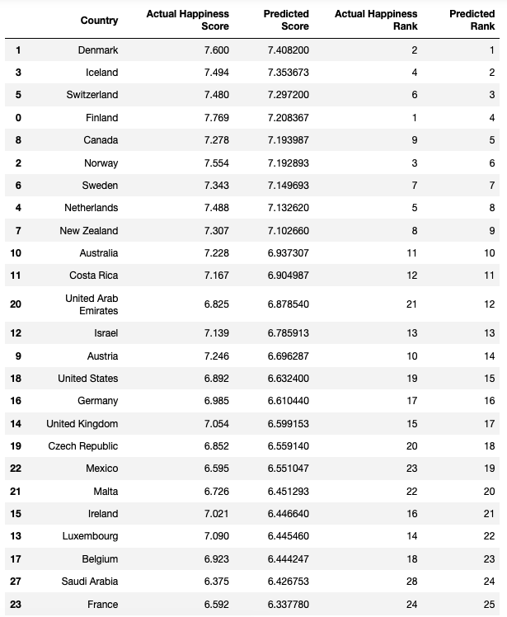
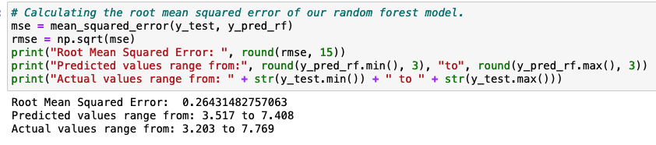
Random Forest Outcome
Root Mean Squared Error: measure of the difference between predicted and actual observed values.
Notes:
The Root Mean Squared Error in this Random Forest model is relatively high at 0.2643, where the actual range of happiness score ranges from 3.203 and 7.769. If a country's predicted value was 0.2643 off its actual value, it could potentially drop their happiness rank by more than 10 ranks from the official list. When I said drop happiness rank, the numerical value of the rank increases (1->12), where 1 is the best rank and 12 is a lower rank. The predicted range is from 3.517 to 7.408, while the actual range is 3.203 to 7.769. The predictive range was smaller, which means predictive capability could've been better.

Slide 35
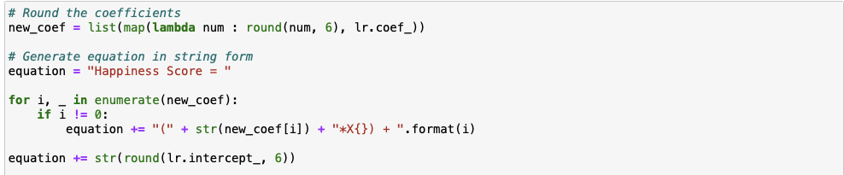
Best Model Formula
Our custom equation:
Happiness Score = (1.000047*X1) + (0.999984*X2) + (0.99988*X3) + (0.999961*X4) + (0.999884*X5) + (1.000147*X6) + (0.999984*X7) + -0.015099
X1: GDP per capita
X2: Family or Social Support
X3: Life Expectancy
X4: Freedom
X5: Trust
X6: Generosity
X7: Dystopia Residual
Notes:
State that the linear regression model had the best prediction thus we used it to generate the happiness formula.

Slide 36

The End!
Hope you were “happy” with our presentation!
Notes:
Ask audience for any questions.

