Slide 1


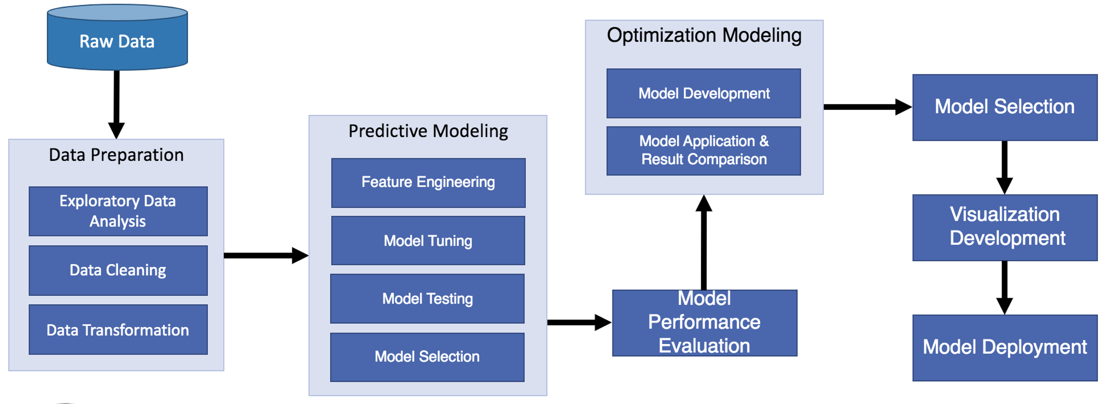
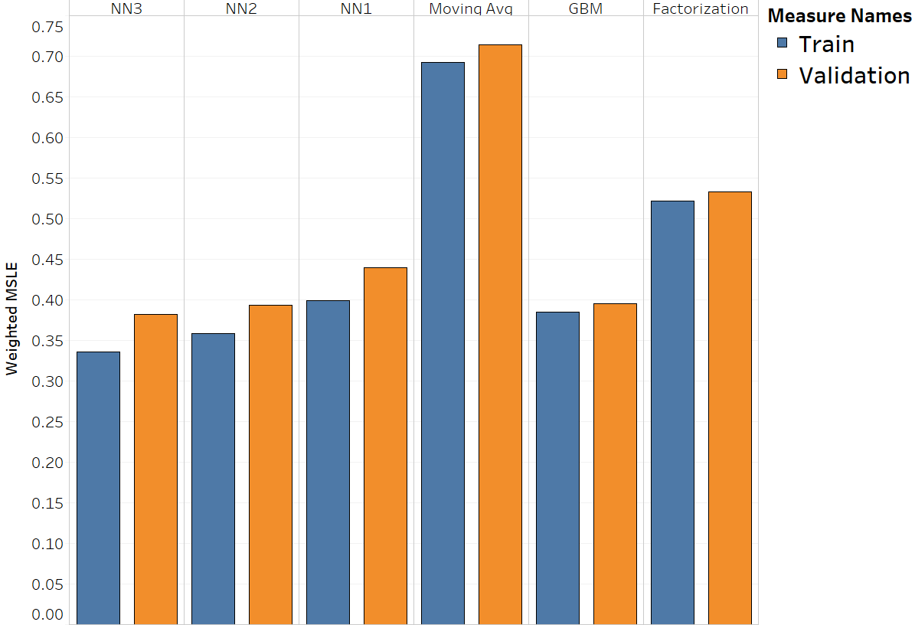
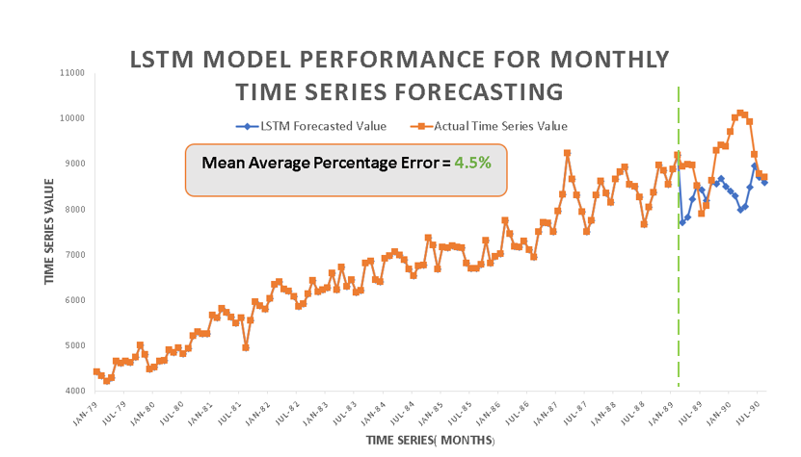
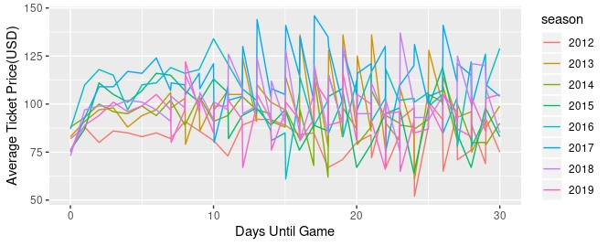
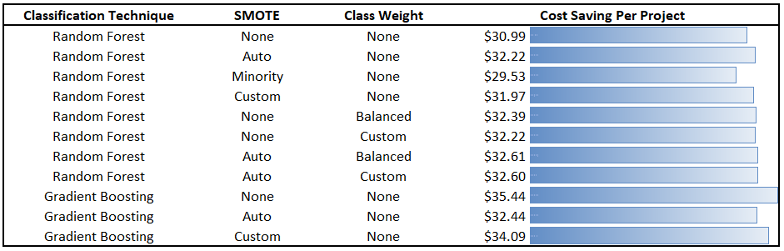
Dynamic Pricing For Sports Event Tickets
Ziyun Huang, Wenying Huang, Wei-Cheng Chen, Matthew A. Lanham
Purdue University Krannert School of Management
huang747@purdue.edu; huang814@purdue.edu; chen1614@purdue.edu; lanhamm@purdue.edu
Abstract
Methodology
Results
The objective of this paper is to create a dynamic pricing model that could achieve revenue improvement for a National Football League (NFL) team. The motivation of this research is the increased willingness for sports franchises to adopt data analytics as a tool to support their pricing decisions. Demand for sports event are varying in nature due to different factors (i.e., opponent, weather, star players). We examined single-game ticket data from both primary and secondary market and evaluated several demand forecasting models. Next, we implemented an optimization model to determine an optimal price that maximizes the revenue. Finally we built an interactive dashboard that visualizes the model result to provide a clearer picture for the franchise decision maker.
.
Data
Indianapolis Colts ticket sales transaction on the primary and secondary markets from 2012 to 2019 (unsold inventory data missing from 2012 to 2016).
Data Cleaning & Pre-Processing
The secondary table includes all available transaction information on the secondary market. Different types of transactions in the secondary market like posting, resale, cancel and expired are all cleaned up and labeled for the target. All the columns are formatted into consistency and typos are fixed. After all data is cleaned, the four tables are merged into one to prepare for model training
Feature Selection
Columns of event_name, sale_date ,season, team and event_date are all dropped as these are for identification purposes instead of being relevant features in a model. In order to enable the optimization model to be dynamic, a column that indicate how many days the transaction happen before game is included. Day of week of the game is also used as a feature considering it is reasonable to believe that people's demand for football tickets differs within a week. Opponent and Home Team current win rate before the game day was considered as current performance might affect tickets demand
Model Design
one specific game from 2019 season would be taken out of the training process and be used as the testing set. This game would then be used as demonstration for the optimization model. A game from 2019 season which is more recent could be more similar to current and future situations. Leaving this game out of the training set could guarantee the precision testing statistics and business performance analysis.
Methodology (Approach) Selection
The Randon Forest Algorithm would be used to build a predictive model in order to learn the demand of the market under different circumstances.
Given P (a ticket being sold | price, time & others) that is provided by the predictive model. We would have the expected revenue as E(Revenue) = P(ticket sold | …) * Price. Therefore, we could use a recurring method to optimize the price for every ticket to reach a maximum expected revenue.
Model Evaluation / Statistical & Business Performance Measures
The predictive models were evaluated on overall accuracy and AUC statistical performance measures because what we need from the predictive model is the predicted probability instead of the predicted outcome. Therefore, AUC would be a more reasonable indicator comparing to others like accuracy. The business performance measure we consider is the expected revenue generated from the model.
Discuss the performance of your models and refer to the figure. Don’t use a table, create a nice looking plot in Tableau, Excel, or R.
Create a plot that shows your best model predict. If it’s a classification problem, maybe create a decision boundary plot, calibration plot, lift plot, or something like that. If a regression problem show well it predicts on the test set (show Y vs Yhat). Here is a figure of a time-series forecast on a holdout set window.
Introduction
Figure 2. Study Design
Dynamic pricing allows sports team to make the optimal pricing strategy for event tickets and act upon the constantly changing market conditions to increase attendance and maximize profits with each customers, eventually boosting sales and competitiveness. The most common methods are cost-based, competitors-based, and demand-based, and the price optimization in this study is aligned with demand. To predict customer purchasing behavior at different time, we deploy machine learning tools to evaluate external factors like weather, traffic and internal factors related to past sales and team performance to generate demand prediction. The final goal is to sell the price-segmented tickets to the interested customers at the specific time through the targeted sales channel with articulated prices.
Research questions:
How well do popular machine learning approaches perform at predicting ticket demand?
How much does our pricing optimization approaches increase revenues of the past games?
Figure 4. Model Evaluation
Figure 5. Look how awesome our best model performs….
Figure 1. Indianapolis Colts Average Ticket Price vs. Days Until Games
Literature Review
Figure 6. Look how this classification performance translate into $$$$.....
Our study is novel because we compare and contrast all the methods used previously, but also ensemble them together….
Conclusions
Author | Summary | Methodology
Strnad et al. (2015) | Predict soccer match attendance by comparing numerous NN models | 3-layer MLP, 3-layer TLFN, 3-layer Elman RNN, 2-layer RBFN
Kemper et al. (2016) | Applied mathematical theory of dynamic pricing with empirical methods | Monte Carlo, Linear Regression, Logistic Regression
Shapiro et al. (2012) | Examine factors influencing ticket price for MLB team in both primary and secondary market | Compare the results of 1) 2SLS using season ticket and secondary market price as input variable and 2) OLS model excluding those variables
Diehl et al. (2015) | Investigate elasticity of demand in the secondary market for NFL ticket and how elasticity varies across different seat types | General Linear Model, includes NFL Fan Cost Index (FCI) for concessions
Reiterate why the problem is important in a sentence or two.
Provide the answers to your research questions.
Discuss how your findings can be used for improved decision-support or decision-making or anything else you feel is an important take-away from what you learned.
Table 1. Literature review summary
Acknowledgements
We thank Professor Matthew Lanham for constant guidance on this project.

