Slide 1
Craigslist Auto Categorization
for Sale Posts
Proposed Date: 12/4/19
Group 3: Ziyun Huang, Cheng Cheng, Wei-Cheng Chen, Luqi Chen, Wenying Huang

Slide 2
Agenda
2. Proposed Solution
4. Model Building
Business
Problem
3. Data
Processing
5. Future Application

Slide 3



1. Business Problem
Users are not sure of the category of product and post in general category
Reduce in view of posts
Less sales are made, Lower customer satisfaction

Slide 4


2. Proposed Solution
Collect data from categorized posts
Build a model based on collected text and image data
Use the model to implement auto-categorization function

Slide 5
3. Data Processing
Convert
Scrapy
Multiple pages
Nested layer pages – 3 layers
Data Overview
40+ Categories
81,000+ posts till 12/3/2019
21,000+ extracted sample data
3 features: Category, Title, Description
500 for each category
Convert to term-document matrix for models
Training: 70%
Validating: 30%
Text-level representation
Normalization
Remove high-frequency words
Data Cleaning
Take out general category and partition
Pre-processing
Token, Lemmatize, Remove Stop words
Data Collection
Utilize Scrapy to collect existing posts
Notes:
40+ Categories
81,000+ posts till 12/3/2019
21,000+ extracted sample data
3 features: Category, Title, Description
500 for each category

Slide 6

4. Model Building - Text
01
Support Vector Machine
Valid Accuracy: 61.79%
Naïve Bayes
Valid Accuracy: 55.11%
03
02
Logit Regression
Valid Accuracy: 57.99%
Random Forest
Valid Accuracy: 52.81%
04

Slide 7
Prediction Result
On the general category
Pred_Cat | Title
clothing & accessories | brand jacket
sporting goods | ice fishing
furniture | doctor office closing everything must go
photo/video | slabdoctor digital level
appliances | kitchen pan vintage cook boiler fryer sears roebuck aluminum
farm & garden | blue viper battery powered weed sprayer
books & magazines | comic book
video gaming | xbox one x forza horizon bundle month game pas
cars & trucks | cadillac escalade esv mile
household items | vintage hamilton beach electric knife wall holder
bicycle parts | bike rack
appliances | double stainless steel kitchen sink faucet
business/commercial | track light head
wanted | light bedroom hall foyer
toys & games | luvabella doll
bicycles | original schwinn typhoon whitewalls tire
cars & trucks | heavy cedar lattice panel
bicycle parts | tsi aluminum recycling baler
photo/video | darkroom photography photo equipment enlarger timer etc
farm & garden | snowblower

Slide 8

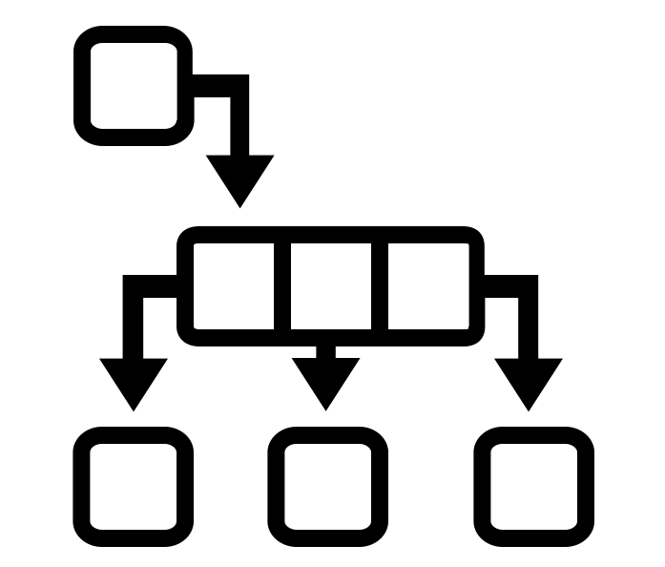


4. Model Building - Image
CNN Architectures
Pre-Trained Models
Product Categorization
Feature Extractions
Transfer Learning

Slide 9
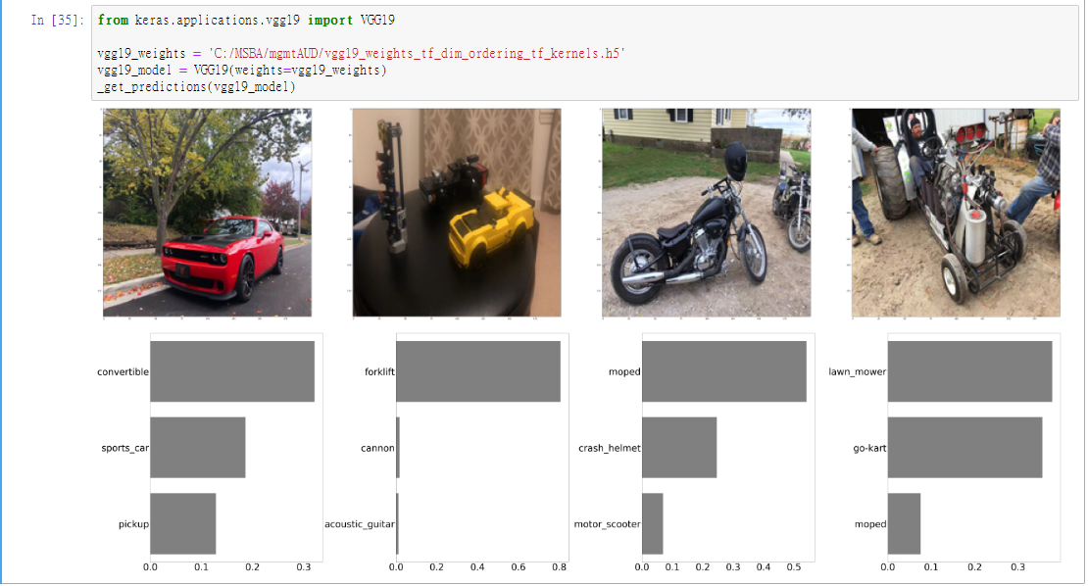
Performance Test

Slide 10
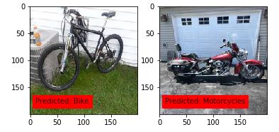
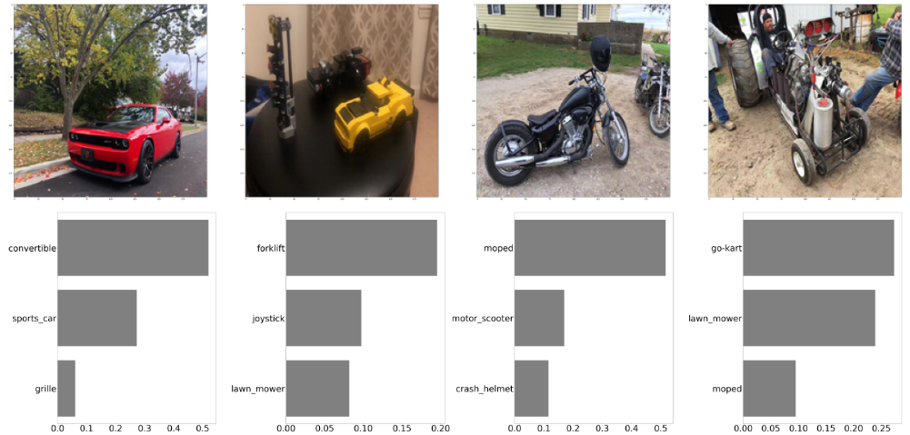
Prediction Result

Slide 11
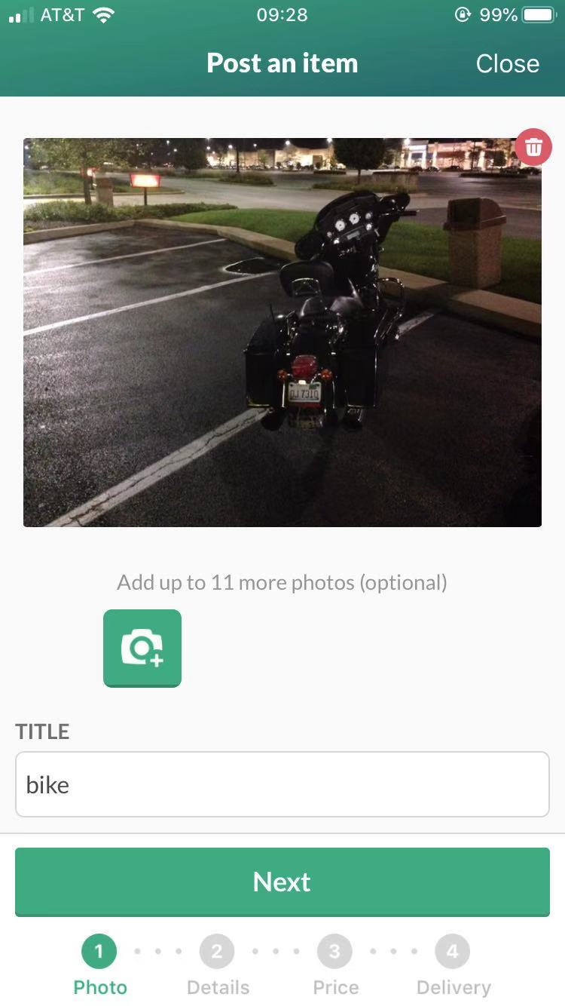
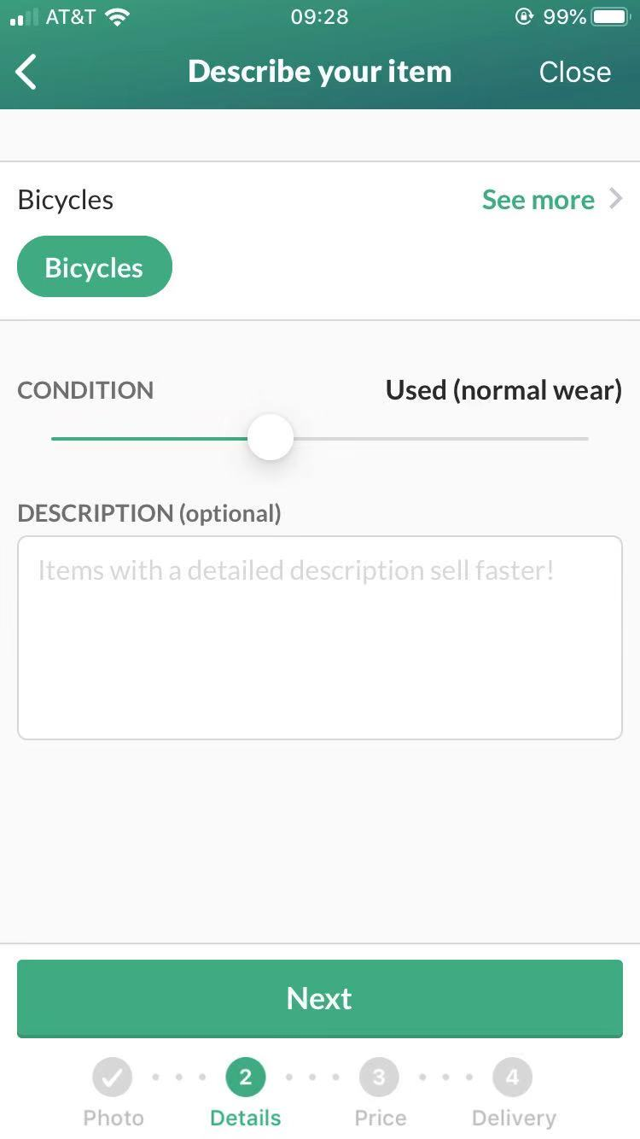

5. Future Application
implement auto-categorization function to avoid misplace of posting
Enable “batch upload & categorize”
Spam and fraud detection

Slide 12
Conclusion
Text
Image
Automatic
Categorization
Ambiguous, uncategorized posts
Irrelevant title & description
Unpleasant User Experience
Precise single-label Classifier
Minimal user interventions
Spam Detection

Slide 13
Thank you
Question & Comments

Slide 14
01
02
Content Here
Content Here
Get a modern PowerPoint Presentation that is beautifully designed. hope and I believe that this Template will your Time.
Get a modern PowerPoint Presentation that is beautifully designed. hope and I believe that this Template will your Time.
03
Content Here
Content Here
Get a modern PowerPoint Presentation that is beautifully designed. hope and I believe that this Template will your Time.
04
Get a modern PowerPoint Presentation that is beautifully designed. hope and I believe that this Template will your Time.

Slide 15
Fully Editable Icon Sets: A

Slide 16
Fully Editable Icon Sets: B

Slide 17
Fully Editable Icon Sets: C

Slide 18
