Slide 1
Approximation of Vertex Cover
Chase Briles

Slide 2
Pseudocode of Approximation
Given graph G and all edges in graph
Get each vertex(U)
if U has not been visited
Get all each adjacent vertex(V)
If V has not been visited
Set both U and V to visited
Go to next vertex

Slide 3
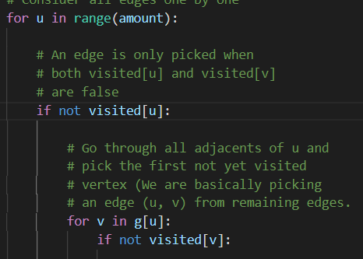
Performance Bounds
Given a graph with set vertexes V and edges E
The overall run time is O(V+E)
Most costly methods come from running both for loops

Slide 4
Algorithm Choices for Vertex Cover
Sketch algorithm choices (anytime algorithms, greedy algorithms, stochastic algorithms).
Bounds on its performance
Plot comparing difference in run time and solution quality using your test cases.

