Slide 1
Auto://

Slide 2


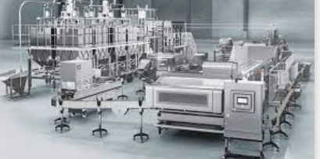
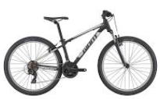
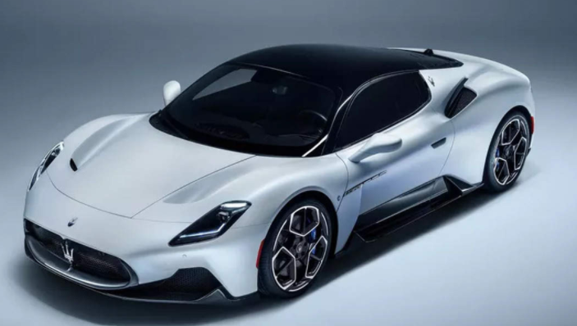
auto://center
Autonomous Services Center
auto center(cloud)
rundown
rundown
rundown
rundown
(playbook)
(clock in/report)
Virtual auto
(audio play / video drop)
Static auto
(monitoring/optimizing)
Low-Speed auto
(record/alert)
High-Speed auto
(path scheduling/mission assign)

Slide 3
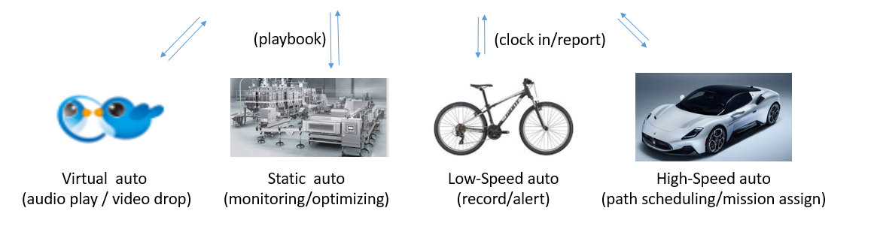
mod://play
comm://tg
odoo:// portal
watch://event
auto://center
Autonomous Services Center
filter://chart

Slide 4



auto://center
Autonomous Services Center
log://
tg://
assign
pd://
clockin
playbook

Slide 5
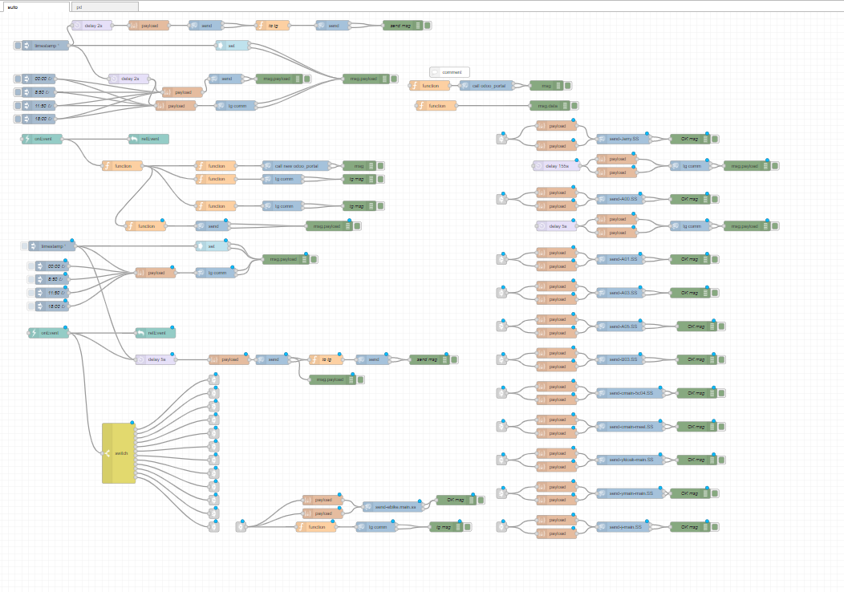

Slide 6
give it a shot !

Slide 7
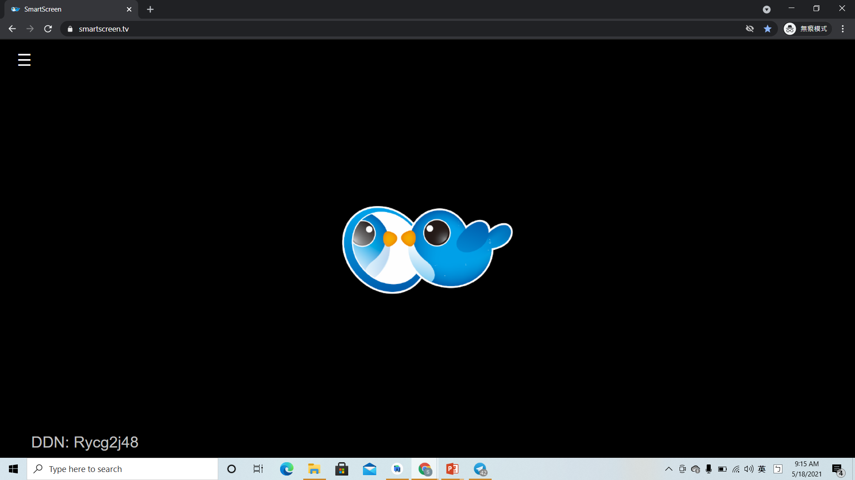
1. https://smartscreen.tv/

Slide 8
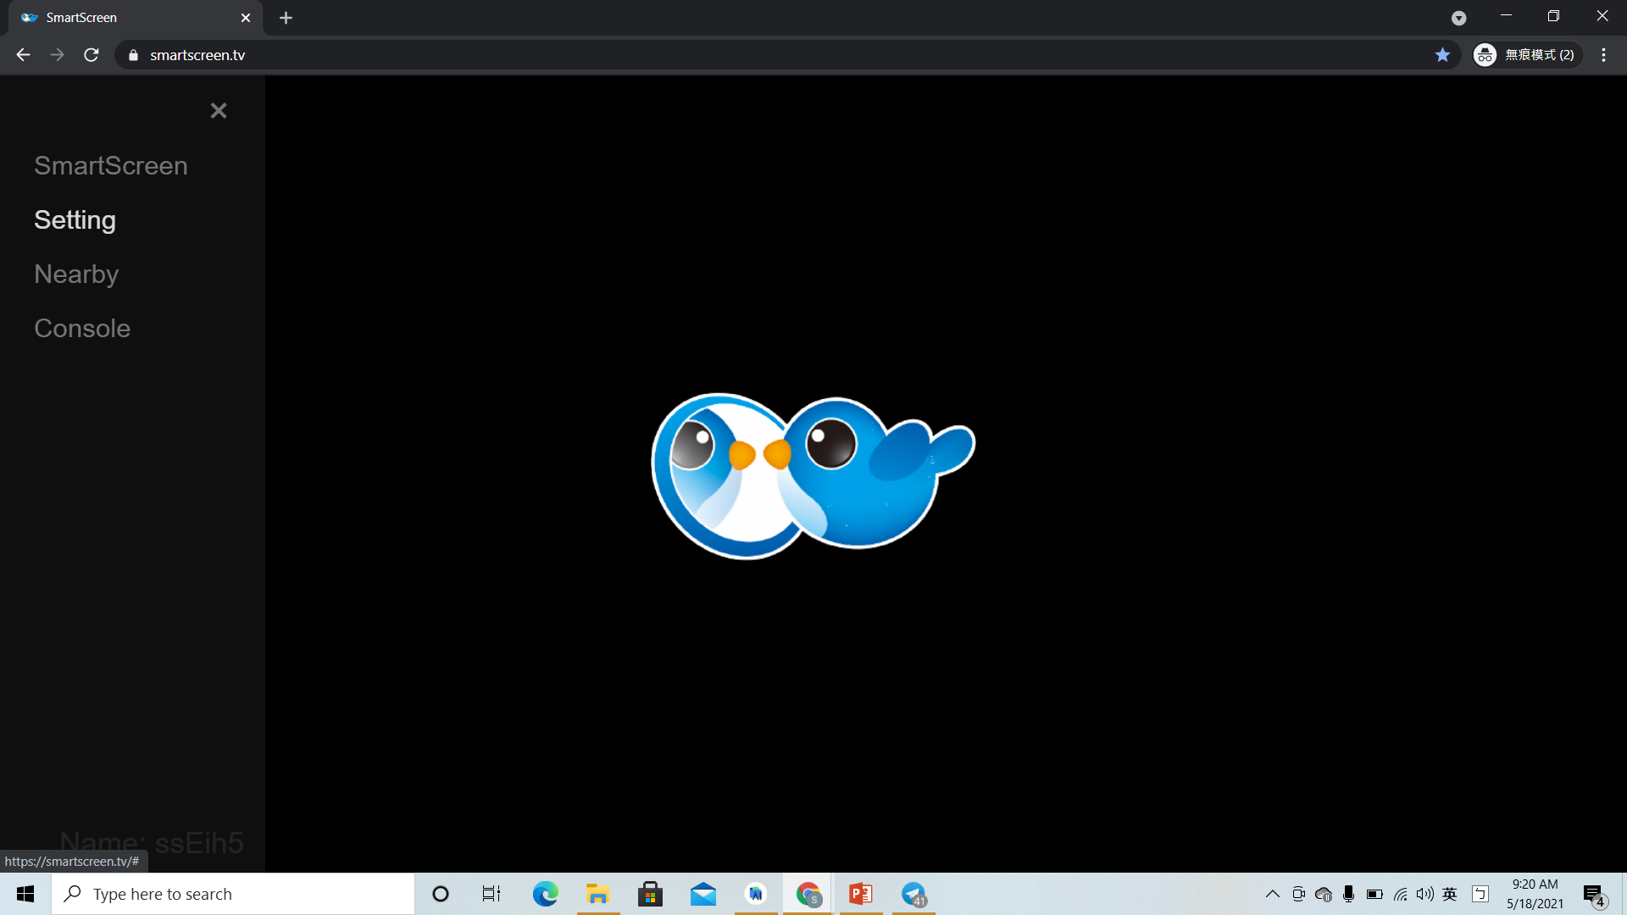
2.left upper corner button >> setting

Slide 9
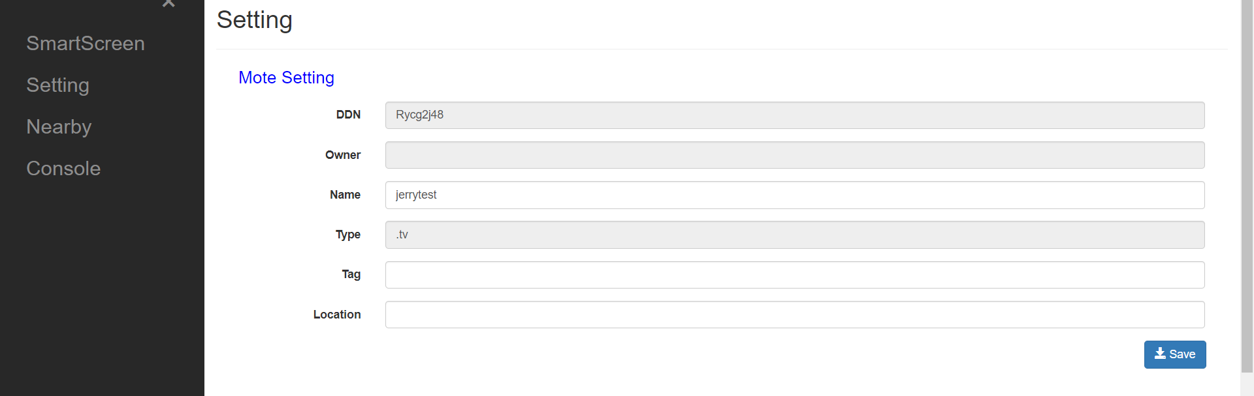
3.Mote Setting>>name*modify>>save

Slide 10
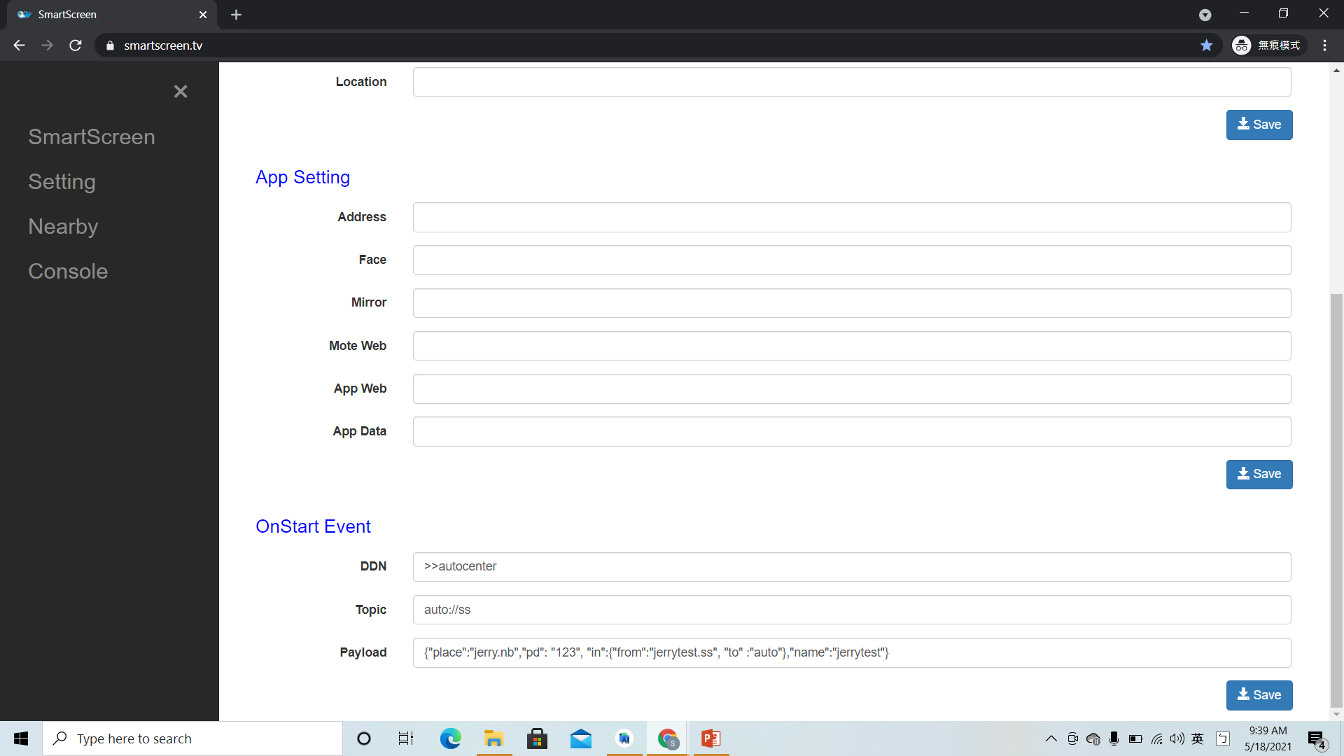
4. OnStart Event:
DDN : >>autocenter
Topic: auto://ss
Payload:
{"place":"jerry.nb","pd": "123", "in":{"from":"jerry.ss","to":"auto"},"name":"jerry"}
save

Slide 11

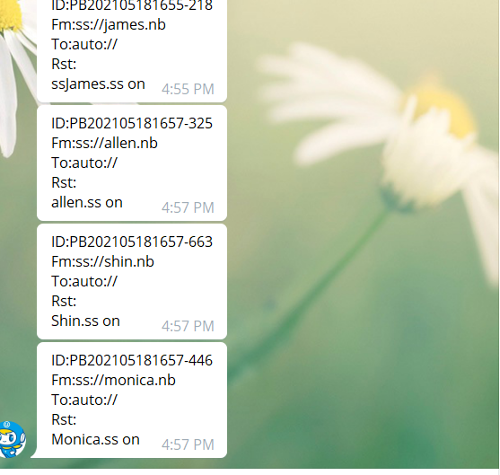
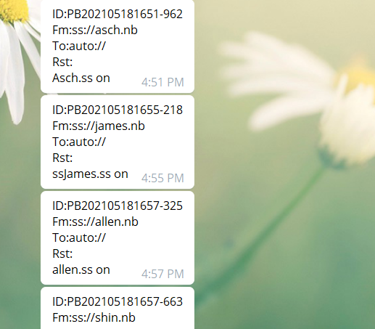

Slide 12
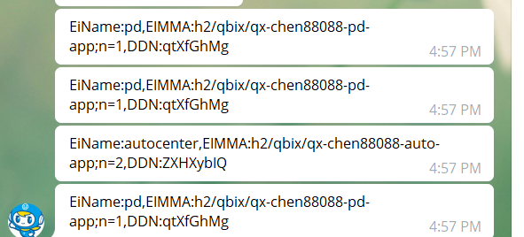

Slide 13
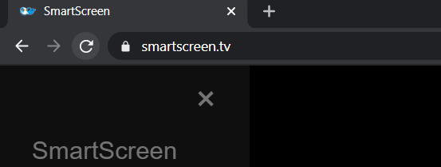
Restart! And check telegram!

Slide 14
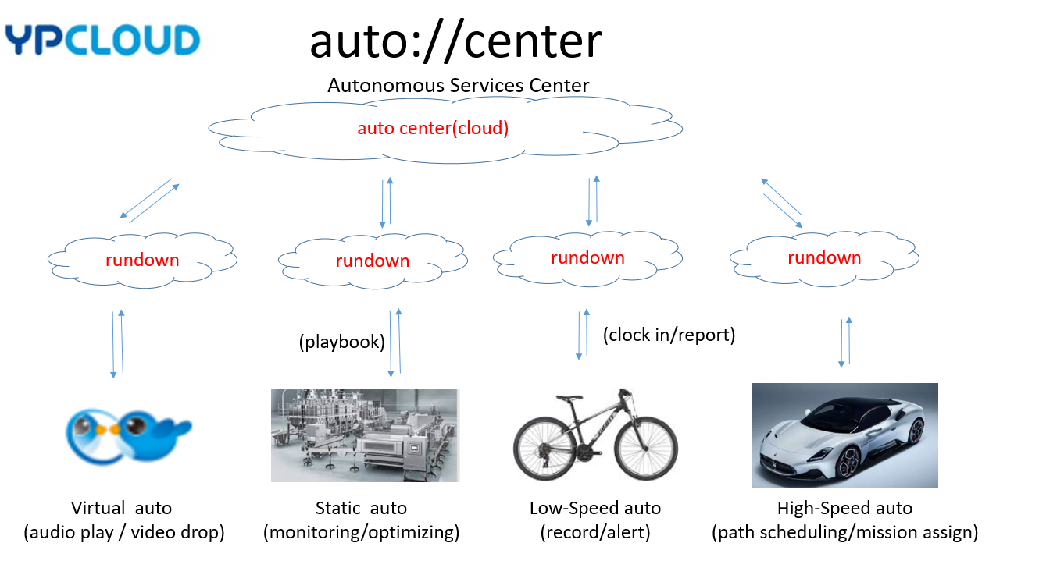

Slide 15
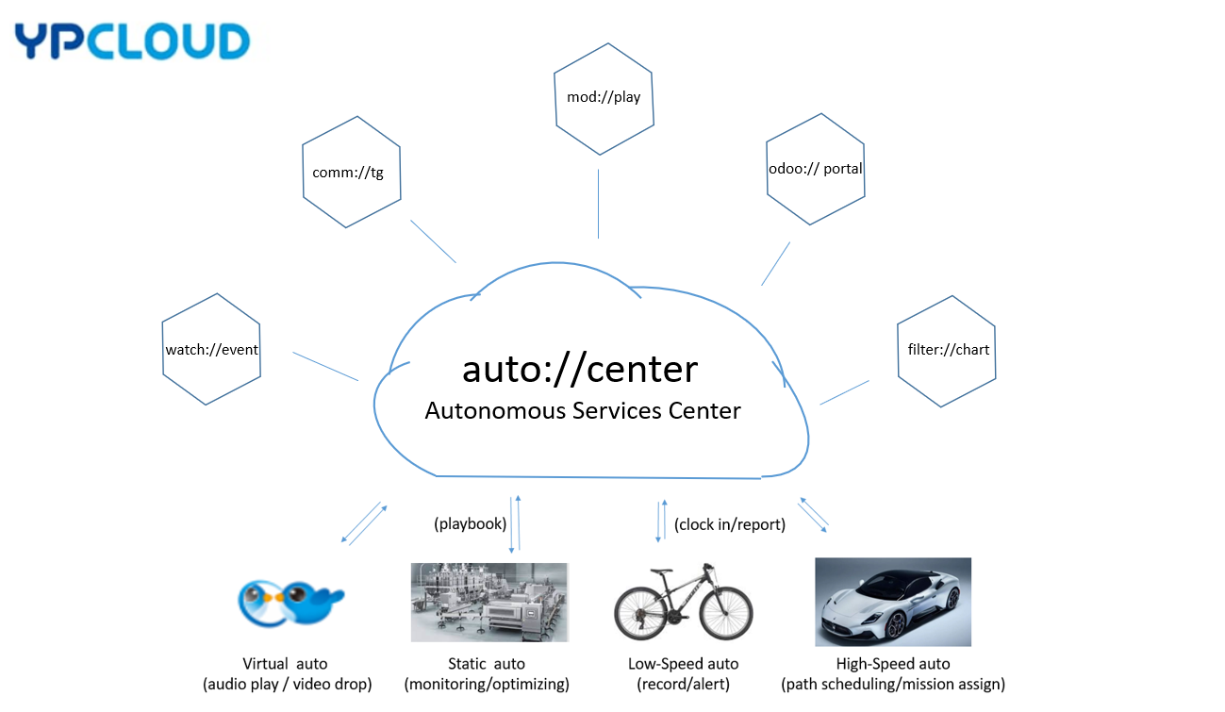

Slide 16
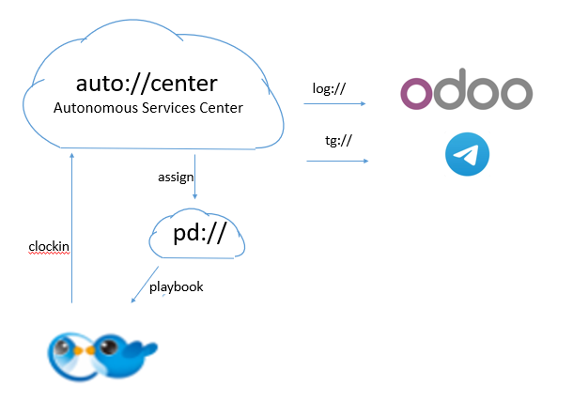

Slide 17
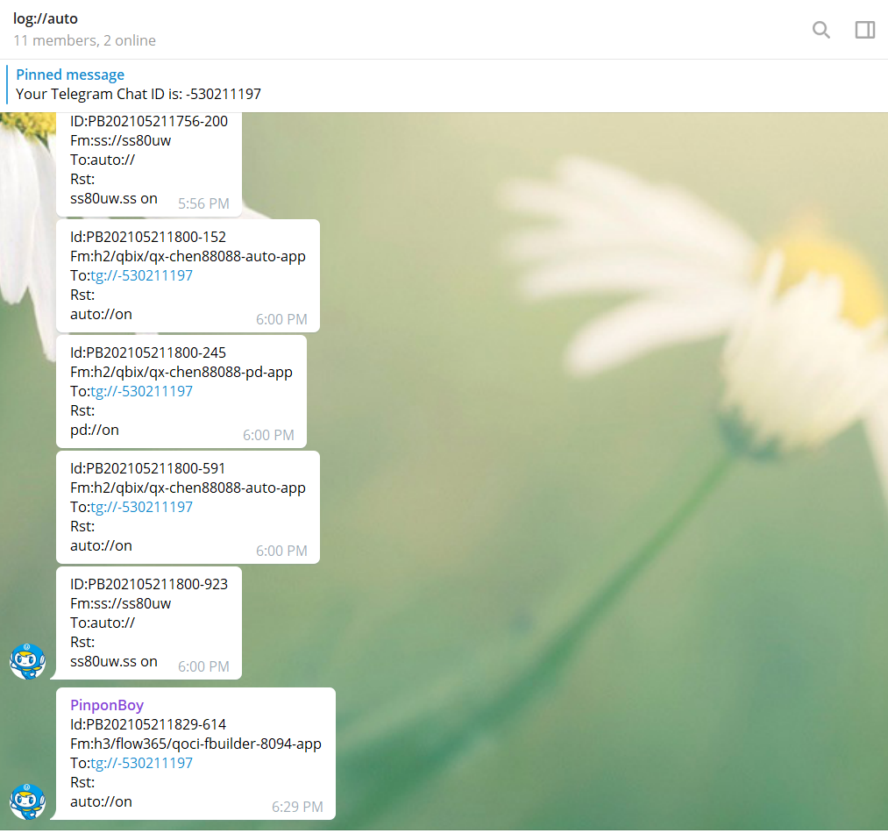

Slide 18
