Slide 1

Answer Identification from Product Reviews for User Questions by Multi-task Attentive Networks
AAAI - 2019
Long Chen
Northwest University, China

Slide 2
OUTLINE
Background
Problem
Our method
Experiments
Conclusions

Slide 3

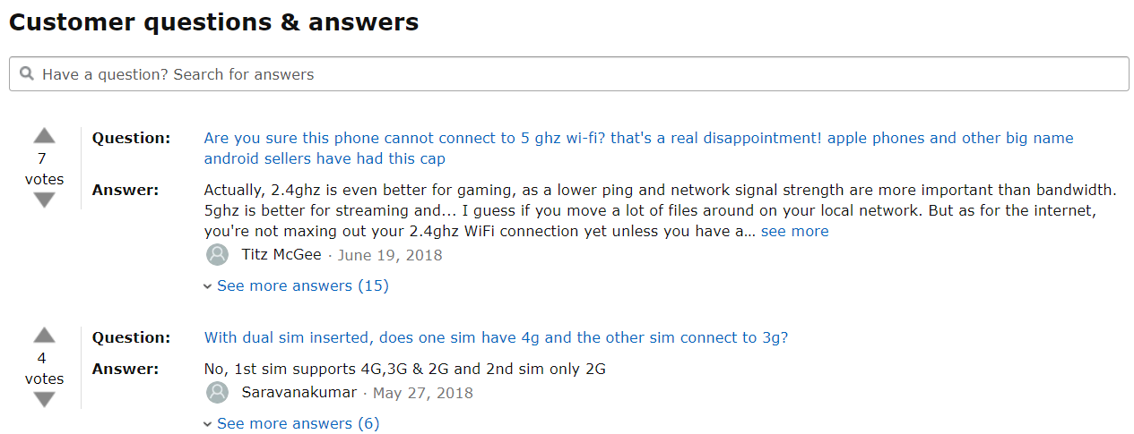
Background
Quick response for askers on e-commerce Websites
Askers have to wait patiently for others’ replies !

Slide 4

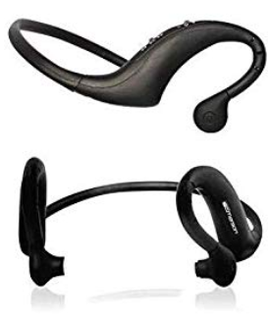

Problem
Idea： Find plausible answers from product reviews
Emerson EM510 Stereo Wireless Headset - Bluetooth Headset - Retail Packaging - Black
Question:
How long does the battery last?
An review sentence :
I work long hours and the battery last 10 to 12 hours.
Notes:
Explain plausible answers.

Slide 5
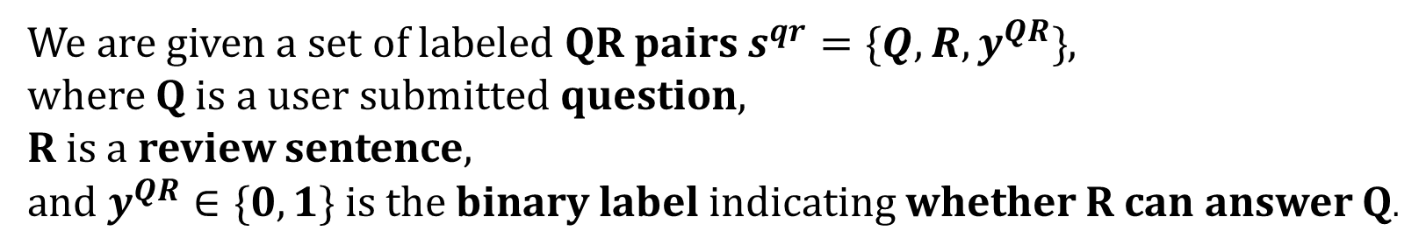
Problem
Definition: a binary classification on QR pairs
We are given a set of labeled QR pairs $s^{qr}=\{Q,R, y^{QR}\}$,
where Q is a user submitted question,
R is a review sentence,
and $y^{QR}∈\{0,1\}$ is the binary label indicating whether R can answer Q.

Slide 6
Problem
Challenge： rare plausible answers in large review data
The labeled data is limited:
Reviewer’ behavior: most reviews do not include the plausible answers since reviewers comment the product with no questions promoted by others.
Observation: in our labeled data, just 6% of are positive QR pairs.
But recognizing the pattern in positive QR pairs is the key for our problem.
Notes:
Explain plausible answers.

Slide 7

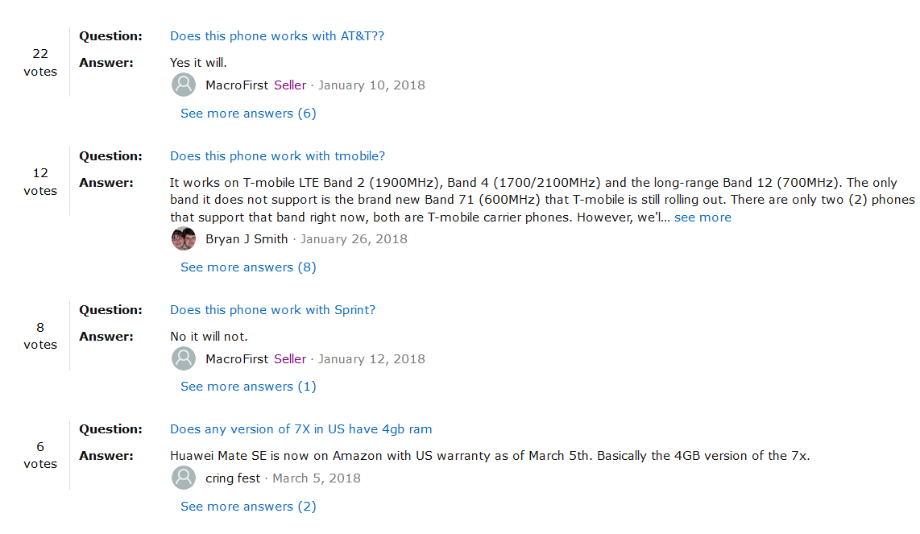
Problem
The large amount of existing QA data
Intuition: these QA data may be helpful for our problem.
Notes:
Explain plausible answers.

Slide 8
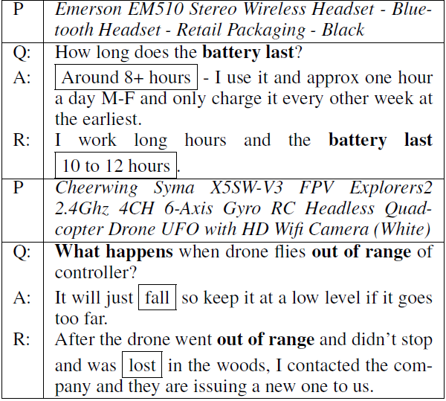
Problem
Data Observation: patterns among Q, A , R
Focus
Answer Pattern
Positive QR pairs include Focus + Answer Pattern.
Difference between A and R: People tend to omit Focus.
Similarity between A and R: they both have similar answer patterns.
The key idea of our method:
using the large amount of existing QA data to assist QR matching.

Slide 9
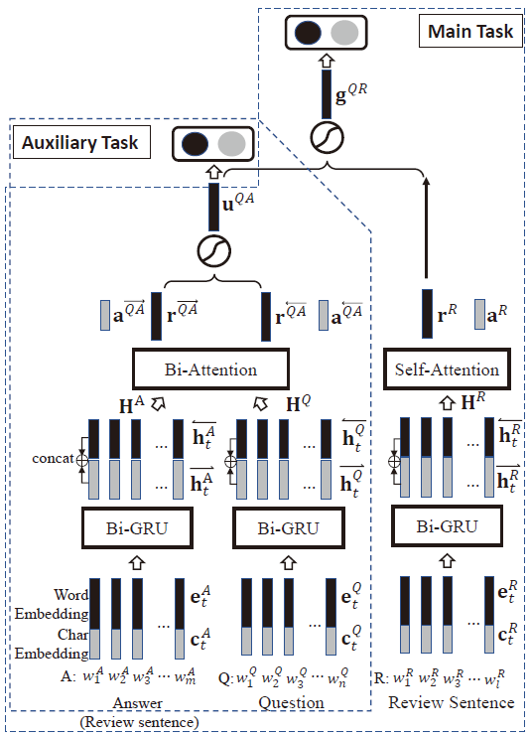
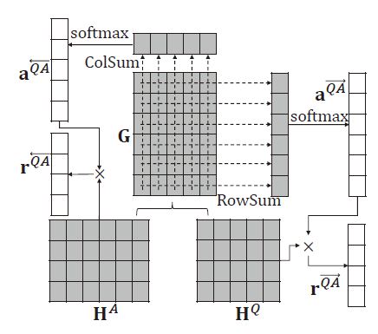




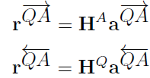
Our Method
Model structure
Attention vector
Attention
vectors

Slide 10

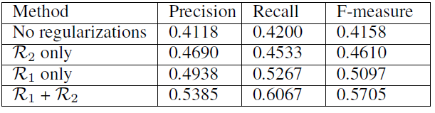




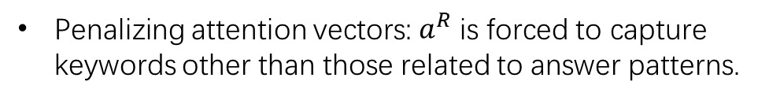
Our Method
Objective Functions for Two tasks
Objective Function for Auxiliary Task (QA)
Objective Function for Main Task (QR)
Penalizing attention vectors: $a^{R}$ is forced to capture keywords other than those related to answer patterns.
Penalize their Euclidean distance: for positive pairs we want both of attention vectors to capture the question focus.

Slide 11
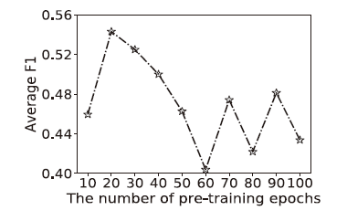
Our Method
Training Strategy: pre-training on QA and fine-tune on QR
QA TASK
QR TASK
Validation performance of QAR-net when varying the number of pre-training epochs
Q-subnet
A-subnet
R-subnet
QA
QR

Slide 12
Experiment
Dataset: Amazon product dataset[1]
Two domains : “Electronics” and “Cellphones & Accessories”
QA : 1,000,139 pairs (Existing data).
QR : 7,466 pairs (Labeled data).
[1] McAuley J, Yang A. Addressing complex and subjective product-related queries with customer reviews[C]//Proceedings of the 25th International Conference on World Wide Web. International World Wide Web Conferences Steering Committee, 2016: 625-635.
http://jmcauley.ucsd.edu/data/amazon/

Slide 13
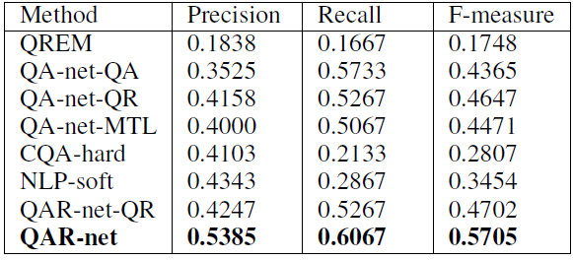
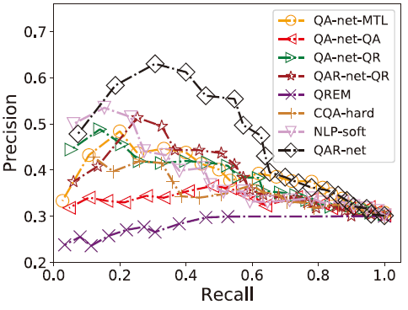
Experiment
Main Results

Slide 14
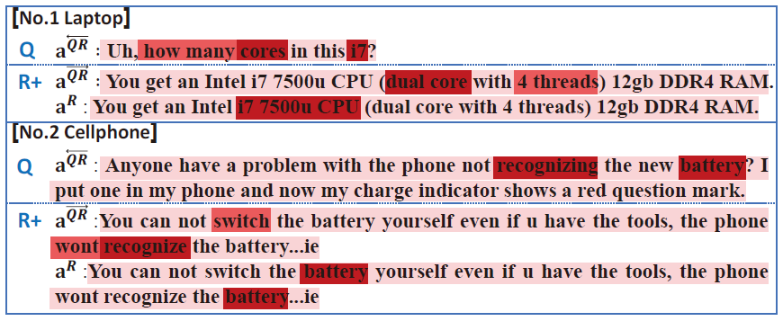
Experiment
Attention Visualization

Slide 15
Conclusions
The positive QR pattern includes Focus and Answer Pattern.
Answers can share useful answer patterns with QR matching task.
Two attention mechanisms in our model are effective to capture the focus and answer pattern.
Figuring out the differences and connections between QA and QR is important for our multi-task model.

Slide 16
Thanks! Q & A
Email : longchen@stumail.nwu.edu.cn

