Slide 1
Music information retrieval FINAL REPORT
陳宇煊 鄭旭航

Slide 2
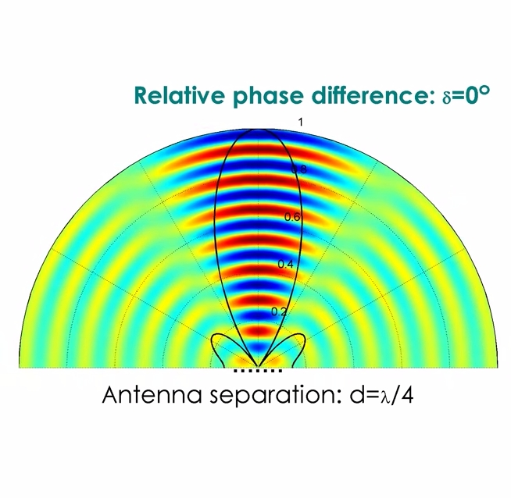
BEAMFORMING
y
Sound source
θ
x
d

Slide 3
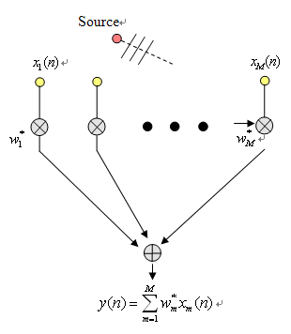
DAS

Slide 4
MPDR

Slide 5
MUSIC

Slide 6
OMP

Slide 7
ARRAY BASE LOCATION AND SEPARATION

Slide 8
Binaural audio reproduction
image source
image source

Slide 9
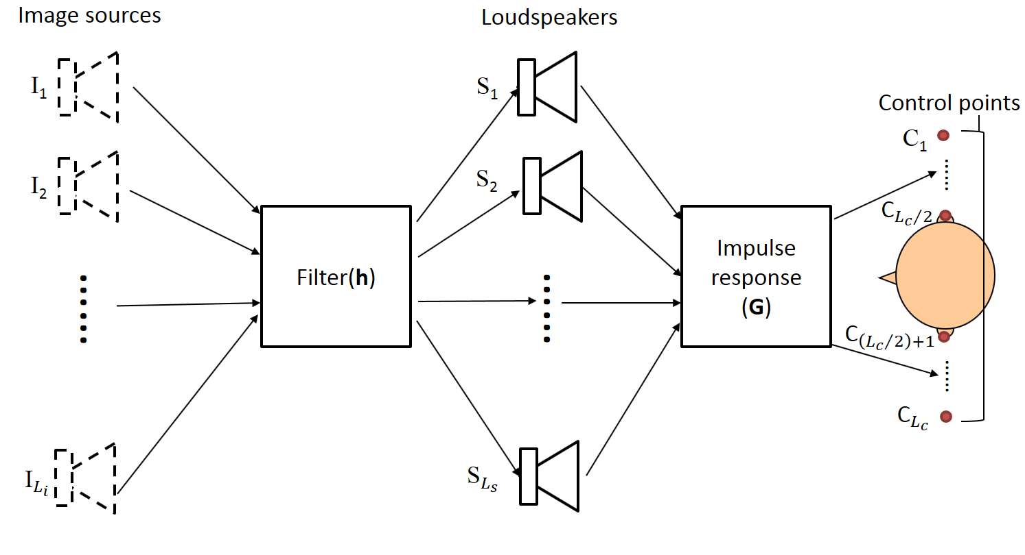

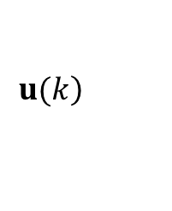




Matching model
$$M=GH$$
$$M$$
+
$$\left.u(k\right)$$
-
$$e\left(k\right)$$
Image sources
Filters
H
$$G$$
$$v\left(k\right)$$
Speaker input signal

Slide 10
3D audio effect
5-channel standard size | Source widening | Virtual surround

Slide 11
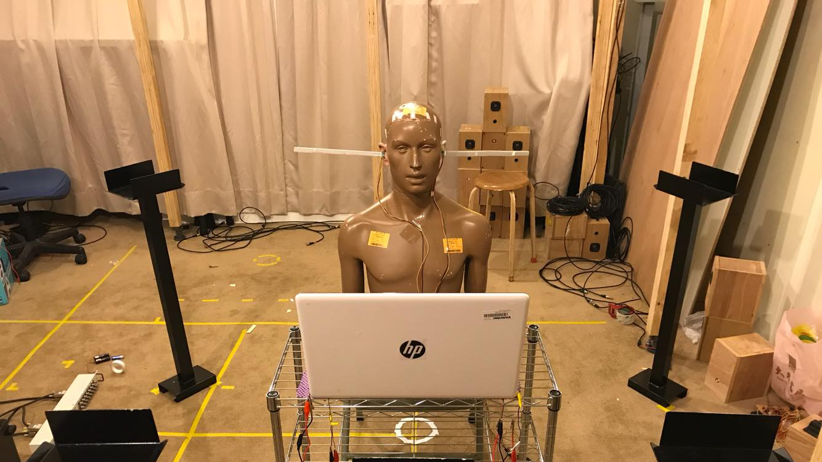

Slide 12
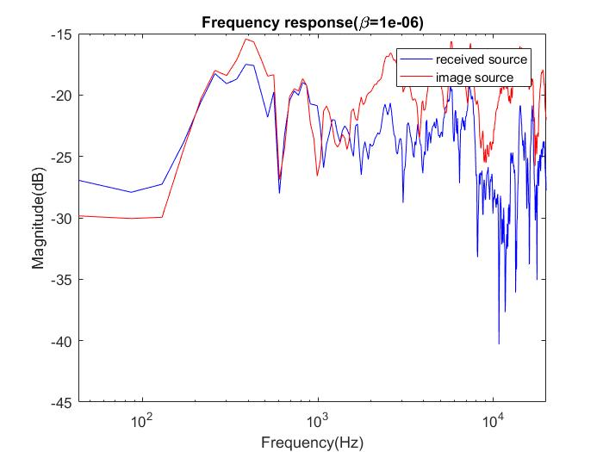
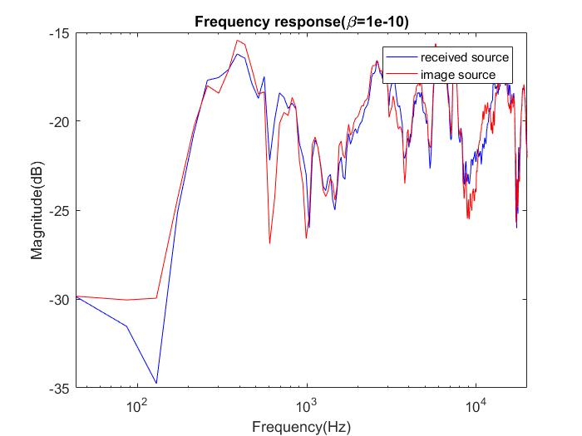

Slide 13
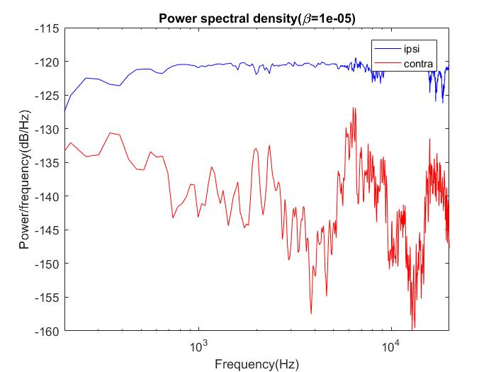
Cross-talk cancellation
Left channel
Right channel

