Slide 1
CS513
Final Project Object detection in Point Cloud: Pole
Professor: Xin Chen
Group Member: Chen Xu A20377739
Shujun Zhang A20306899
Lan Wei A20278475

Slide 2
Outline
OVERVIEW
INTRODUCTION
APPROACH I
APPROACH II
CONCLUSIONS & FUTURE
REFERENCES

Slide 3
OVERVIEW
In the real world, object detection relies on advanced algorithms trained on extensively labelled datasets
In this project, an algorithm is developed to automatically locate, segment and classify small objects (in our case, pole) in 3D scan of urban environment.

Slide 4
OVERVIEW
Approach 1:
Matlab R2016b
Approach 2:
Python 3.6.4
Numpy 1.14.0
PCL 1.8.1

Slide 5
INTRODUCTION
A point cloud is a set of data points in some coordinate system. In a three dimensional coordinate system, these points are usually defined by X, Y, and Z coordinates, and often are intended to represent the external surface of an object.
Object detection in point cloud is popular in HD Map and Sensor-Based autonomous driving. There are basically four types of object which can be obtained from daily scenarios like: lane, guardrail, pole, road surface etc.

Slide 6
APPROACH I
Data Processing
Read Data file final_project_point_cloud.fuse, and convert the velocities from World Geodetic System coordinate to camera coordinate system (LLA -> ECEF -> END -> Camera Coordinate), using Camera information given in image/camera.config.
Data processing is done by Matlab

Slide 7
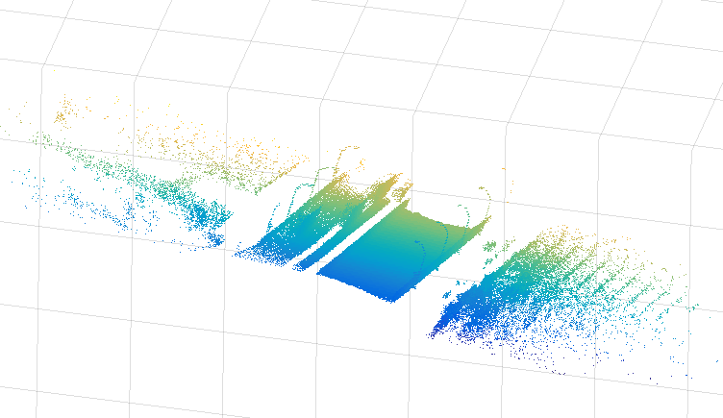
Original Point Cloud Data Image

Slide 8
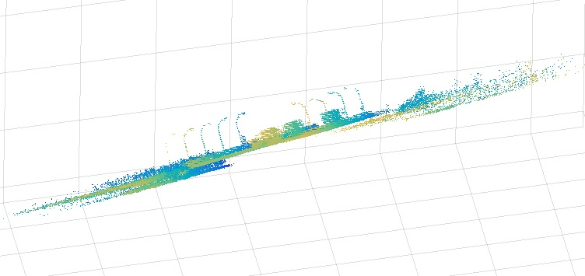
The Poles need to be detected (9 poles on image)

Slide 9
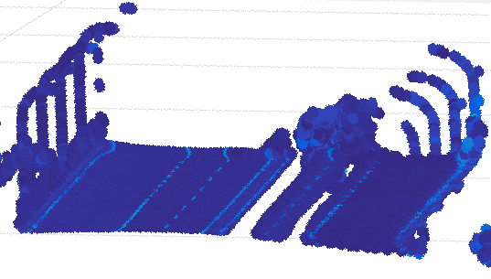
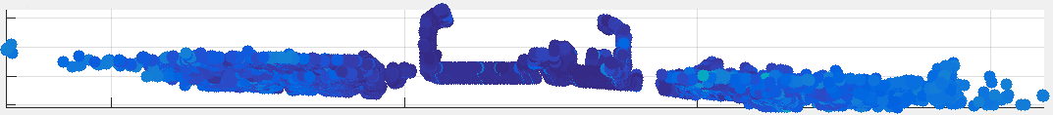
APPROACH I
Aim to find the points in point cloud, which belong to the poles.

Slide 10
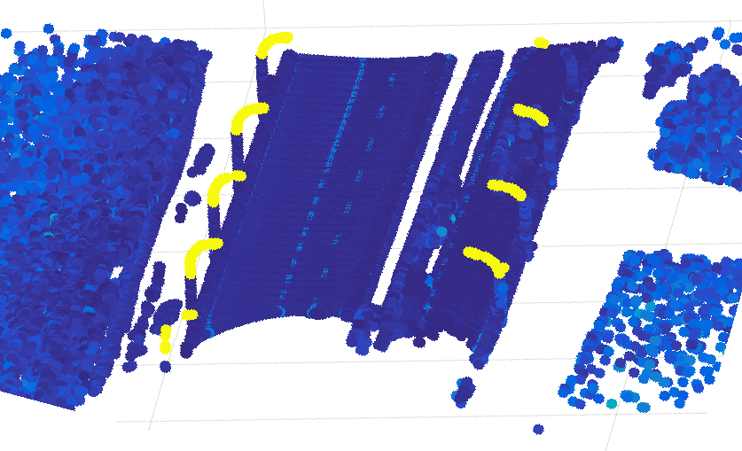
APPROACH I
Look for items which are higher than threshold (0.75) and on the edges of road.

Slide 11
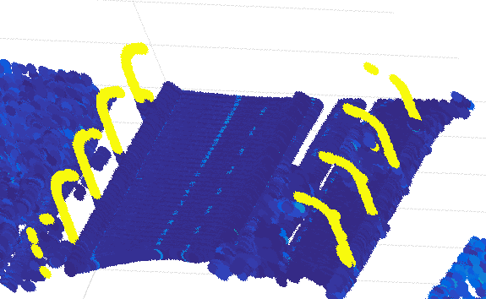
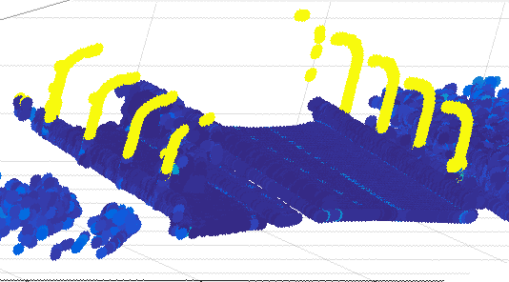
APPROACH I
Highlight all found items

Slide 12
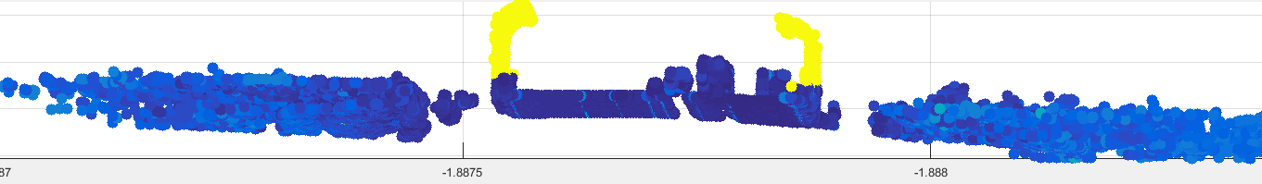
APPROACH I
RESULT I & Discussion I
Approach I is quick and simple. But it would successfully find out poles in most of the cases.

Slide 13
APPROACH II
Process data
Load converted data processed by Matlab from Approach 1 result: matlabData.csv.
Preprocess Converted points into array.
PCL: use from_array() function to load points into pointcloud.

Slide 14
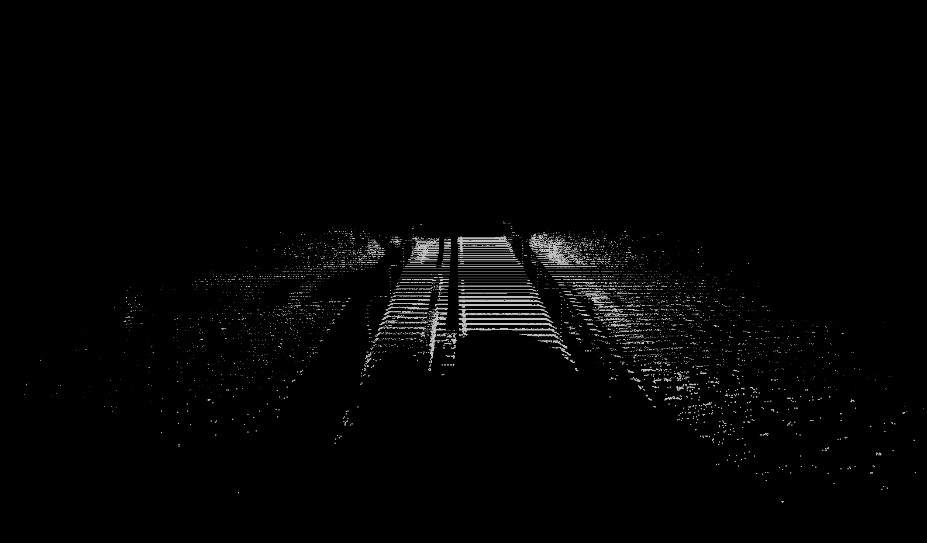
RESULT II
OriginalCloud.pcd(430736 points)

Slide 15
APPROACH II
Remove outliers
Remove outliers, reducing noise in original data.
PCL: Statistical Outlier Filter is used to remove outliers.
This uses point neighborhood statistics to filter outliers from data.
This will compute the average distance that each point has to its k-nearest neighbors. The value of k is set to be 50
Next, mean and standard deviation are computed for all the distances
The standard deviation multiplier threshold is set to 5
Points with distance greater than 5 standard deviations away from mean distance from isolated point are removed.

Slide 16
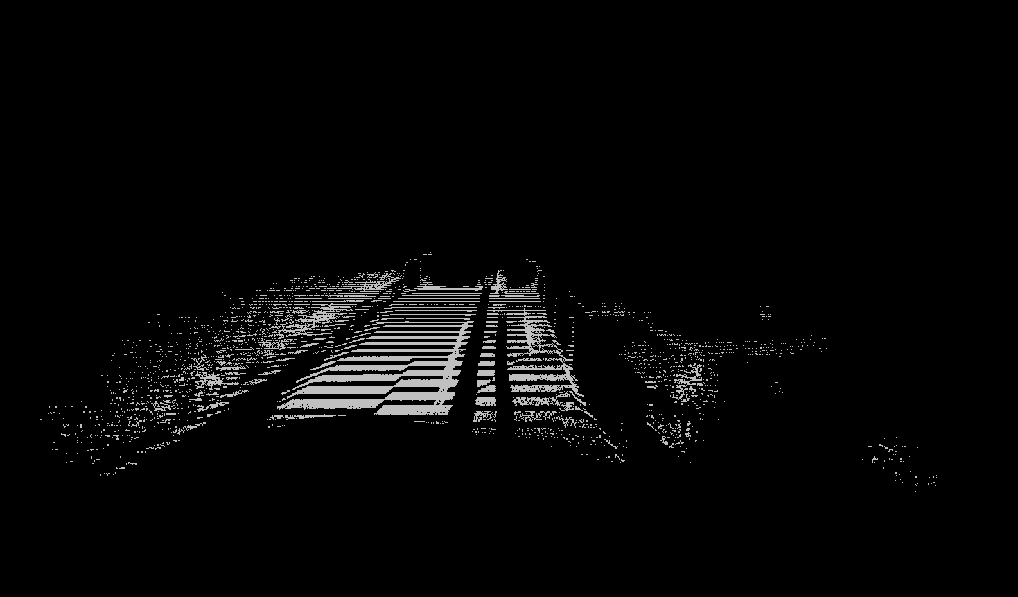
RESULT II
OutlierFilteredCloud.pcd(428073 points)

Slide 17
APPROACH II
Remove large Components
Remove the points associated with the roads, mountains and buildings which will obstruct the poles.
KD-Tree is built upon the filtered data obtained after removing outliers in previous step.
For each point, find closest points and squared distances.
Summed squared distances per tentative component
Taking 5000 as threshold, if summed squared distance is less than 5000, remove this component

Slide 18
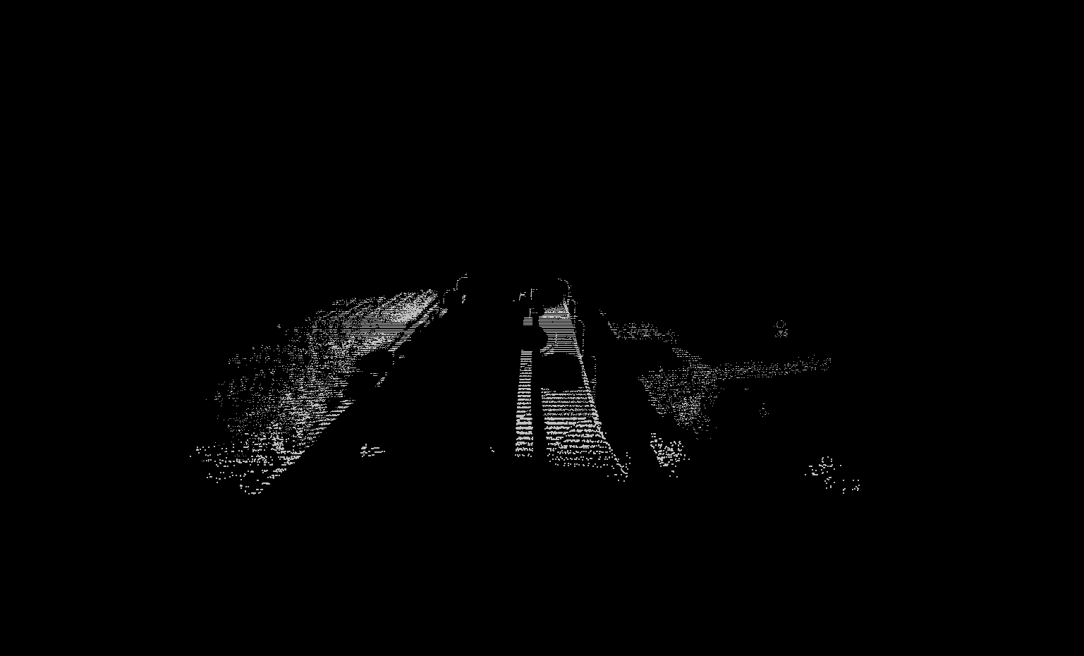
RESULT II
LargeComponentsFilteredCloud.pcd
(42034 points)

Slide 19
APPROACH II
Segmentation 1: Plane model
Our goal is to filter out points close to the ground, which is estimated at uniformly spaced positions with iterative plane fitting.
This is final step that isolates the ground plane and keeps everything but isolated segments.
PCL: SACMODEL_PLANE segmentation is used to isolate ground plane.
Extracted all indices found within the segmented plane
A coordinate-based filter is applied to remove all points below threshold. Filter bounds: 6363082.8, 6363093.0

Slide 20
APPROACH II
Segmentation 2 :Cylinder model
Our goal is to segment out cylind objects and discard all other points.
SACMODEL_CYLINDER segmentation is used to isolate poles.
Segment for points that were in a cylinder with radius between bounds 0 and 10.
Distance threshold between points is set to 20.

Slide 21
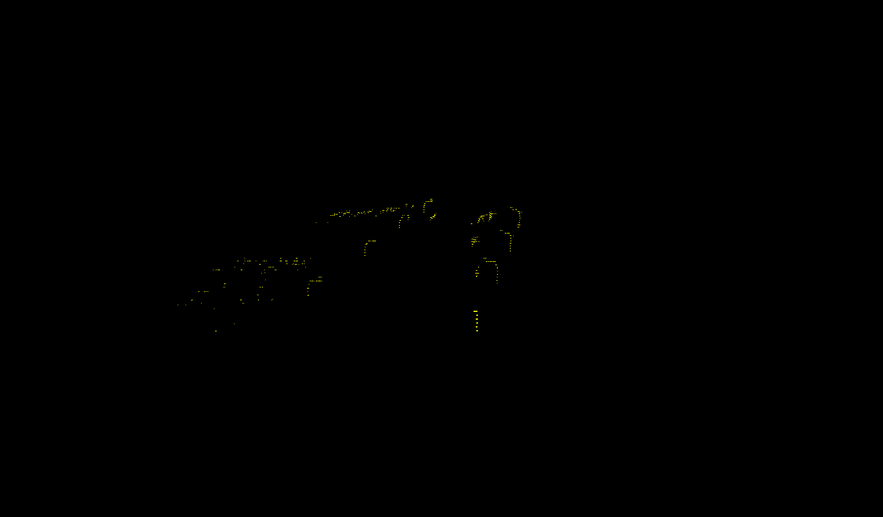
RESULT II
final.pcd(1374 points)

Slide 22
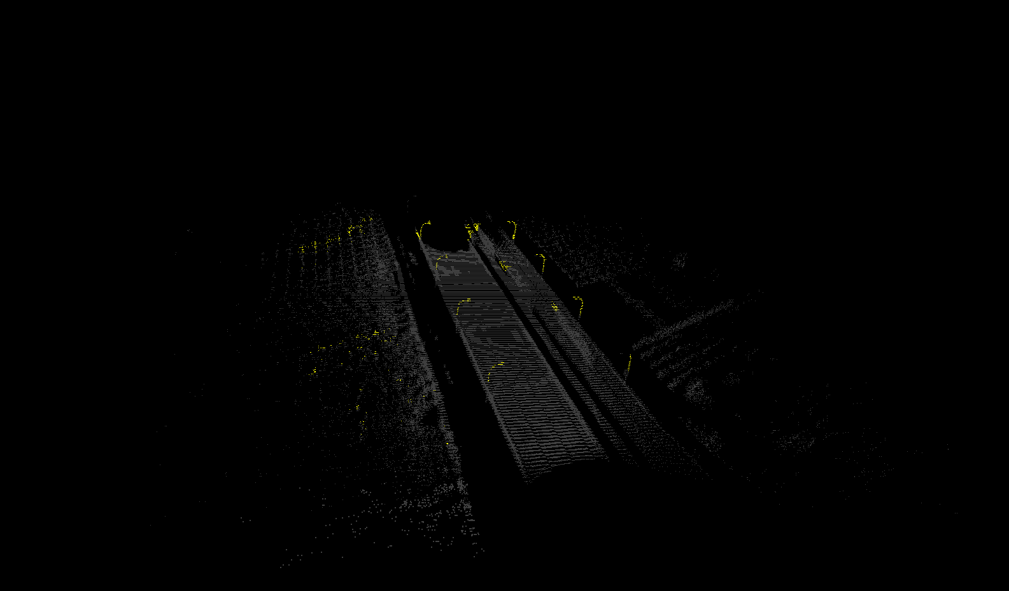
RESULT II
Final combine with original pointcloud

Slide 23
APPROACH II
DISCUSSION II
The final result shows the output of the cloud points after filtering and segmentation.
The poles are isolated and intact.
The final points data can be found in final.obj file.
This process removed approximately 429362 data points.

Slide 24
CONCLUSIONS & FUTURE
Two approaches can both successfully detect the poles out.
They catch the points in points cloud directly, which would make the results be easily used without extra transformation.
For Future works, We need to implement points convert using python method. And use training models to improve the accuracy.

Slide 25
REFERENCES
Golovinskiy, Aleksey, Vladimir G. Kim, and Thomas Funkhouser. "Shape-based recognition of 3D point clouds in urban environments." Computer Vision, 2009 IEEE 12th International Conference on. IEEE, 2009.
Zhu, Jijie. "Conversion of Earth-centered Earth-fixed coordinates to geodetic coordinates." IEEE Transactions on Aerospace and Electronic Systems 30.3 (1994): 957-961.
http://pointclouds.org/documentation/tutorials/cylinder_segmentation.php
http://pointclouds.org/documentation/tutorials/planar_segmentation.php
http://mathforum.org/library/drmath/view/51832.html

