Slide 1
ActionDirector Mobile v2.10 Proposal
PM: Elvis Chen

Slide 2
Schedule & Scope
v2.10 (1/10 GM)
Allow user to add multiple music

Slide 3
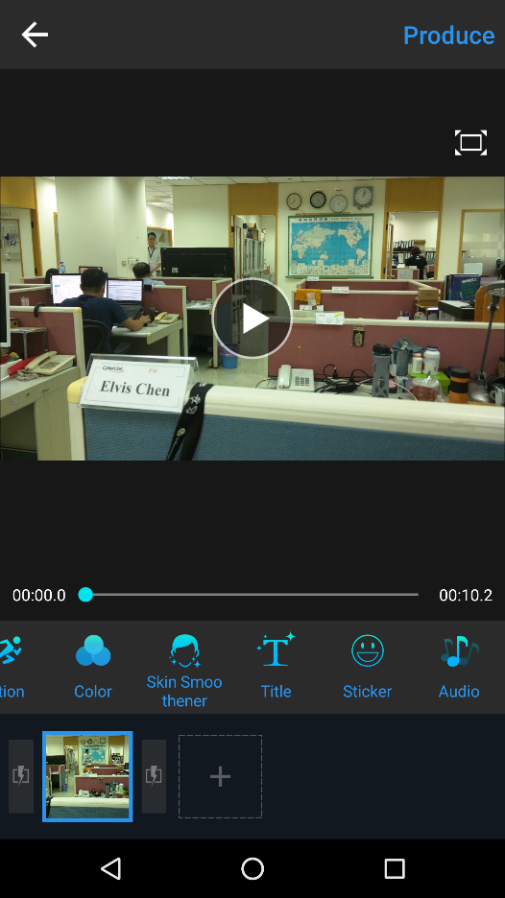

Slide 4
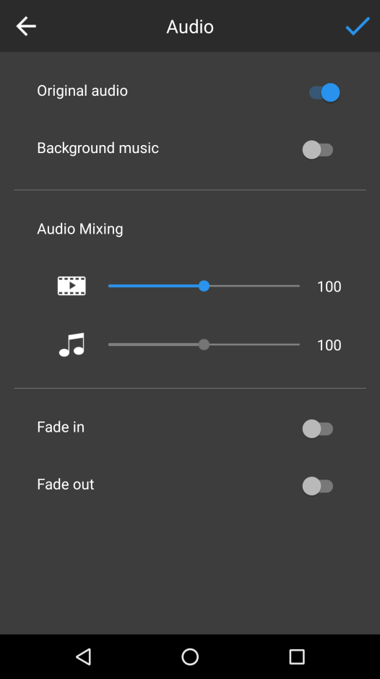


Slide 5
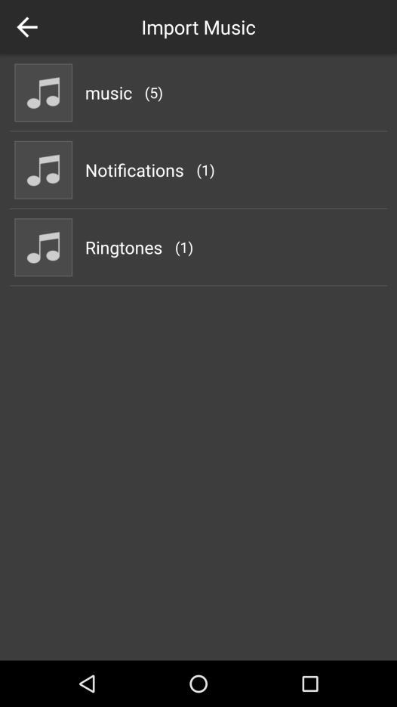

Slide 6
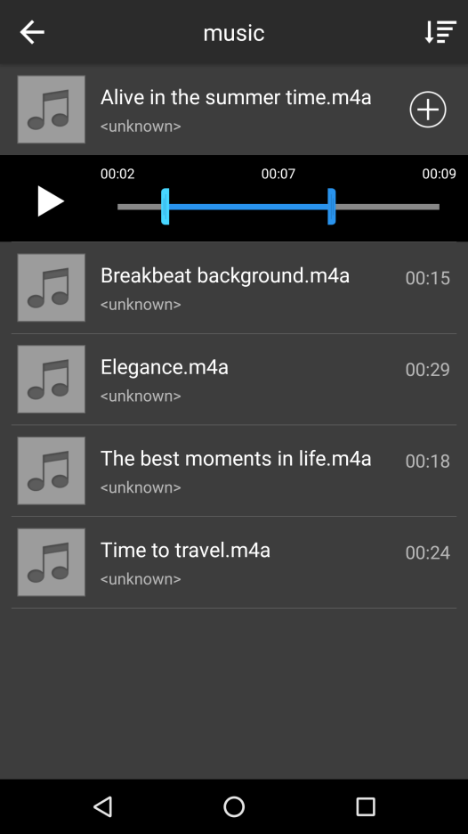

Slide 7
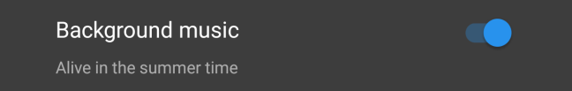
Display the new entry to Multi Music mode by adding more music
Add more music

Slide 8
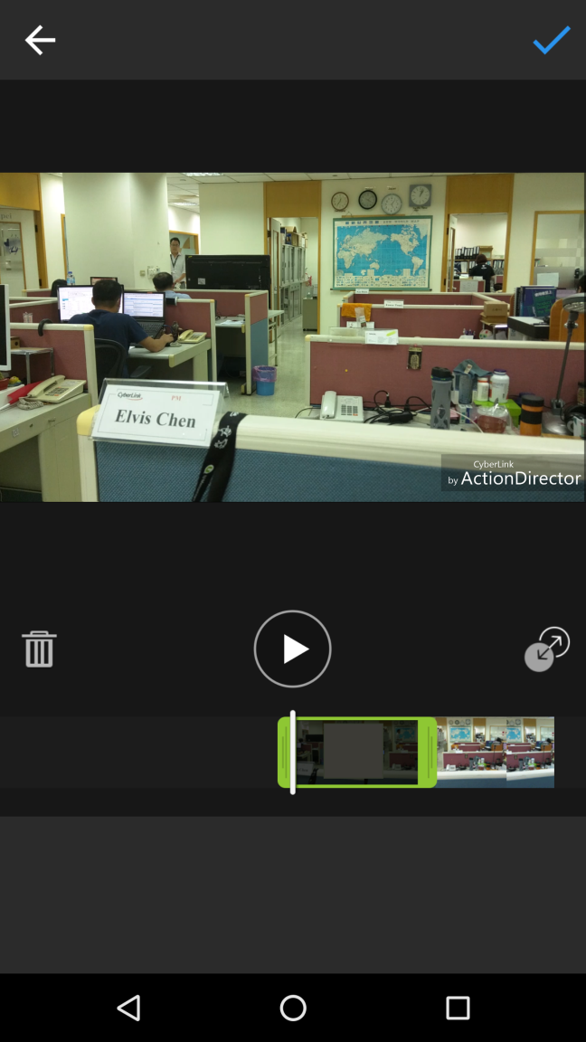



Multi Music
Enable/Disable fade in/out
Delete selected audio
Drag to mark in/out
Drag the handle to move audio clip on timeline

Slide 9
Multi Music
Tap to open library to add another clip

Slide 12

Multi Music
OK to Audio page (slide 2)
Back to timeline and select to the new clip
User may switch to another clip to edit

Slide 13
Multi Music
Cannot overlap another audio clip
Error handling:
Pop up a toast when user trying to overlap another audio clip

