Slide 1
ActionDirector Android v2.3 Proposal
PM: Elvis Chen

Slide 2
New Features
Supports photo editing
Ken Burns
Crop
Rotate
Flip
Color adjustment
Brightness, Contrast, Saturation
Duration adjustment

Slide 3
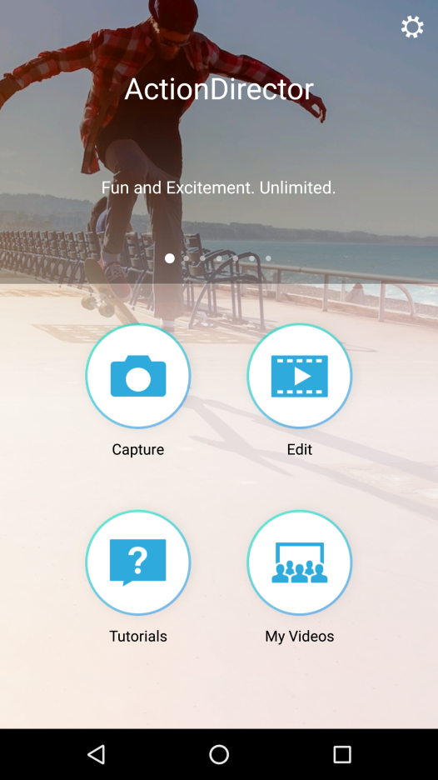



Capture
Photo Video
User needs to choose to capture photo or video then inter-op camera app

Slide 4
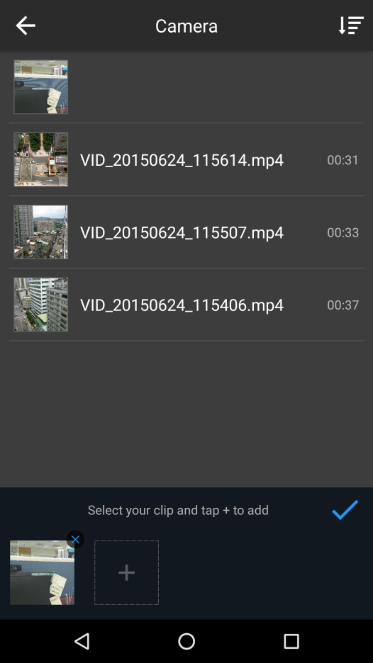
To Media Library
IMG_20170203_180000.JPG
No duration display (as 0 when sorting)
Add captured photo to timeline

Slide 5
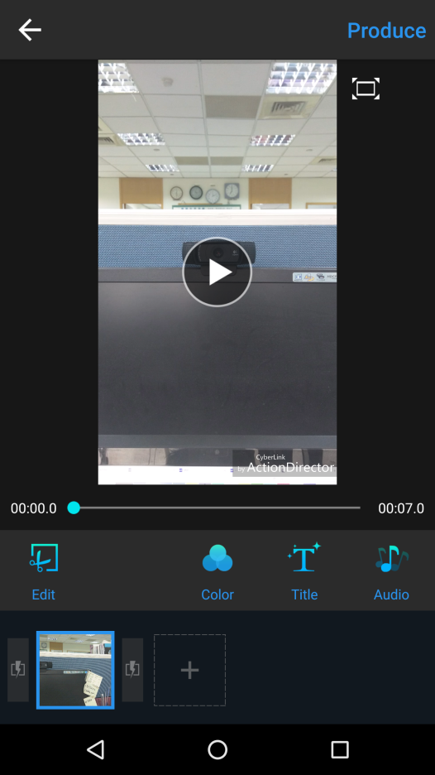
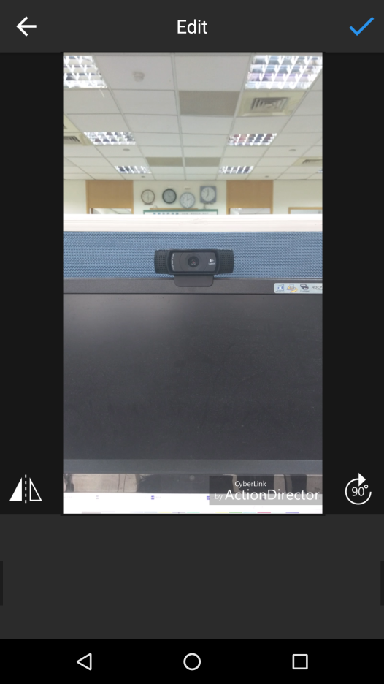
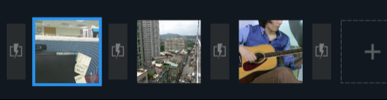

Edit Page
Remove play button
Flip
Rotate
Pan & Zoom
5.0

Slide 6
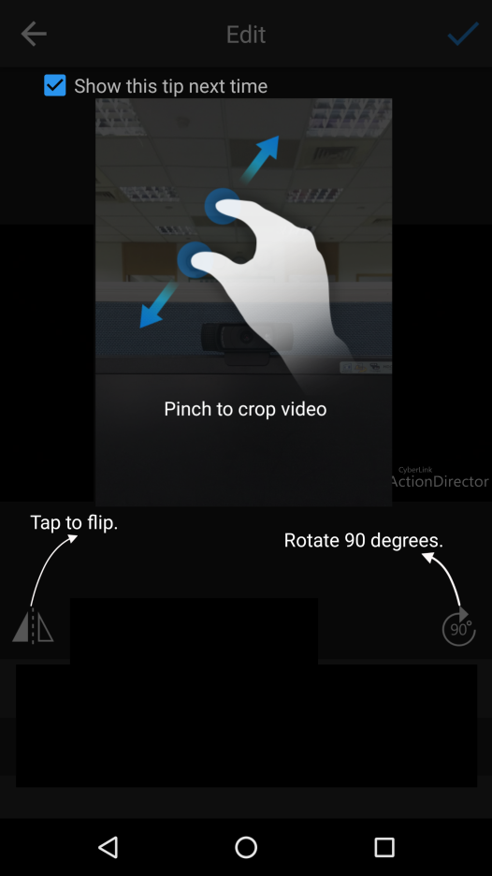
Edit Page
Tips for photo editing
Pinch to crop image
Adjust image duration.
5.0

Slide 7
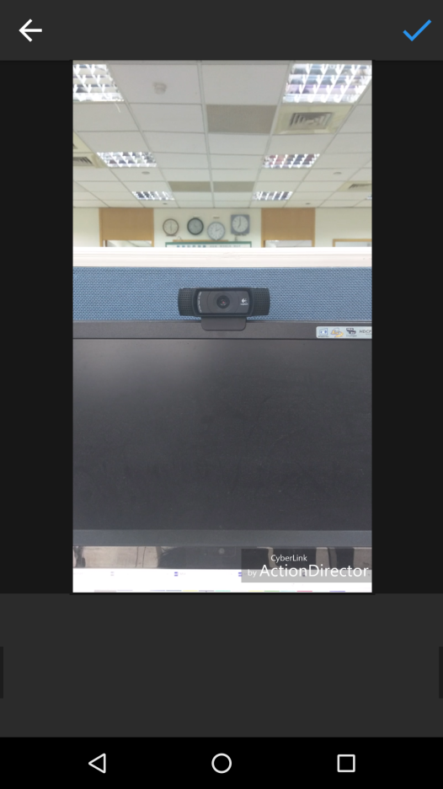


Ken Burns Page
Pan & Zoom
Reset the positions
Ken Burns
Behavior is the same as PDR
Pan & Zoom
Start Position
End Position

Slide 8
Ken Burns Page
Pan & Zoom
Reset current settings
Tips for photo editing
Pinch to select focus area
Tap the thumbnail to jump to start/end position.
Start Position
End Position

Slide 9
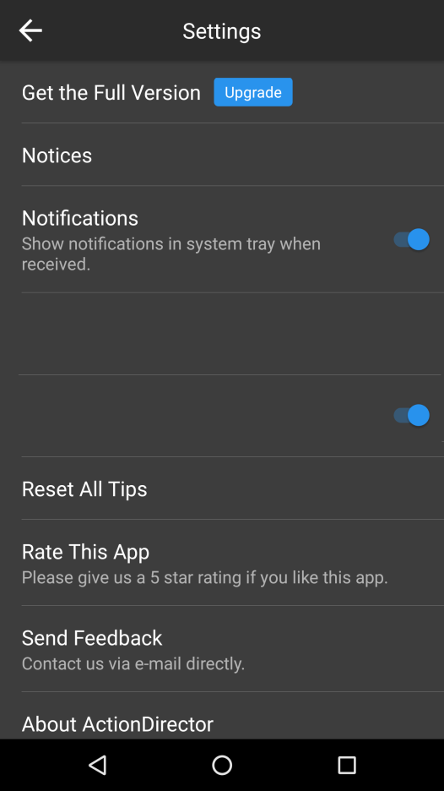
Settings
Add 2 options to Settings
Default Image Duration
Default Image Duration
3.0 second(s)
5.0 second(s)
Default Image Effect
Default Image Effect
3.0
Default is 3 sec
Pan & Zoom (Ken Burns)
Pan & Zoom (Ken Burns)

