Slide 1
ActionDirector Android v2.4 Proposal
PM: Elvis Chen

Slide 2
New Features
Stickers
Free stickers from PDR: 8 in the app and 84 for download
Premium stickers for IAP will be later

Slide 3
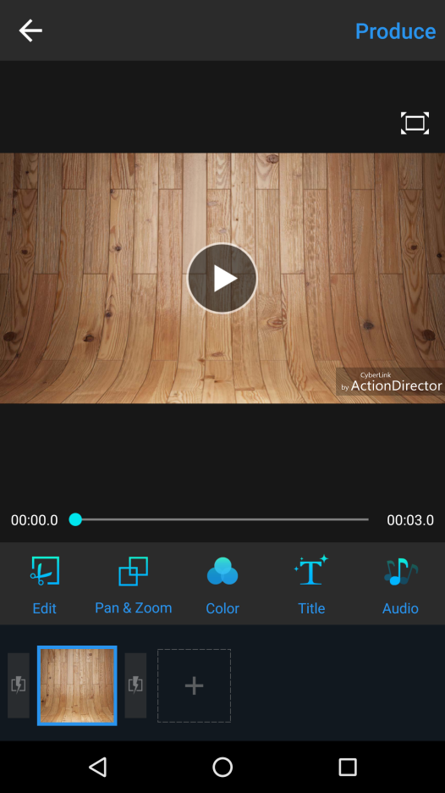

Entry Point Add a sticker btn next to title
Need to scroll to access music
(add fading effect to the edge to attract user to scroll)
Sticker

Slide 4
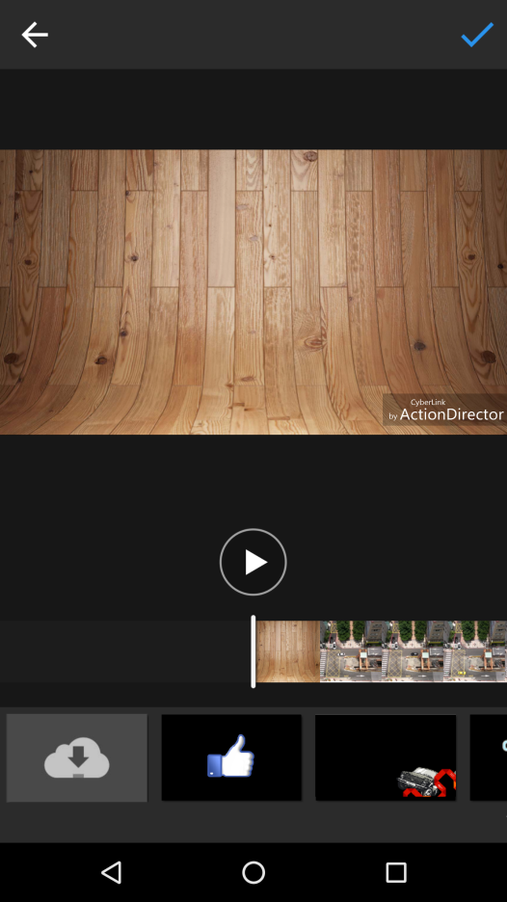
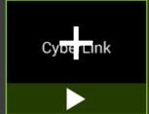
Sticker Library
Sticker
Timeline view as Title
Tap to preview/add to timeline as title
Including default stickers as PDR
Get more
Like
Road Trip

Slide 5

Sticker Library
Sticker
To download page (share with PDR)
Get more
Like
Road Trip

Slide 6

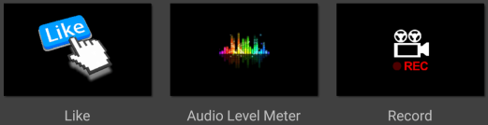
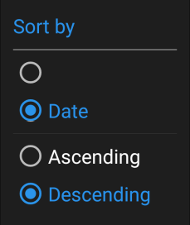

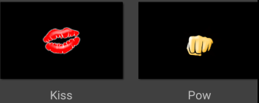

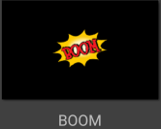
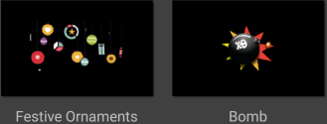
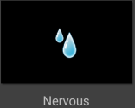
Sticker Library
Sticker
Sorting option
(Default: Sort by date)
Download
Tap to download
(the same behavior as PDR)
Get more
Like
Road Trip

