Slide 1
ActionDirector Mobile v2.5 UI Spec
PM: Elvis Chen

Slide 2
V2.5 Features (5/4 GM)
Animated GIF support
Import
Preview
Edit (the same as in PDR)
Transition duration adjustment
Ad
4 places

Slide 3
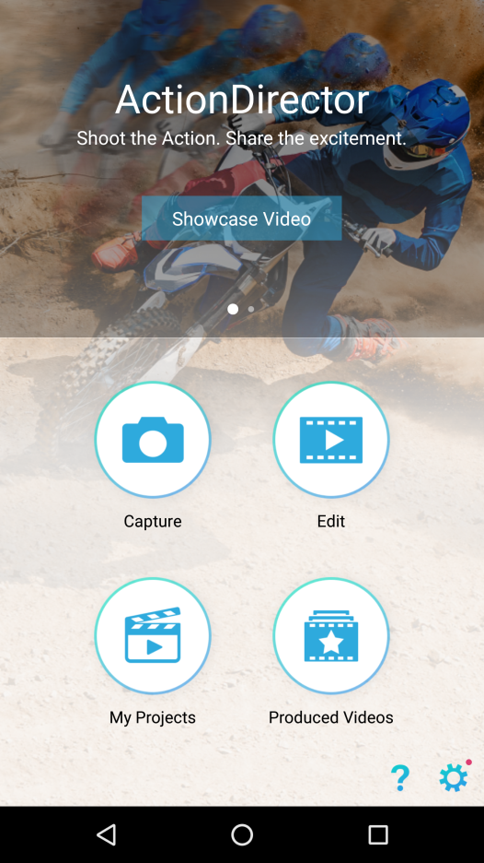

Animated GIF Support

Slide 4
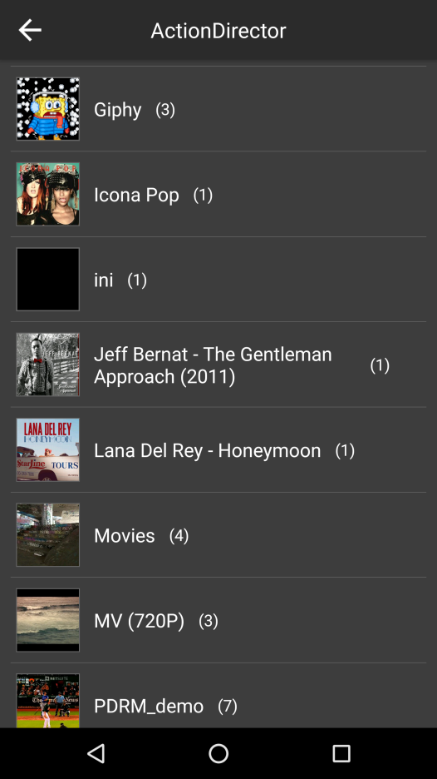
Animated GIF Support
GIF

Slide 5
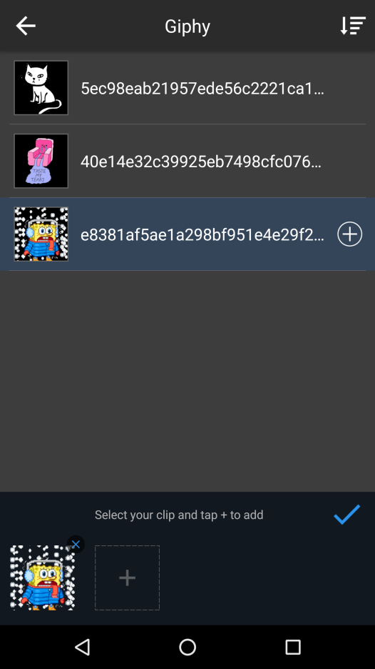
Animated GIF Support
GIF

Slide 6
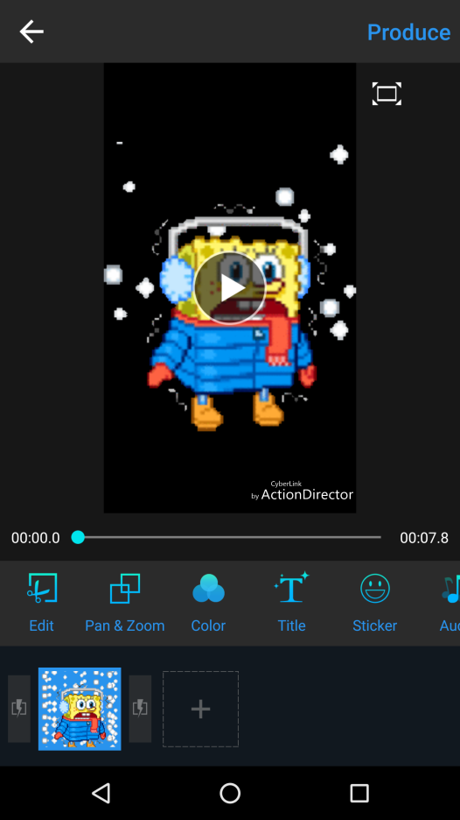
Animated GIF Support
Same features/behavior as in PDR

Slide 7
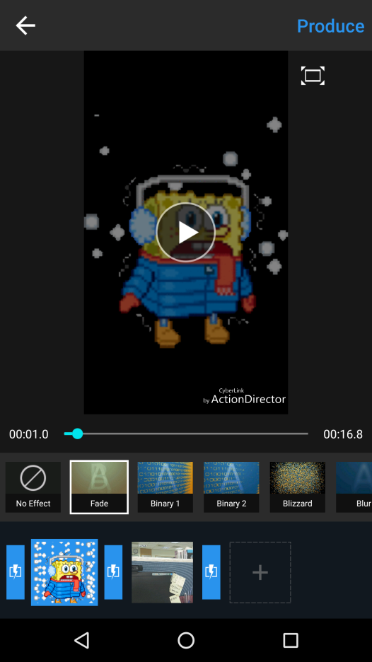

Transition Duration Adjustment
Add a duration button
Tap to seek to the start of transition.
After selecting transition, don’t hide the transition library until user tab the transition button

Slide 8
Transition Duration Adjustment
Default is 2 sec

Slide 9
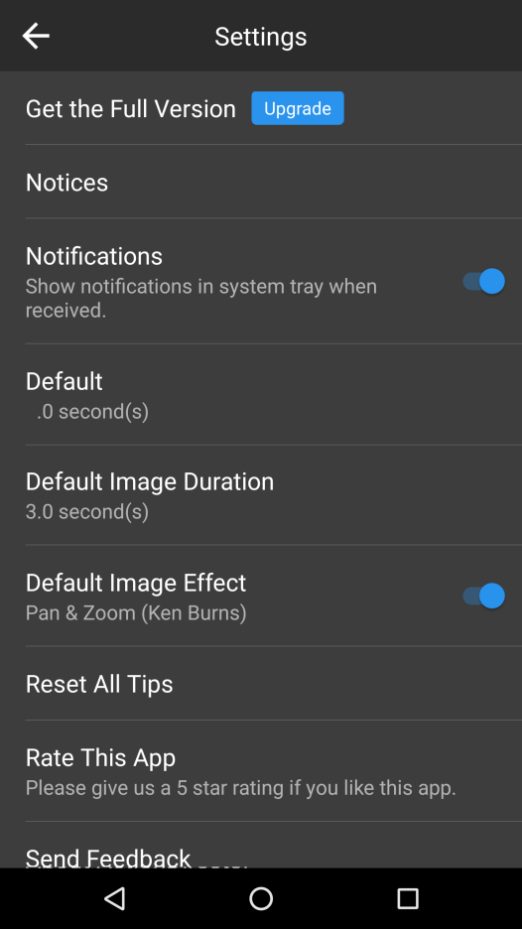
Transition Duration Adjustment
Add the option to settings.
Transition Duration
2

Slide 10


Advertisement
Native ad
Native ad
Back key to leave

Slide 11
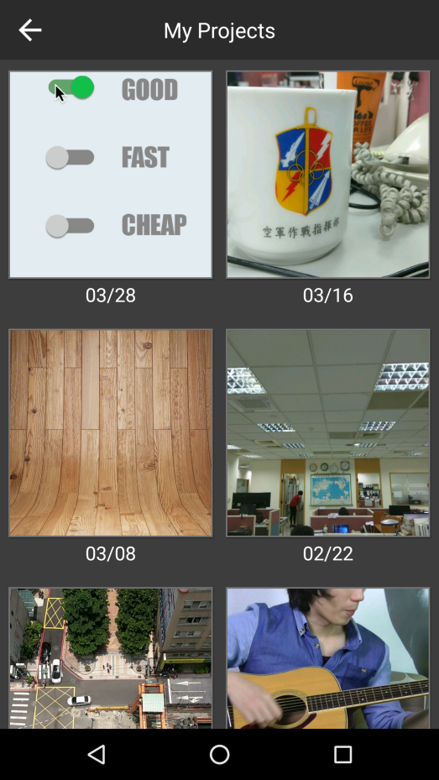
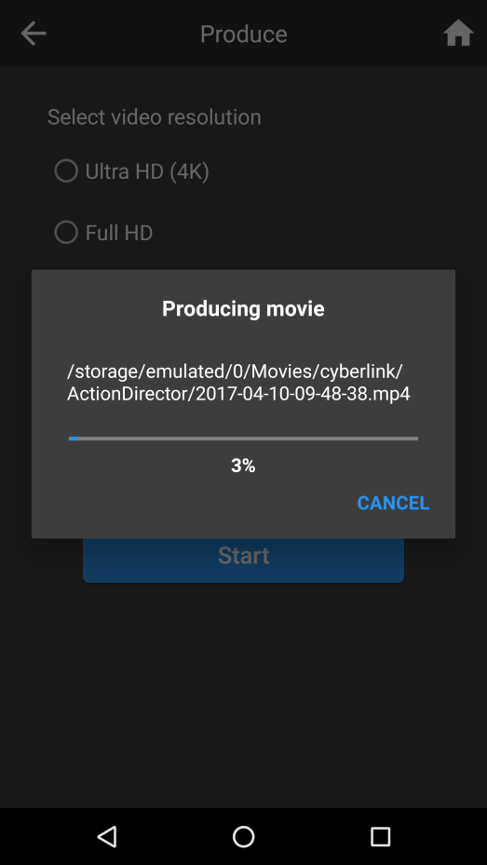
Advertisement
Native ad
Native ad

