Slide 1
ActionDirector Mobile v2.7 & v2.8 UI Spec
PM: Elvis Chen

Slide 2
ACDA Schedule & Scope
v2.7 (7/6 GM)
V2.8 (8/3 GM)
Video cropping
Fade options for sticker
Free stickers to download
More color presets
Custom fonts
No UI
Have demo video/FAQ only

Slide 3
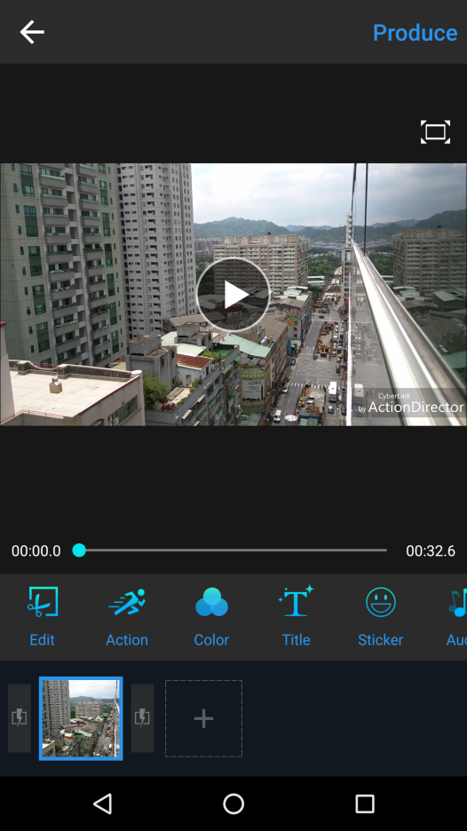

Video Cropping
Entry: Edit

Slide 4
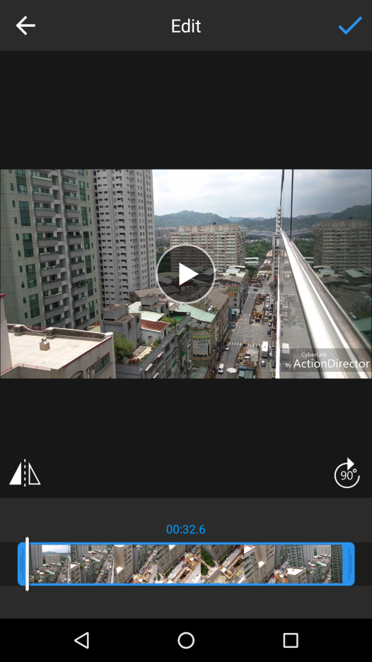

Video Cropping
Tap to enable cropping mode

Slide 5

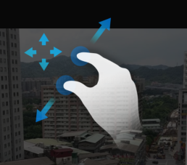
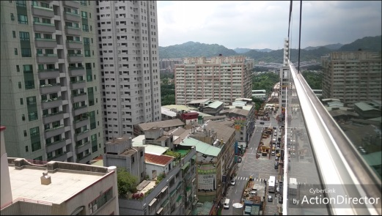
Video Cropping
Crop
Pinch to crop video.

Slide 6
Video Cropping
Crop
Tap to apply and back to Edit

Slide 7
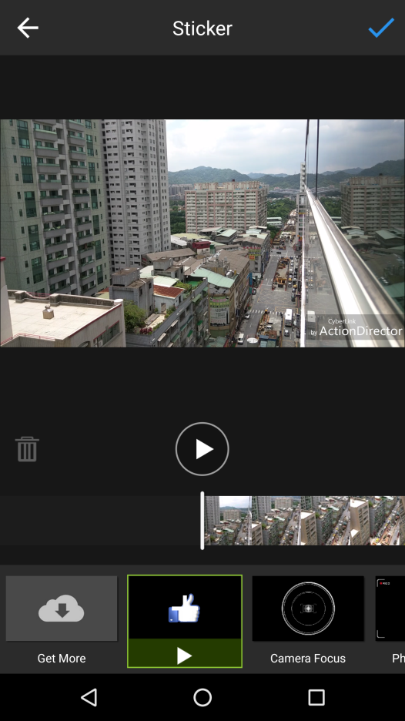

Fade Options for Sticker

Slide 8
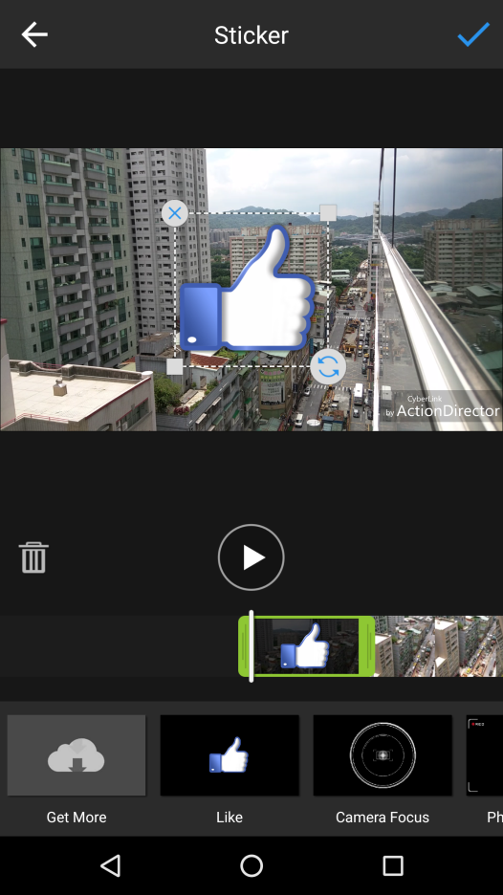
Fade Options for Sticker
Tap to pop up Fade options

Slide 9


Fade Options for Sticker
Fade in
Fade out
OK

