Slide 1
ActionDirector Mobile v2.8 UI Spec
PM: Elvis Chen

Slide 2
Schedule & Scope
v2.8 (9/14 GM)
New content packs
Color preset *5 for free download
No IAP
Add shopping cart button to the home page.

Slide 3
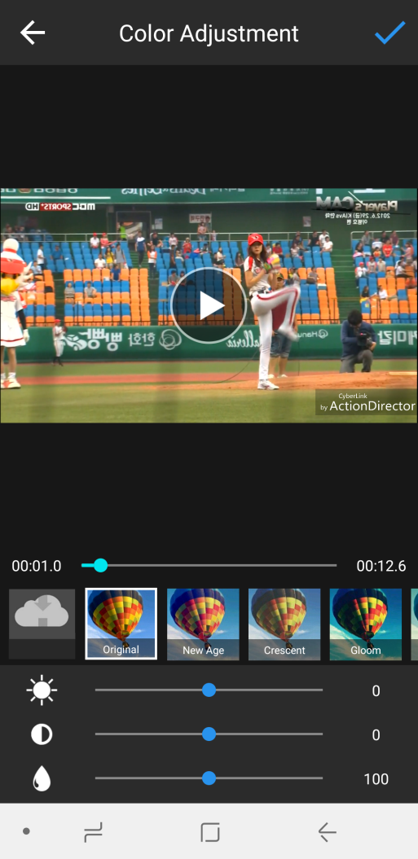
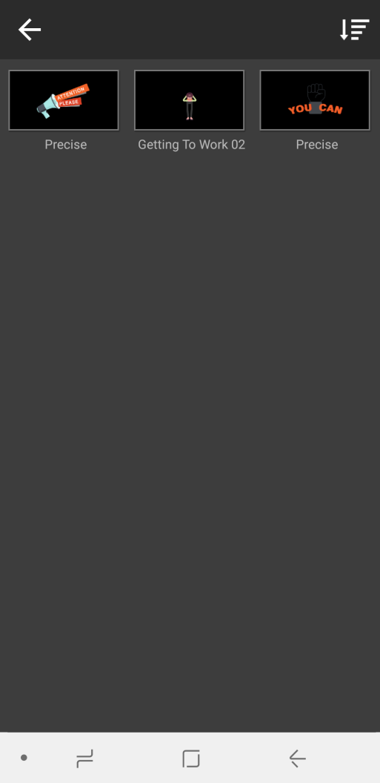
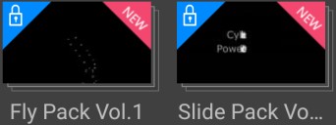
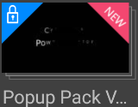






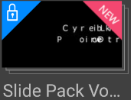

Color Presets
Color Presets
Get more

Slide 4
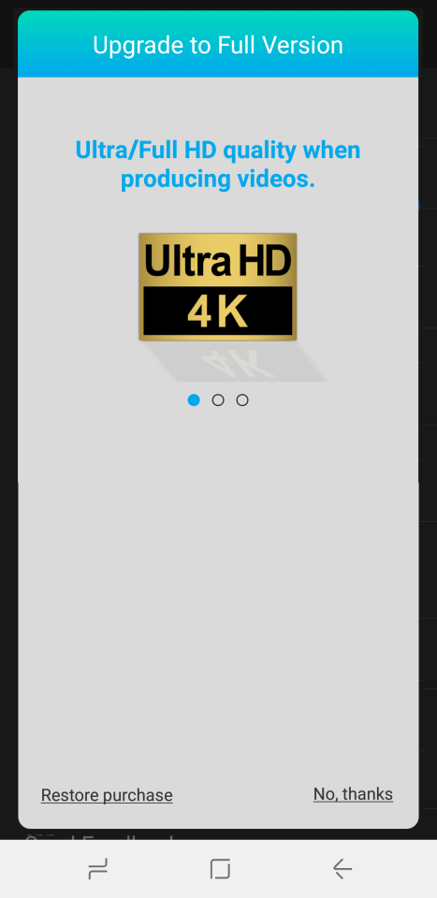


Color Presets
Beauty
Pack name
Auto rolling sample images (same as in PDR’s store page)
Preset name & Pack description
Light
Tap to download the whole pack to library and mark as “New”
Bright, young, and beautiful, create the most.
Download
Tap to back or the empty area to library (or tap back key)

Slide 5
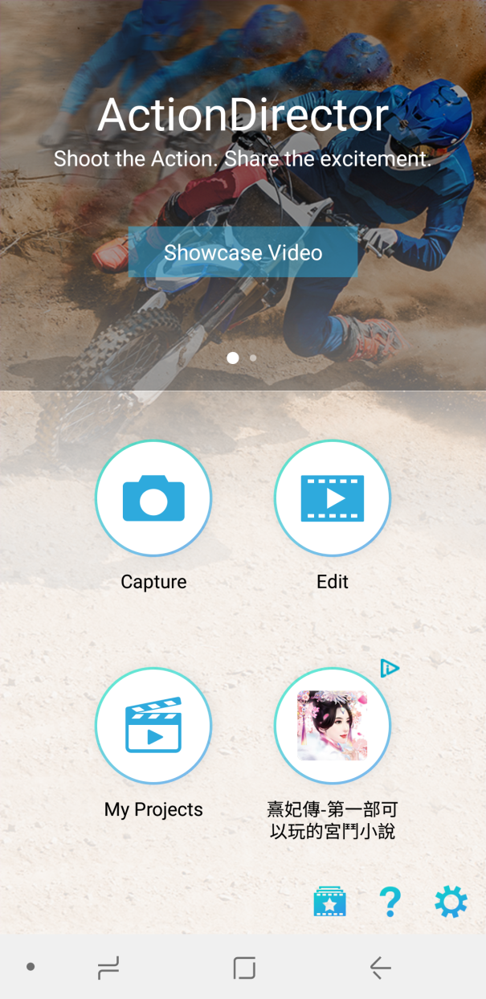

Tap shopping cart button to pop-up IAP dialog

