Slide 1
ActionDirector Mobile v2.9 UI Spec
PM: Elvis Chen

Slide 2
Schedule & Scope
v2.9 (11/9 GM)
New tool: Skin Smoother
V2.9.1 (11/23 GM)
Bug fix

Slide 3
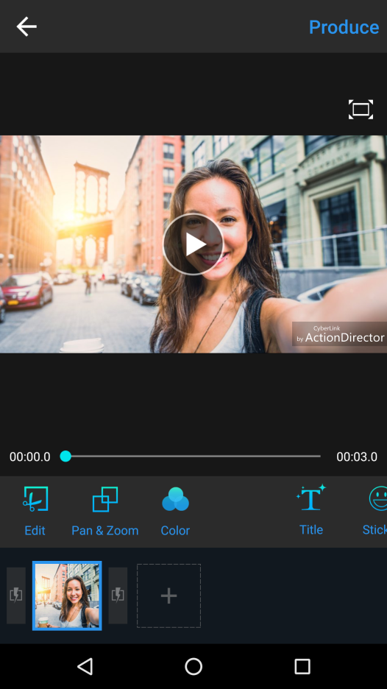

Entry point
Skin
Smoother
Add a new button to the tool menu

Slide 4
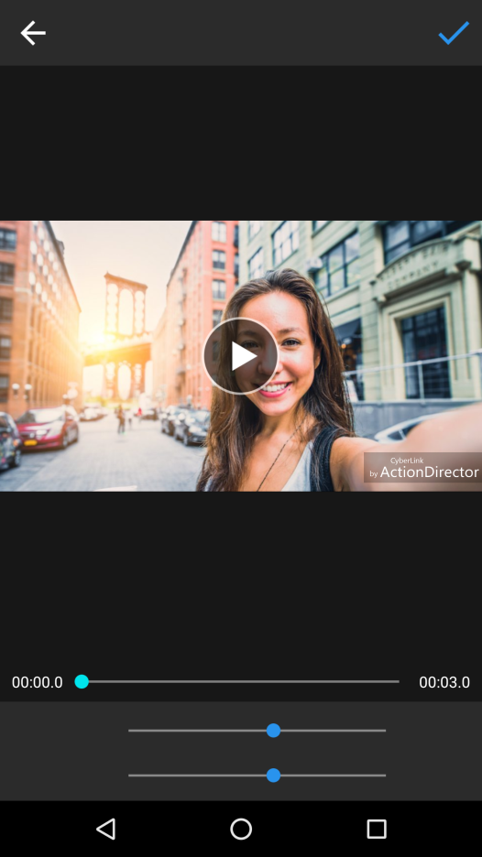

Controls
Skin Smoother
Tap to apply and back to main UI
Press & hold to show original
Press & hold to show the original image, and have an OSD to say that
Should snap to the default value when drag to it.
(color adjustments should have this behavior too)
2 sliders for skin brightness and smoothness strength: 0~200, default is 160
Original
Brightness
160
Smoothness
160

