Slide 1
ActionDirector Mobile Feature Proposal
PM: Elvis Chen

Slide 2
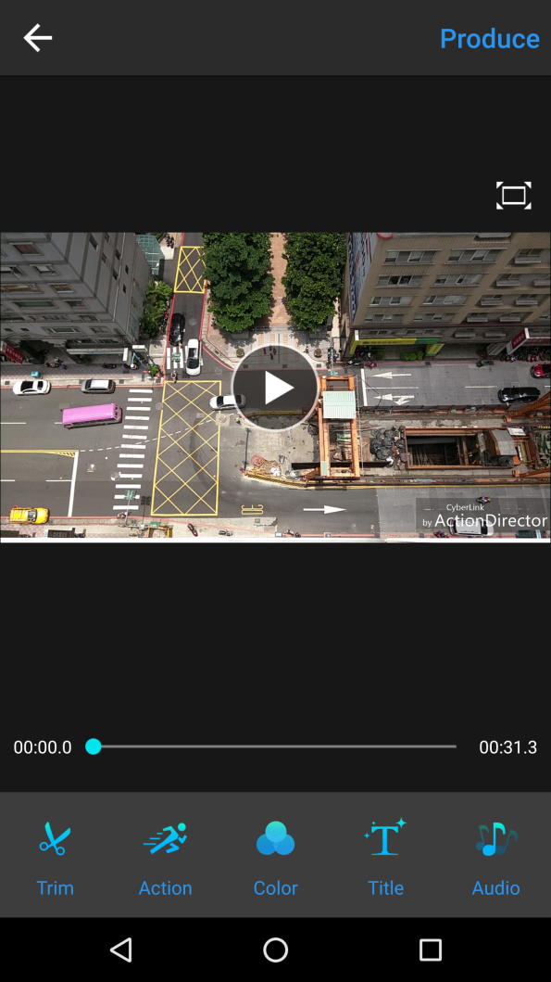
Support Flip & Rotate
New icon and change “Trim” to “Basic Edit”
Basic Edit

Slide 3
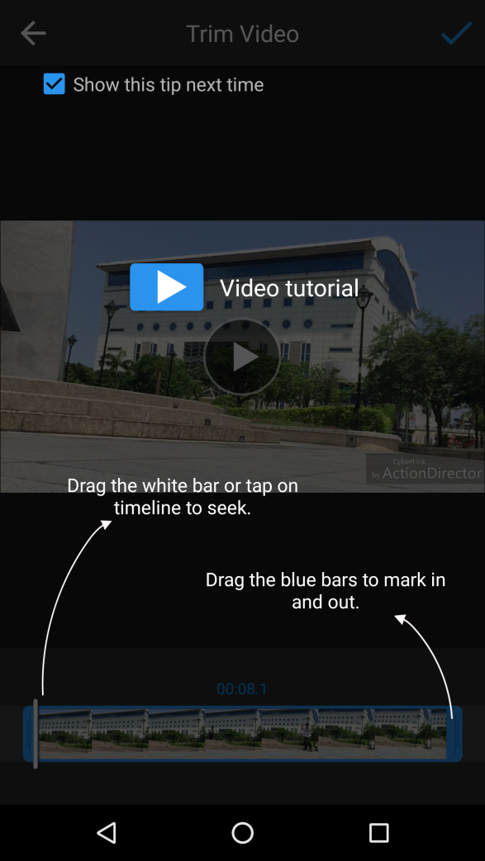


Tips
Tap to flip
Rotate 90 degree

Slide 4
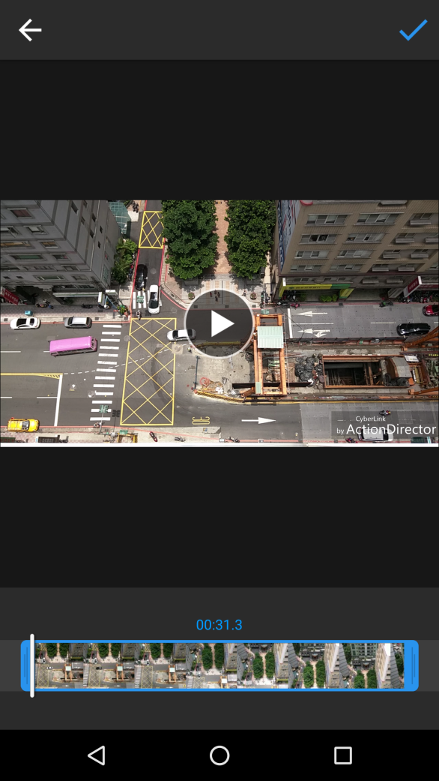
Trim
Tap to flip
Tap to rotate 90 degree directly

