Slide 1
ActionDirector Mobile v2.0 Feature Proposal
PM: Elvis Chen

Slide 2
Feature & Schedule
2016
2017
11/3 v1.01
Rate us & Send feedback
11/17 v1.02
On screen helps (Tips)
11/24 v1.1
Title Designer: Border & Shadow
12/1 v1.2
Color Presets
12/15 v1.3
Rotate & Flip
12/29 v1.31
Add more color presets
1/12 v2.0
Multiple clips support
Project

Slide 3
V2.0 Multiple clip supports
Related Features
Project
Project creation/delete
Auto save
Project list page
Editing
Storyboard
Able to add multiple clips
Cross-clip title
Transition (fade only)
Support photo later

Slide 4
Workflow
Home page:
Import clip(s)/Capture
(Create project automatically)
Add to/Remove from storyboard
Edit page:
Select a clip to edit
Produce/Share

Slide 5
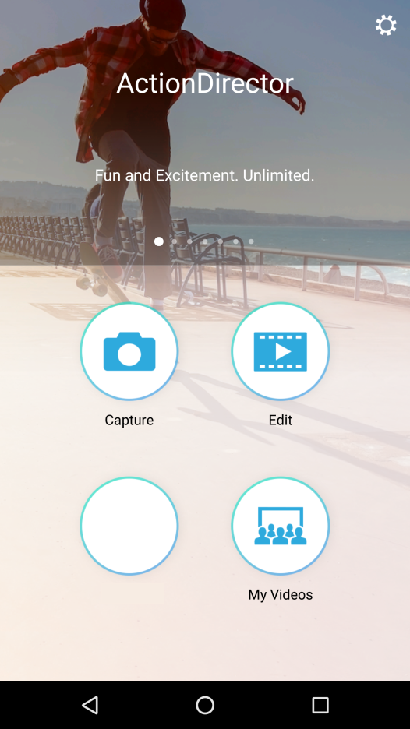


UI Mockup: Home Page
Add My Projects
Move settings and tutorials to bottom right (as PMP)
My Projects
?

Slide 6
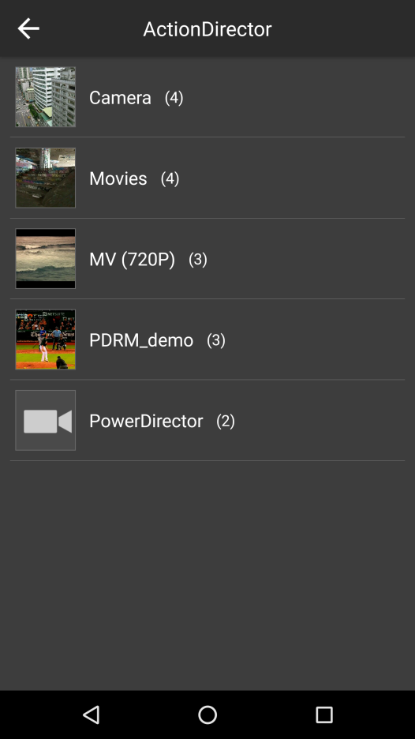

Edit > Select folder

Slide 7
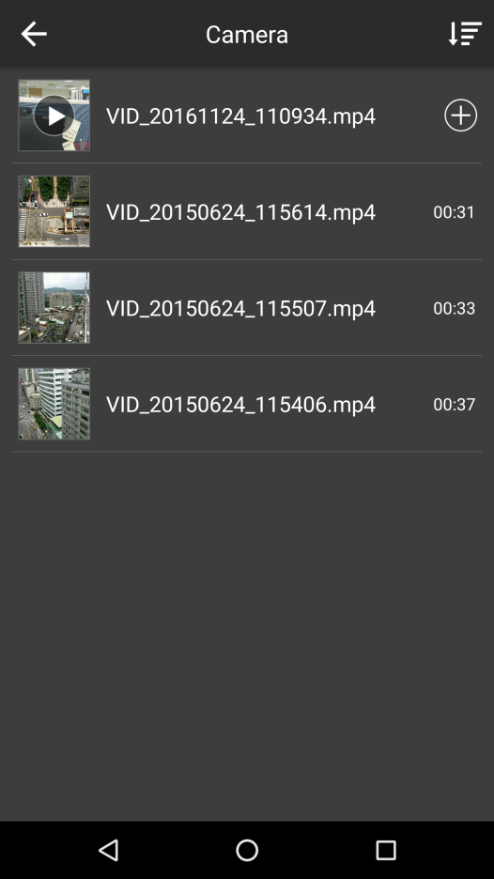


Storyboard
Tap to add to storyboard
If user select Capture in home page, jump to Camera folder and add the captured clip to storyboard directly.
Tap to remove
Tap to edit page.
Pop up a toast to tell user to add a clip first if nothing on storyboard
Press & hold clip to reorder
Show storyboard when entering folder
X
Show the next placeholder after adding a clip

Slide 8
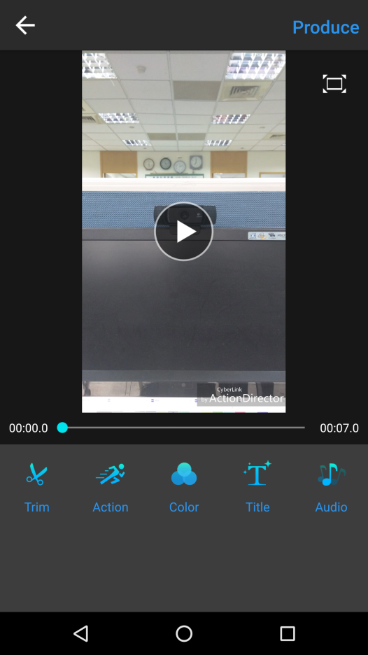



Edit Page
The 1 clip define the project aspect ratio
Tap + to back to clip selection page
Highlight the clip of where the CTI is.
Able to scroll when no space
+
Tap the place holder to add transition
Able to long press to reorder.

Slide 9




Transition
Support fade first
Fade
+

Slide 10
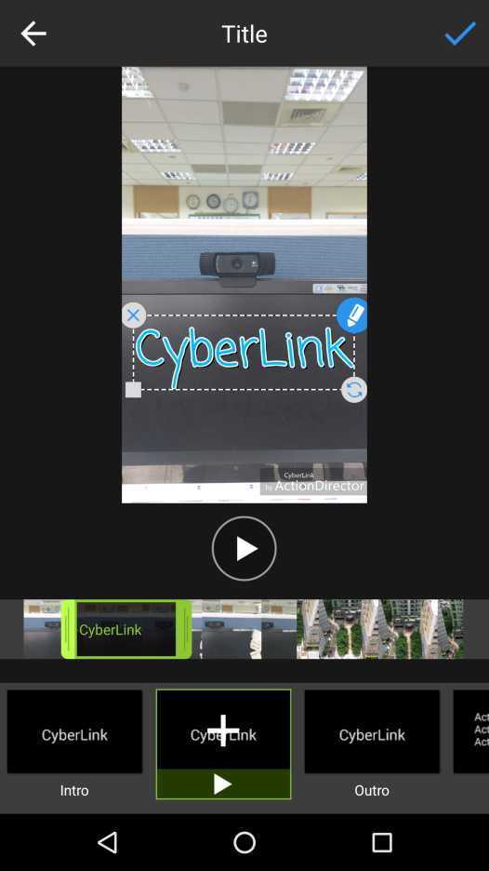
Title
Show timecode when seeking
00:26
Show the whole timeline for adding title, user may pinch to zoom in/out
Fix the CTI to the center and scrolling timeline when playing/seeking

Slide 11
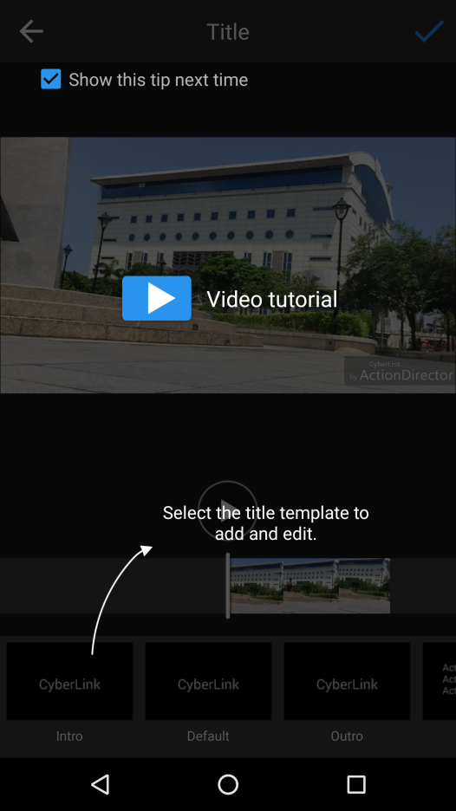
Title
Add gesture tips
Use the pinch gesture to scale the timeline view.

Slide 12
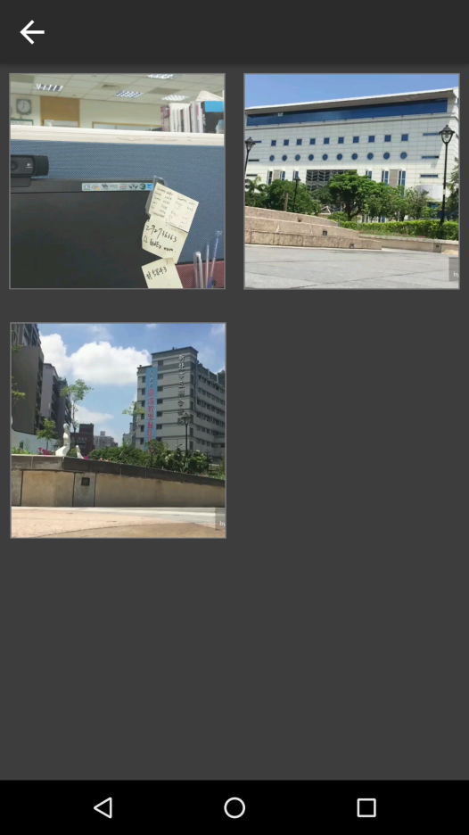
My Projects
My Projects
MM/DD
12/1
Default project name is MM/DD, user can tap to edit it
10/10

Slide 13
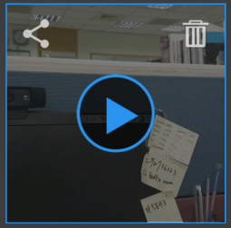
My Projects
Produce
My Projects
Ask before delete
Tap to preview project
Edit
Today
12/1
Tap to Edit page
Tap to Edit project name
10/10

Slide 14
Edit Page
Tap back to My Projects
Tap + to back to clip selection page
+

