Slide 1
Alirocumab therapy in individuals with type 2 diabetes mellitus and atherosclerotic cardiovascular disease: analysis of the ODYSSEY DM-DYSLIPIDEMIA and DM-INSULIN studies
Alirocumab治疗2型糖尿病和动脉粥样硬化性心血管疾病患者：ODYSSEY DM-DYSLIPIDEMIA和DM-INSULIN研究分析。
Cardiovascular Diabetology
2020-12-28

Slide 2
论文发表信息
PMID：31706300
DOI：10.1186/s12933-019-0951-9
期刊：Cardiovascular Diabetology
发表日期：9-11-2019
关键词：Alirocumab、Atherosclerotic cardiovascular disease、Type 2 diabetes mellitus、Low-density lipoprotein cholesterol、Dyslipidemia

Slide 3
作者信息
作者列表：Kausik K. Ray、Stefano Del Prato、Dirk Müller-Wieland、Bertrand Cariou、Helen M. Colhoun、Francisco J. Tinahones、Catherine Domenger、Alexia Letierce、Jonas Mandel、Rita Samuel、Maja Bujas-Bobanovic、Lawrence A. Leiter
单位列表： 1. 0000 0001 2113 8111 grid.7445.2 Imperial Centre for Cardiovascular Disease Prevention, Department of Primary Care and Public Health, Imperial College, Kensington, London, SW7 2AZ UK 2. 0000 0004 1757 3729 grid.5395.a Department of Clinical and Experimental Medicine, University of Pisa, Pisa, Italy 3. 0000 0000 8653 1507 grid.412301.5 Department of Internal Medicine I, University Hospital Aachen, Aachen, Germany 4. 0000 0004 0472 0371 grid.277151.7 l’institut du thorax, Department of Endocrinology, CHU Nantes, INSERM, 1413 Nantes, France 5. 0000 0004 1936 7988 grid.4305.2 University of Edinburgh, Edinburgh, Scotland, UK 6. Department of Clinical Endocrinology and Nutrition (IBIMA), Hospital Virgen de la Victoria, University of Málaga, CIBER Fisiopatología de la Obesidad y Nutrición (CIBERobn), Instituto de Salud Carlos III, Málaga, Spain 7. grid.417924.d Sanofi, Gentilly, France 8. grid.417924.d Biostatistics and Programming Department, Sanofi, Chilly-Mazarin, France 9. IviData Stats, Levallois-Perret, France 10. 0000 0004 0472 2713 grid.418961.3 Regeneron Pharmaceuticals, Inc., Tarrytown, New York, NY USA 11. grid.417924.d Sanofi, Paris, France 12. 0000 0001 2157 2938 grid.17063.33 Li Ka Shing Knowledge Institute, St. Michael’s Hospital, University of Toronto, Toronto, ON Canada

Slide 4
文献摘要
Background：Individuals with diabetes often have high levels of atherogenic lipoproteins and cholesterol reflected by elevated low-density lipoprotein cholesterol (LDL-C), non-high-density lipoprotein cholesterol (non-HDL-C), apolipoprotein B (ApoB), and LDL particle number (LDL-PN). The presence of atherosclerotic cardiovascular disease (ASCVD) increases the risk of future cardiovascular events. We evaluated the efficacy and safety of the proprotein convertase subtilisin/kexin type 9 (PCSK9) inhibitor, alirocumab, among individuals with type 2 diabetes (T2DM), high LDL-C or non-HDL-C, and established ASCVD receiving maximally tolerated statin in ODYSSEY DM-DYSLIPIDEMIA (NCT02642159) and DM-INSULIN (NCT02585778).
Methods：In DM-DYSLIPIDEMIA, individuals with T2DM and mixed dyslipidemia (non-HDL-C ≥ 100 mg/dL; n = 413) were randomized to open-label alirocumab 75 mg every 2 weeks (Q2W) or usual care (UC) for 24 weeks, with UC options selected before stratified randomization. In DM-INSULIN, insulin-treated individuals with T2DM (LDL-C ≥ 70 mg/dL; n = 441) were randomized in a double-blind fashion to alirocumab 75 mg Q2W or placebo for 24 weeks. Study participants also had a glycated hemoglobin < 9% (DM-DYSLIPIDEMIA) or < 10% (DM-INSULIN). Alirocumab dose was increased to 150 mg Q2W at week 12 if week 8 LDL-C was ≥ 70 mg/dL (DM-INSULIN) or non-HDL-C was ≥ 100 mg/dL (DM-DYSLIPIDEMIA). Lipid reductions and safety were assessed in patients with ASCVD from these studies.
Results：This analysis included 142 DM-DYSLIPIDEMIA and 177 DM-INSULIN participants with ASCVD, including 95.1% and 86.4% with coronary heart disease, and 32.4% and 49.7% with microvascular diabetes complications, respectively. At week 24, alirocumab significantly reduced LDL-C, non-HDL-C, ApoB, and LDL-PN from baseline versus control. This translated into a greater proportion of individuals achieving non-HDL-C < 100 mg/dL (64.6% alirocumab/23.8% UC [DM-DYSLIPIDEMIA]; 65.4% alirocumab/14.9% placebo [DM-INSULIN]) and ApoB < 80 mg/dL (75.1% alirocumab/35.4% UC and 76.8% alirocumab/24.8% placebo, respectively) versus control at week 24 (all P < 0.0001). In pooling these studies, 66.4% (alirocumab) and 67.0% (control) of individuals reported treatment-emergent adverse events. The adverse event pattern was similar with alirocumab versus controls.
Conclusions：Among individuals with T2DM and ASCVD who had high non-HDL-C/LDL-C levels despite maximally tolerated statin, alirocumab significantly reduced atherogenic cholesterol and LDL-PN versus control. Alirocumab was generally well tolerated.

Slide 5
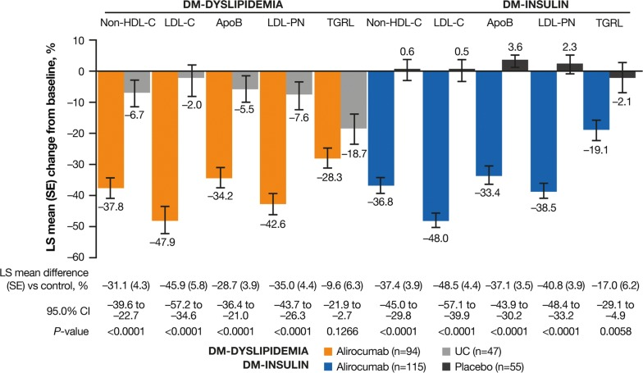
Figure 1
Percentage change from baseline to week 24 in non-HDL-C, LDL-C, ApoB, LDL-PN (ITT). Apo apolipoprotein, HDL-C high-density lipoprotein cholesterol, ITT intent-to-treat, LDL-C low-density lipoprotein cholesterol, LDL-PN low-density lipoprotein particle number, LS least-squares, SE standard error, UC usual care

Slide 6
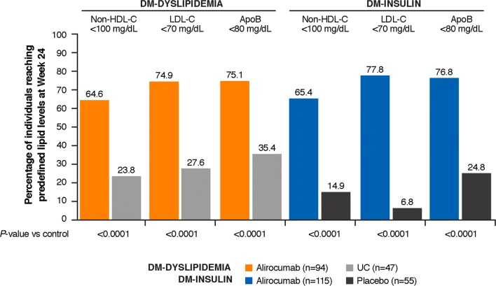
Figure 2
Percentage of individuals achieving non-HDL-C, LDL-C, and ApoB targets at week 24 (ITT). Non-HDL-C: 100 mg/dL = 2.59 mmol/L; LDL-C: 70 mg/dL = 1.81 mmol/L. Apo apolipoprotein, HDL-C high-density lipoprotein cholesterol, ITT intent-to-treat, LDL-C low-density lipoprotein cholesterol, UC usual care

Slide 7
Table 1
Unnamed: 0_level_0 Unnamed: 0_level_1 | DM-DYSLIPIDEMIA Alirocumab (n = 95) | DM-DYSLIPIDEMIA UC (n = 47) | DM-INSULIN Alirocumab (n = 119) | DM-INSULIN Placebo (n = 58)
Age, years, mean (SD) | 64.9 (9.1) | 65.4 (8.1) | 66.2 (8.7) | 64.9 (8.9)
Gender, male, n (%) | 65 (68.4) | 31 (66.0) | 79 (66.4) | 32 (55.2)
BMI, kg/m2, mean (SD) | 33.0 (5.4) | 32.7 (4.9) | 32.6 (4.5) | 33.4 (5.8)
CHD, n (%) | 90 (94.7) | 45 (95.7) | 102 (85.7) | 51 (87.9)
Acute MI | 43 (45.3) | 20 (42.6) | 59 (49.6) | 18 (31.0)
Silent MI | 5 (5.3) | 1 (2.1) | 4 (3.4) | 4 (6.9)
Unstable angina | 15 (15.8) | 9 (19.1) | 15 (12.6) | 4 (6.9)
Coronary revascularization | 77 (81.1) | 35 (74.5) | 80 (67.2) | 37 (63.8)
Other clinically significant CHDa | 20 (21.1) | 14 (29.8) | 31 (26.1) | 15 (25.9)
Ischemic stroke, n (%) | 14 (14.7) | 5 (10.6) | 27 (22.7) | 9 (15.5)
PAD, n (%) | 6 (6.3) | 4 (8.5) | 13 (10.9) | 6 (10.3)
HTNb, n (%) | 89 (93.7) | 44 (93.6) | 105 (88.2) | 53 (91.4)
CKDc, n (%) | 15 (15.8) | 11 (23.4) | 37 (31.1) | 13 (22.4)
Diabetes target organ damaged, n (%) | 31 (32.6) | 15 (31.9) | 60 (50.4) | 28 (48.3)
Statin, n (%) | 80 (84.2) | 41 (87.2) | 92 (77.3) | 42 (72.4)
Low intensity | 6 (7.5) | 0 | 3 (3.3) | 1 (2.4)
Moderate intensity | 21 (26.3) | 20 (48.8) | 46 (50.0) | 24 (57.1)
High intensity | 53 (66.3) | 21 (51.2) | 43 (46.7) | 16 (38.1)
LLT other than statine, n (%) | 0 | 2 (4.3) | 34 (28.6) | 11 (19.0)
HbA1c, %, mean (SD) | 7.0 (0.8) | 7.2 (0.8) | 7.5 (0.9) | 7.4 (1.0)
FPG, mg/dL [mmol/L], mean (SD) | 144.1 (39.3) [8.0 (2.2)] | 152.6 (41.7) [8.5 (2.3)] | 162.6 (52.5) [9.0 (2.9)] | 146.7 (45.2) [8.1 (2.5)]
Insulin, n (%) | 40 (42.1) | 19 (40.4) | 119 (100) | 57 (98.3)f
Non-insulin GLT, n (%) | Non-insulin GLT, n (%) | Non-insulin GLT, n (%) | Non-insulin GLT, n (%) | Non-insulin GLT, n (%)
Biguanides | 72 (75.8) | 34 (72.3) | 57 (47.9) | 33 (56.9)
Sulfonylureas | 29 (30.5) | 18 (38.3) | 11 (9.2) | 7 (12.1)
DPP-4 inhibitor | 12 (12.6) | 8 (17.0) | 21 (17.6) | 7 (12.1)
GLP-1 receptor agonist | 16 (16.8) | 6 (12.8) | 11 (9.2) | 8 (13.8)
SGLT2 inhibitor | 10 (10.5) | 5 (10.6) | 10 (8.4) | 11 (19.0)
Lipids, mg/dL [mmol/L], mean (SD) | Lipids, mg/dL [mmol/L], mean (SD) | Lipids, mg/dL [mmol/L], mean (SD) | Lipids, mg/dL [mmol/L], mean (SD) | Lipids, mg/dL [mmol/L], mean (SD)
Non-HDL-C | 156.5 (48.4) [4.05 (1.26)] | 156.8 (43.3) [4.06 (1.12)] | 142.8 (41.5) [3.70 (1.08)] | 147.0 (54.9) [3.81 (1.42)]
LDL-C | 108.3 (46.3) [2.81 (1.20)] | 109.4 (44.0) [2.83 (1.14)] | 107.2 (35.1) [2.78 (0.91)] | 111.9 (46.4) [2.90 (1.20)]
ApoB | 103.0 (26.7) | 104.3 (27.8) | 96.4 (25.1) | 98.7 (32.0)
LDL-PN, nmol/L, mean (SD) | 1400.2 (489.8) | 1437.4 (479.4) | 1339.5 (408.5) | 1425.0 (467.9)
Baseline characteristics (randomized population)

Slide 8
Table 2
n ( % ) | A l i r o c u m a b ( n = 2 1 3 ) | C o n t r o l ( n = 1 0 4 )
TEAEs | 142 (66.7) | 70 (67.3)
Treatment-emergent SAEs | 28 (13.1) | 10 (9.6)
TEAEs leading to death | 1 (0.5) | 1 (1.0)
TEAEs occurring in ≥ 2% of individuals by preferred term | TEAEs occurring in ≥ 2% of individuals by preferred term | TEAEs occurring in ≥ 2% of individuals by preferred term
Urinary tract infection | 8 (3.8) | 6 (5.8)
Diarrhea | 8 (3.8) | 6 (5.8)
Hypertension | 8 (3.8) | 4 (3.8)
Influenza | 7 (3.3) | 4 (3.8)
Headache | 7 (3.3) | 1 (1.0)
Musculoskeletal pain | 7 (3.3) | 3 (2.9)
Nasopharyngitis | 6 (2.8) | 5 (4.8)
Back pain | 6 (2.8) | 2 (1.9)
Dizziness | 6 (2.8) | 3 (2.9)
Fatigue | 5 (2.3) | 3 (2.9)
Cataract | 5 (2.3) | 1 (1.0)
Myalgia | 5 (2.3) | 1 (1.0)
Nausea | 4 (1.9) | 3 (2.9)
Pain in extremity | 4 (1.9) | 3 (2.9)
Arthralgia | 3 (1.4) | 3 (2.9)
Bronchitis | 3 (1.4) | 3 (2.9)
Hypotension | 2 (0.9) | 3 (2.9)
Cough | 1 (0.5) | 3 (2.9)
Hyperglycemia | 0 (0.0) | 3 (2.9)
Safety summary (pool of DM-INSULIN and DM-DYSLIPIDEMIA; safety population)

Slide 9
Table 3
Unnamed: 0_level_0 Unnamed: 0_level_1 | DM-DYSLIPIDEMIA Alirocumab (n = 95) | DM-DYSLIPIDEMIA UC (n = 47) | DM-INSULIN Alirocumab (n = 118) | DM-INSULIN Placebo (n = 57)
TEAEs occurring in ≥ 2% of individuals by preferred term, n (%) | TEAEs occurring in ≥ 2% of individuals by preferred term, n (%) | TEAEs occurring in ≥ 2% of individuals by preferred term, n (%) | TEAEs occurring in ≥ 2% of individuals by preferred term, n (%) | TEAEs occurring in ≥ 2% of individuals by preferred term, n (%)
Urinary tract infection | 5 (5.3) | 2 (4.3) | 3 (2.5) | 4 (7.0)
Diarrhea | 5 (5.3) | 3 (6.4) | 3 (2.5) | 3 (5.3)
Hypertension | 3 (3.2) | 1 (2.1) | 5 (4.2) | 3 (5.3)
Influenza | 3 (3.2) | 3 (6.4) | 4 (3.4) | 1 (1.8)
Musculoskeletal pain | 4 (4.2) | 1 (2.1) | 3 (2.5) | 2 (3.5)
Back pain | 2 (2.1) | 2 (4.3) | 4 (3.4) | 0
Dizziness | 3 (3.2) | 1 (2.1) | 3 (2.5) | 2 (3.5)
Fatigue | 2 (2.1) | 2 (4.3) | 3 (2.5) | 1 (1.8)
Cataract | 1 (1.1) | 1 (2.1) | 4 (3.4) | 0
Myalgia | 2 (2.1) | 1 (2.1) | 3 (2.5) | 0
Nausea | 2 (2.1) | 1 (2.1) | 2 (1.7) | 2 (3.5)
Pain in extremity | 2 (2.1) | 2 (4.3) | 2 (1.7) | 1 (1.8)
Bronchitis | 0 | 2 (4.3) | 3 (2.5) | 1 (1.8)
Safety summary (randomized population)

