Slide 1
MOB_lib + DummyTest
By icandoit

Slide 2
MOB_lib
D:\svn\common\Server\GameServer\MOB_lib\
MOB_lib.vcproj

Slide 3
MOB Server 모듈 구성도.
MOB_lib
게임 Logic
(DualGoServer.exe)
PacketDispath Lib
(google protocal 래퍼)

Slide 4
MOB_lib
Asio관련 네트웍 처리부분만 분리.
MOB_net_interface.h
로직에서 사용하는 해더.
d:\svn\common\Server\GameServer\MOB_lib\MOB_net_interface.h

Slide 5
MOB_net_interface.h의 내용.
MOB_Iconnection
MOB_INetIOModel
void run_tcp_server(Plugin_INetIOModel*,int port);

Slide 6
MOB_Lib
m_pParent
MOB_INetIOModel
MOB_IConnection
m_pPlugin
m_pPlugin
Game Logic
void run_tcp_server(Plugin_INetIOModel*,int port);
m_pMOB_IConnection
m_pMOB_INetIOModel
SAMPLE_Plugin_Connection
SAMPLE_Plugin_NetIOModel
m_pSAMPLE_Plugin_NetIOModel
SampleServer.exe

Slide 7
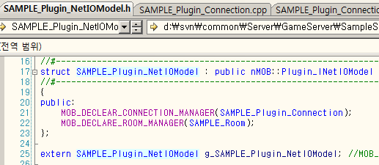
SAMPLE_Plugin_NetIOModel
MOB_lib의 MOB_INetIOModel에 바인딩될 게임로직 객체
접속 컨넥션(or 소켓 or session)관리.
방 관리

Slide 8
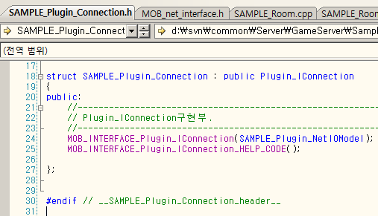
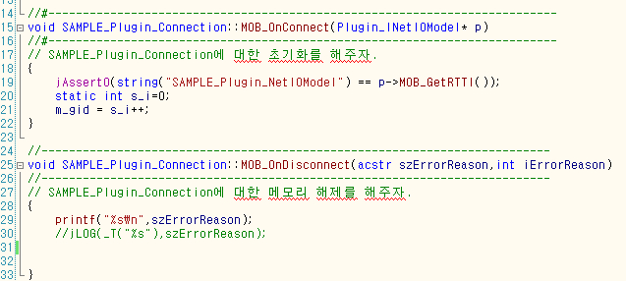
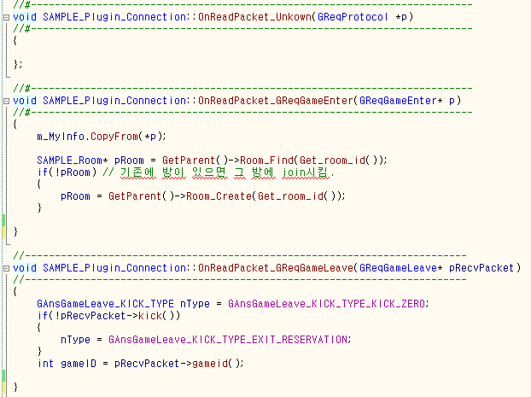
SAMPLE_Plugin_Connection
유저 접속
.h
유저 접속해제
알수없는 패킷이 왔을때
UG로 부터 유저가 방입장 요청
UG로 부터 유저 방퇴장 요청.

Slide 9
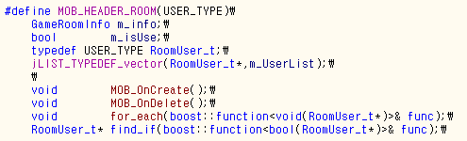
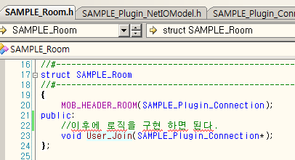
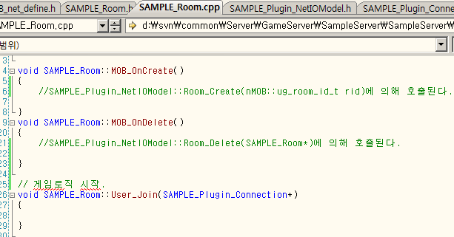
SAMPLE_Room 객체

Slide 10
DummyTest
빌드
D:\svn\common\Server\Tool\DummyTest\DummyTest.sln
@dummy.CallPython 0 0 call_req_game_test_packet is 1234 test

Slide 11
Packet Dispath Lib
(google protocal 래퍼)

Slide 12
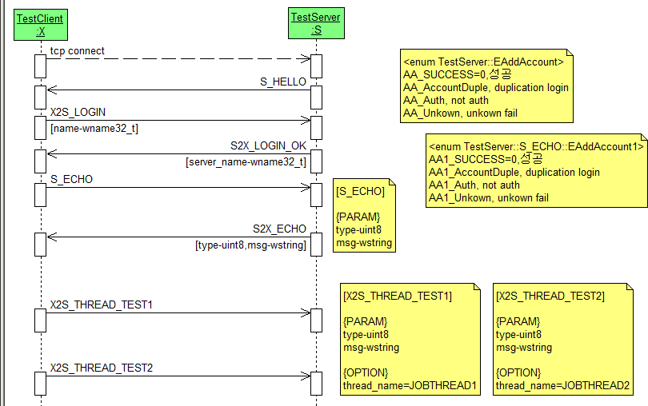
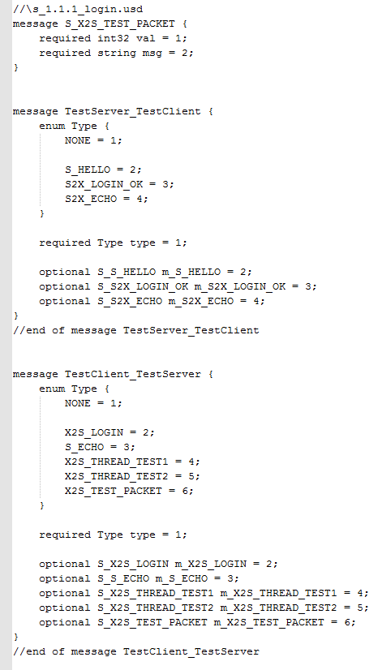
http://nwmsvn.nwinet.co.kr/svn/common/lib/windows/mech/src/server/TestServer/sequence/TestServer/ s_1.1.1_Login.usd

Slide 13
.proto파일 작성 규칙.
최신 버전 : http://nwmsvn.nwinet.co.kr/svn/common/protobuf/proto.intro
# symbol introduction
c - client,a - admin link,ug - user gateway,p - presence,g - game server
U - unlogged,L - logged,G - playing game, +D - detached flag on
# control flow
login
c -> ug(p+ confirm) -> p
'U' -> 'L'
logout
c -> ug -> p
'L' -> 'U'
gameEnter
c -> ug -> p -> ug -> g -> ug
'L' -> 'G'
gameLeave
(c ->) ug -> g -> ug -> p -> ug
'G' -> 'L'
gameArrive
g -> ug -> c
no self state transition
detach
ug -> (g -> ug ->) p -> ug
'GL'->+D
plug
c -> ug -> (g -> ug ->) p -> ug
'GL'->-D
kill (not implemented)
(c/a -> p c/a ->) ug -> g -> ug -> p -> ug
'LG' -> 'U'
# file
# PACKET TYPE PREFIX/PACKET NAME PREFIX/PROTOCOL
ug.proto
c -> ug UReq, req, UReqProtocol
ug -> c UAns, ans, UAnsProtocol
presence.proto
ug -> p PReq, req, PReqProtocol
p -> ug PAns, ans, PAnsProtocol
game.proto - game flow protocol for game servers
ug -> g, GReq, req, GReqProtocol
g -> ug, GAns, ans, GAnsProtocol
gameGoStop.proto - game logic protocol for game servers
ug -> g, GLReq, req, GLReqProtocol
g -> ug, GLAns, ans, GLAnsProtocol

Slide 14
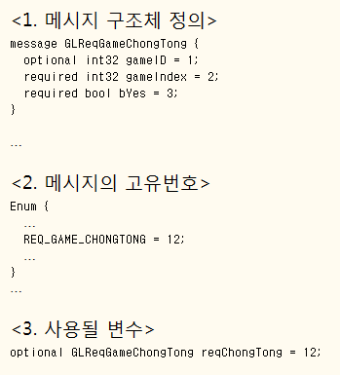
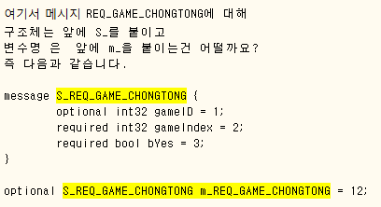
제안사항.

Slide 15
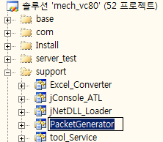
PacketGenerator.exe
http://nwmsvn.nwinet.co.kr/svn/common/lib/windows/mech/src/build/
mech_vc80.sln
Umlpad.exe로 작성한 문서를 .proto파일로 변환시켜준다.
실행
PacketGenerator.exe usd <output_dir> <input_dir_usd>

