Slide 1
asio

Slide 2
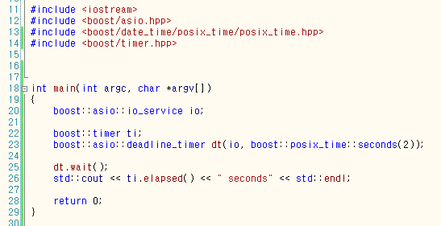

Timer + deadline_timer (windows)

Slide 3
Timer + deadline_timer (Linux)
bash-3.2$ cat deadline_timer.cpp
#include <iostream>
#include <boost/timer.hpp>
#include <boost/asio.hpp>
#include <boost/date_time/posix_time/posix_time.hpp>
int main(int argc, char *argv[])
{
boost::asio::io_service io;
boost::timer ti;
boost::asio::deadline_timer dt(io, boost::posix_time::seconds(2));
dt.wait();
std::cout << ti.elapsed() << " seconds" << std::endl;
return 0;
}
bash-3.2$ g++ deadline_timer.cpp -lboost_system -lpthread
bash-3.2$ ./a.out
0.000219 seconds
bash-3.2$
---
http://kldp.org/node/107343
리눅스에서는 timer에 의한 시간 측정이 정확하지 않다.

Slide 4
progress_timer
progress_timer t;
start = t.elapsed();
Cout << t.elapsed() - start << " seconds \n" << endl;

Slide 5
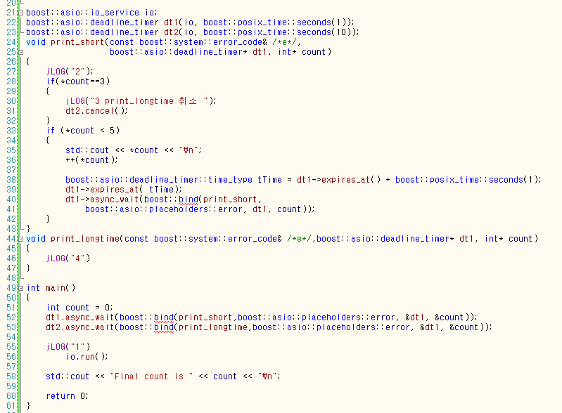
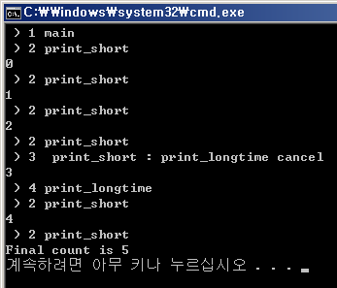

Slide 6
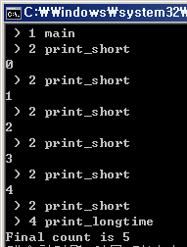

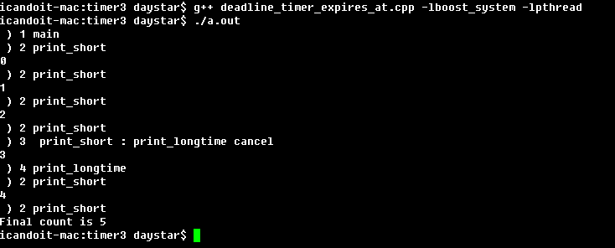
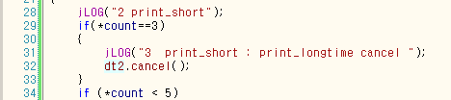

Slide 7
Asio::deadline_time::cancel
Cancel시 핸들러가 즉시 호출되므로 핸들러의 error_code로 호출이유를 확인해야 한다.
Void timer_handle(const boost::system::error_code& error)
{
if (error == boost::asio::error::operation_aborted)
{
std::cout << "Timer was canceled" << std::endl;
return;
}

