Slide 1
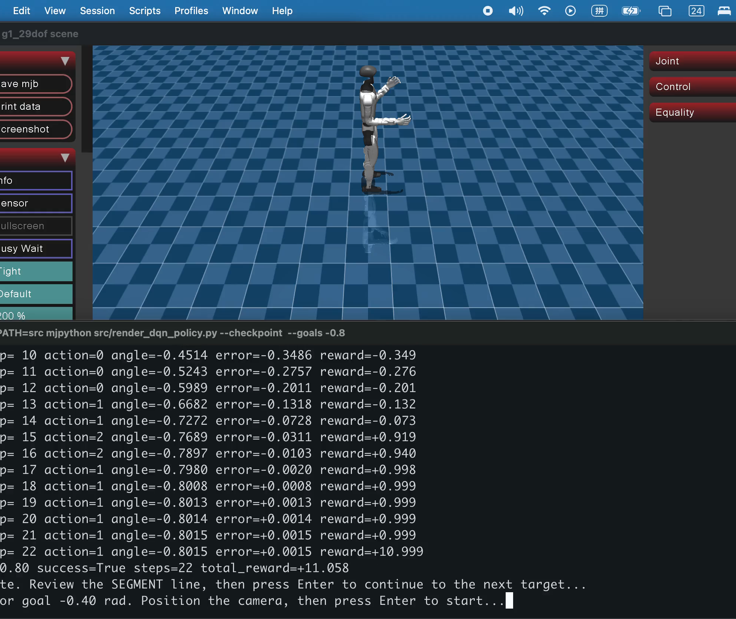
UNITREE G1 · GROUP 2
Reach-and-touch
is now executable
Dry-run evidence and the path from our A3 DQN baseline to a learned multi-joint task
A3 trained policy evidence
CSCN8020 · Final Project Dry Run
Saved DQN checkpoint controlling the G1 left elbow

Slide 2
We are extending a proven controller into a measurable task
01
02
03
A3 BASELINE
CURRENT DEMO
FINAL POLICY
Control one joint
Validate the task
Learn the sequence
→
→
DQN selects decrease, hold, or increase for the left elbow target.
Scripted PD targets drive shoulder and elbow through reach, hold, and return.
DQN or PPO will replace scripted targets and learn from task rewards.
The dry run proves the middle step; training remains the next milestone.
2

Slide 3
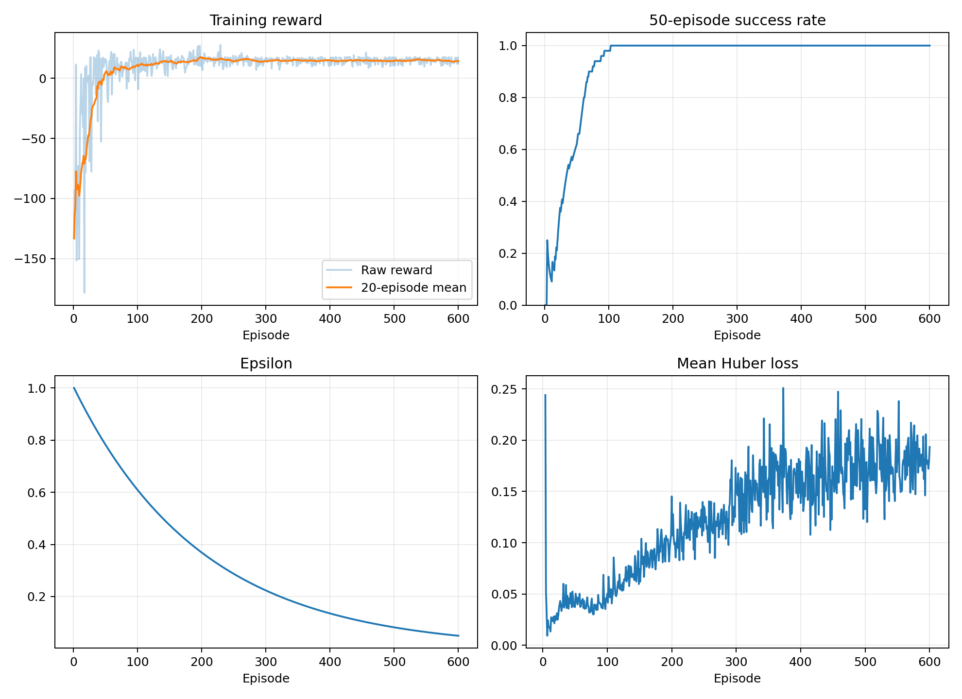
The A3 DQN already provides a reliable learning baseline
20 / 20
greedy evaluation successes
100%
evaluation success rate
0.00491 rad
mean final absolute error reported for Config A
3

Slide 4
Touch becomes a measurable RL objective
OBSERVATION
ACTION
SUCCESS
Joint angles and velocities
Hand and target positions
Hand-to-target error
Current task phase
Discrete target changes
for shoulder and elbow
Initial baseline stays
compatible with DQN
Distance ≤ target radius
and hold duration ≥ threshold
Return to neutral pose
is evaluated separately
rₜ = − ‖p_hand − p_target‖₂ + b_touch − λ · smoothness
Reward closer motion, sustained contact, and stability while penalizing unnecessary oscillation.
4

Slide 5
The demo validates one complete reach-touch-return cycle
REST
REACH
TOUCH / HOLD
RETURN
→
→
→
Stabilize the robot
Interpolate arm targets
Stay inside the target
Recover neutral pose
target-radius = 0.045 m
required-hold = 1.5 s
The hand is touching when endpoint distance is within 4.5 cm.
The run succeeds only after enough contact time accumulates during TOUCH/HOLD.
5

Slide 6
The demo succeeds with 1.2 mm endpoint accuracy
0.0012 m
minimum endpoint distance
2.002 s
accumulated touch time
SUCCESS
Headless verification and the visual demo use the same thresholds.
6

Slide 7
The demo proves task mechanics, not learned behavior
PROVEN NOW
STILL TO LEARN
✓ Multi-joint arm actuation
✓ Virtual target visualization
✓ Endpoint-distance measurement
✓ Touch and hold success rule
✓ Reach, hold, and return phases
✓ Reproducible CSV evidence
○ Action selection from observations
○ Reward-driven policy improvement
○ Robustness across target positions
○ Comparison against scripted baseline
○ Motion smoothness under DQN or PPO
○ Held-out multi-seed evaluation
This distinction keeps the dry-run claim accurate and gives us a clean experimental baseline.
7

Slide 8
Next, the learned policy must beat the scripted baseline
01
02
03
04
Environment
Training
Evaluation
Decision
Expose state, discrete actions, reward, and termination through Gymnasium.
Train DQN across randomized reachable targets and tune reward weights.
Report success rate, distance, hold time, reward, and smoothness over fixed seeds.
Keep DQN if motion is stable; compare PPO if discrete control remains jerky.
Dry-run ask
Confirm the task definition and evaluation criteria before full training.
8

