Slide 1
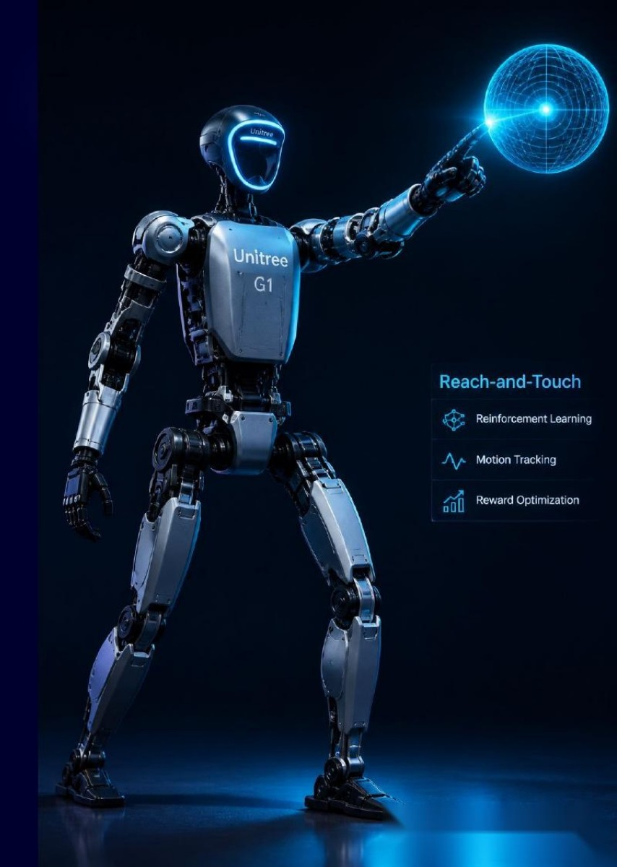
CSCN8020 FINAL PROJECT
Unitree G1 Actor-Critic
Reach-and-Touch
Project Progress Report
Group 2
Haibo Yuan | Ce Chen | Zhuoran Zhang
A learned policy that adapts to different reachable targets

Slide 2
— CURRENT IMPLEMENTATION
02
The learned policy now reaches different blue targets
Current milestone
Target-conditioned behavior
PPO Actor-Critic controls the left arm while the Inspire hand remains in a validated pointing pose.
A new reachable 3D target is generated each episode and included in the state.
100/100
0.0185 m
4
Independent successes
Mean minimum distance
Controlled arm joints
randomized evaluation targets
touch tolerance = 0.045 m
continuous Actor actions
Evidence
Scope boundary
Saved checkpoint selected at PPO update 35; deterministic evaluation uses separate seeds.
This is a kinematic reaching baseline with virtual touch, not torque control or detailed physical contact.
The target changes, the state changes, and the Actor produces a different joint trajectory.

Slide 3
— WHAT THE ROBOT LEARNS
03
The Actor learns a target-conditioned reaching policy
Observe
Act
Evaluate
Improve
Robot joints, fingertip,
blue target and relative error
Four continuous joint-position
increments from the Actor
Critic estimates V(s) and
PPO computes an advantage
Increase probability of actions
that produce higher return
sₜ
→
aₜ ~ πθ(a|sₜ)
→
rₜ , sₜ₊₁
→
δₜ
Learning means the same saved Actor can reach different targets because target position is part of its input.

Slide 4
— MDP DEFINITION
04
The state explicitly describes the robot and its target
State sₜ = [ qₜ, q̇ₜ, pᵗⁱᵖₜ, pᵗᵃʳᵍᵉᵗ, Δpₜ, dₜ, hₜ ] ∈ ℝ¹⁹
qₜ ∈ ℝ⁴
q̇ₜ ∈ ℝ⁴
pᵗⁱᵖ, pᵗᵃʳᵍᵉᵗ ∈ ℝ³
Δpₜ ∈ ℝ³
Controlled joint angles
Controlled joint velocities
Fingertip and blue-target positions
Target minus fingertip
dₜ = ‖Δpₜ‖₂
hₜ ∈ [0,1]
Euclidean fingertip distance
Normalized touch-hold progress
Including pᵗᵃʳᵍᵉᵗ and Δpₜ is what lets the policy react when the blue target moves.

Slide 5
— ACTOR-CRITIC LEARNING LOOP
05
Actor and Critic improve together through PPO
State sₜ
Actor πθ
MuJoCo
Critic Vφ
PPO update
→
→
→
→
19-value observation
selects action aₜ
returns rₜ, sₜ₊₁
estimates state value
improves θ and φ
Training
Evaluation
Stochastic Gaussian actions
PPO clipped policy update
Deterministic Actor mean
No exploration and no retraining
The Actor chooses actions; the Critic supplies the learning signal. They are not DQN online and target networks.

Slide 6
— MATH TO CODE
06
PPO turns Critic estimates into an Actor update
TD error
δₜ = rₜ + γVφ(sₜ₊₁) − Vφ(sₜ)
Implementation
action, log_prob, value = actor_critic.act(state)
delta = reward + gamma * next_value - value
advantages, returns = generalized_advantage_estimate(...)
ratio = exp(new_log_prob - old_log_prob)
actor_loss = -min(ratio * advantage, clipped * advantage)
critic_loss = 0.5 * (return - value)²
Generalized advantage
Âₜ = δₜ + γλδₜ₊₁ + ⋯
Clipped Actor objective
Lᴾᴾᴼ = −min(ρₜÂₜ, clip(ρₜ)Âₜ)
The Critic learns V(s); its advantage estimate tells the Actor which target-conditioned actions performed better than expected.

Slide 7
— RESULTS AND EVIDENCE
07
The selected policy succeeds on 100 unseen target episodes
100/100
0.0185 m
35
0.045 m
Evaluation successes
Mean minimum distance
Selected PPO update
Touch tolerance
seeds 1000–1099
well within 0.045 m tolerance
best validation checkpoint
8 consecutive steps
Validation success during training
What the evidence means
• The checkpoint reloads without retraining.
• Every evaluation seed produces a different reachable target.
• Success requires sustained fingertip proximity, not a single close frame.

Slide 8
— LIMITATIONS AND NEXT STEPS
08
The current policy proves adaptation, with clear physical limits
Completed
Current limitations
Next engineering steps
• Five-finger Inspire model
• Randomized reachable targets
• PPO Actor and Value Critic
• Saved-model evaluation
• Kinematic joint increments
• Virtual distance-based touch
• Pointing hand is fixed
• Target moves between episodes
• Cartesian target input
• Mid-episode target movement
• Dynamic/torque controller
• Simplified physical contact
Question for feedback
Is this target-conditioned kinematic baseline an appropriate foundation before introducing torque control and physical contact?

Slide 9
— LIVE DEMO
09
The saved Actor now follows five different blue targets
Run command
macOS $ mjpython final_project/evaluate_actor_critic.py --episodes 5 --viewer
Windows/Linux $ python final_project/evaluate_actor_critic.py --episodes 5 --viewer
1
Checkpoint loaded
2
Blue target moves
3
Actor controls arm
4
Touch is measured
PPO update 35
new target each episode
four continuous actions
distance, reward, success
Watch the blue target change, the fingertip distance fall, and TOUCH SUCCESS appear without retraining.

