Slide 1
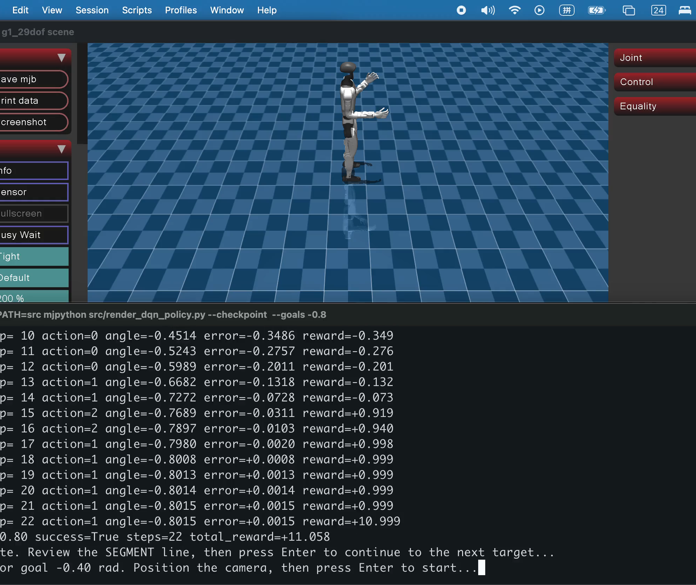
UNITREE G1 + INSPIRE · GROUP 2
Five-finger pointing
is now executable
An articulated Inspire-hand baseline with fingertip-level success measurement
A3 learning baseline
CSCN8020 · Final Project Dry Run
Earlier checkpoint evidence; Inspire demo follows live
Notes:
Open by naming the scope precisely: this is an executable Inspire five-finger scripted baseline, not a trained reach-and-touch policy. The actual modeled left index fingertip is the endpoint.

Slide 2
The Inspire demo connects our proven DQN to a richer task
01
02
03
A3 BASELINE
INSPIRE DEMO
ADAPTIVE POLICY
Learn one joint
Validate the hand
Generalize targets
→
→
DQN selects discrete changes for the left-elbow target.
Scripted joint targets drive the left arm and articulated fingers.
IK first, then DQN or PPO across reachable target positions.
The dry run validates mechanics; adaptation and training remain next.
2
Notes:
Explain the three stages. A3 proved DQN infrastructure. This Inspire demo validates articulated-hand mechanics. The next stage adds target adaptation and then policy learning.

Slide 3
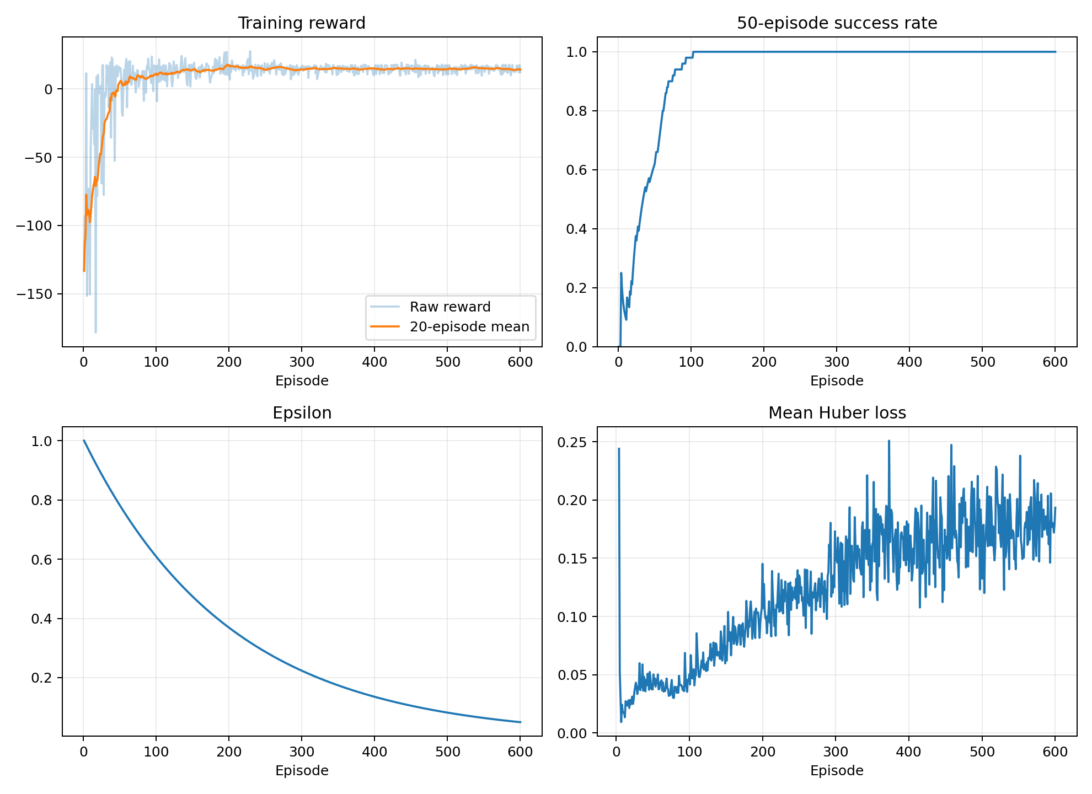
The A3 DQN still provides our learning foundation
20 / 20
greedy evaluation successes
100%
evaluation success rate
0.00491 rad
mean final absolute error reported for Config A
3
Notes:
Use the A3 numbers only as evidence that our DQN training and evaluation pipeline works. Do not claim these elbow-only results prove the new five-finger task.

Slide 4
The endpoint is now an actuated index fingertip
MODEL
CONTROL NOW
MEASUREMENT
53 modeled joints
29 body + 24 hand joints
Left Inspire hand articulated
Right side visually simplified
7 left-arm targets
12 left-finger targets
Deterministic scripted
joint-position baseline
Actual index-tip site
Distance ≤ target radius
Hold ≥ threshold
and complete the sequence
Planned RL: rₜ = − ‖p_tip − p_target‖₂ + b_touch − λ · smoothness
The scripted baseline validates every signal required by the future RL objective.
4
Notes:
Point out the 53-joint model: 29 body joints plus 24 hand joints. The baseline commands seven left-arm and twelve left-hand targets. The planned RL objective will use fingertip distance, touch reward, and smoothness.

Slide 5
Six phases produce one complete point-touch-return cycle
REST / POINT
REACH
TOUCH / HOLD
RETURN / RELAX
→
→
→
Relax, then shape the fingers
Move the actual fingertip
Accumulate valid contact time
Return arm and open hand
target-radius = 0.045 m
required-hold = 1.5 s
The index-tip site must remain within 4.5 cm of target centre.
At least 1.5 s must accumulate during TOUCH/HOLD.
5
Notes:
Walk through REST, POINT, REACH, TOUCH/HOLD, RETURN, and RELAX. Define target-radius as the allowed centre distance and required-hold as accumulated valid time.

Slide 6
The Inspire baseline reaches the target and holds
0.0000 m
minimum index-tip distance
2.002 s
accumulated touch time
SUCCESS
Visual and headless runs use the same fingertip endpoint and thresholds.
6
Notes:
State the verified headless result: minimum distance 0.0000 m, touch time 2.002 s, success=True. These are fixed-target scripted results, not learned accuracy.

Slide 7
This demo validates mechanics only
PROVEN NOW
STILL TO LEARN
✓ Articulated five-finger model
✓ Actual index-tip endpoint
✓ Natural point gesture
✓ Six-phase task sequence
✓ Touch-and-hold criterion
✓ Reproducible CSV evidence
○ Adapt to a moved target
○ IK or policy action selection
○ Reward-driven improvement
○ Multiple target positions
○ DQN/PPO baseline comparison
○ Held-out multi-seed evaluation
Today the target is fixed from TOUCH_ARM; moving it requires IK or a learned controller.
7
Notes:
Be explicit about the boundary. We have validated the model, endpoint, gesture, task phases, thresholds, and metrics. The arm does not yet adapt if the target moves.

Slide 8
Next, make the fingertip adapt before full RL training
01
02
03
04
Environment
Adaptation
Training
Evaluation
Expose fingertip error, actions, reward, and termination through Gymnasium.
Add IK so the arm responds when target position changes.
Train DQN or PPO across randomized reachable targets.
Compare success, distance, hold time, reward, and smoothness.
Dry-run ask
Confirm the Inspire task scope before adaptive control and training.
8
Notes:
Close with the sequence: expose Gymnasium signals, add IK for target adaptation, train DQN or PPO, and evaluate against this scripted baseline. Ask whether the task scope is appropriate.

