Slide 1
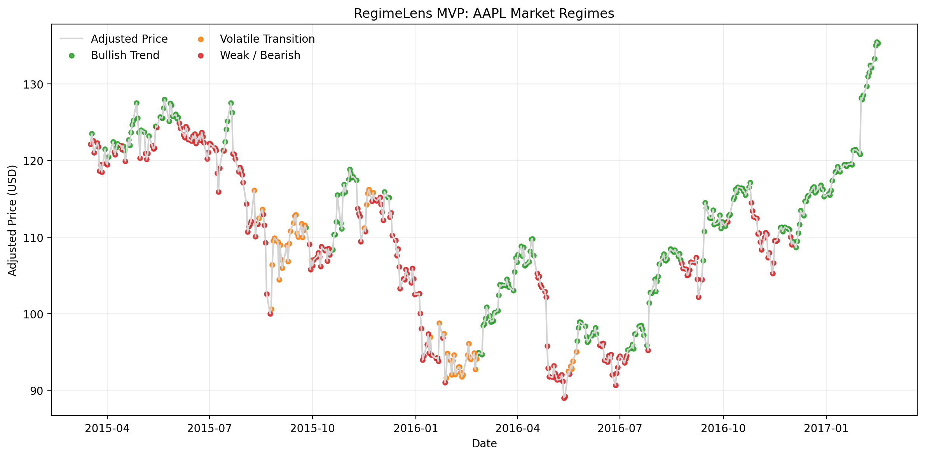
RegimeLens MVP
An explainable AI prototype for single-asset market regime detection
Data + Indicators
KMeans
Visualization
Prepared submission package includes the notebook, dataset, exported results, presentation, and project README.
Scrum Team 2: Ce Chen, Abdallah Mohamed
Notes:
[Sources] - Assignment 1 MVP definition and project framing: user-uploaded file Ce_Chen_SENG8100_Assignment1 (2).pdf, pages 2-4. - Regime chart generated from local analysis of dataset.csv in this submission package.

Slide 2
Problem and MVP goal
From concept to a demo-ready prototype
Problem
Product idea
MVP target
Financial markets do not stay in one stable condition. A simple price chart rarely explains whether the asset is trending, weak, or entering a volatile transition.
RegimeLens focuses on explainability. Instead of predicting price direction, it identifies market states from historical data and shows them directly on the chart.
One user can analyze one asset, generate features, detect regimes, and export the results in a format ready for presentation or review.
Core demo flow
1
Load
AAPL dataset
2
Compute
technical indicators
3
Cluster
3 regimes
4
Name and
explain regimes
5
Visualize and
export results
→
→
→
→
Notes:
[Sources] - Problem statement and MVP focus adapted from Ce_Chen_SENG8100_Assignment1 (2).pdf, pages 2 and 4. - Workflow aligned with Sprint 1 planning and selected backlog items in Sprint1_Planning_Agenda_RegimeLens (1).pdf, pages 1-2.

Slide 3
Scope of the deliverable
A stable MVP is better than a large unfinished system
Included in this MVP
Deliberately excluded
Why this is presentation-ready
• Single asset analysis
• Historical price dataset
• Return, MA20, RSI14, volatility
• KMeans clustering with k=3
• Chart overlay + CSV export
• No live API dependency in the demo
• No price prediction model
• No web front-end
• No portfolio optimization
• No multi-asset comparison
The notebook runs on the submitted local dataset, so the demonstration is simple, reproducible, and does not depend on classroom internet access.
Submission package
• RegimeLens_MVP.ipynb
• RegimeLens_Final_Presentation.pptx
Demo script in one sentence: open the notebook, run all cells, show the regime chart and the exported CSV outputs.
• dataset.csv
• README.md
• regime_results.csv
• requirements.txt
• regime_summary.csv
Notes:
[Sources] - File list and local execution behavior are based on artifacts generated for this submission. - MVP boundaries are consistent with the earlier product vision in Ce_Chen_SENG8100_Assignment1 (2).pdf.

Slide 4
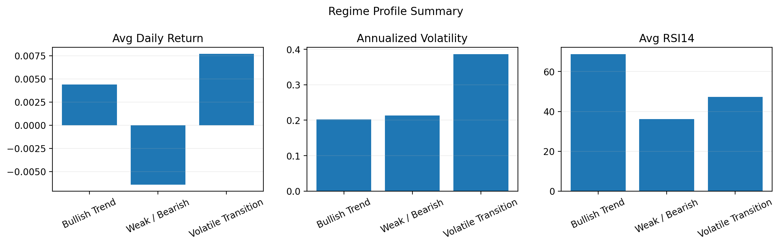
Dataset and features
Local data keeps the final demo reproducible
Dataset used
Asset: AAPL
Rows: 506 daily observations
Fields: Date, OHLC, Volume, Adjusted
Source: Plotly public sample dataset
Usage: submitted as dataset.csv with source URL included
Feature set
• Return: day-over-day price change
• MA20: 20-day moving average
• Volatility20: annualized 20-day rolling std
• RSI14: short-term momentum
• Close vs MA20: distance from trend baseline
Notes:
[Sources] - Dataset URL: https://raw.githubusercontent.com/plotly/datasets/master/finance-charts-apple.csv - Feature engineering implemented in the submitted notebook RegimeLens_MVP.ipynb.

Slide 5
Method: simple, interpretable, and demo-friendly
Unsupervised clustering turns technical signals into market states
1
Prepare data
Sort by date, remove duplicates, and keep the adjusted price as the main signal.
2
Engineer features
Create return, volatility, RSI14, MA20, and distance from MA20.
3
Standardize
Scale the feature matrix so KMeans is not dominated by a single variable range.
4
Cluster with KMeans
Use k = 3 to separate periods into three broad market states.
5
Interpret clusters
Compare cluster-level averages and assign human-readable regime names.
6
Export outputs
Save row-level results and summary tables for the report and presentation.
Notes:
[Sources] - Technical method described from the submitted notebook RegimeLens_MVP.ipynb and exported results. - Earlier sprint scope for indicators and clustering is also reflected in SENG8100_Assignment2_CeChen (1).pdf and Sprint1_Planning_Agenda_RegimeLens (1).pdf.

Slide 6
Main result: price chart with regime overlay
The chart is the clearest MVP artifact because it makes the clusters visible
Bullish Trend
Positive average return, stronger RSI, and price mostly above MA20.
Weak / Bearish
Softer returns and weaker price position relative to the 20-day average.
Volatile Transition
Highest volatility regime; useful for signaling unstable periods or shifts.
Notes:
[Sources] - Chart generated from outputs/regime_chart.png produced by the submitted notebook and regime_results.csv.

Slide 7
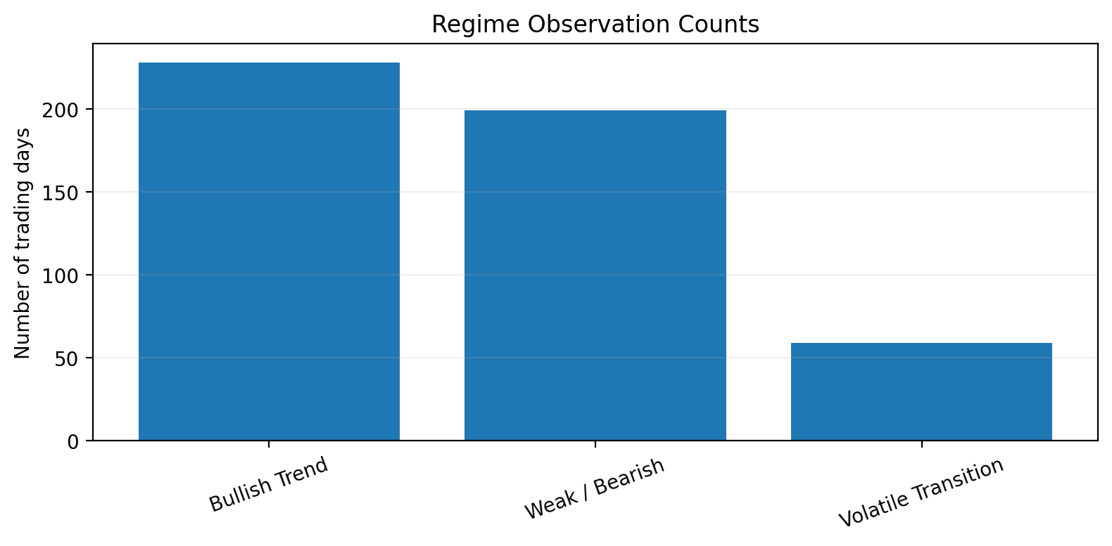
Interpretation summary
Cluster statistics are translated into plain-language regime labels
Bullish Trend
Weak / Bearish
Volatile Transition
The model groups many green periods where returns are positive and momentum is healthier. This is the regime most consistent with sustained upside movement.
The red cluster collects days with weaker performance and lower relative price levels. It can help a user recognize softer market phases quickly.
The orange cluster is smaller but important. It highlights periods where volatility spikes and the market appears less stable.
Practical interpretation for the demo
A user does not need to understand the clustering math to benefit from the output. The colored chart plus short explanation already answers the core product question: “What kind of market state is this asset in?”
Notes:
[Sources] - Summary based on regime_summary.csv and outputs/regime_counts.png from this submission package.

Slide 8
Thank You!
Notes:
[Sources] - Assignment 1 MVP definition and project framing: user-uploaded file Ce_Chen_SENG8100_Assignment1 (2).pdf, pages 2-4. - Regime chart generated from local analysis of dataset.csv in this submission package.

