Slide 1


Opsa
Your Round-the-Clock Sales
Team That Never Stops Selling
Unlock incremental revenue with Opsa's autonomous AI Sales Agent

Slide 2
Overview
Key Challenges
How Opsa Solves This
Reps spend 60% of time on admin
Autopilot outbound — 24/7
Quoting and re-keying orders, not selling
AI prospects and engages around the clock
Pricing lives in spreadsheets
Personalized offers + auto follow-up
Inconsistent quotes. Margins leak.
Right message, right buyer, right moment
Trade show leads die
Smart deal routing by stage
Most contacts never get a follow-up
Knows when to go autonomous vs. loop in your team
Quote-to-order takes days
Converts conversations into orders
Slower response = lost deals
From first touch to closed deal, automated

Slide 3






How Sales Agent Works
From data to closed deals in 5 steps
1
2
3
4
5
Connect Your Data
Build Buyer Profiles
Launch Smart Outreach
Handle Replies
Close the Deal
ERP, leads, and inventory in one place.
AI profiles every buyer account.
Right buyer, right offer, right time.
AI responds; flags your team when ready.
Quotes sent, orders confirmed, team notified.

Slide 4
Buyer Intelligence
AI-empowered intelligence for wholesale B2B — built from your data, not guesswork
DATA INPUTS
PROFILE SIGNALS
ERP & Transaction History
⬤ Brand Affinity
⬤ Purchase Frequency
BUYER PROFILE
360°
Buyer View
Quote & Order Activity
⬤ Price Sensitivity
⬤ Channel Fit
Opsa Outreach Interactions
⬤ Engagement Style
⬤ Intent Signals
Every profile is built from your actual data — not generic signals

Slide 5
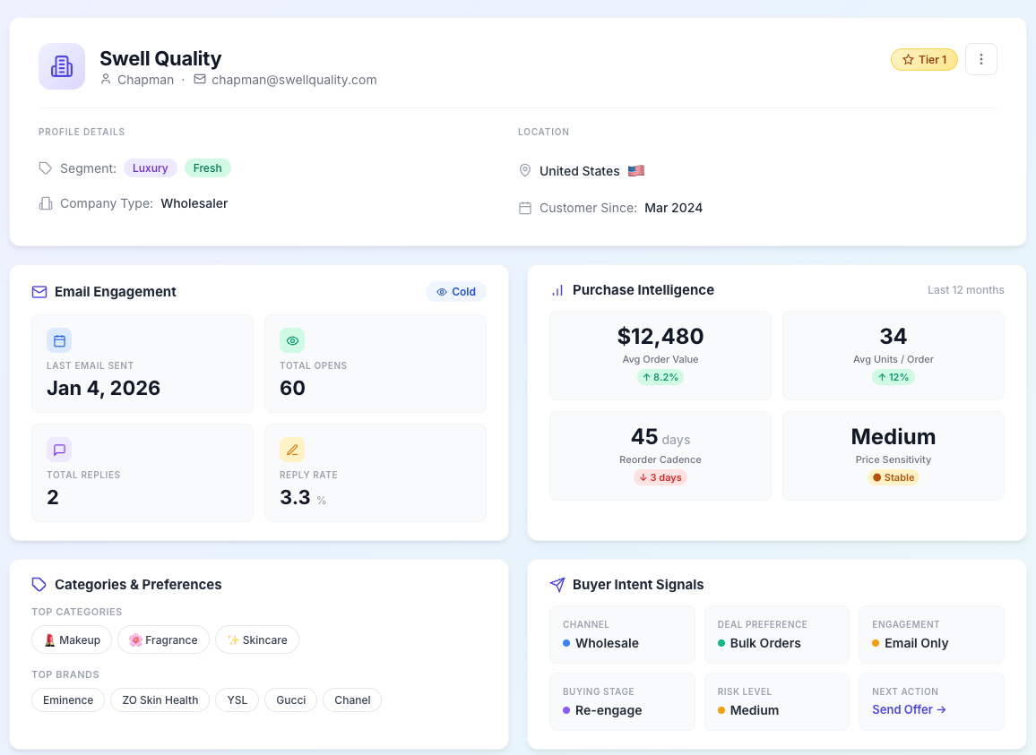
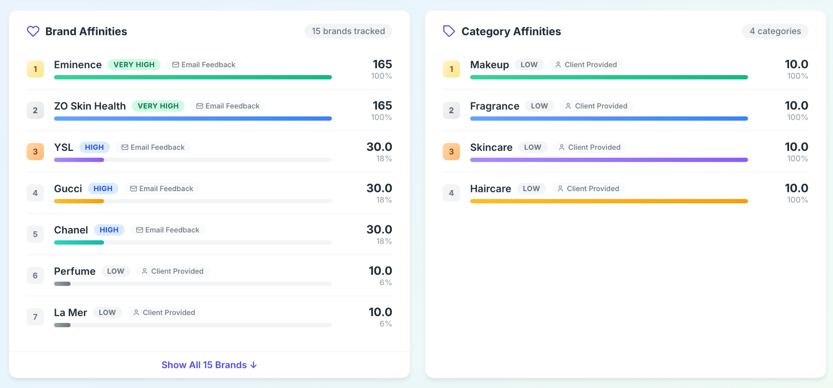
Lead Card
Every potential buyer gets enriched by Opsa’s Buyer Knowledge Graph

Slide 6
From Intelligence to Action
Two inputs. One brain. Continuous automated sales execution.
Opsa Engagement Engine
Automated Actions
BUYER PROFILE
Buyer Intelligence
Decides who, what, when, how
Personalized Offers
Quotes & Negotiation
Automated Follow-Up
Order Processing
Who to prioritize
What to offer
ERP + CATALOG
Inventory & Pricing
When to engage
How to price
Runs autonomously, 24/7
↺ Every response feeds back into the buyer knowledge graph — Opsa gets smarter with every interaction

Slide 7

Next Steps
Let's explore how Opsa can transform your sales operation

Slide 8
Business Impact You Can Expect
Based on results from our design partners
$125K
60%
40+
incremental monthly revenue per partner
of dormant leads re-activated
orders closed by first customer alone
(90-day average)
(within 3 months)
(in 90 days)
We share the risk — Opsa only charges when it generates measurable incremental revenue.

Slide 9
Is Opsa Right for You?
Great Fit
Not a Fit
Wholesaler, distributor, or manufacturer doing B2B sales
Have inventory or brands you actively want to push
Want to scale outbound without hiring
Believe incremental revenue is worth automation
Want visibility and control, not a black-box tool
Few SKUs, few long-term accounts
Inbound-only, no outbound motion
Want a CRM or email blast tool
Leads-only, no sales motion

Slide 10
Program & Pricing
Program Overview
Pricing
First month
Share inventory & brand priorities
Provide a target prospect list
Set up an AI email address
Opsa deploys your AI agent
Reps take over to close deals
Track incremental revenue
FREE
After trial
$2,000/mo
Only if AI generates $20K+ in incremental sales.
Otherwise, it's free.

Slide 11
Your 90-Day Pilot Plan
From setup to results in 12 weeks
Week 1–2
Week 3–4
Week 5–12
Setup & Integration
Agent Training
Live & Optimize
Connect ERP data, inventory feeds, and buyer lists. Configure pricing rules and margin guardrails.
→
Opsa learns your buyer base, SKU catalog, and deal patterns. First outbound campaigns launch.
→
AI runs outbound in parallel with your team. Weekly check-ins. Continuous optimization.
What we need from you: 1 point of contact, ERP access, and a target buyer list. We handle the rest.

Slide 12

Excited About Our
Upcoming Partnership
Let's grow your revenue together.

Slide 13




Sales and Admin Dashboard
Full visibility into every conversation
Pending Actions
Approval Workflows
All AI-assigned threads in one view
Admin approval for high-value exceptions
Actionable Insights
Engagements Metrics
Deal velocity and bottleneck tracking
Performance by brand, customer, and offer

Slide 14
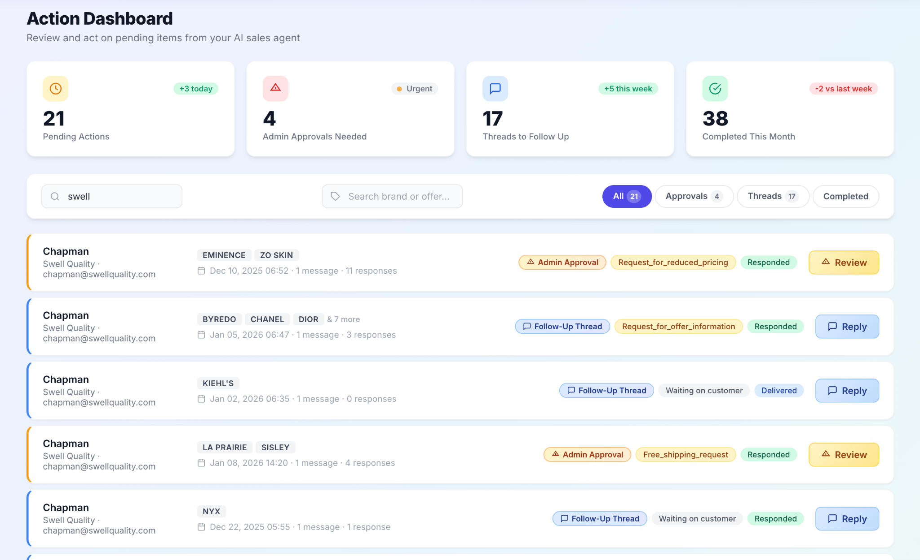
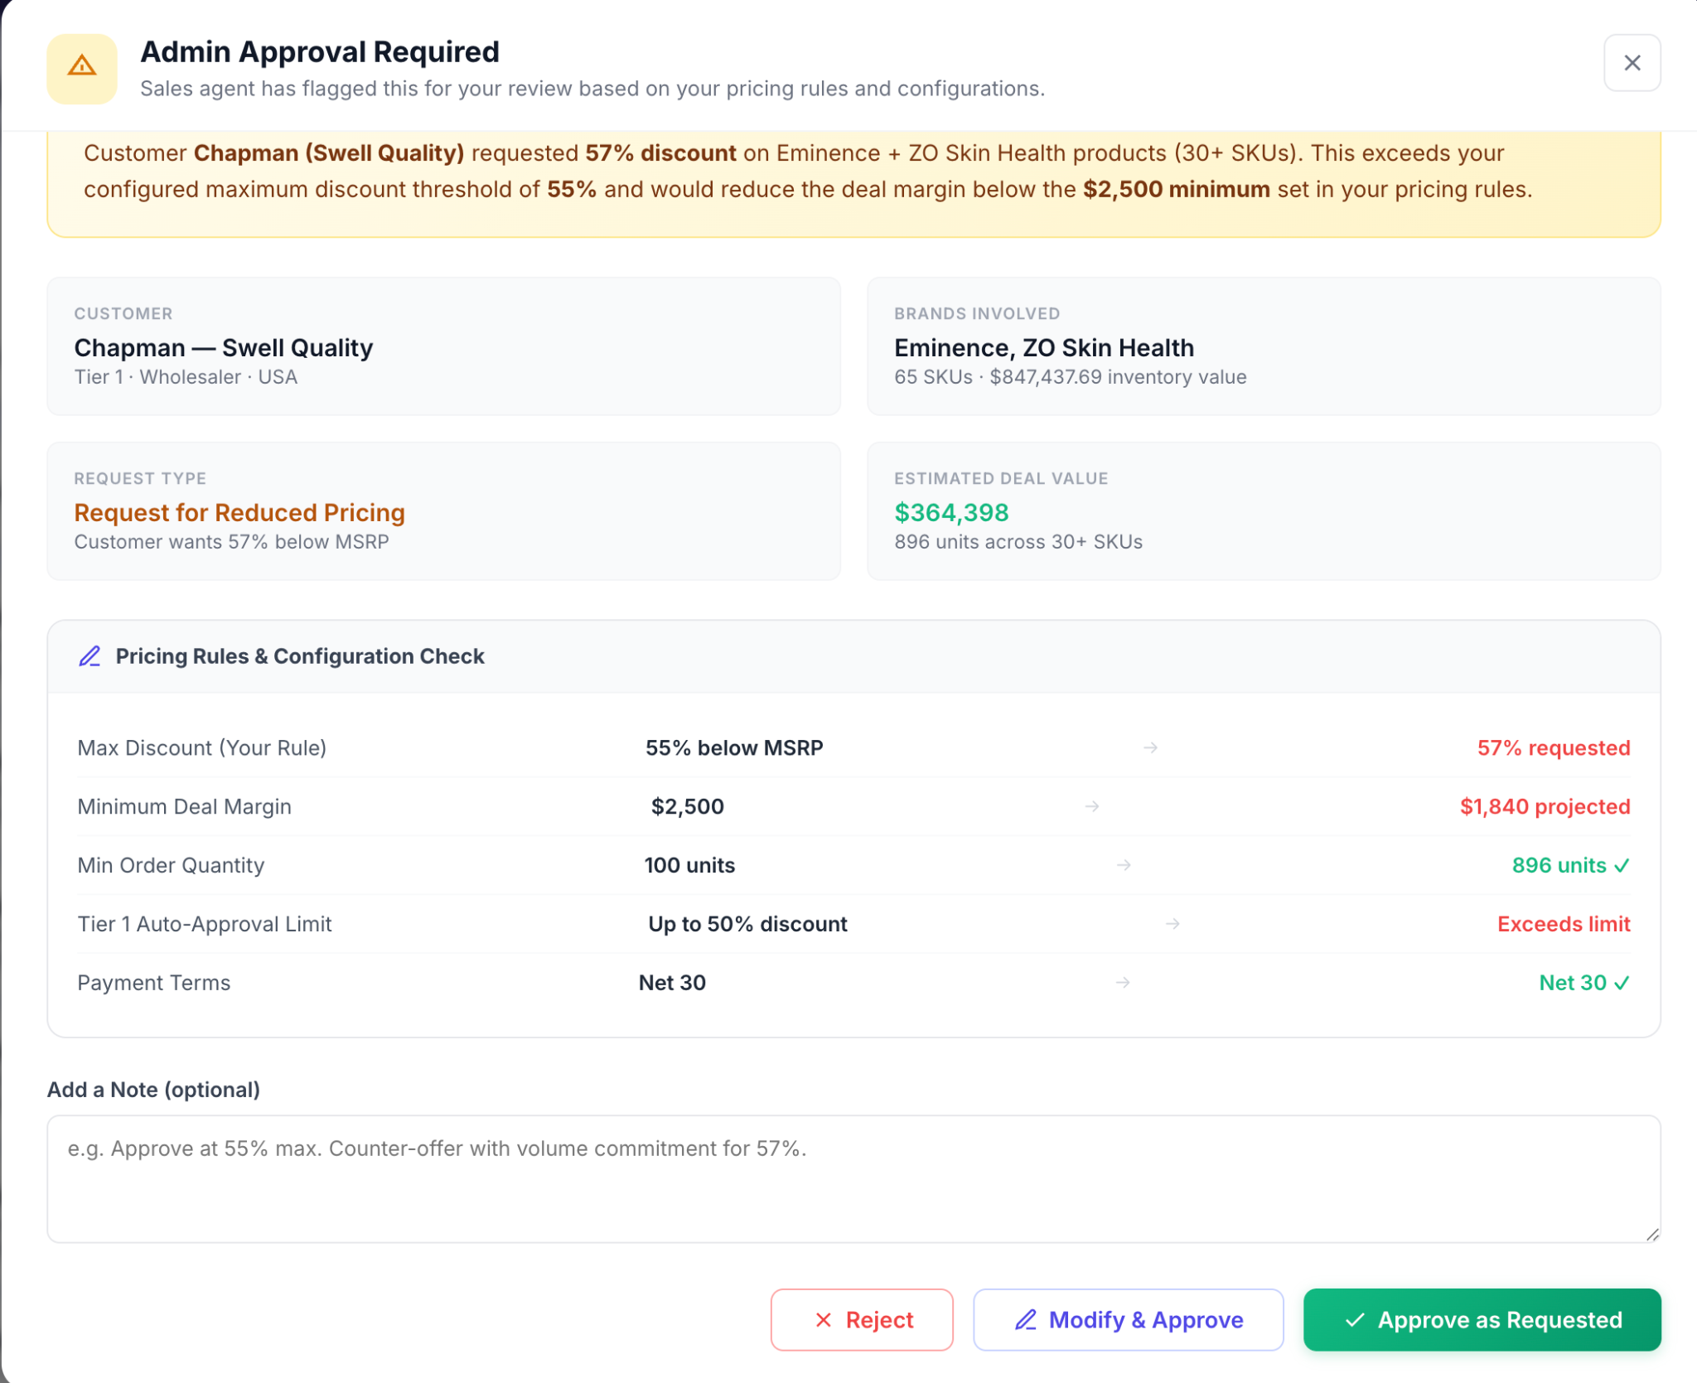
Pending Action Dashboard
Real time visibility to all the pending threads that allows you to jump in or take over the thread any time

Slide 15
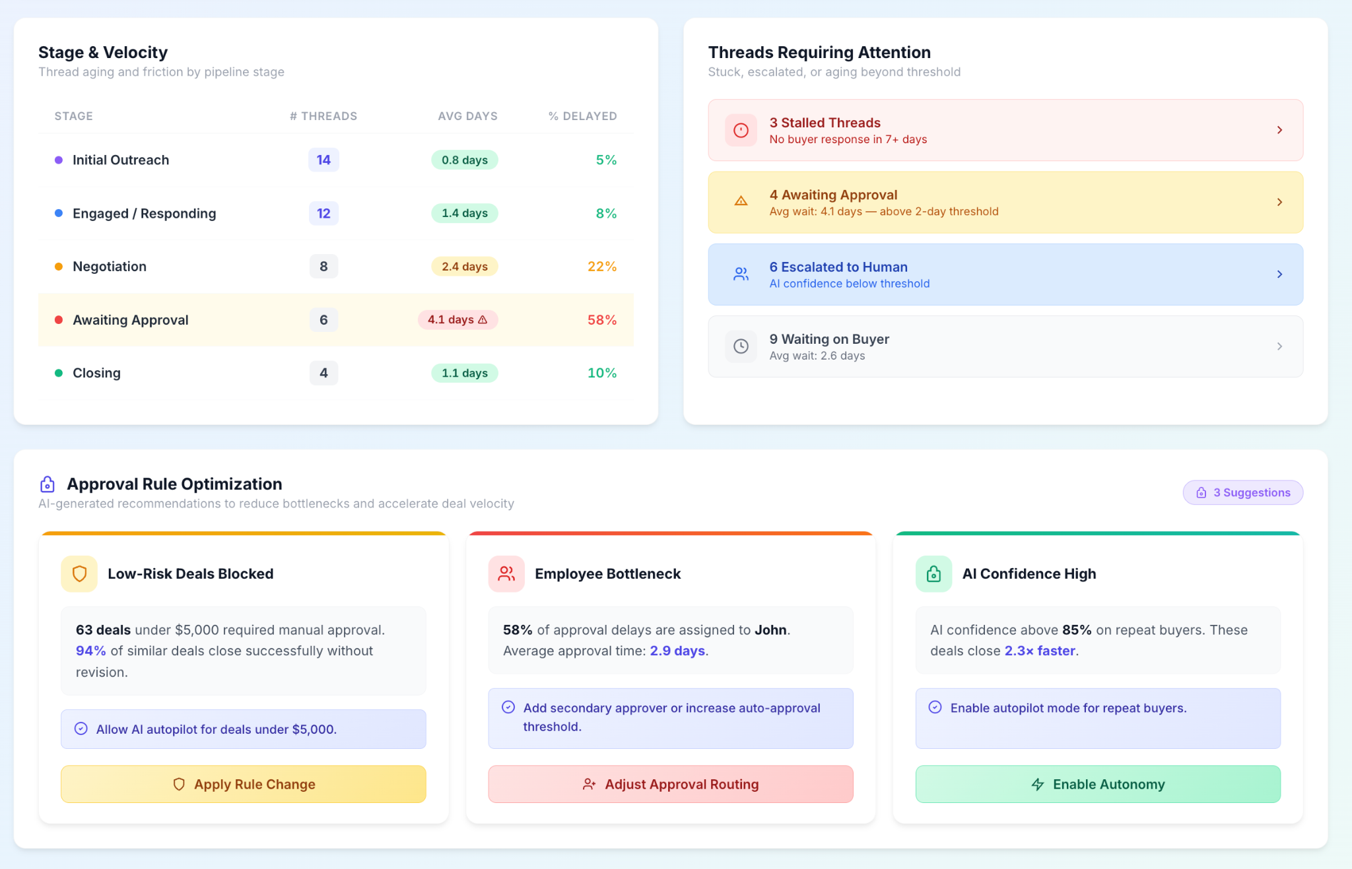
Actionable Insights
Insights on deal velocity, bottlenecks, and AI-driven optimization opportunities.

