Slide 1
OPSA
Agentic Commerce for B2B, Starting with Wholesale
Seed Round | Confidential | 2026

Slide 2
THE INSIGHT
ERP records transactions.
It doesn't drive them.
B2B commerce is still manual — transactions happen over email, spreadsheets, and ERPs that don't make decisions. The next evolution is agentic: autonomous AI agents that perceive demand, decide what to sell, and execute transactions end-to-end.

Slide 3
Wholesale Sales Is Running on Manual
Sales Lives in the Inbox
Selling Doesn't Scale
Quotes, pricing, and negotiations buried in email and WhatsApp. No system of record, no intelligence layer.
When demand spikes, reps bottleneck. Manual quoting and ad-hoc follow-ups lead to slow responses and lost deals.
Revenue Driven by Memory
Margin Leaks at Every Step
Upsells rely on tribal knowledge. Inventory sits idle while buyers receive generic offers.
Pricing rules applied inconsistently. ERPs exist — but there is no revenue operating system.

Slide 4
WHY NOW
The Technology Window Is Open
01
02
03
LLM
ERP API Access
Email & Inbox Control
LLMs can now read, understand, and respond to wholesale emails and negotiations with human-level comprehension.
Modern ERPs expose APIs. Agents can query inventory, check margins, and create orders programmatically — in real time.
Agents can now live natively inside email and WhatsApp — where wholesale selling already happens. No workflow change required.
For the first time, distributors can automate quoting, inventory matching, follow-ups, and buyer re-engagement — without replacing ERP or retraining teams.

Slide 5
Wholesale Distribution: The Perfect Beachhead
The most 'agent-ready' industry in B2B
High Transaction Frequency — Hundreds of orders per day, per customer
The current state:
Email-Driven Ordering — Sales motion already happens in the inbox
• Sales reps manually send offers
• Pricing lives in spreadsheets
Dynamic Pricing — Margin optimization requires real-time intelligence
• Reorders depend on rep memory
Massive Manual Overhead — Reps spend 60%+ of time on admin, not selling
• Trade show leads die in inboxes
• ERP records, but never decides
ERP-Dependent — Data exists; agents just need to act on it
Agents create immediate ROI here.

Slide 6
THE SOLUTION
Opsa: The Agentic Commerce Layer
Signal → Decide → Act → Learn
01
02
03
04
SIGNAL Detect
DECIDE Rank
ACT Execute
LEARN Improve
• Email & WhatsApp signals
• Best offers by margin
• Send personalized pricing
• Learn from every outcome
• ERP inventory data
• Buyer purchase history
• Negotiate within guardrails
• Sharpen buyer profiles
• Trade show leads
• Price sensitivity
• Create sales orders
• Compound intelligence

Slide 7
Three Orchestration Modes
From fully autonomous to human-guided — Opsa adapts to every deal type
Inbound Autonomy
Returning customer emails to reorder. Opsa recognizes the buyer, checks inventory, quotes, and processes — fully automatically. No human needed.
FULL AUTO
Repeat orders
Autonomous Full Cycle
AI Sales Agent engages a familiar buyer, negotiates within pre-set margin and discount limits, and completes the deal without human involvement.
AI-LED
Known buyers
Supervised Orchestration
New buyer or high-value order triggers manager approval before AI completes. Opsa prepares the deal; a human greenlights it.
HUMAN-IN-LOOP
New / high-value
Additional modes available: Assisted Sales (rep-controlled) and Exception Handling (edge cases). Opsa covers the full spectrum.

Slide 8
TRACTION
Early Signals Are Strong
$200K
$125K
60%
40+
Annual Recurring Revenue
Incremental Monthly Revenue
Lead Re-engagement Rate
Orders Closed in 90 Days
3 paying design partners;
More onboarding and pilots;
Per design partner, 90-day avg
Dormant buyers reactivated in 3 months
First customer alone
3 paying design partners. 3 new pilot customers currently onboarding, not yet in ARR.

Slide 9
A Large, Underserved Market
TAM
SAM
SOM · Year 3
$10.5B
$2.1B
$21M
U.S. Wholesale Distribution Software Market
Mid-Market U.S. Distributors ($10M–$500M)
ARR Target: 500 Customers
Growing at 8.5% CAGR to $20.7B by 2033. 92% of distributors already run ERP — the buyer and budget exist.
50,000 companies × $42K ACV. Enough volume for agents, without enterprise IT friction.
<1% SAM penetration. Food & beverage, industrial, specialty goods. Expand upmarket from there.
Expansion: Mid-market wholesale → Manufacturers → Enterprise distributors → B2B marketplaces

Slide 10
A Gap No One Owns
Opsa is the only ERP-native, wholesale-specific, agentic commerce engine
Competitor
Category
ERP-Native
Wholesale Domain
Commerce Execution
Agentic
Artisan AI / 11x
AI SDR Agent
✗
✗
✗
✓
Apollo.io
Sales Intelligence
✗
✗
✗
Partial
Prokeep
Wholesale CRM/Messaging
Partial
✓
✗
✗
Salesforce Agentforce
Enterprise CRM + AI
Partial
✗
Partial
Partial
PROS Holdings
B2B Pricing Optimization
Partial
Partial
✗
✗
Opsa
Agentic Commerce
✓
✓
✓
✓

Slide 11
COMPETITIVE MOAT
Vertical Expertise
Wholesale-specific intelligence that horizontal competitors can’t replicate
01
02
Learns margin dynamics across SKU clusters from buyer behavior, channel patterns, and inventory velocity.
Deal Taxonomy & Engagement Intelligence
Maps which deals need autonomy vs. human judgment. Optimizes engagement timing, channels, and patterns by pipeline stage.
SKU-Level Margin Optimization Engine
03
Unifies fragmented signals from email, WhatsApp, POs, and trade shows into a prioritized demand graph.
04
Agents learn from fulfillment outcomes, inventory velocity, and margin realized. Every deployment compounds the moat.
Multi-Channel Demand Signal Aggregation
ERP-Embedded Agent Learning Loop
A horizontal competitor cannot buy or shortcut their way into this depth — they would need years of domain data and workflow integrations to catch up.

Slide 12
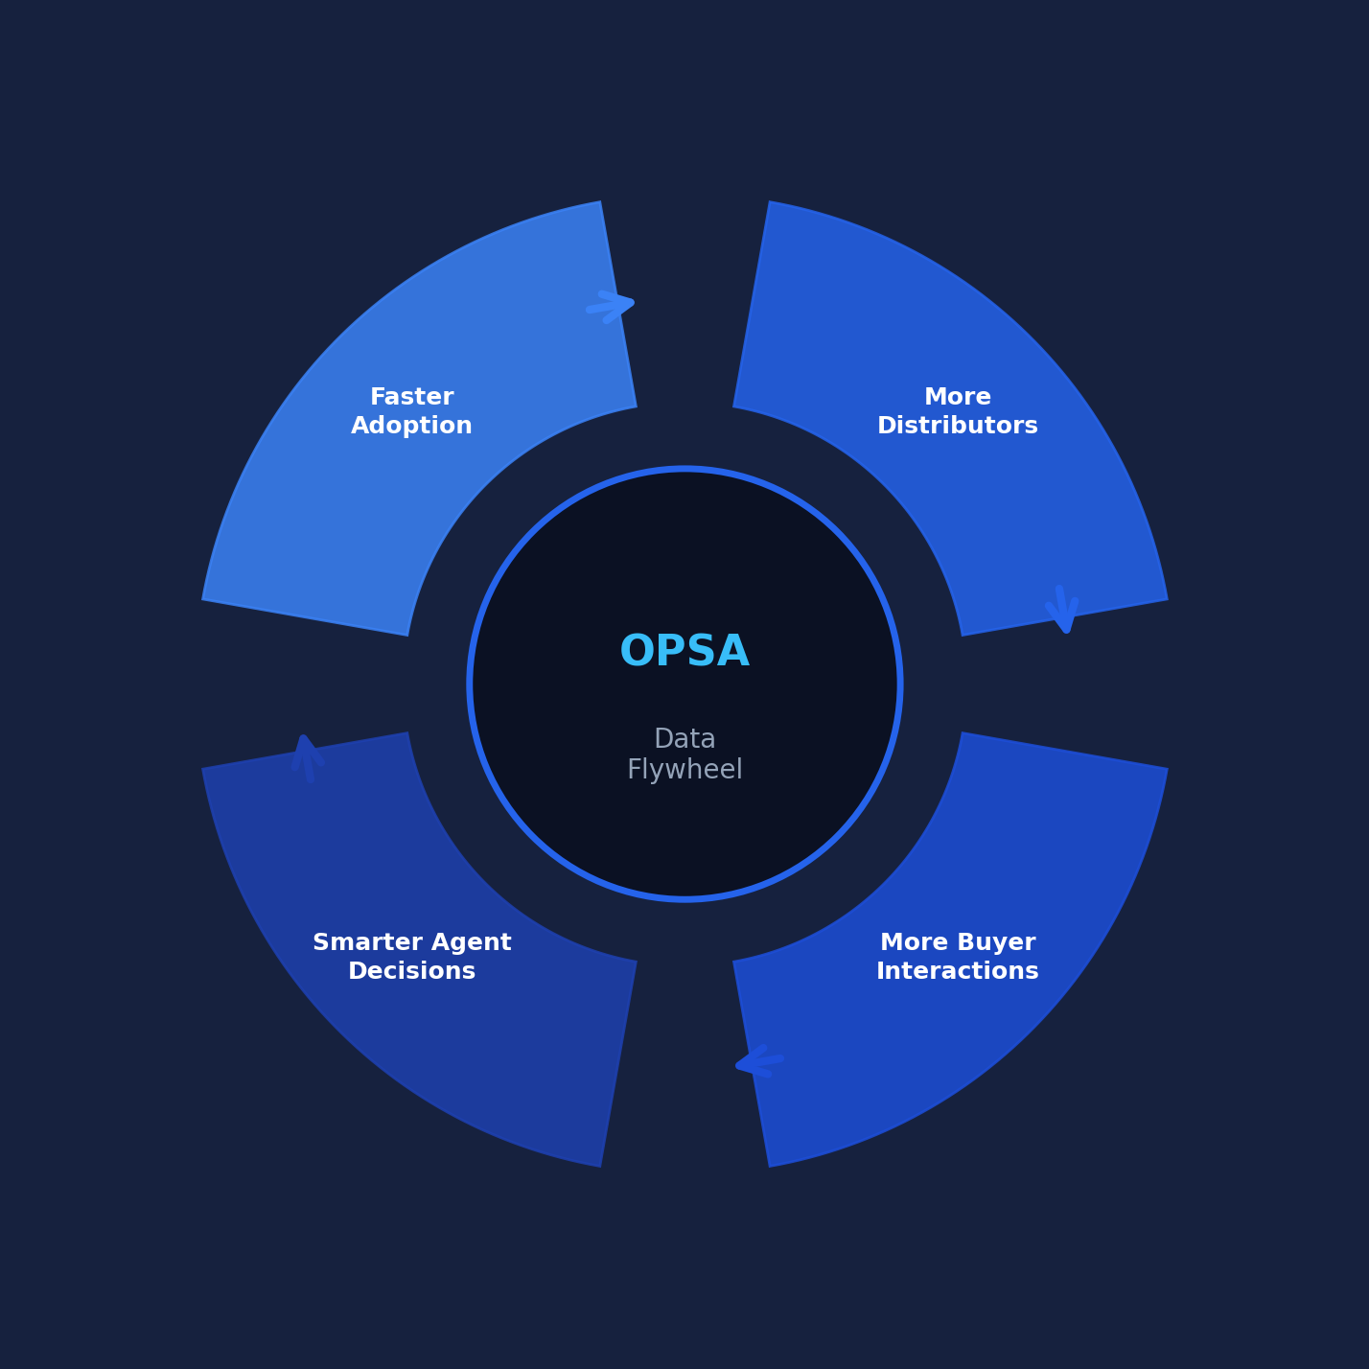
COMPETITIVE MOAT
The Data Flywheel
Each turn compounds:
More data → better offers → more wins → more customers
Late entrants can't replicate:
Years of transaction data and buyer intelligence across the platform
Each customer makes Opsa smarter for every customer. The moat widens with every deployment.

Slide 13
Simple, Scalable Pricing
Platform fee + usage expansion. ACV $24K–$120K+.
MOST POPULAR
STARTER
GROWTH
SCALE
$2,000
$5,000
$10,000+
/mo
/mo
/mo
$24K ACV
$60K ACV
$120K+ ACV
• Up to 500 orders/mo
• Up to 2,000 orders/mo
• Unlimited orders
• 1 ERP integration
• 2 ERP integrations + analytics
• Dedicated CS + custom workflows
• $5 per order above cap
• $3 per order above cap
• Multi-ERP support
• Best for: First deployment
• Best for: Scaling teams
• Best for: Enterprise rollout
Usage overages ($3–$5/order above cap) create natural land-and-expand dynamics.

Slide 14
Built by the Right Team
Three Instacart and LinkedIn veterans who spent careers building exactly what Opsa automates — at scale, in production, for real commerce.
Ashish
Collin
Chencheng
Co-founder & CEO
Co-founder, Engineering
Founding Team Member
10+ years building large-scale commerce systems. Led fulfillment engineering at Instacart, scaling infrastructure for millions of orders. Previously founded a B2B commerce company and grew up in wholesale distribution.
10 years engineering leadership at LinkedIn and Instacart. Led a 60-person org owning Instacart's shopper fulfillment platform — shipping AI/ML systems for picking intelligence and order execution.
Built LinkedIn's B2B sales platform from zero to a billion-dollar business; led growth engineering at Instacart.
Instacart
Instacart
LinkedIn
B2B Commerce
LinkedIn
Instacart

Slide 15
THE ASK
Raising Our Seed Round
$5M
Use of Funds
Engineering & Product | 50%
Seed Round
AI engineers, ERP integrations, model fine-tuning
18-month target: $6M ARR | 150 paying customers.
Sales & GTM | 30%
First sales hire, CS, pilots → paid conversion
We are partnering with a small group of high-conviction investors.
Operations | 10%
Legal, finance, compliance, HR
AI Infrastructure | 10%
LLM APIs, cloud hosting, data pipeline
opsa.ai | ashish@opsa.ai

