Slide 1

cBio Cancer Genomics Portal
Tutorial: The Network View
- Genes in context of biological interactions
- Genomic profiles overlaid on interaction network
Filtering by genes of interest, interaction type & source, and genomic profile
Automatic network layout
Exporting as an image

Slide 2
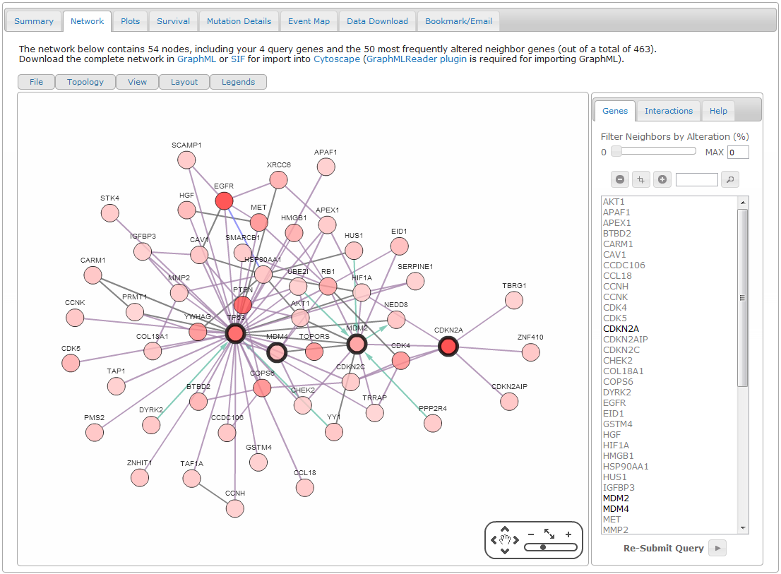
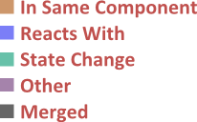
Genes in context of biological interactions
Seed (specified) genes
Interactions
Others link seeds through interactions complied in Pathway Commons

Slide 3
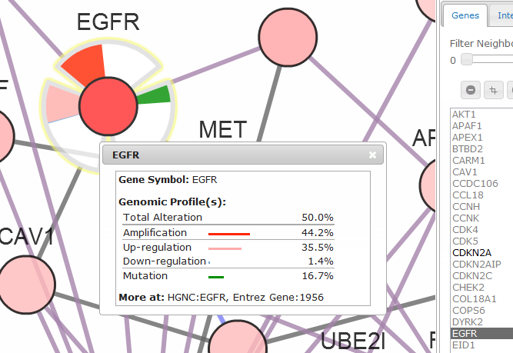
Genomic profiles overlaid on interaction network
White to red color gradient for frequency of total alteration
Genomic profile data (mutation, copy number and mRNA expression profiles)

Slide 4
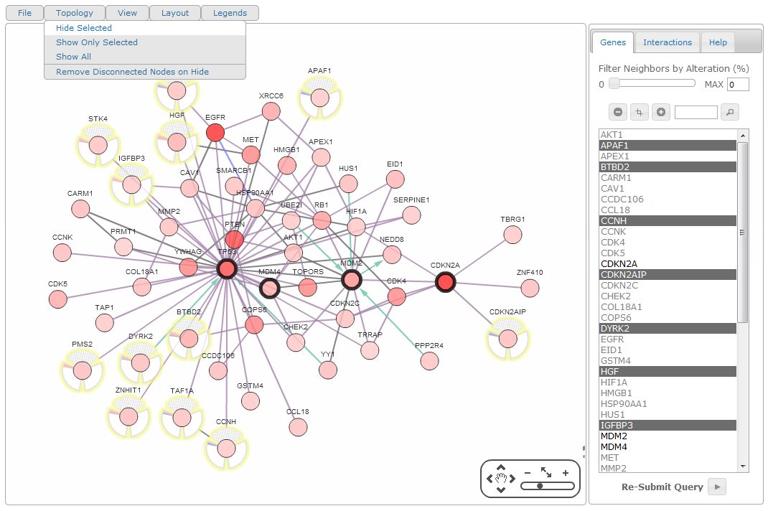
Filtering by genes of interest
Hide selected genes from the network
Search genes by name
Select genes from canvas or gene list under Genes tab

Slide 5
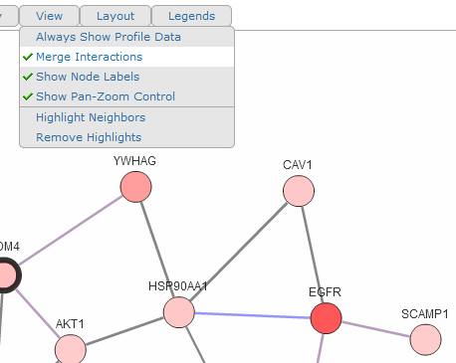
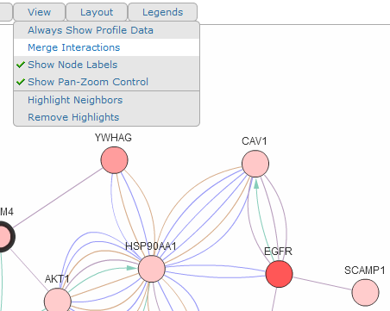
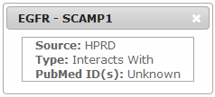
Filtering by interaction type & source
Interactions merged by default
Type (color-coded) & source shown in interaction details
Shown individually

Slide 6
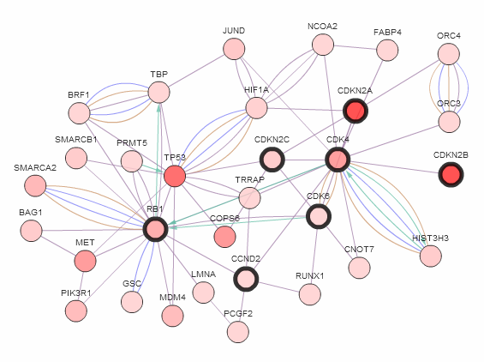
Filtering by interaction type & source
Partial RB pathway with Glioblostama genomic profile data

Slide 7
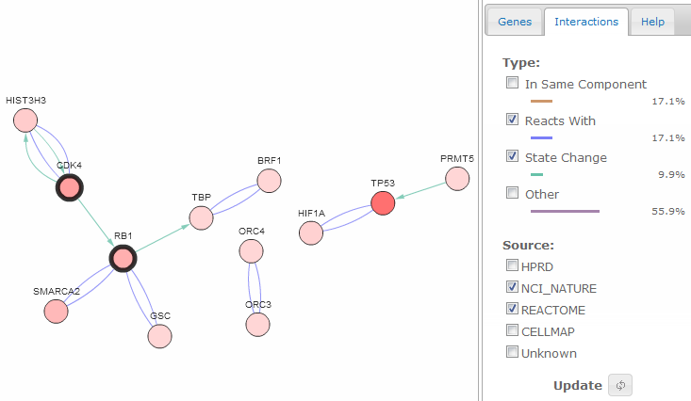
Filtering by interaction type & source
Same pathway after filtering applied for edge types and sources
Uncheck
Click

Slide 8
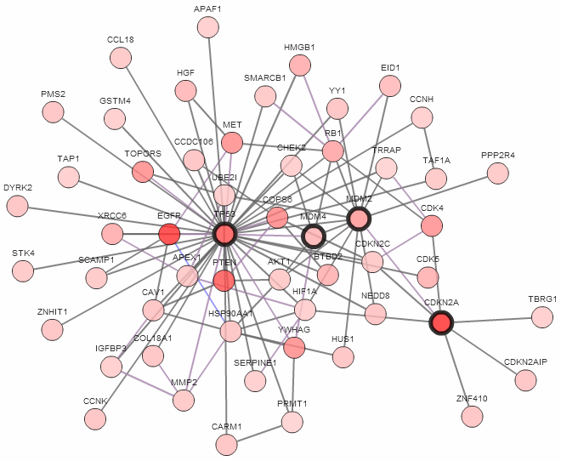
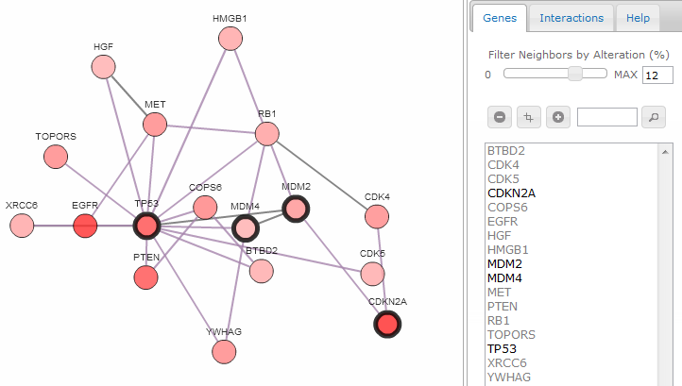
Filtering by genomic profile
Same pathway after genes with total alteration frequency 12% or less filtered out
Slide to threshold value
Or type threshold value
TP53 pathway

Slide 9
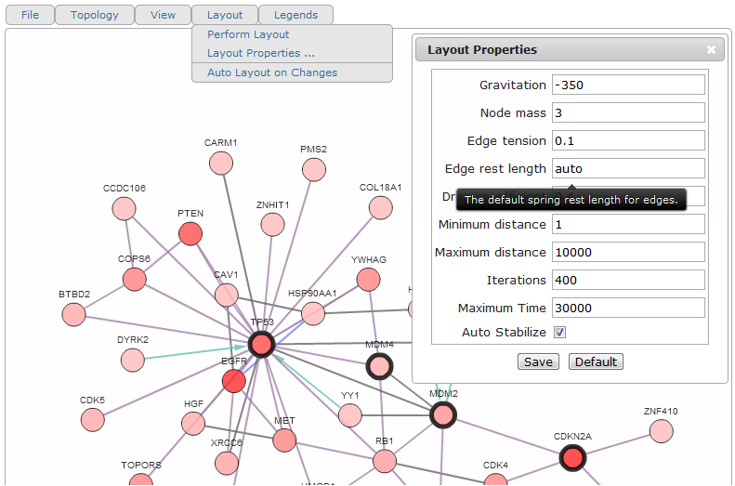
Automatic network layout
Open Layout Options Dialog
Recalculate layout
Recalculate layout upon filtering operations
Hover over option to get quick help

Slide 10
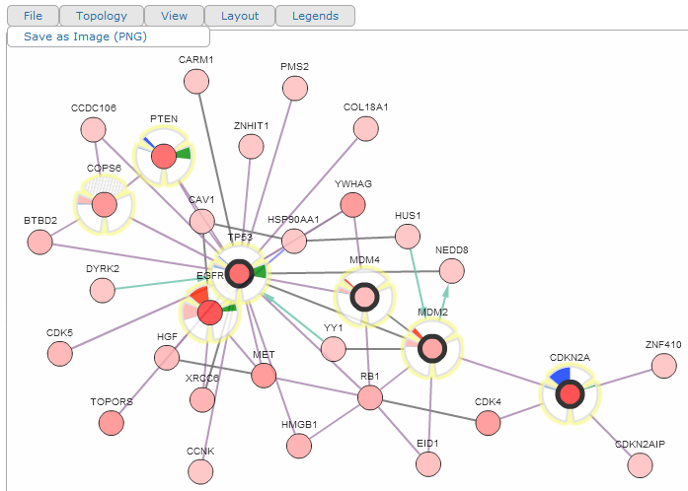
Exporting as an image
Save current network view as PNG image

Slide 11
Questions?
Send us an email at:
cancergenomics@cbio.mskcc.org

