Slide 1
AutoTriager
Evidence-grounded incident investigation
Dahe Chen
CS 5588: Challenge 2 Human–AI Co-Design
A working local application for analyzing recorded incidents
and reviewing the evidence behind each candidate explanation.
https://github.com/chendahe666/AutoTriager-CoDesign
01
Notes:
The first P1 combines loading actual incident data with running an existing analysis method. The delivered feature includes basic evidence inspection and human review. This is a course engineering implementation, with no claim of production validation or a new RCA algorithm.
Sources
https://github.com/chendahe666/AutoTriager-CoDesign

Slide 2
Problem, users and first task
Users: on-call developers and site reliability engineers.
Problem: several components can show symptoms during one incident.
Input: a time window, metrics, logs and observed calls.
First P1: load one case and run an existing analysis method.
Output: candidate component, possible cause, sources and uncertainty.
Scope: one Bank system, offline records and read-only investigation.
02
Notes:
A candidate explanation is an investigation lead. A matching benchmark answer is not proof that a causal account is complete. The chosen slice is small enough to demonstrate and test before richer cross-component interaction.
Sources
https://github.com/microsoft/OpenRCA

Slide 3
Human design and AI implementation
Human decisions | Codex implementation
One system and an existing method | Pinned EviRCA and actual Bank data
Evidence inspection and judgment | Source indexing and run-bound feedback
Free Gemini, local demonstration | Bounded API calls and Streamlit
Chinese and English interface | Static translations and state preservation
Final submission and acceptance of a diagnosis remain human decisions.
03
Notes:
The student defined priorities, language, cost and interaction. Codex wrote and tested the implementation. Browser feedback in screenshots is explicitly marked as an automated test, not student acceptance. Runtime adaptation decisions and failed tests are documented in the repository.
Sources
https://github.com/chendahe666/AutoTriager-CoDesign/blob/main/docs/Implementation_Decisions.md

Slide 4
Implemented analysis workflow
Stage | Responsibility
1. Load and validate | Case window, units, required files and input version
2. Extract observations | EviRCA baselines, anomaly entries, logs and calls
3. Investigate | Gemini selects read-only EviRCA tools
4. Validate output | Candidate fields, evidence IDs and source linkage
5. Review | Inspect records and accept, reject or defer
At most six API requests. A temporary 5xx retry stays within this budget.
04
Notes:
The application reuses upstream evidence functions and tools. Its own loop replaces the original forced-answer and fallback behavior. It permits unresolved fields and does not use an API failure as a reason to generate a deterministic diagnosis. Scoring labels remain outside runtime inputs.
Sources
https://github.com/yuhao541/EviRCA
https://github.com/chendahe666/AutoTriager-CoDesign/blob/main/autotriager/analysis.py

Slide 5
Data, method and model
Data: two Bank development cases from March 4 and March 6, 2021.
Full-day baselines are preserved; telemetry remains local.
EviRCA: unchanged adapter, evidence extraction and investigation tools.
Gemini 3.1 Flash-Lite: interpretation through constrained tool calls.
Engineering adaptation with explicit uncertainty and source validation.
github.com/microsoft/OpenRCA github.com/yuhao541/EviRCA
05
Notes:
OpenRCA revision c1bd4af7f635171a1c31cdd567c07d698dff6abc. EviRCA revision bc11c06932717751f68b8ed7da6d31f5c23c952c. Two full days were obtained from the official archive using partial downloads, with local hashes and CRC verification. The cases are development examples already discussed in planning. The EviRCA revision has no license file; its code is fetched separately and is not republished. Gemini free-tier availability was checked and actual API calls were made. The project does not claim exact reproduction.
Sources
https://github.com/microsoft/OpenRCA
https://github.com/yuhao541/EviRCA
https://ai.google.dev/gemini-api/docs/pricing
https://drive.google.com/drive/folders/1wGiEnu4OkWrjPxfx5ZTROnU37-5UDoPM

Slide 6
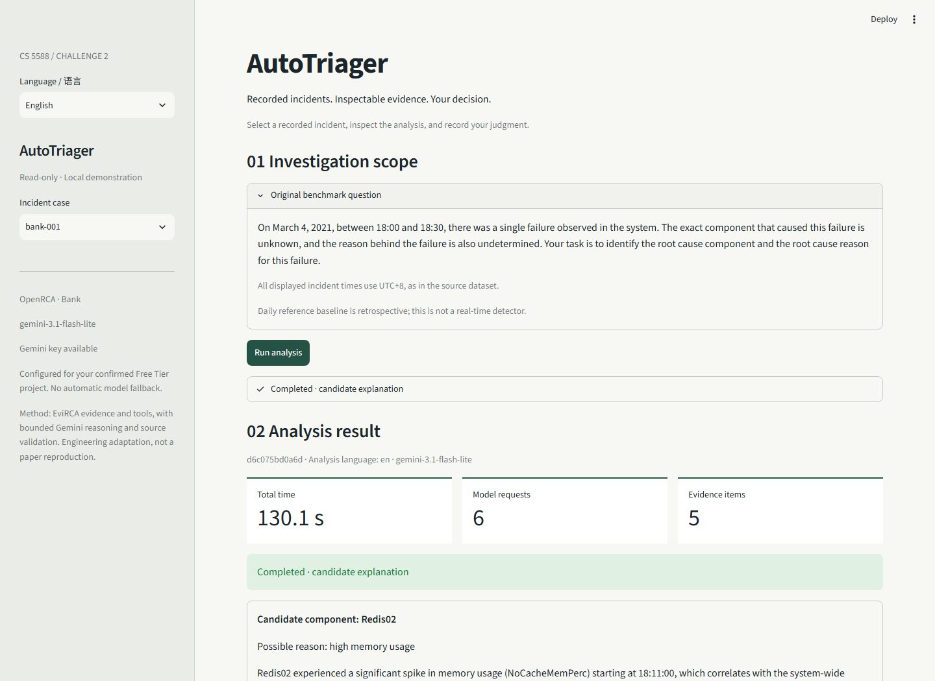
Working local application
Select a real case.
Run bounded analysis.
Inspect candidates and limits.
Switch UI language without a new request.
Actual Streamlit screenshot. The local server binds to 127.0.0.1.
06
Notes:
The screenshot comes from a real browser run against the real Gemini API, not a mockup or preloaded answer. The UI uses the selected language for a new analysis and preserves existing output language when switching labels. The app requires local data and an API key; it is not publicly hosted.
Sources
https://github.com/chendahe666/AutoTriager-CoDesign

Slide 7
A traceable development example
Case: March 4, 18:00–18:30, Bank system (UTC+8).
Candidate: Redis02, high memory usage.
Observed peak: NoCacheMemPerc = 92.6839 in the raw metrics.
Source: metric_container.csv, CSV data record 956231.
Official component/reason score: 1.0. First run: 84.8 seconds.
A correct answer on one development case does not establish production accuracy.
07
Notes:
Run 319be82eec24. Original file data/Bank/telemetry/2021_03_04/metric/metric_container.csv. The record is 1-based excluding the header. Timestamp 1614852840, component Redis02, KPI OSLinux-OSLinux_MEMORY_MEMORY_NoCacheMemPerc, value 92.6839. Upstream displays the rounded peak 92.684. The requested fields are component and reason, not onset. The scorer awards 1.0. Full output and observations are local run artifacts. Source linkage verifies the observation, not the entire causal narrative.
Sources
https://github.com/microsoft/OpenRCA/blob/main/main/evaluate.py
https://github.com/chendahe666/AutoTriager-CoDesign/blob/main/docs/Validation_Report.md

Slide 8
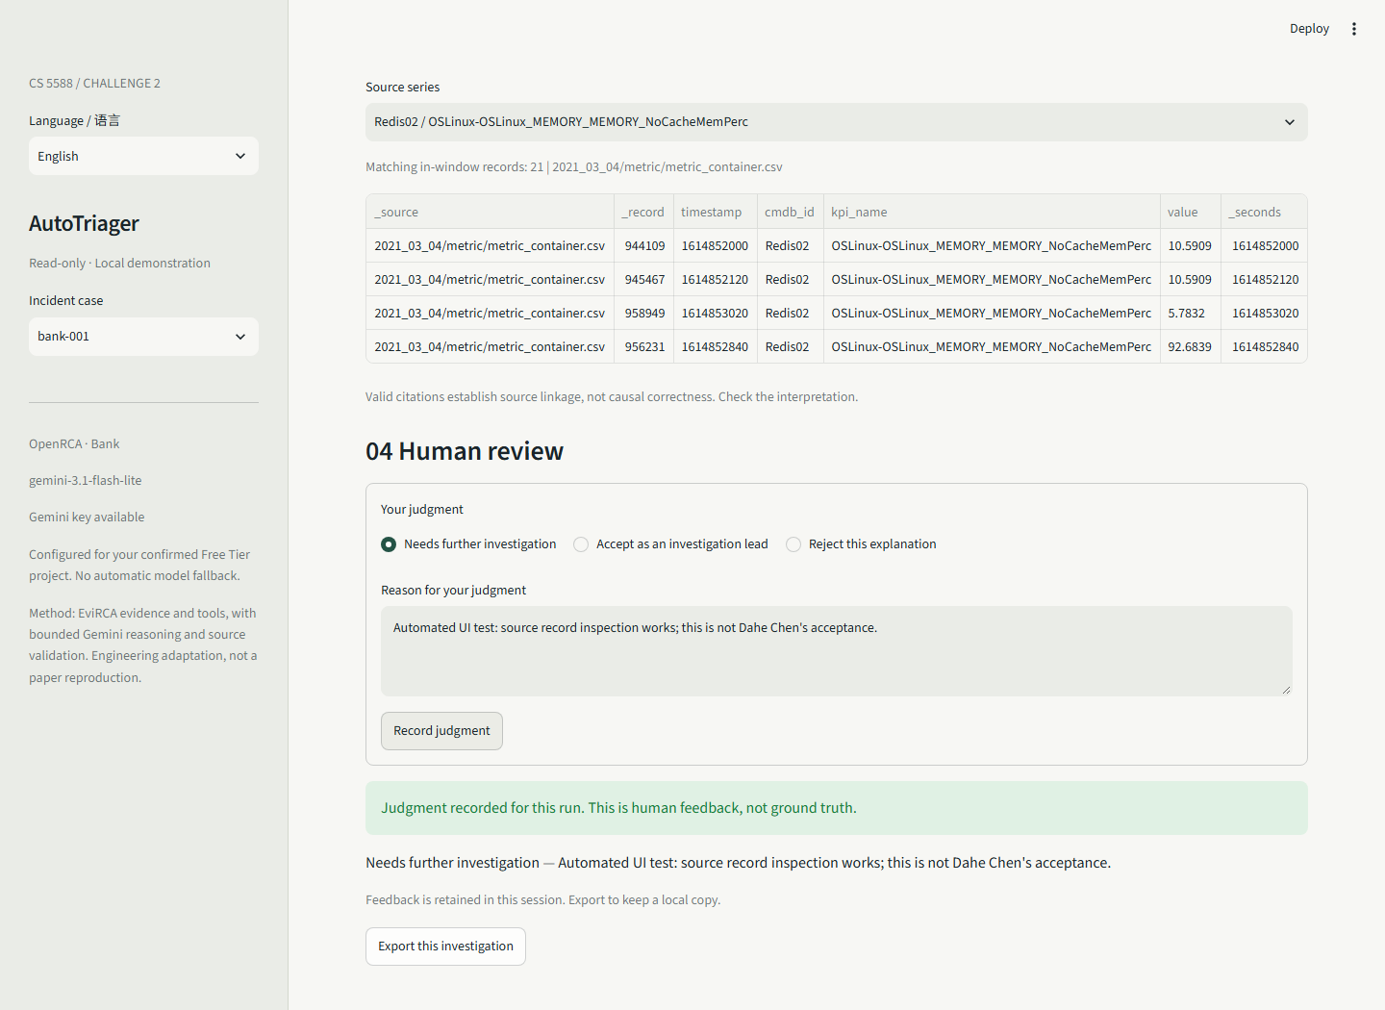
Human evidence review
Open source records.
Accept, reject or mark unresolved.
Give a reason for the judgment.
Export the investigation and feedback.
Screenshot feedback is automated test input, not Dahe Chen’s acceptance.
08
Notes:
The judgment is associated with a run ID and retained within the session. The browser test checks language switching, export and case switching. It exposed a form-restoration bug, which was corrected and retested. A judgment is not treated as a benchmark label or training data.
Sources
https://github.com/chendahe666/AutoTriager-CoDesign/blob/main/autotriager/state.py

Slide 9
Observed results and failure checks
Development case | Output | Official score
Bank 001 | Redis02 / high memory usage | 1.0
Bank 004 | Tomcat04 / reason unresolved | 0.5
Nine checks cover input, sources, feedback, missing data, citations and errors.
Real browser checks cover language, export and case isolation.
Recorded failures include API 503 and an overly strict citation check.
Scores above describe selected runs; all attempts remain in the audit.
09
Notes:
Bank 004 run 61d22bf8c6fa took 155.72 seconds. Correct component, unresolved required reason: score 0.5. Two cases, nine engineering checks, no held-out accuracy claim. An earlier run rejected system-level golden-signal evidence because it had no component ID; the validator now permits this supporting evidence but still requires at least one component-specific source. Earlier API failures remain in the report and score zero. The final real browser check passed for run d6c075bd0a6d.
Sources
https://github.com/microsoft/OpenRCA/blob/main/main/evaluate.py
https://github.com/chendahe666/AutoTriager-CoDesign/blob/main/docs/Validation_Report.md

Slide 10
Limits and next application features
Current limit: two development cases and retrospective daily baselines.
Network latency and packet loss remain unresolved in this MVP.
Challenge 3: compare component evidence and ask bounded follow-up questions.
Challenge 4: evaluate investigation with incomplete or conflicting evidence.
Challenge 5: integration, reproducibility and final demonstration.
https://github.com/chendahe666/AutoTriager-CoDesign
10
Notes:
Each later stage is a feature plus evaluation, not a technology label. RAG or additional agents are options only if they address a demonstrated limitation. Controlled missing-data variants must be labeled as such rather than represented as new natural incidents. Multi-system support remains optional. User acceptance and final course submission are pending human review.
Sources
https://github.com/chendahe666/AutoTriager-CoDesign

