Slide 1
AutoTriager Shop
Evidence-grounded incident investigation
Dahe Chen
User: an on-call developer new to the shopping system
P1: load a captured checkout incident and inspect a checkable service suggestion
Question: can bounded evidence support an inspection priority while allowing deferral?
Dahe Chen / CS 5588 / October 1, 2026 checkpoint
1
Notes:
Current checkpoint, not a backdated September submission. Sources: docs/OFFICIAL_SHOP_WORKSHOP_DRAFT.md sections1,2; original Enhancement handout. Present the bounded feature and preserved failures without a novelty or user-benefit claim.

Slide 2
Instructor feedback and design changes
Feedback | Change | Evidence
Who needs this? | Focus on a developer new to this system | Concrete checkout investigation
Use a real scenario | Run official Astronomy Shop locally | 25 containers and captured telemetry
Evaluate the AI | Keep controls, direct reference and failures | 30 calls, 28 responses, 2 errors
Make findings checkable | Retain IDs, values and trace relationships | Saved inputs and source inspection
The current study measures label agreement and evidence limits. User benefit remains unmeasured.
Dahe Chen / CS 5588 / October 1, 2026 checkpoint
2
Notes:
Feedback paraphrases the user-provided teacher discussion, not a verbatim instructor quotation. Evidence: pinned official source, runtime receipts, nine examples, frozen comparison results, claim audit. The user requested the scenario reset despite the Enhancement default to improve existing work.

Slide 3
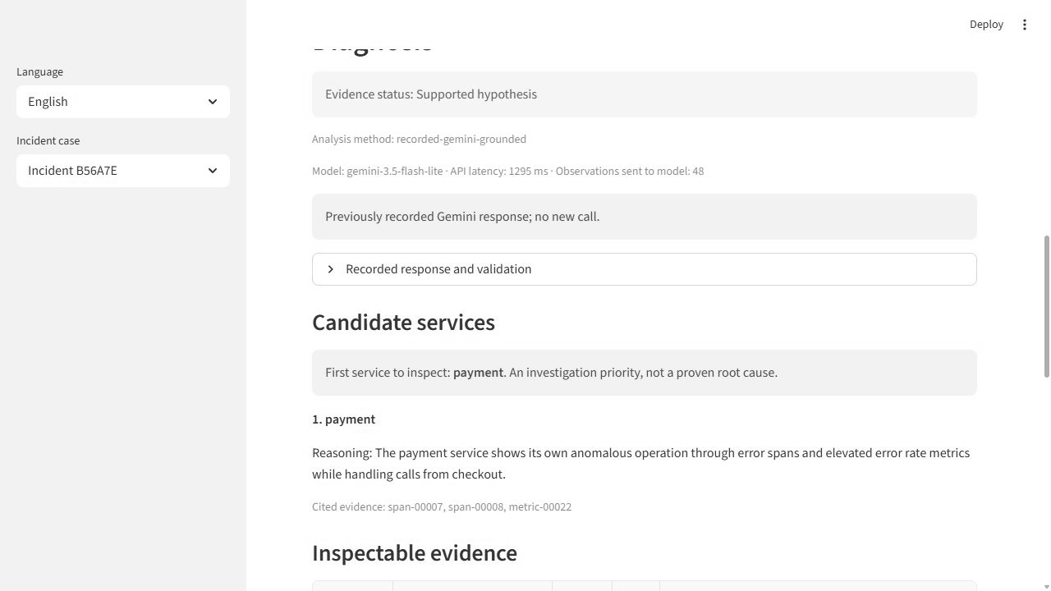
Working investigation feature
Select a captured interval
Inspect the suggested service and cited observations
Accept, reject or defer with a reason
Local demo: http://127.0.0.1:8510
Offline replay requires no API key. Live Gemini analysis requires explicit data-sharing consent.
Dahe Chen / CS 5588 / October 1, 2026 checkpoint
3
Notes:
Actual recorded official fault view: results/screenshots/official_case_app_20261001.jpg. The model returned payment on development002-b. This is saved response replay and does not make a new API call. App.py and ui.py implement scope/source/review. No real human rating is supplied. Local URL is not remotely accessible.

Slide 4
Research context and reused ideas
OpenRCA: public telemetry benchmark and RCA-Agent. Learn structured fault queries and evaluation boundaries.
EviRCA: deterministic extraction before read-only reasoning. Evidence cards are an existing method.
MicroRCA-Agent: structured diagnosis with documented invented call-chain evidence. Audit claim support separately.
Own study data: official Shop 3.1.0 captures. Benchmark scores do not validate this live scenario.
github.com/microsoft/OpenRCA github.com/yuhao541/EviRCA
github.com/tangpan360/MicroRCA-Agent github.com/open-telemetry/opentelemetry-demo
Dahe Chen / CS 5588 / October 1, 2026 checkpoint
4
Notes:
Primary sources checked in research/closest_work.md: OpenRCA ICLR2025 Section2.3, https://github.com/microsoft/OpenRCA and https://proceedings.iclr.cc/paper_files/paper/2025/file/d29b8d53678015079e1d245c023e49d2-Paper-Conference.pdf; EviRCA preprint https://arxiv.org/html/2609.19825v1 III-B/C,V-B, code https://github.com/yuhao541/EviRCA; MicroRCA-Agent competition report https://arxiv.org/html/2509.15635v1 3.5,4.1, code https://github.com/tangpan360/MicroRCA-Agent. No local closest-method reproduction or cross-paper score comparison. Dataset/source: https://github.com/open-telemetry/opentelemetry-demo/tree/dedc0178918e260823323b8d95005a8cb924b007 Apache2.0.

Slide 5
Methods and evaluation
Data: 9 phase windows, 8,379 observations, one injected payment-failure mechanism
Processing: preserve numerical values, IDs, UTC times and observed parent links
Model: Gemini 3.5 Flash-Lite, 48-record cap, temperature 0, no retries
References: direct prompt and transparent rule ranking
Measures: injected-service agreement, control deferral, claim support, tokens and latency
Direct asks for an initiating service. The amended method asks for an inspection priority.
These questions prevent a same-task superiority claim.
Dahe Chen / CS 5588 / October 1, 2026 checkpoint
5
Notes:
Sources: research/program.md, experiment_plan.json,A1/A2/A3 amendments,selected_method.json, results/official_research_round_20261001.json. Both conditions see same records/order within condition but direct asks initiating service whereas amended grounded asks inspection priority. Thus descriptive comparison only. Frozen run has48 cap, metric/span balancing, structural citations validator, no independent logs.

Slide 6
Frozen confirmation results
Measure | Direct reference | Evidence-grounded
Fault label agreement | 2 / 2 | 1 / 2
Control deferral | 4 / 4 | 4 / 4
Other fault suggestion | None | Checkout in group 003
30 total calls: 28 completed and 2 development HTTP 503 failures
Capture yield: 10 accepted of 13 attempted phases
No evidence of superiority, optimal first action or cross-fault generalization
Dahe Chen / CS 5588 / October 1, 2026 checkpoint
6
Notes:
Sources: public aggregate results and scored confirmation003/005.2faultwindows and4controls in2dependentgroups. Raw/application same candidate outcomes. Directpayment2/2,groundedpayment1/2 checkout1/2. Rule reference uses fullpool and abstainsallconfirmation6 windows, input budget unmatched.30calls28completed2dev503.205778known total tokens for28 responses, two failures usageunknown. No significance/speed/SOTA claims.

Slide 7
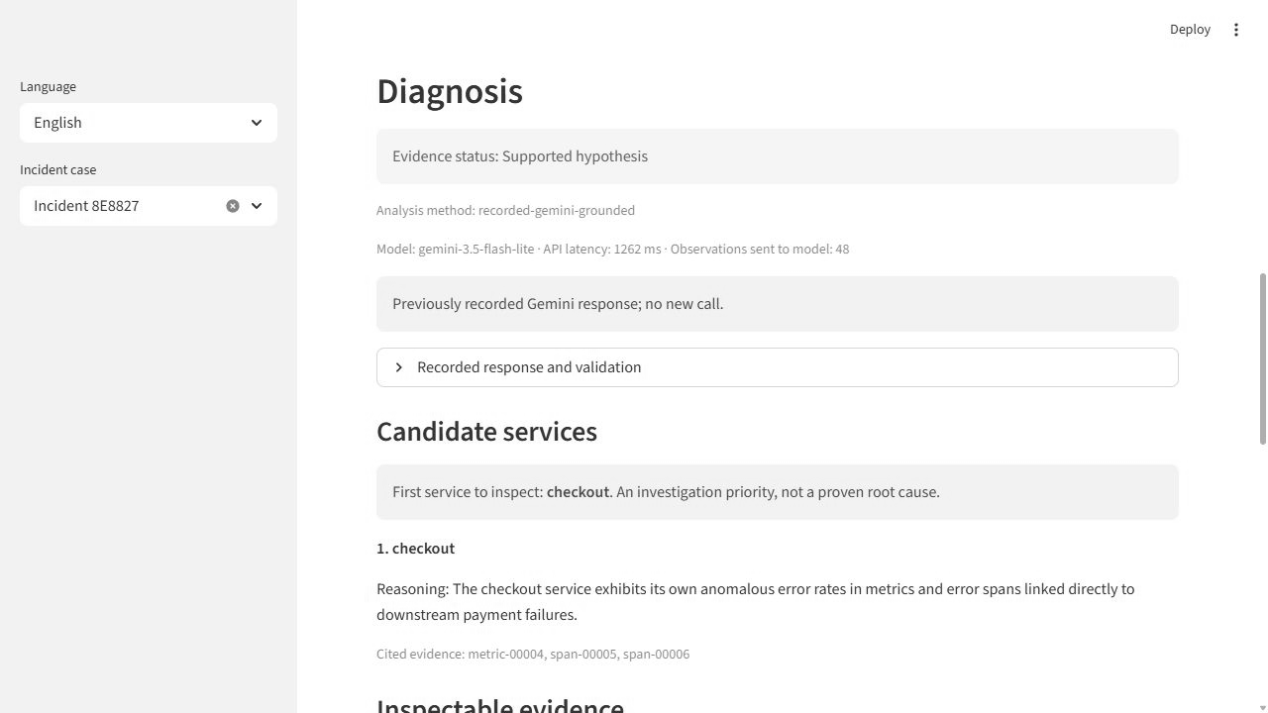
Testing and a retained failure
9 recorded windows cover normal, injected fault and recovery
Group 003 suggests checkout although the intervention targets payment
A normal-window explanation overlooks selected load-generator errors
Valid evidence IDs do not guarantee a faithful explanation. Preserve the negative case.
Dahe Chen / CS 5588 / October 1, 2026 checkpoint
7
Notes:
Real confirmation003-b screenshot results/screenshots/official_confirmation_counterexample_20261001.jpg. Candidatecheckout is a label nonmatch, not proof of a bad first inspection action. paymentERRORselectedspan7/8 were available but uncited. Grounded003-a reason sayszeroerroracrossservices despite selectedloadgenmetric19 positiveandERRORspan; actualclaim audit preserves this counterexample. Ninebundles are phasewindows onone mechanism, not9independentfaultcategories.

Slide 8
Delivery and next experiment
Available: local app, official captures, replay examples, evaluation code and English report
Remaining: observed human review and a matched investigation-task comparison
Challenge 3: compare competing service explanations with checkable evidence
Challenge 4: evaluate predefined missing or delayed telemetry
Challenge 5: integrate verified features and prepare the live demonstration
Application: http://127.0.0.1:8510 (local demonstration)
Repository: https://github.com/chendahe666/AutoTriager-Shop
Dahe Chen / CS 5588 / October 1, 2026 checkpoint
8
Notes:
Sources: README, docs/PROJECT_PLAN, actual report and ninepublic examples. Course/currentimplemented bounded cycle complete except originalpre-AIworkflow unavailable, meaningfulactualhumanreview notyetrecorded. Newcomponent comparison is post-studyengineering, no additional modelclaims. C3 competing hypotheses and action-quality criteria; C4 missing/delayed signals; C5 integration. Do not advance merely by techadditions.

