Slide 1
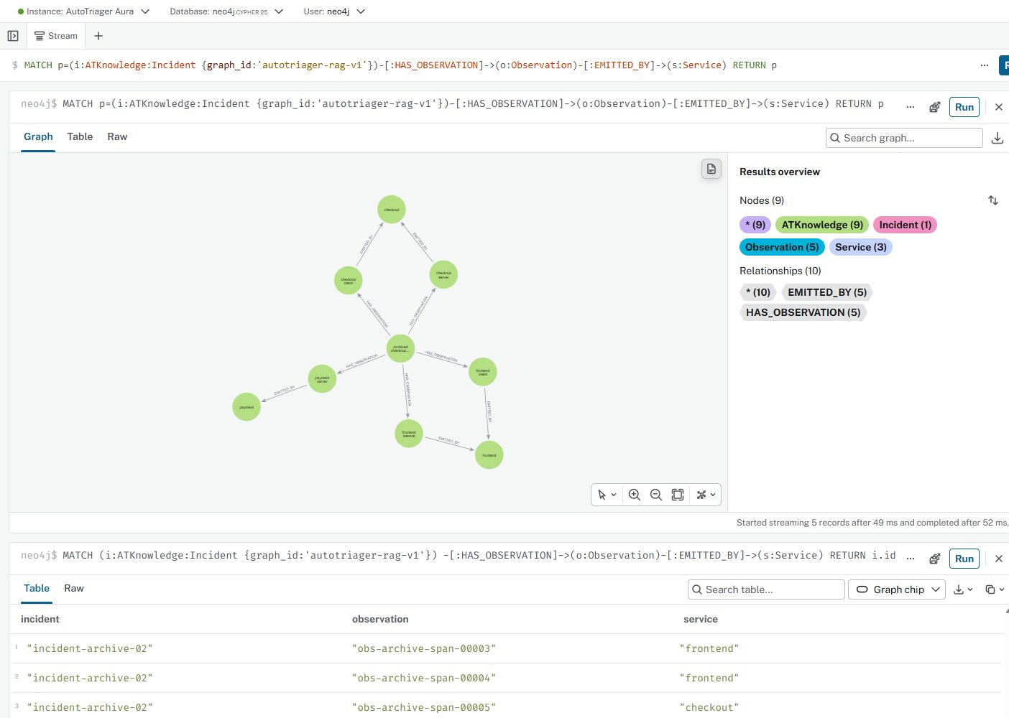
AutoTriager GraphRAG
Dahe Chen, CS 5588 Human-AI Co-Design, October 15, 2026
An engineer investigating checkout
Errors appear across services. The engineer needs to connect observations with the interface and call-path knowledge that gives them meaning.
73 nodes and 124 relationships
23 knowledge passages
Output: evidence for the next inspection.
Actual Aura screenshot, October 13.
The focused view shows 9 nodes and 10 links.
Whole-namespace counts verified October 15.
Project and source graph: github.com/chendahe666/AutoTriager-Shop
01

Slide 2
Evidence retrieval and answer generation
Each question uses the same archived checkout incident and a bounded context packet.
Question + incident
Time and services
Neo4j retrieval
Paths + passages
Evidence packet
IDs + source limits
Gemini
Cited claims
Reference validation and separate claim review
Student evaluation remains pending
Each v2 packet: 48 local observations, 10 Aura passages, 3 static relations.
Entity matching, bounded graph traversal and lexical ranking. No training or embeddings.
Primary grounding: OpenTelemetry
W3C PROV-O
Pinned Shop source: dedc017
02

Slide 3
Human-AI co-design and the review boundary
A real student decision changed the response policy. Correctness judgments remain deferred.
Stage | Recorded interaction
AI review finding | A payment database check assumed an undocumented dependency.
Student decision | First confirm whether payment has a database. Check its connection only if it exists.
Implementation | The prompt requires existence-first verification before a conditional dependency check.
Student answer evaluation: pending
The student requested a domain explanation rather than giving an uncertain assessment.
This policy decision does not approve any complete model answer.
Actual student reply and boundary: human_evaluation.json
03

Slide 4
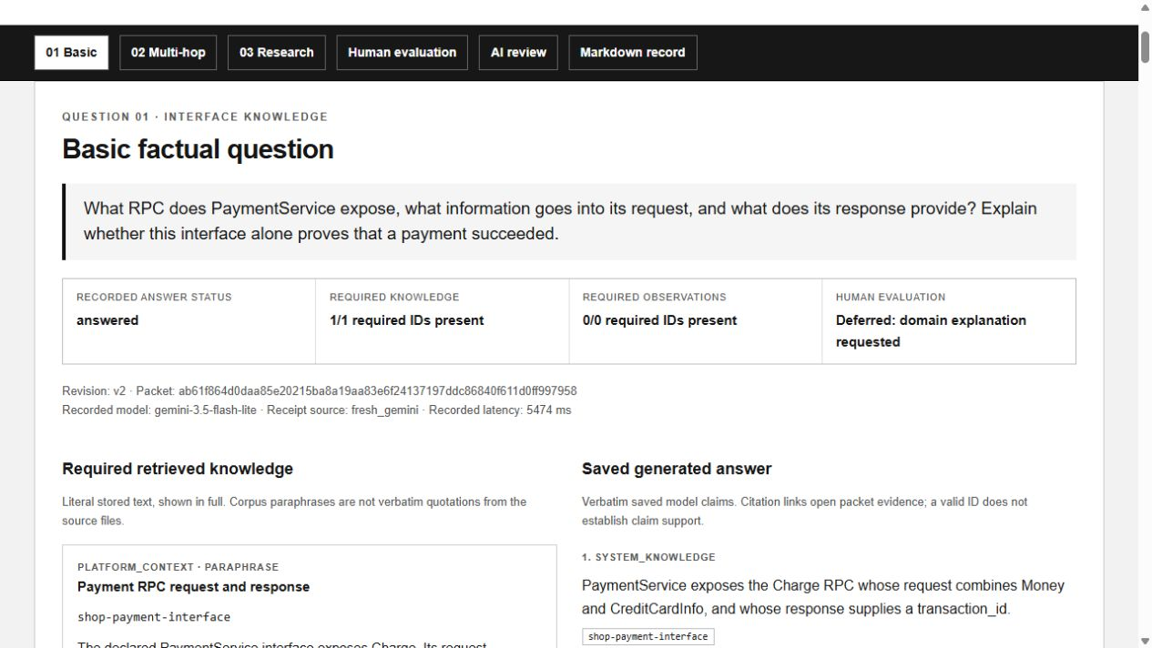
Basic question: the payment interface
Question, shortened: What enters Charge, what returns, and does the contract prove success?
Retrieved passage, summary
PaymentService exposes Charge.
Request: Money + CreditCardInfo
Response: transaction_id
Success requires incident evidence.
Saved model answer, excerpt
“The declared PaymentService interface describes message shape, but this interface alone does not prove that any request succeeded.”
Saved execution replay, October 15
Fresh model call: 5.474 s
AI review: 3 claims pass. Student: deferred.
Source: pb/demo.proto, lines 175–195
Full prompt, original response and evidence
04

Slide 5
Multi-hop question: the observed pathway
Question, shortened: Which services and operations connect frontend, checkout and payment?
Executed Cypher, abridged
Saved model answer, excerpt
MATCH (i:Incident)
-[:HAS_OBSERVATION]->(o:Observation)
-[:EMITTED_BY]->(s:Service)
RETURN i.id,o.id,s.name
“The checkout service emits server-side oteldemo.CheckoutService/PlaceOrder and client-side oteldemo.PaymentService/Charge spans with status ERROR.”
Query observation ID | Service
obs-archive-span-00005 | checkout
obs-archive-span-00006 | checkout
obs-archive-span-00007 | payment
Independent AI review
3 claims pass, 1 is partial.
The answer omits all 4 parent links
and both static conditions.
Frontend-call citation needs support.
3 of 5 rows shown. Separate query, not LLM input.
Namespace filters omitted. Full query linked.
Saved query, context and unchanged answer (5.878 s model call)
05

Slide 6
Research question: why inspect payment?
The evidence can motivate investigation while the initiating cause remains unresolved.
What the packet supports
Independent review objections
span-00007 records a payment server Charge span with ERROR.
The source handler records a caught error and returns it through the RPC callback.
Deployed-source equality and the internal exception remain unknown.
Model claim, excerpt:
“…across multiple traces…”
Citation: span-00007 only
One cited span cannot establish multiple traces. The candidate failure explanation also exceeds what aggregate error rates support.
Saved next check, excerpt
“Verify whether the payment service has any external database or third-party dependencies…”
AI review: 2 pass, 2 partial
Fresh model call: 5.943 s
Source: payment/index.js, lines 12–31
Original research answer and review
06

Slide 7
Observed results and remaining gaps
Three fresh responses concern one previously inspected incident.
Question | Required knowledge | Model latency | AI claim review
Basic | 1 / 1 | 5.474 s | 3 pass, 0 partial
Multi-hop | 3 / 3 | 5.878 s | 3 pass, 1 partial
Research | 2 / 2 | 5.943 s | 2 pass, 2 partial
18 / 18 citation occurrences resolve
8 / 11 claims pass AI support review
3 claims remain partially supported.
Student judgments: all pending or deferred.
Development repair: multi-hop required passage retrieval changed from 1/3 to 3/3.
This rerun on a known question does not measure diagnostic improvement.
Independent simulated review, objections and unchanged raw results
07

Slide 8
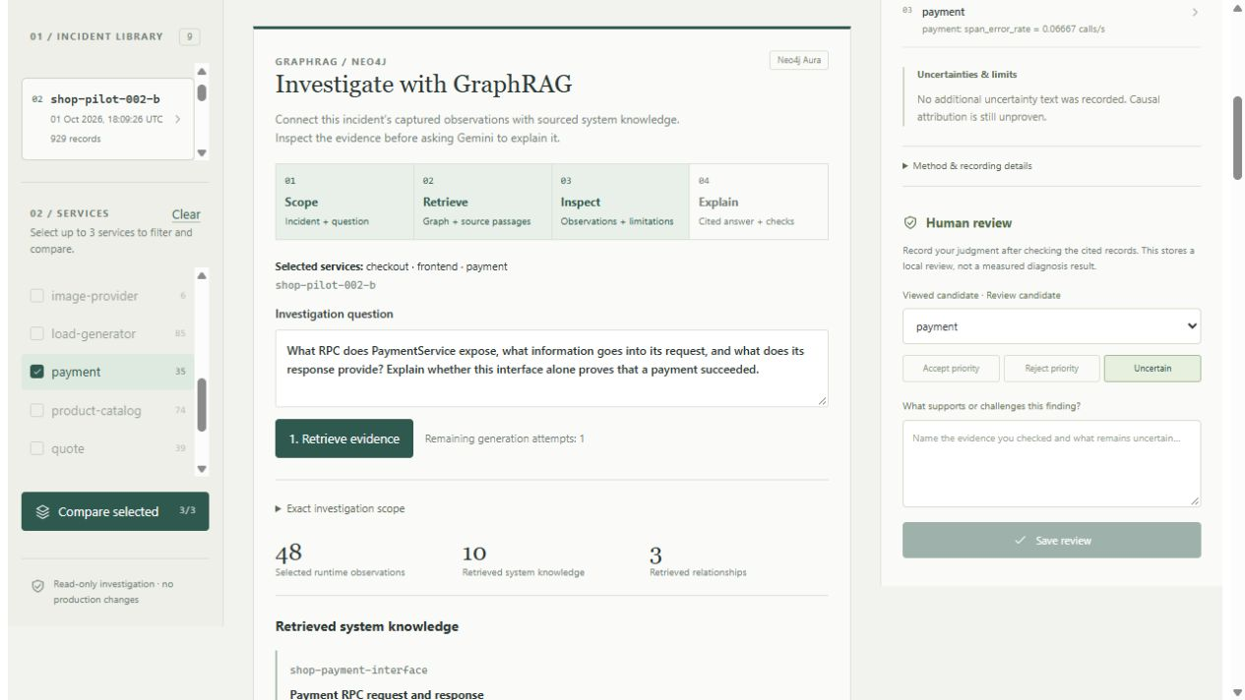
Reproducibility and reflection
The repository preserves exact questions, retrieved packets, original answers and review records.
What another reader can inspect
Source versions, observation IDs and executed graph query rows.
Original responses and separate objections, without rewriting model output.
Python and React, Neo4j Aura, and Gemini 3.5 Flash-Lite.
Reflection
Human review needs domain understanding.
The next step is guided evidence reading,
then an actual student assessment.
Actual workbench retrieval, October 15.
Packet: 48 observations, 10 passages
and 3 relations. No new model call.
Code and reproduction guide
Full questions, evidence and review report
08

