Slide 1
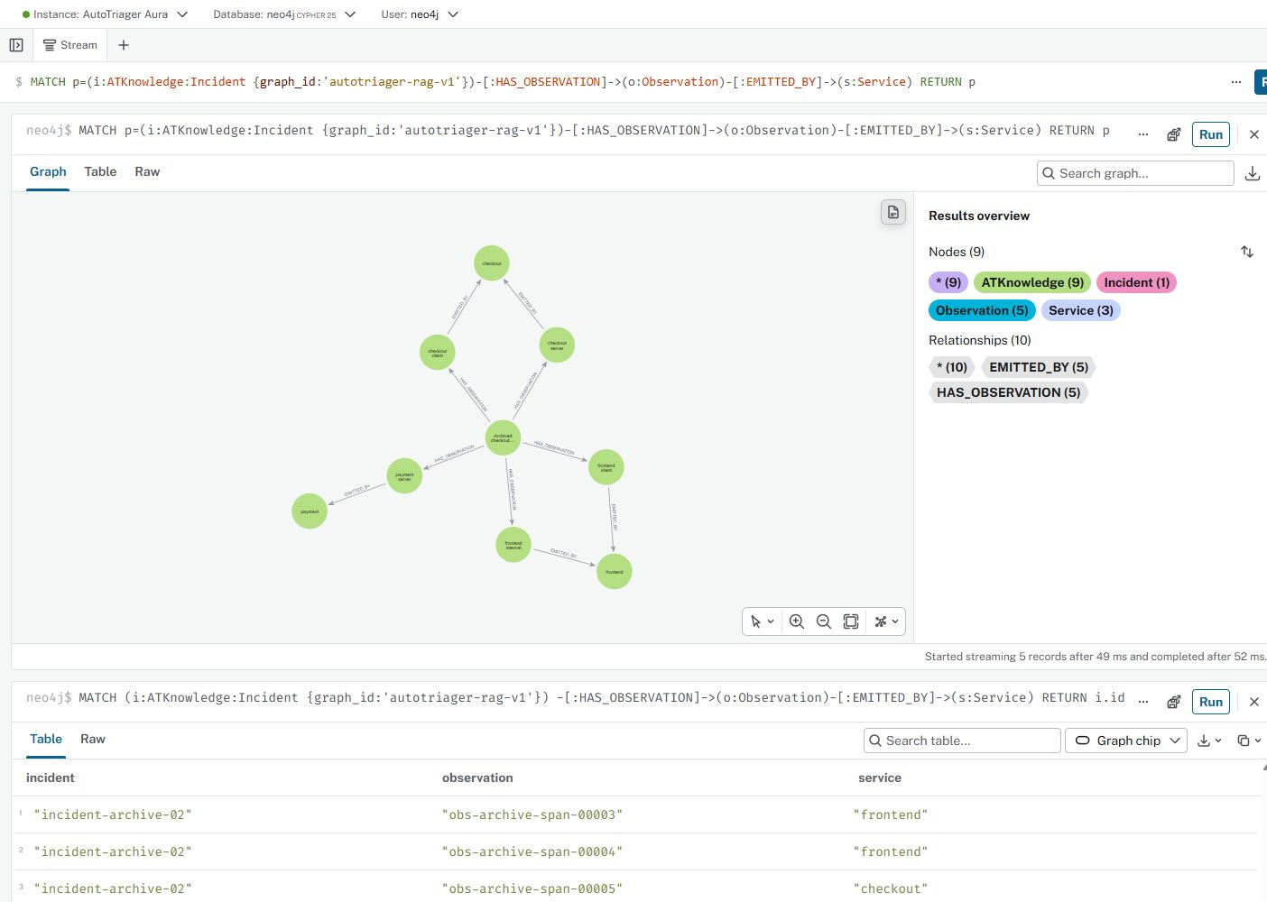
AutoTriager: GNN-enhanced GraphRAG
Dahe Chen, CS 5588 Challenge 3, October 22, 2026
Evidence for an engineer
investigating service failures
Existing GraphRAG connects incident observations with source-backed service knowledge.
Neo4j retrieves passages and paths. Gemini returns claims with evidence references.
Existing KG: 73 nodes, 124 relationships.
Verified October 15. Screenshot: October 13.
Project: github.com/chendahe666/AutoTriager-Shop
01

Slide 2
Why add a GNN?
Question: can connected knowledge improve the evidence ranking?
Current retrieval uses entity matching, graph traversal and lexical scores.
A relevant passage may use different words from the engineer's question.
A service, its operation and its documentation supply complementary context.
A learned node representation can incorporate information from these neighbors.
This experiment measures retrieval. It does not measure root-cause accuracy.
GraphSAGE: Hamilton, Ying and Leskovec, NeurIPS 2017
02

Slide 3
GraphSAGE with mean aggregation
A node combines its own features with the average features of its neighbors.
mᵥ = mean { hᵤ : u ∈ N(v) }
hᵥ′ = ReLU(Wₛ hᵥ + Wₙ mᵥ + b)
One layer maps 364 TF-IDF text features to 32 learned dimensions.
Training reconstructs existing graph links. It uses no question relevance labels.
L2 normalization follows the update. Cosine similarity ranks candidate passages.
Primary method: GraphSAGE, Algorithm 1
Implemented model and objective
03

Slide 4
Message passing in the project graph
PlaceOrder receives messages from 11 neighbors in the static knowledge projection.
PlaceOrder
364 text features
Mean aggregation
+ learned weights
Updated
node embedding
11 graph neighbors
Operations, service
and source passages
Coordinate 0 before normalization:
-0.063994 + 0.127332 + 0.081373
Self Neighbors Bias
ReLU output = 0.144711
Reconstruction error: 2.98 × 10⁻⁸. A message does not prove a causal dependency.
Recorded tensors and numerical reconstruction
04

Slide 5
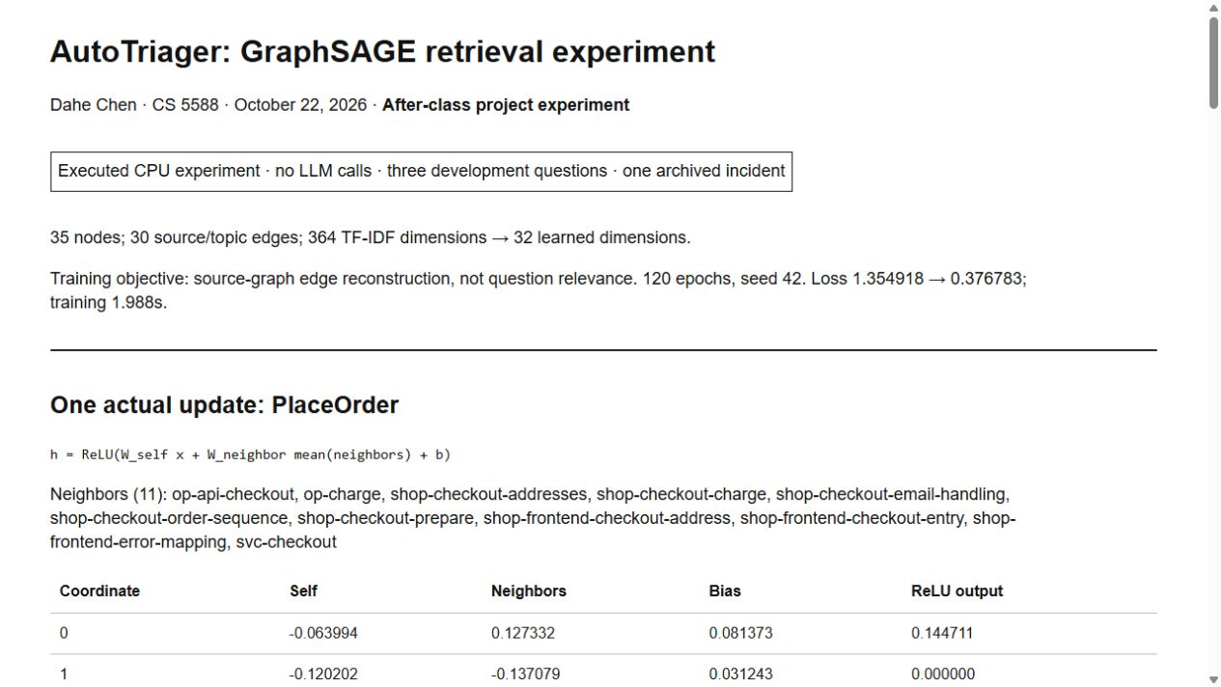
Hands-on project experiment
Independent project exercise, October 22. October 20 class materials were not available.
35 nodes: 5 services, 7 operations and 23 source passages.
30 source/topic links. Both directions contribute to the mean.
PyTorch on CPU, 120 epochs, seed 42.
Training uses source links. Incident labels stay outside the model.
V1 loss: 1.355 to 0.377
Training: 1.988 seconds
Actual experiment report. All numbers
come from the saved local run.
Reproducible code, configuration and results
05

Slide 6
GNN ranking before evidence retrieval
The experiment ranks original evidence from a local snapshot of the existing graph.
Existing KG model
local snapshot
GraphSAGE
node embeddings
Question + 10 candidates
GNN reranking
Existing LLM stage
Not rerun today
Original passages
+ evidence IDs
Top-5 passage IDs
Source corpus lookup
Offline bridge: 9/9 evidence packets pass integrity checks. Original records remain intact.
Aura connection failed. The cloud query and LLM answer stages were not rerun today.
Neo4j GraphRAG for Python
Project integration example
06

Slide 7
An evidence-ranking example
Development question, shortened: Which evidence supports inspecting payment next?
Required source passage | Lexical rank | V2 fusion rank
Payment error handler | 3 | 3
Checkout calls payment | 6 | 5
V2 places both required passages in the first five.
V2: equal-weight reciprocal rank fusion, k = 60.
The lexical cutoff contains tied scores, so this comparison is tie-sensitive.
Exact queries and ranked IDs
RRF: Cormack et al., SIGIR 2009
07

Slide 8
Retrieval results and limits
Three existing development questions, identical ten-candidate pools, Top-5 evidence budget.
Method | Mean Recall@5 | Mean reciprocal rank
Original GraphRAG order | 0.778 | 0.556
Global lexical score | 0.722 | 0.778
V1 GraphSAGE | 0.778 | 0.567
V2 lexical + GraphSAGE | 0.889 | 0.556
Keep lexical retrieval as default. V2 remains experimental.
Lexical cutoff ties permit mean Recall@5 from 0.722 to 0.889. V2 reaches 0.889.
V1 and its no-neighbor control tie. No robust GNN gain is established.
Three known questions, one incident. No new answer-quality test.
Complete metrics and experiment limitations
08

Slide 9
Human-AI co-design
My direction: test GNN on this project, with at most three versions.
Step | Recorded guidance or implementation
My prompt (translated) | Try GNN on our system. Test the benefit. Explain failures and revise, up to three versions.
AI engineering | Train GraphSAGE, preserve baselines and diagnose missing evidence before revising.
Observed revision | V2 adds rank fusion. The tie audit prevents claiming a robust gain. Stop after two versions.
Recorded lesson
My input set the goal and iteration limit. AI implemented and tested alternatives.
Next human review: interpret the trade-off and define unseen test questions.
Recorded human guidance and implementation changes
09

Slide 10
Lessons and next steps
The working example establishes a testable retrieval extension.
Neighbor messages update a real project embedding, with every term preserved.
A lower training loss does not guarantee better retrieval.
The evidence supports a working experiment, with no robust benefit established.
Before the October 26 report
Explain the trade-off, test unseen questions,
and check answer quality before replacing the current retriever.
Code and evidence: github.com/chendahe666/AutoTriager-Shop
10

