Slide 1
AutoTriager
Cloud GraphRAG for Incident Investigation
Dahe Chen
CS 5588 Challenge 3: AI Design and GraphRAG Extension
Users: on-call developers and site reliability engineers.
Problem: errors cross service boundaries, while system knowledge and observations remain separate.
Goal: retrieve relevant dependencies and source passages for an investigation that engineers can verify.
October 13, 2026. Updates the implemented KG and adds the requested GraphRAG extension.
01

Slide 2
Research grounding and co-design
Codex agents assisted source review, schema refinement, implementation, and verification.
Primary source | Concept | Representation
OpenTelemetry | Service identity and trace context | Service, Operation, Observation
W3C PROV-O | Source evidence and derivation | Evidence, locators, content hashes
Official Shop 3.1.0 | Conditional calls and configuration | CALLS, conditions, versioned passages
Human decision: accepted
My design distinguished calls from business dependence. AI proposed separate
source, observed, and verified states. I accepted this and retained unknowns.
OpenTelemetry semantic conventions
W3C PROV-O
Pinned Shop source: dedc017
02

Slide 3
Graph structure and knowledge content
A reusable telemetry foundation joins versioned platform knowledge and scoped observations.
Semantic types | Meaning | Selected fields
Service / Operation | Component and interface ownership | name, protocol, source_version
BusinessWorkflow | Business outcome and conditions | scope, success_criterion
Incident / Observation | A bounded runtime record | time, service, trace_id, span_id
Evidence / Chunk | Locatable source and readable passage | locator, hash, version, application_limit
23 curated passages: 9 telemetry/provenance interpretations + 14 Shop context passages. Conditions remain with the text.
Seven semantic types. Fourteen relationship types include HAS_CHUNK and ABOUT. Source structure is not incident causation.
03

Slide 4
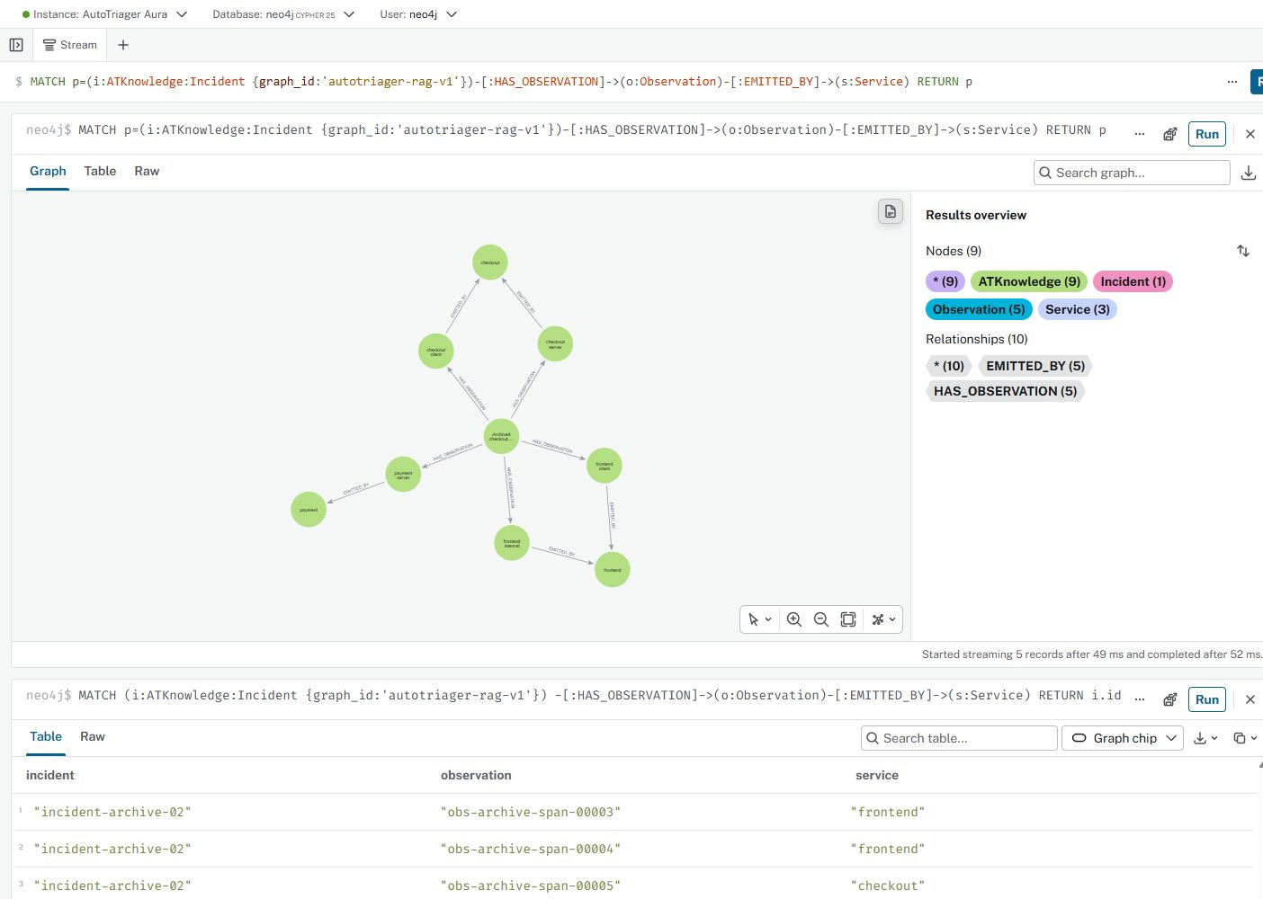
Neo4j Aura implementation
Actual Neo4j Browser connected to Aura. This focused incident view contains 9 nodes and 10 links.
73 nodes
124 relationships
Complete cloud graph: 7 semantic types and 14 relationship types.
Focused view: incident, observations, and emitting services.
23 curated passages supply additional system knowledge.
Screenshot: actual Aura connection, October 13. Whole-project counts come from cloud_verification.json.
04

Slide 5
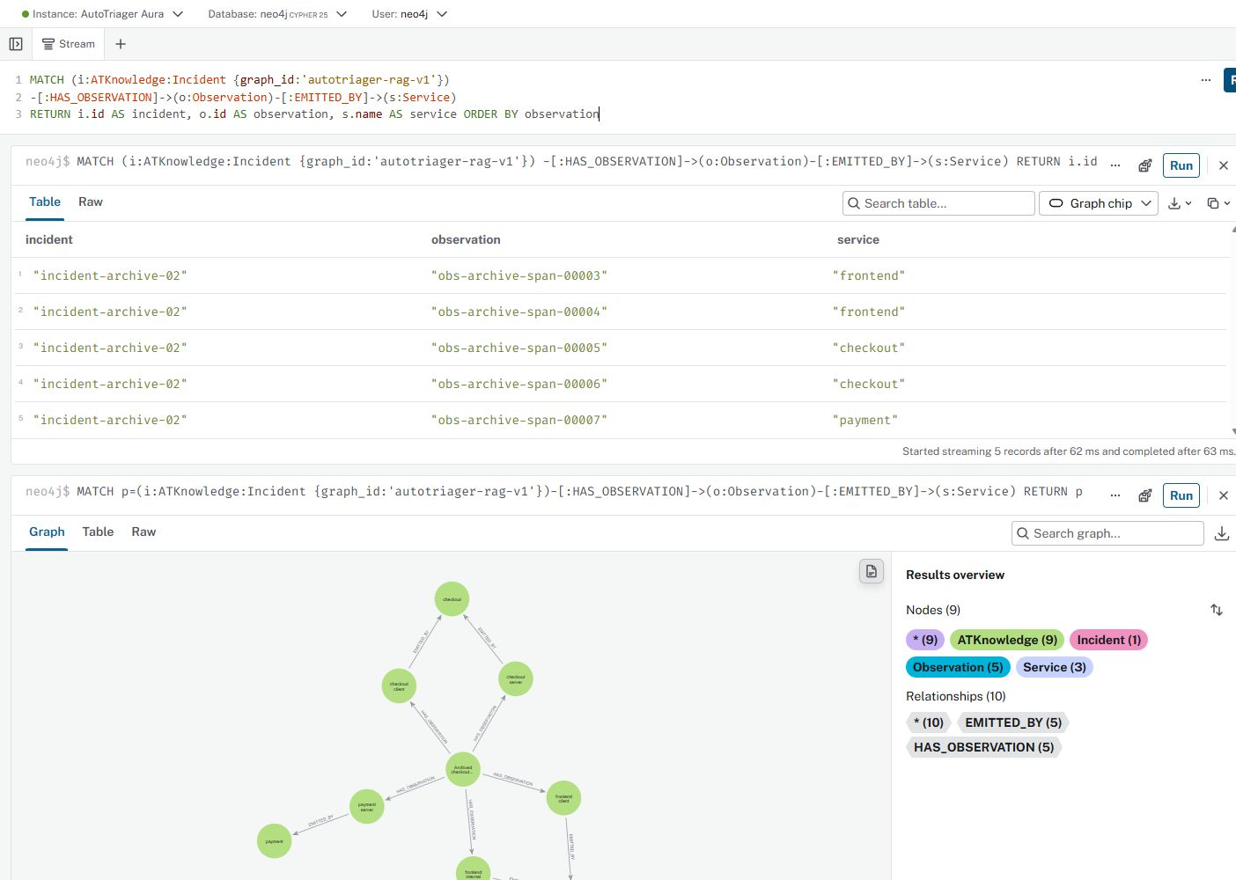
Cypher import and multi-hop retrieval
Import excerpts and an executed two-hop query connect an incident to observations and emitting services.
Import excerpts
Executed Aura query output
MERGE (n:ATKnowledge:Chunk
{graph_id:$graph,id:row.id})
SET n += row
MERGE (a)-[r:CALLS
{graph_id:$graph,
id:row.properties.id}]->(b)
Graph query
MATCH (i:Incident)
-[:HAS_OBSERVATION]->(o)
-[:EMITTED_BY]->(s)
RETURN i.id,o.id,s.name
Five observations from incident-archive-02 map to three emitting services. Cropped result columns shown.
Executed queries also filter the project namespace. Trace propagation and source calls do not prove root cause.
05

Slide 6
GraphRAG in the investigation workflow
The incident scope controls retrieval. The LLM receives a bounded evidence packet.
Incident + question
Time and services
Neo4j retrieval
Paths + source chunks
Evidence packet
IDs, versions, gaps
Gemini
Cited explanation
Citation checks and engineer review
Compare evidence and ask a follow-up
Local snapshot: up to 48 observations. Aura: up to 10 passages using entity matching, graph traversal and lexical ranking. No embedding model.
Neo4j GraphRAG retrieval framework
06

Slide 7
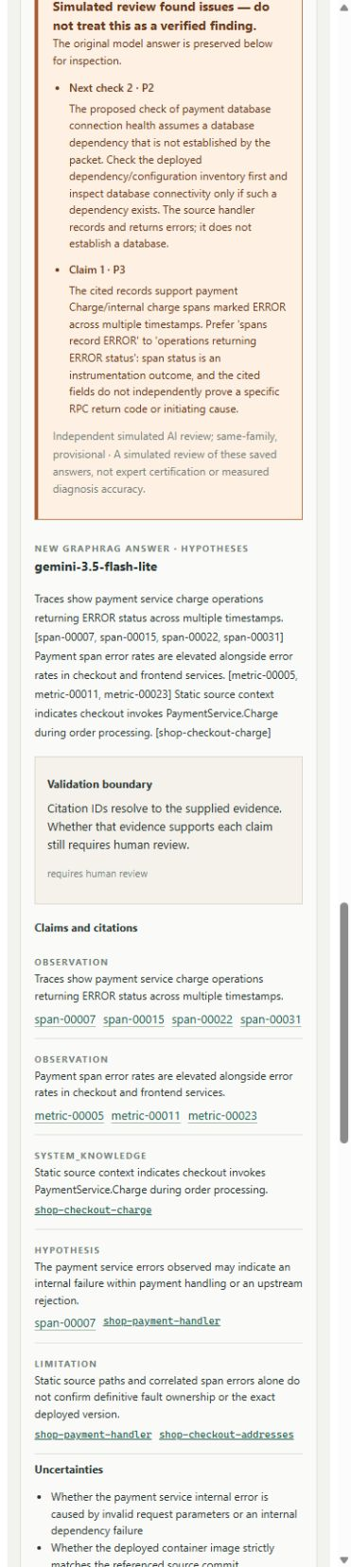
Incident analysis in the workbench
Actual workbench question: which observations justify inspecting payment next?
Gemini 3.5 Flash-Lite
8.48 s model call
Input: 48 observations, 10 passages, and 3 static links.
Citation IDs resolve; each claim still needs semantic review.
Review flagged a database check with no established database dependency.
Span ERROR records do not confirm the initiating cause.
Five development attempts: 2 schema/reference-valid outputs, 2 citation rejections, 1 HTTP 400 response.
07

Slide 8
Validation and next experiment
Construction and development retrieval checks verify the pipeline, not diagnostic improvement.
Check | Observed result | Interpretation
Corpus construction + boundaries | 8 / 8 pass | Pinned files, anchors and negative controls
Required knowledge retrieved | 3 / 3 questions | All 5 selected target passages found
Diagnostic benefit | Not measured | No held-out or paired LLM comparison yet
Current limits
Next comparison
One inspected incident. Partial topology.
Semantic support gaps remain in model output.
Compare direct prompting, document RAG,
and GraphRAG on the same model and budget.
These are development checks. Valid citation IDs alone do not prove that each claim is supported.
08

