Slide 1
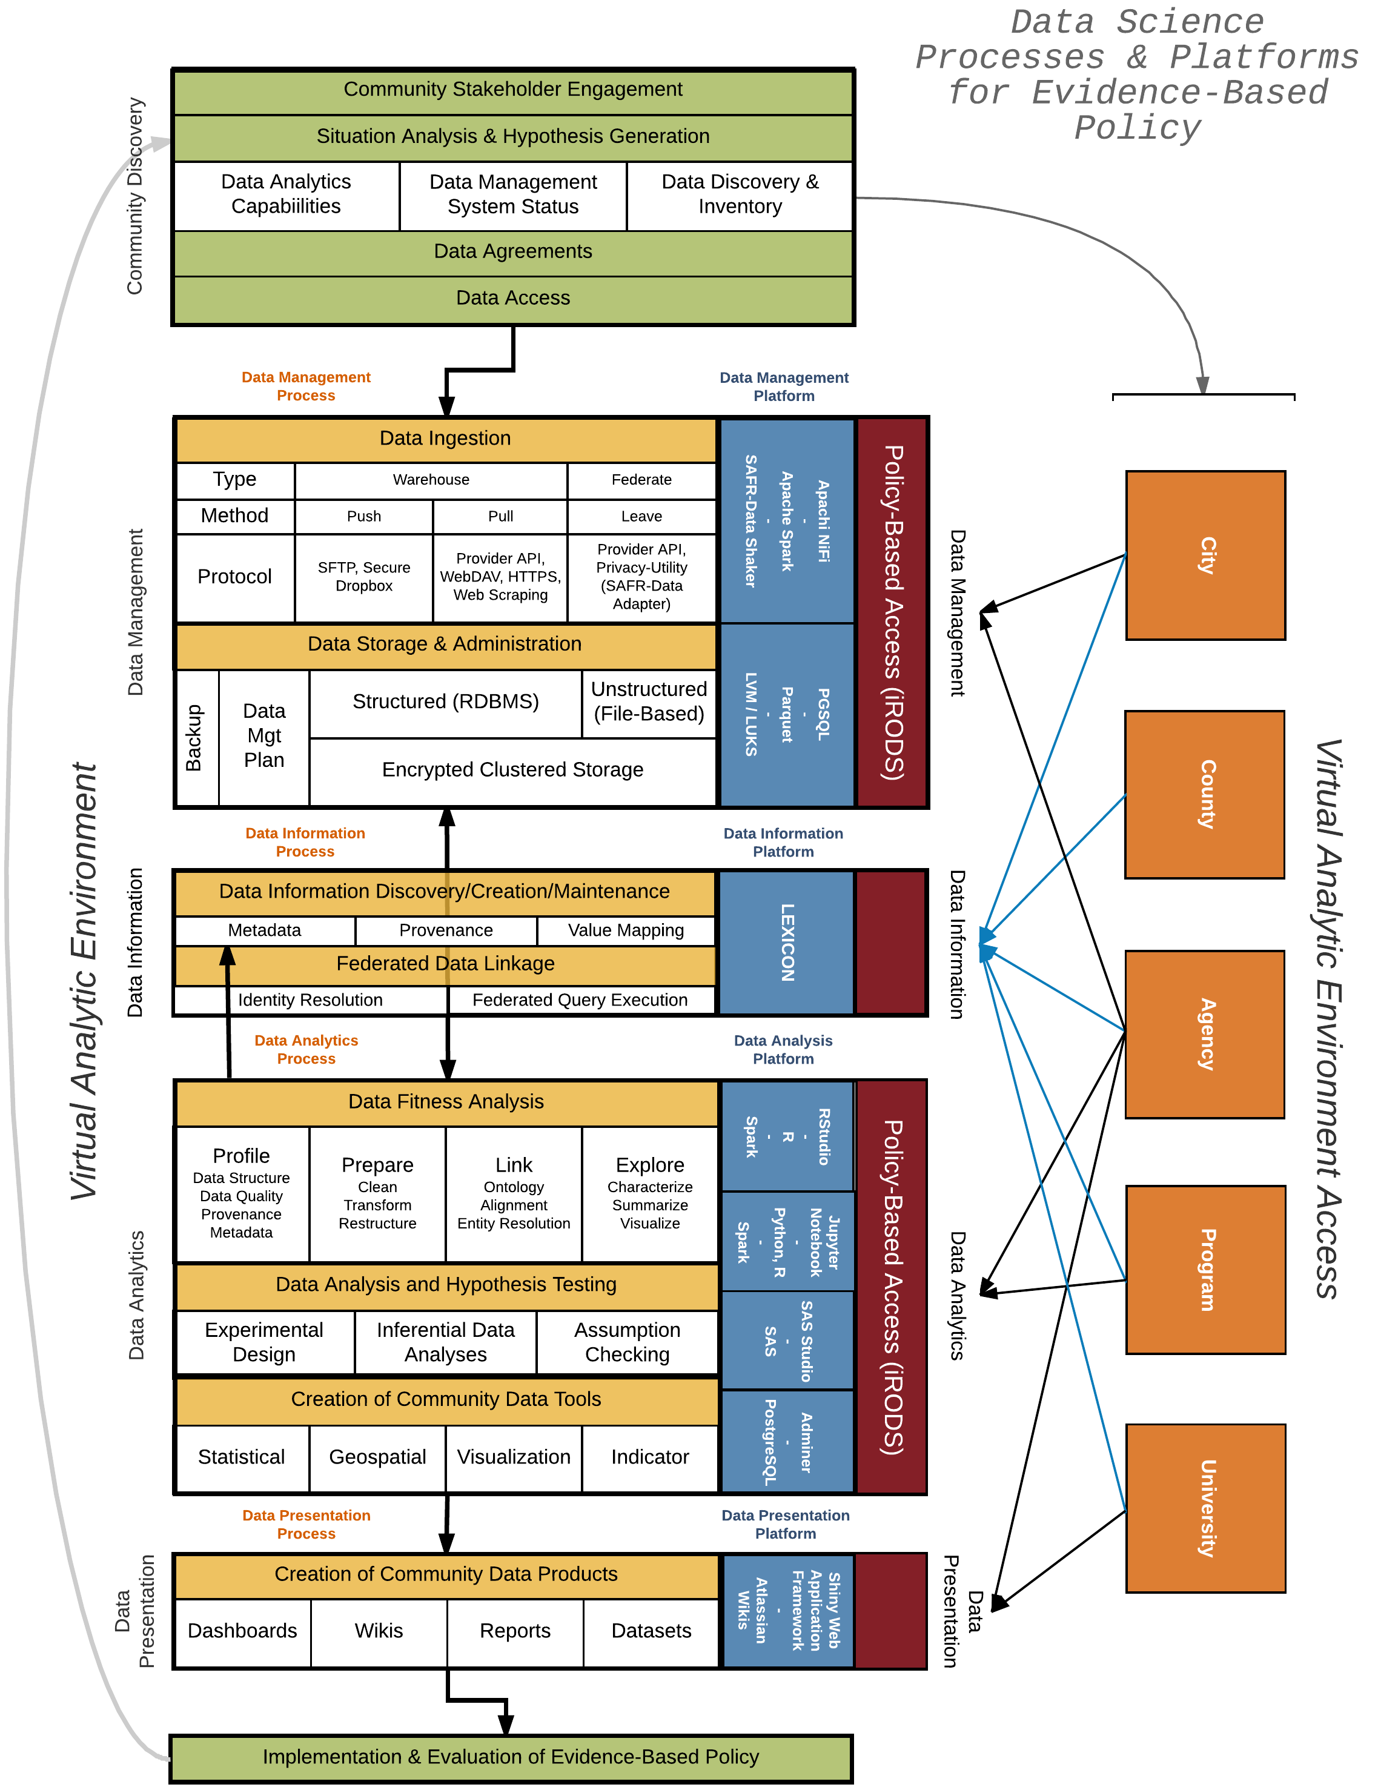
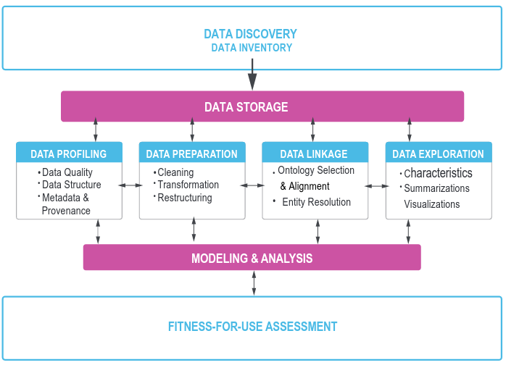
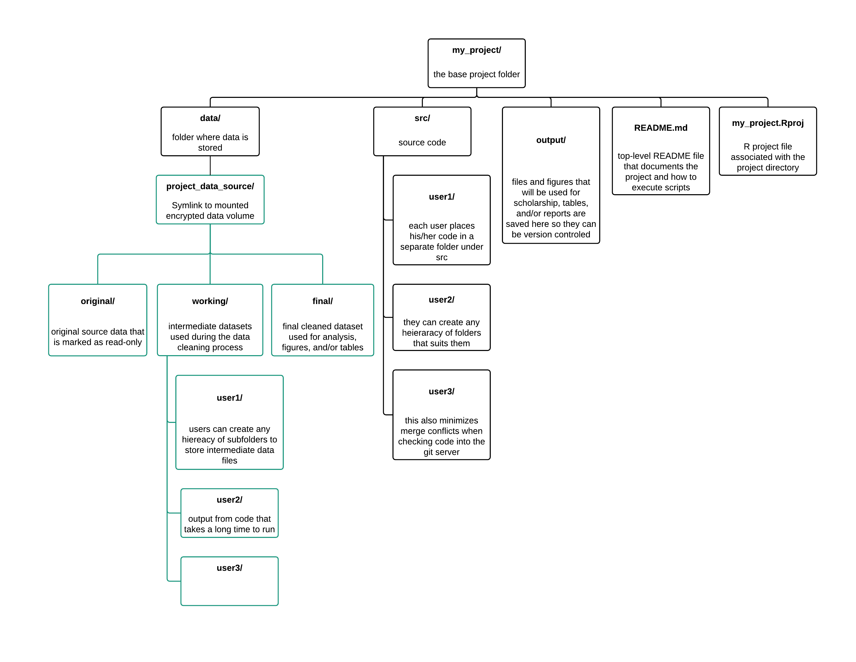
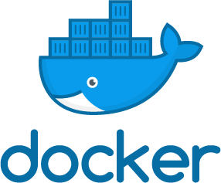
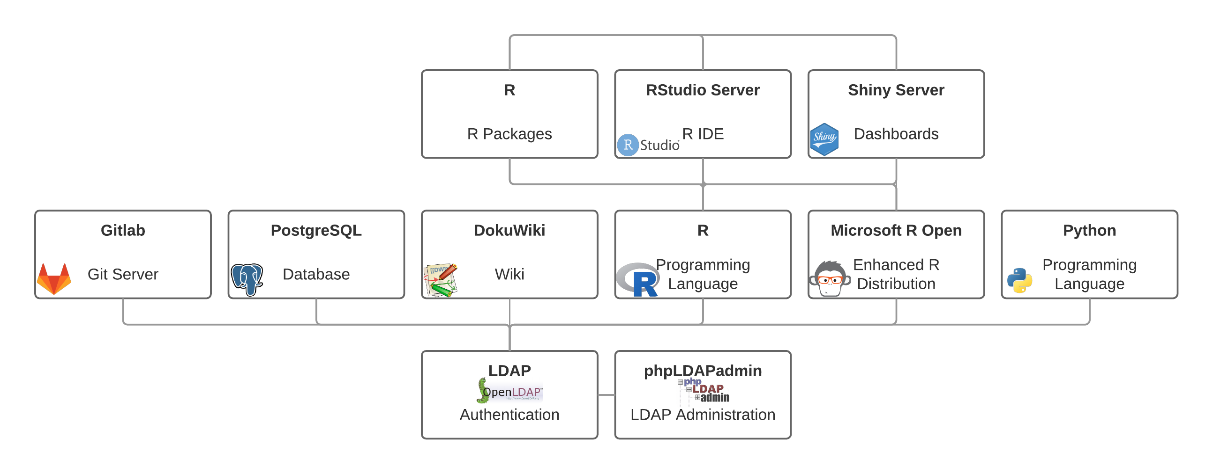
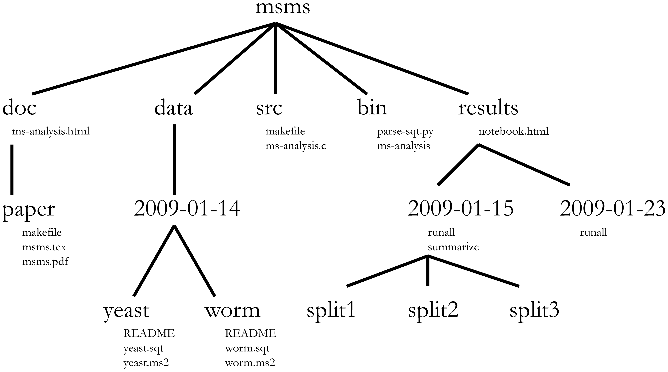

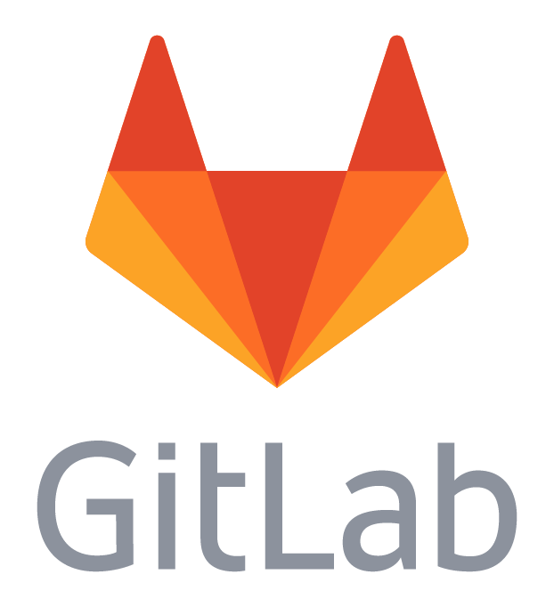

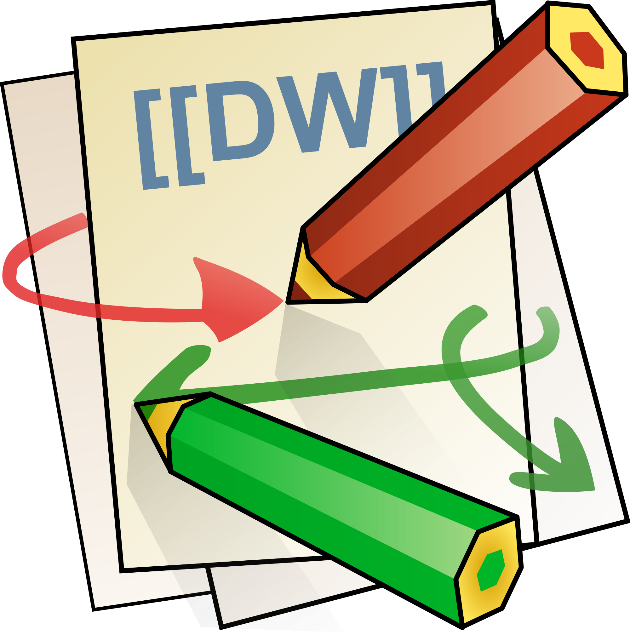

Doing Data Science
Daniel Chen, Aaron Schroeder
Social and Decision Analytics Laboratory
Overview
“Good Enough Practices in Scientific Computing”
Science has a reproducibility problem.
As more science becomes computational, having a system that thoroughly documents and provides provenance for the data used in research findings is increasingly important for replicability and reproducibility.
While these terms, replicability and reproducibility, are often used interchangeably,
There are subtle differences in the definition that are relevant for scientific research.
- Replicability: Results are the same after applying it to new data
- Reproducibility: Results are the same after applying it to the same data
- Provenance: The lineage, transformations, and corrections made
during the data cleaning and analysis
Data management
Save the raw data.
Ensure that raw data are backed up in more than one location.
Create the data you wish to see in the world.
Create analysis-friendly data.
Record all the steps used to process data.
Anticipate the need to use multiple tables, use a unique identifier for every record.
Submit data to a reputable DOI-issuing repository so that others can access and cite it.
Software
Place a brief explanatory comment at the start of every program.
Decompose programs into functions.
Be ruthless about eliminating duplication.
Always search for well-maintained software libraries that do what you need.
Test libraries before relying on them.
Give functions and variables meaningful names.
Make dependencies and requirements explicit.
Do not comment and uncomment sections of code to control a program's behavior.
Provide a simple example or test data set.
Submit code to a reputable DOI-issuing repository.
Collaboration
Create an overview of your project.
Create a shared "to-do" list for the project.
Decide on communication strategies.
Make the license explicit.
Make the project citable.
Project Organization
Put each project in its own directory, which is named after the project.
Put text documents associated with the project in the doc directory.
Put raw data and metadata in a data directory and files generated during cleanup and analysis in a results directory.
Put project source code in the src directory.
Put external scripts or compiled programs in the bin directory.
Name all files to reflect their content or function.
Keeping track of changes
Back up (almost) everything created by a human being as soon as it is created.
Keep changes small.
Share changes frequently.
Create, maintain, and use a checklist for saving and sharing changes to the project.
Store each project in a folder that is mirrored off the researcher's working machine.
Add a file called CHANGELOG.txt to the project's docs subfolder.
Copy the entire project whenever a significant change has been made.
Use a version control system.
Manuscripts
Write manuscripts using online tools with rich formatting, change tracking, and reference management.
Write the manuscript in a plain text format that permits version control.
Data Science Framework
Community Discovery
Working with stakeholders to gain access to data and begin cataloguing and documen-ting the data sources available. This also includes curating publically available data sources that can be used to augment existing data or use as proxies for a mea-surement of interest.
Data Management
Extract, Transform, and Load (ETL) data so there is a consistent location and API to pull data during the analysis phase. This goes in tandem with the project templates so each project has a consistent way to execute code and refer to data within the code
Data Information
Documenting metadata. This includes where the data comes from, survey infor-mation, codebooks, and relevant papers and publications. These can be in with report documents, project documentation, or within the code used for ETL and data management.
Data Analysis
The analysis phase is more than fitting a statistical model. Here we go through the process of determining data fitness by profiling, preparing, linking and exploring the data. The exploratory data analysis phase will determine what models can be used, and what data products can be created.
Data Presentation
Dashboards, wikis, reports, and cleaned datasets are all products that can be used by stakeholders for policy decisions, or further research questions. These products are different from the academic research paper for information dissemination.
From Discovery to Fitness
Once the data have been through the ETL process and stored for use, storage, profiling, preparation, linkage, exploration, and modeling is a constant and cyclical process.
Infrastructure
Project Directory Template
Project templates provide a consistent and predictable manner for code execution and data location.
Docker
This was after deploying infrastructure using Oracle VM VirtualBox and LXC
Linux Containers, the current core infrastructure is implemented using Docker.
This gives us the ability to build smaller images and quickly tear down and spin-up any part of the infrastructure stack when something goes wrong. It also provides a system to mirror changes and updates to software on our test server before deploying the changes to the production server. Container orchestration is done using docker-compose.
The portion in green are links to an encrypted data volume, whereas the portion in black are all under Git version control.
Our project template (right) is an adaptation from the computational biology project template described from Noble 2009 (below).
Our Docker infrastructure. Applications and services used in the laboratory and the container dependencies.
The R Packages container provides a separate environment to install R packages for all users in the lab without having each individual compile the same library. These "pre-installed” libraries are used by the Rstudio Server and Shiny Server containers using Docker data volumes.
In both cases, the working directory for the code to execute is clearly defined. We use RStudio projects, so the working directory within the project folder will always be the root project folder. Noble specifies a Makefile that will the location of the working directory. Both examples make opening project folders less confusing because there is a systematic way to access current and new projects. This is particularly helpful when a new researcher is added to a project and needs to quickly understand and the code and data to run an analysis.
Software and code
Source code are all under Git for version control. Online Git services such as Github and GitLab provide an additional backup layer, as well as a system to do project management (issues panel) and code review (pull/merge requests).
Our Docker infrastructure and software packages: http://github.com/bi-sdal
Scholarship and reports
Google Drive and DokuWiki serve as the systems to share and document project files. Overleaf provides a collaborative LaTeX environment for scholarship.
References
Good enough practices in scientific computing
Wilson G, Bryan J, Cranston K, Kitzes J, Nederbragt L, et al. (2017) Good enough practices in scientific computing. PLOS Computational Biology 13(6): e1005510.https://doi.org/10.1371/journal.pcbi.1005510
A Quick Guide to Organizing Computational Biology Projects
Noble WS (2009) A Quick Guide to Organizing Computational Biology Projects. PLOS Computational Biology 5(7): e1000424. https://doi.org/10.1371/journal.pcbi.1000424

