Slide 1


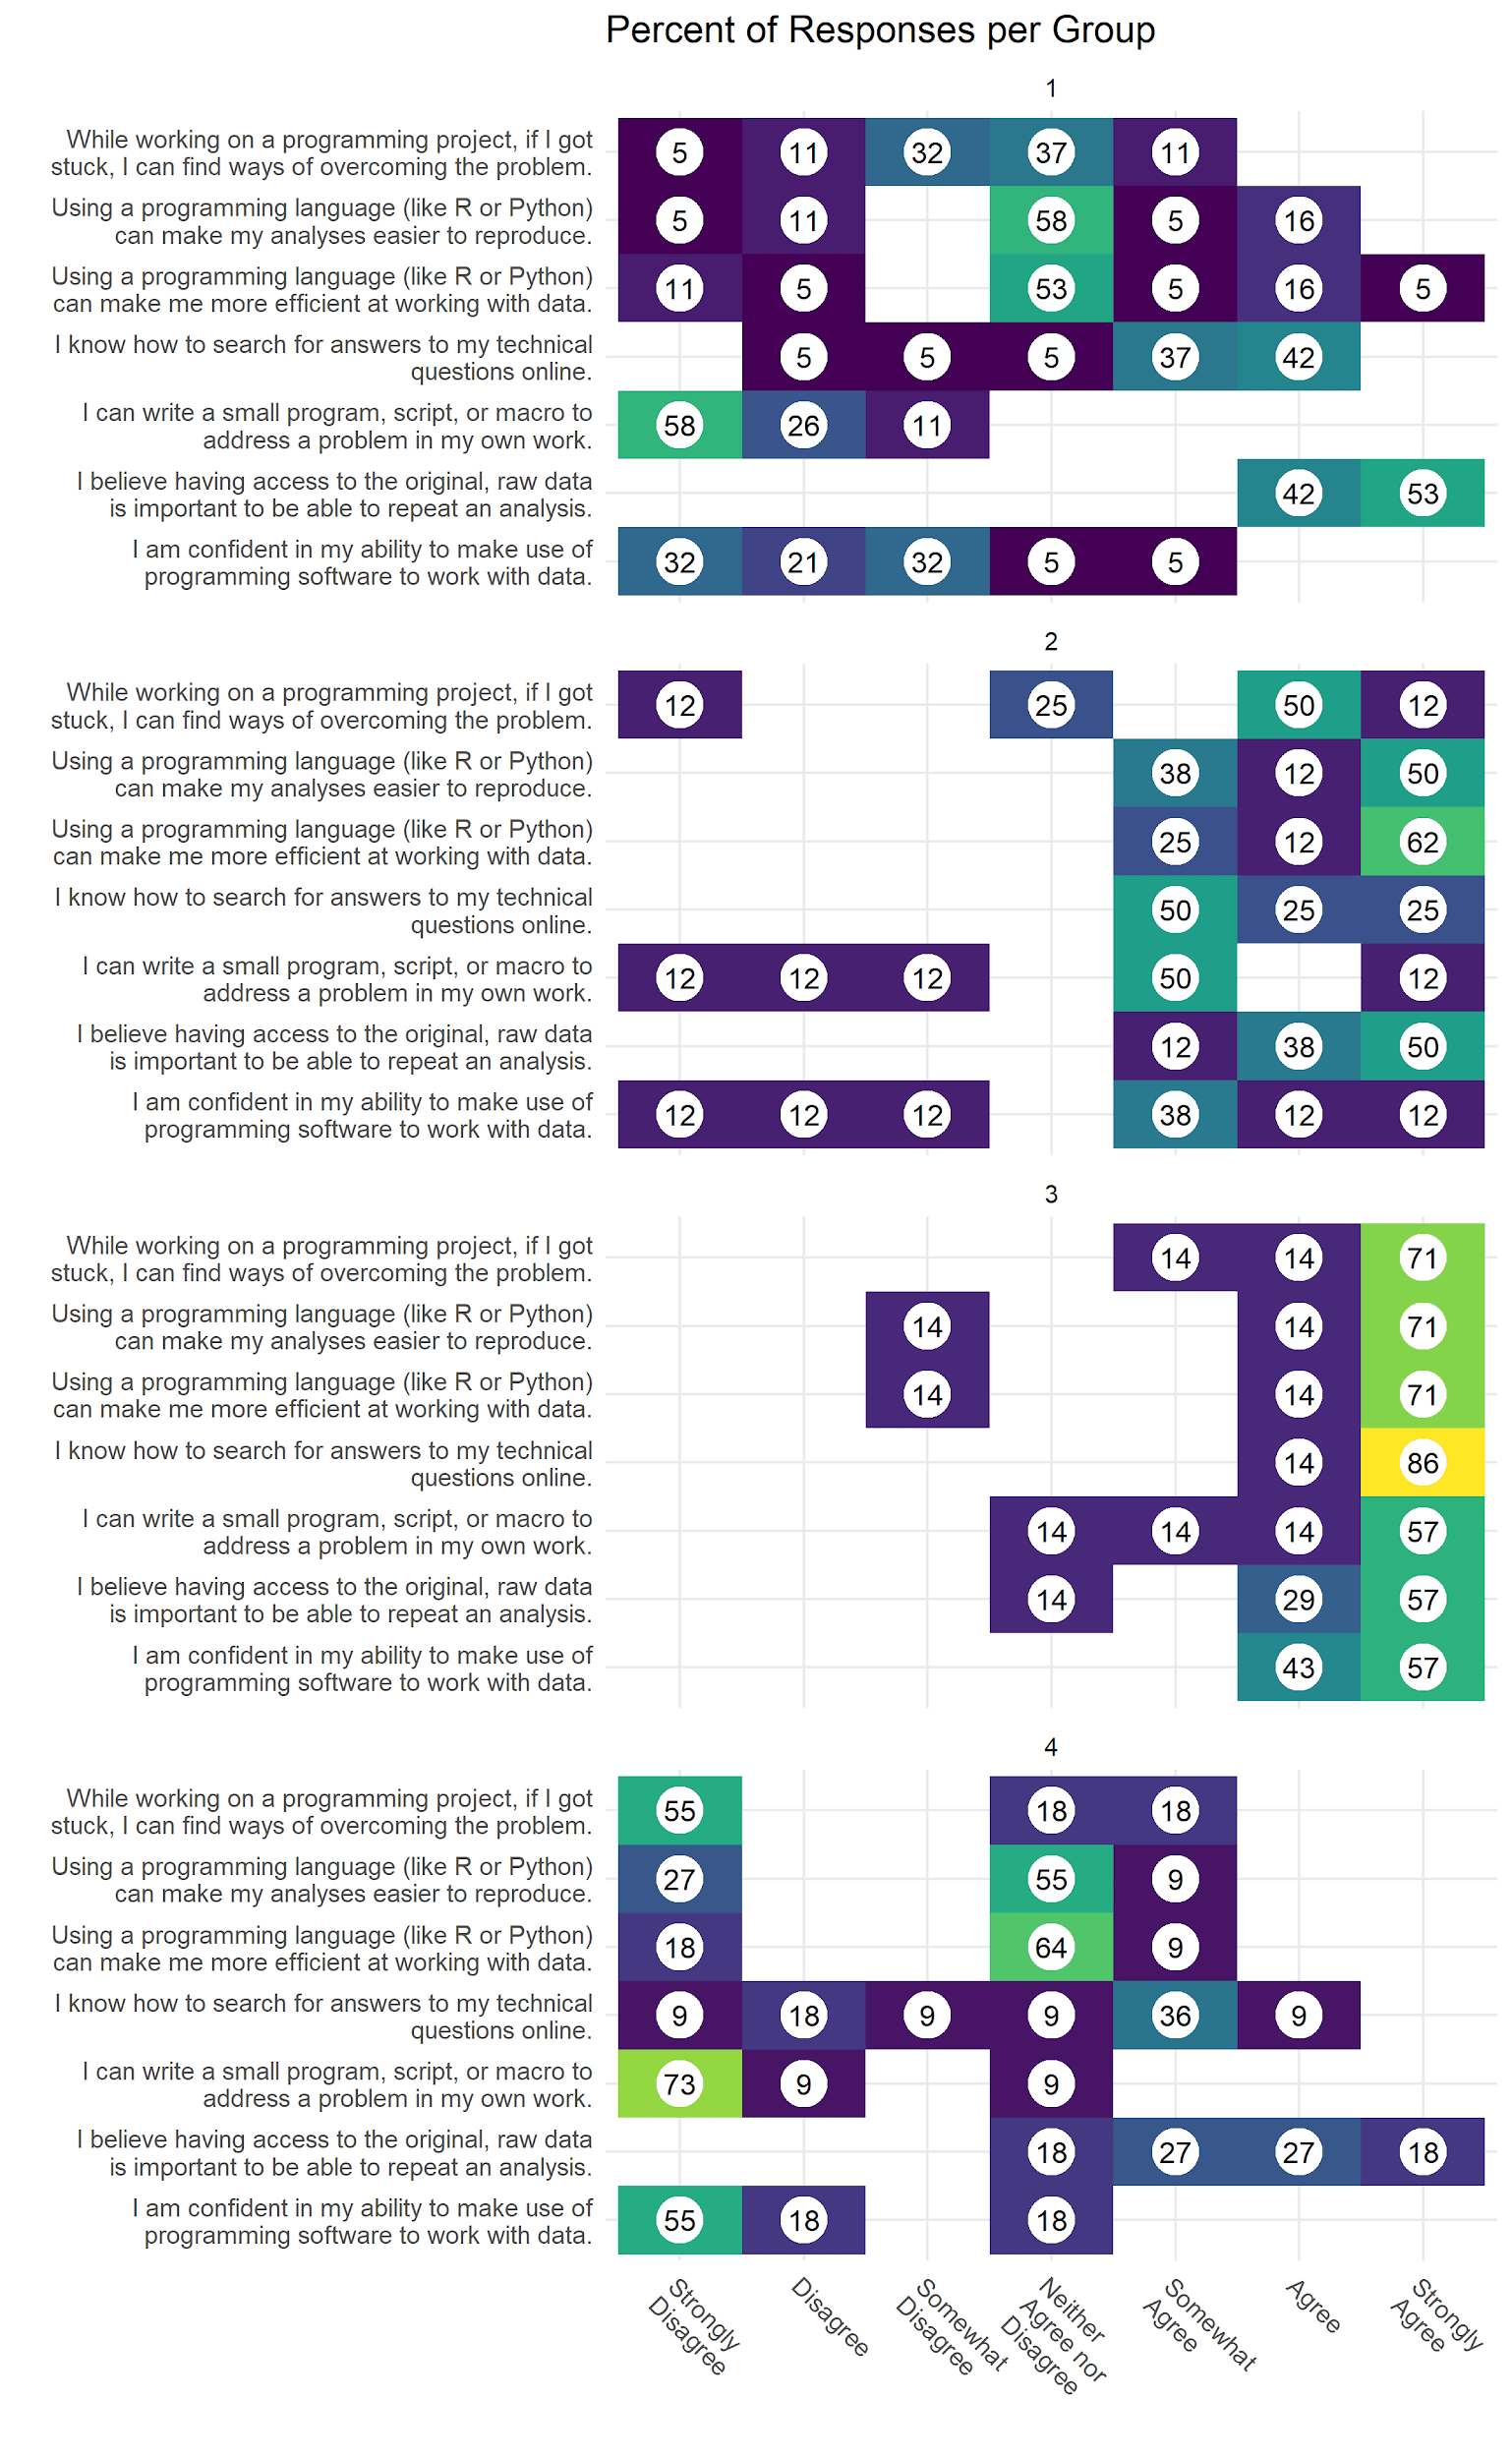

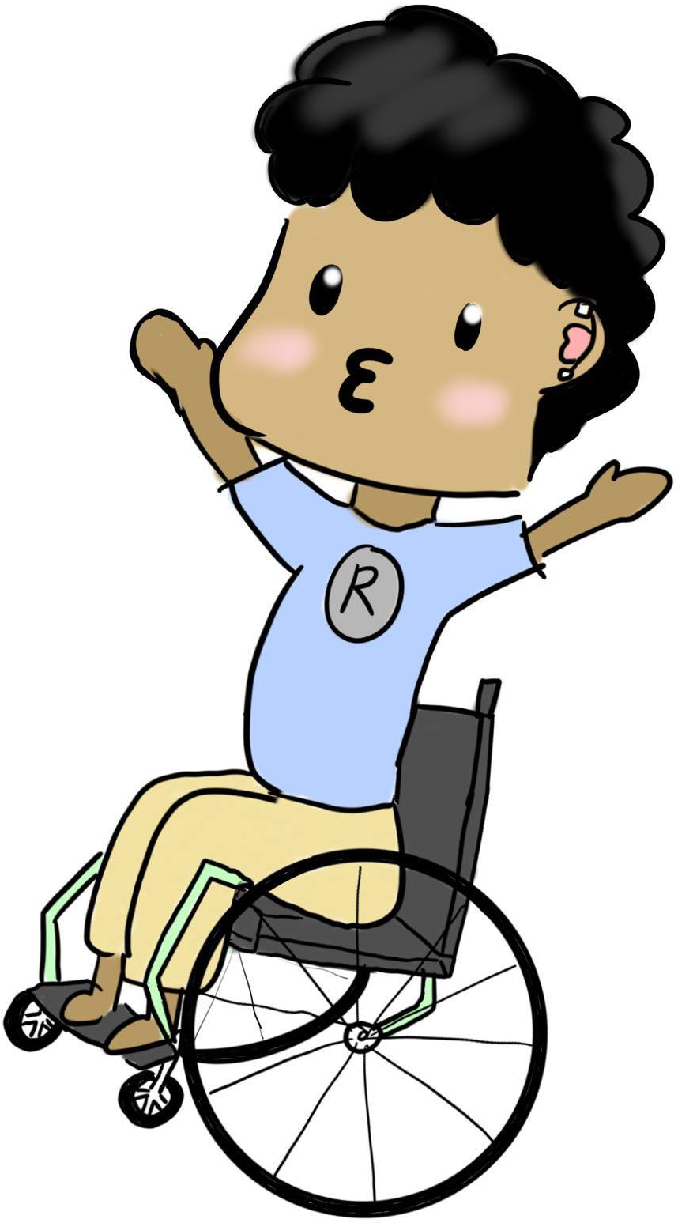

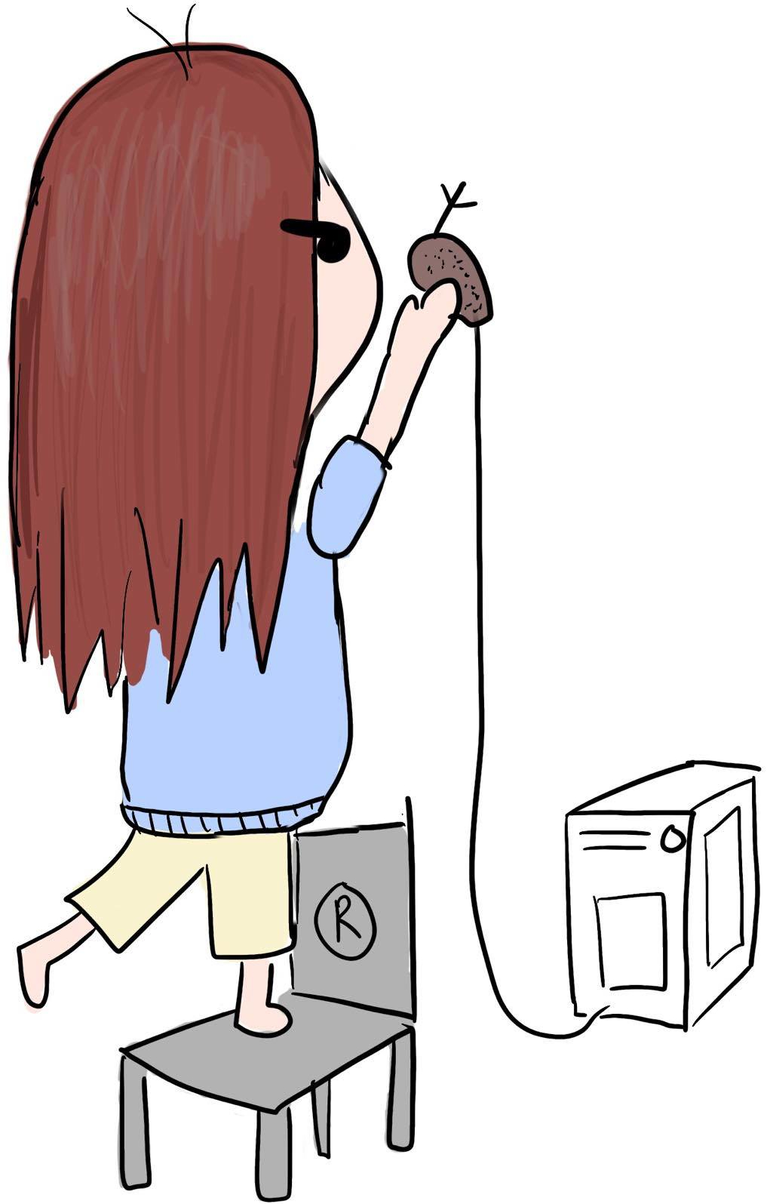
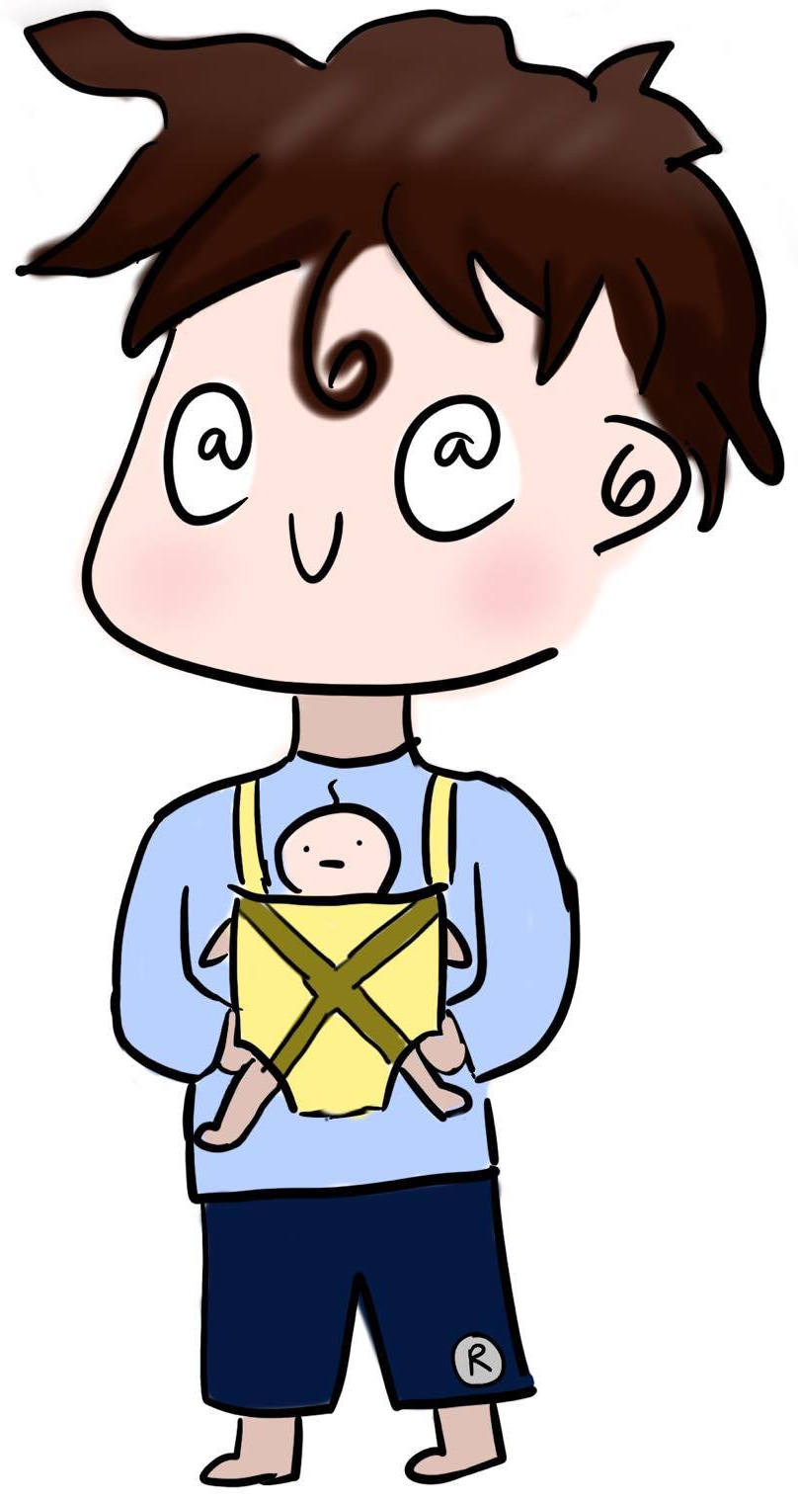
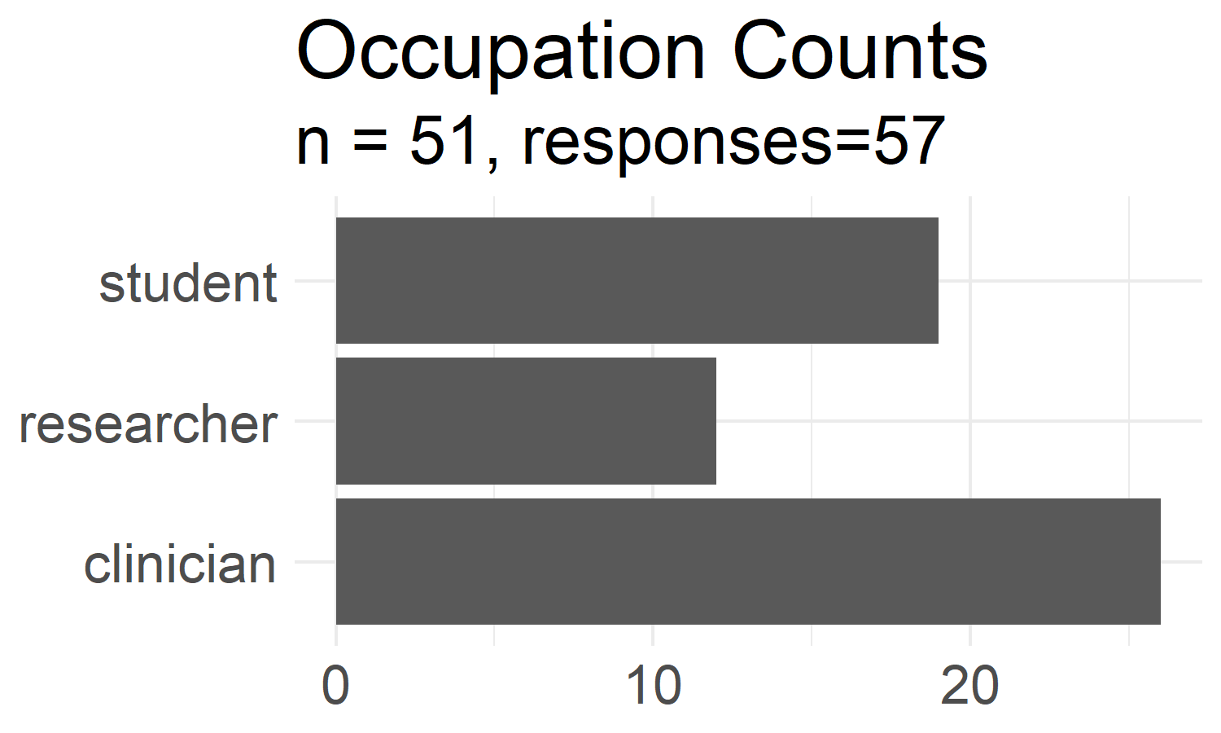
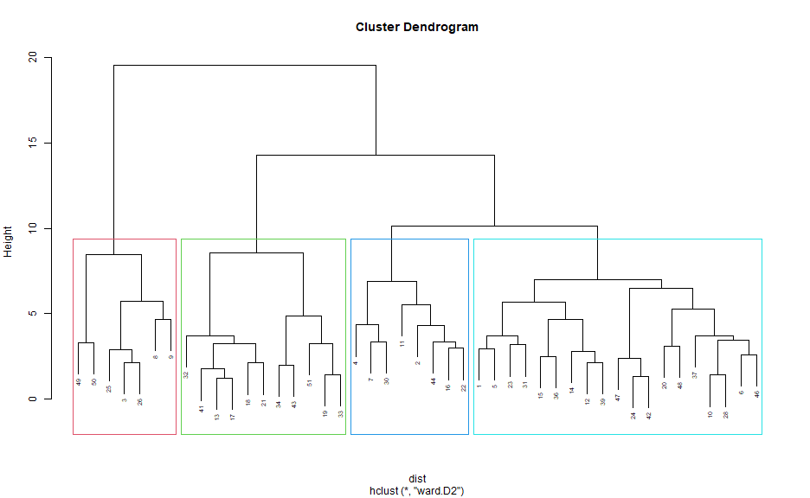



Creation of Learner Personas for a Biomedical Data Science Curriculum
Daniel Y Chen^{1,2} and Anne M. Brown^{1,2,3}
¹ Research and Informatics, University Libraries, Virginia Tech, Blacksburg, VA
² Interdisciplinary Program in Genetics, Bioinformatics, and Computational Biology (GBCB), Virginia Tech, Blacksburg, VA
³ Department of Biochemistry, Virginia Tech, Blacksburg, VA
INTRODUCTION
Personas
Results
Learner's prior knowledge and organizational structure in their mental model will affect the way they learn
We created a self-assessment survey to create learner personas to discern both current knowledge and knowledge gaps/needs
Learner personas are fictional characters that represent key characteristics of a particular learner: background, prior knowledge or experience, perception of needs, and special considerations
The accelerating changes in medical education incorporating data science competencies indicate the growing need of data science education in the biomedical sciences
A backward design approach using learner personas for creating lessons kept content creation and teaching focused and maintain alignment with the overall learning objectives
Simplified survey down to 3 questions using the highest EFA factor loading for 3 factors, one for each question domain:
Data: Do you know what "long" and "wide" data are?
Programming: How familiar are you with interactive programming languages like Python or R?
Statistics: If you were given a dataset containing an individual's smoking status (binary variable) and whether or not they have hypertension (binary variable), would you know how to conduct a statistical analysis to see if smoking has an increased relative risk or odds of hypertension? Any type of model will suffice.
Alex
Academic
Methods
These personas were used to create lesson materials to teach data science skills to people who work in the medical and biomedical sciences: https://ds4biomed.tech/
31-question learner self-assessment survey
Questions on: prior programming, statistics, and data knowledge
Hierarchical clustering using scaled euclidean distance and Ward’s clustering criterion to cluster observations
Elbow method, gap statistic, and interpretability were used to pick the number of clusters (i.e., personas)
PCA (principal component analysis) and EFA (exploratory factor analysis) using promax rotation used to validate the survey and simplify the original survey
Samir Student
Conclusion
Creation of learner personas that resonated with workshop attendees
Structured learning material creation based on learner personas will aid in information content and knowledge retention
The learner self-assessment survey and clustering methodology can be adapted to other disciplines
Patricia Programmer
Demographics and Clusters
57 respondents, 51 consented
45 responses were used for the clustering due to missing responses
References
Figure 1. Survey demographic information and clustering. Top - Counts of each occupation group. Respondents were able to select more than one occupation. Groups shown were aggregated from original choices Right - Dendrogram clusters. Left to right: programmers, clinicians, students, academics
Clare Clinician
Ambrose, Susan A, Michael W Bridges, Michele DiPietro, Marsha C Lovett, and Marie K Norman. How Learning Works: Seven Research-Based Principles for Smart Teaching. John Wiley & Sons, 2010.
Jordan, Kari, François Michonneau, and Belinda Weaver. “Analysis of Software and Data Carpentry’s Pre- and Post-Workshop Surveys.” Zenodo, July 17, 2018. https://doi.org/10.5281/zenodo.1325464.
RStudio, Education Team. “RStudio Learner Personas,” 2019. https://rstudio-education.github.io/learner-personas/.
Wilson, Greg. Teaching Tech Together: How to Make Your Lessons Work and Build a Teaching Community around Them. CRC Press, 2019.
Zagallo, Patricia, Jill McCourt, Robert Idsardi, Michelle K Smith, Mark Urban-Lurain, Tessa C Andrews, Kevin Haudek, et al. “Through the Eyes of Faculty: Using Personas as a Tool for Learner-Centered Professional Development.” CBE—Life Sciences Education 18, no. 4 (2019): ar62.
Figure 2. Responses to likert questions in the learner self-assessment survey by each cluster (i.e., persona). Colors and values show the percent of respondents in each cluster and their agreement with each statement.
Poster: https://github.com/chendaniely/dissertation-presentations
Twitter: @chendaniely @biochem_anne

