Slide 1
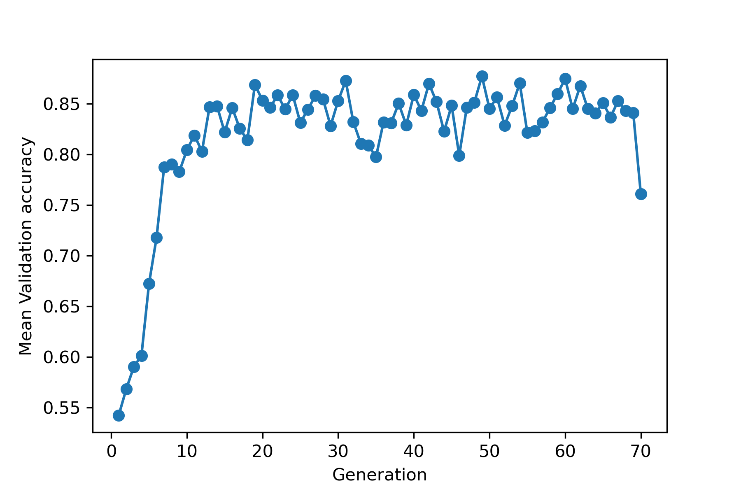
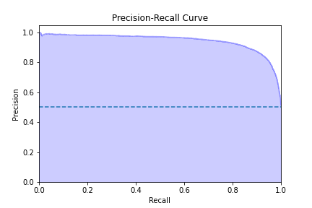
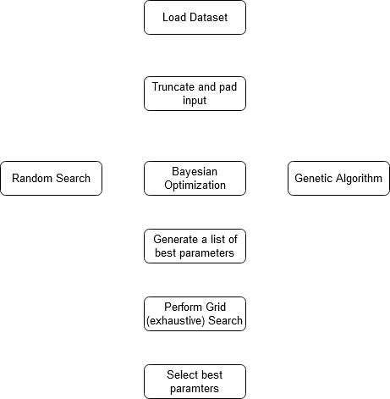
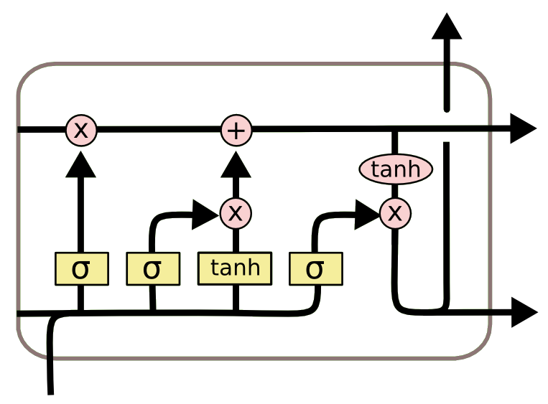
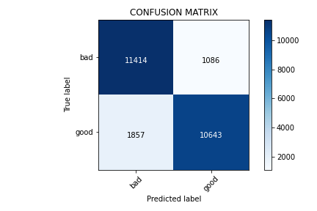
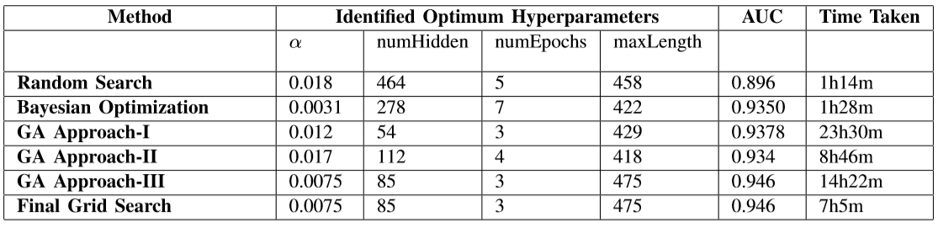


Genetic Algorithm provides best result for finding and tuning hyperparameters for an LSTM network.
Title: Hyperparameter Tuning in LSTM
Network
BACKGROUND
Dataset Used: IMDB Review dataset
HYPERPARAMETERS USED
Learning rate
Number of hidden units
Input Length
Number of Epochs
SEARCH METHODS USED
Random Search (RS)
Bayesian Optimization (BO)
Genetic Algorithm (GA)
Grid Search (GS)
RESEARCH QUESTIONS
RQ1: How do the hyperparameter tuning techniques compare with each other?
RQ2: Which set of above-mentioned hyperparameters yields the best results for LSTM?
RANDOM SEARCH
Arbitrary search in random search space.
BAYESIAN OPTIMIZATION
Guided search in random search space.
GENETIC ALGORITHM
Approach-I
From 20 pass top one, create new 19, Relatively more difference in probability between high and poor performing models.
Approach-II
From 20 pass best 10, create new 10. Relatively more difference in probability between high and poor performing models.
Approach-III
From 20 pass best 10, create new 10. Relatively more difference in probability between high and poor performing models.
GRID SEARCH
5 top models [ GA-I, GA-II. GA-III, RS, BO ]
* Figure 1 taken from
https://colah.github.io/posts/2015-08-Understanding-LSTMs/
Fig: Validation accuracy for GA approach-III by generation
Fig: Area Under Precision-Recall Curve for GA approach-III
Figure 1: Basic LSTM Cell*
Fig: Confusion Matrix for GA approach-III
RESULTS
Our approach for Genetic Algorithm yielded the best results.
The best model has:
AUC value: 0.946.
Precision: 0.90, Recall: 0.85 and F1 score: 0.88.
DISCUSSION
Different approach to hyperparameter tuning were compared with respect to time and quality of results.
Random search was the quickest whereas genetic algorithm gave the best result.
Figure 2: System Workflow
Take a picture to download the full paper
Prabesh Poudel, Prabesh Pathak, Binish Koirala, Bishal Neupane
Notes:
Notes:
In Powerpoint, click View > Guides
Keep text within gutter guides.
Author list: Don’t split names onto two lines (e.g., “Jimmy [break] Smith”). If that happens, use a new line, unless you need the space. Bold the first names of anybody who’s presenting in person.
Intro/methods/result: Do not drop below font size 28, but if you have extra space, jack up the font size until the space is full.
Do not use color in the sidebars except in graphs/figures. It’ll pull attention from the center and slow interpretation for passersby.

