Slide 1
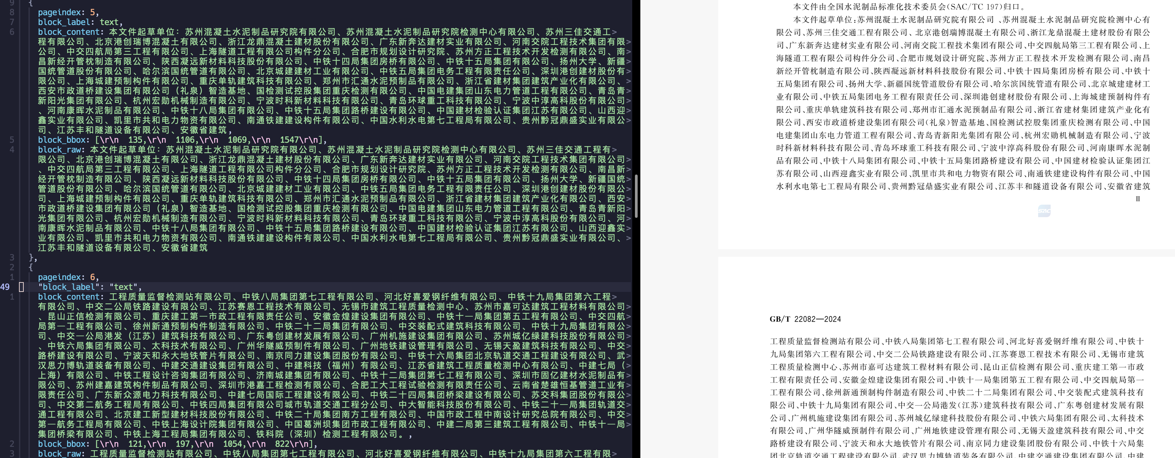

Slide 2
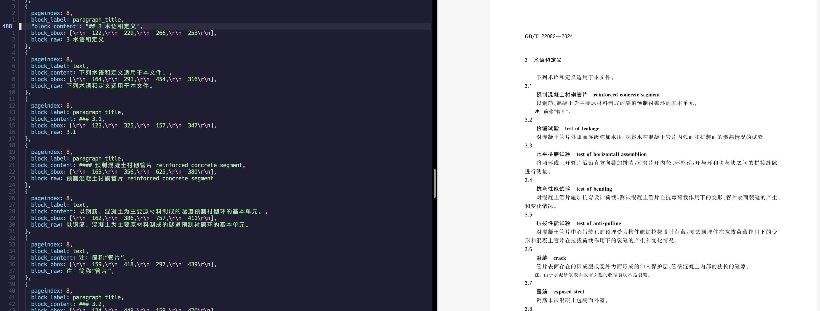
能够比较好地识别标题，但有些错误，需要个性化处理，将相邻的章节编号和标题合为一体

Slide 3
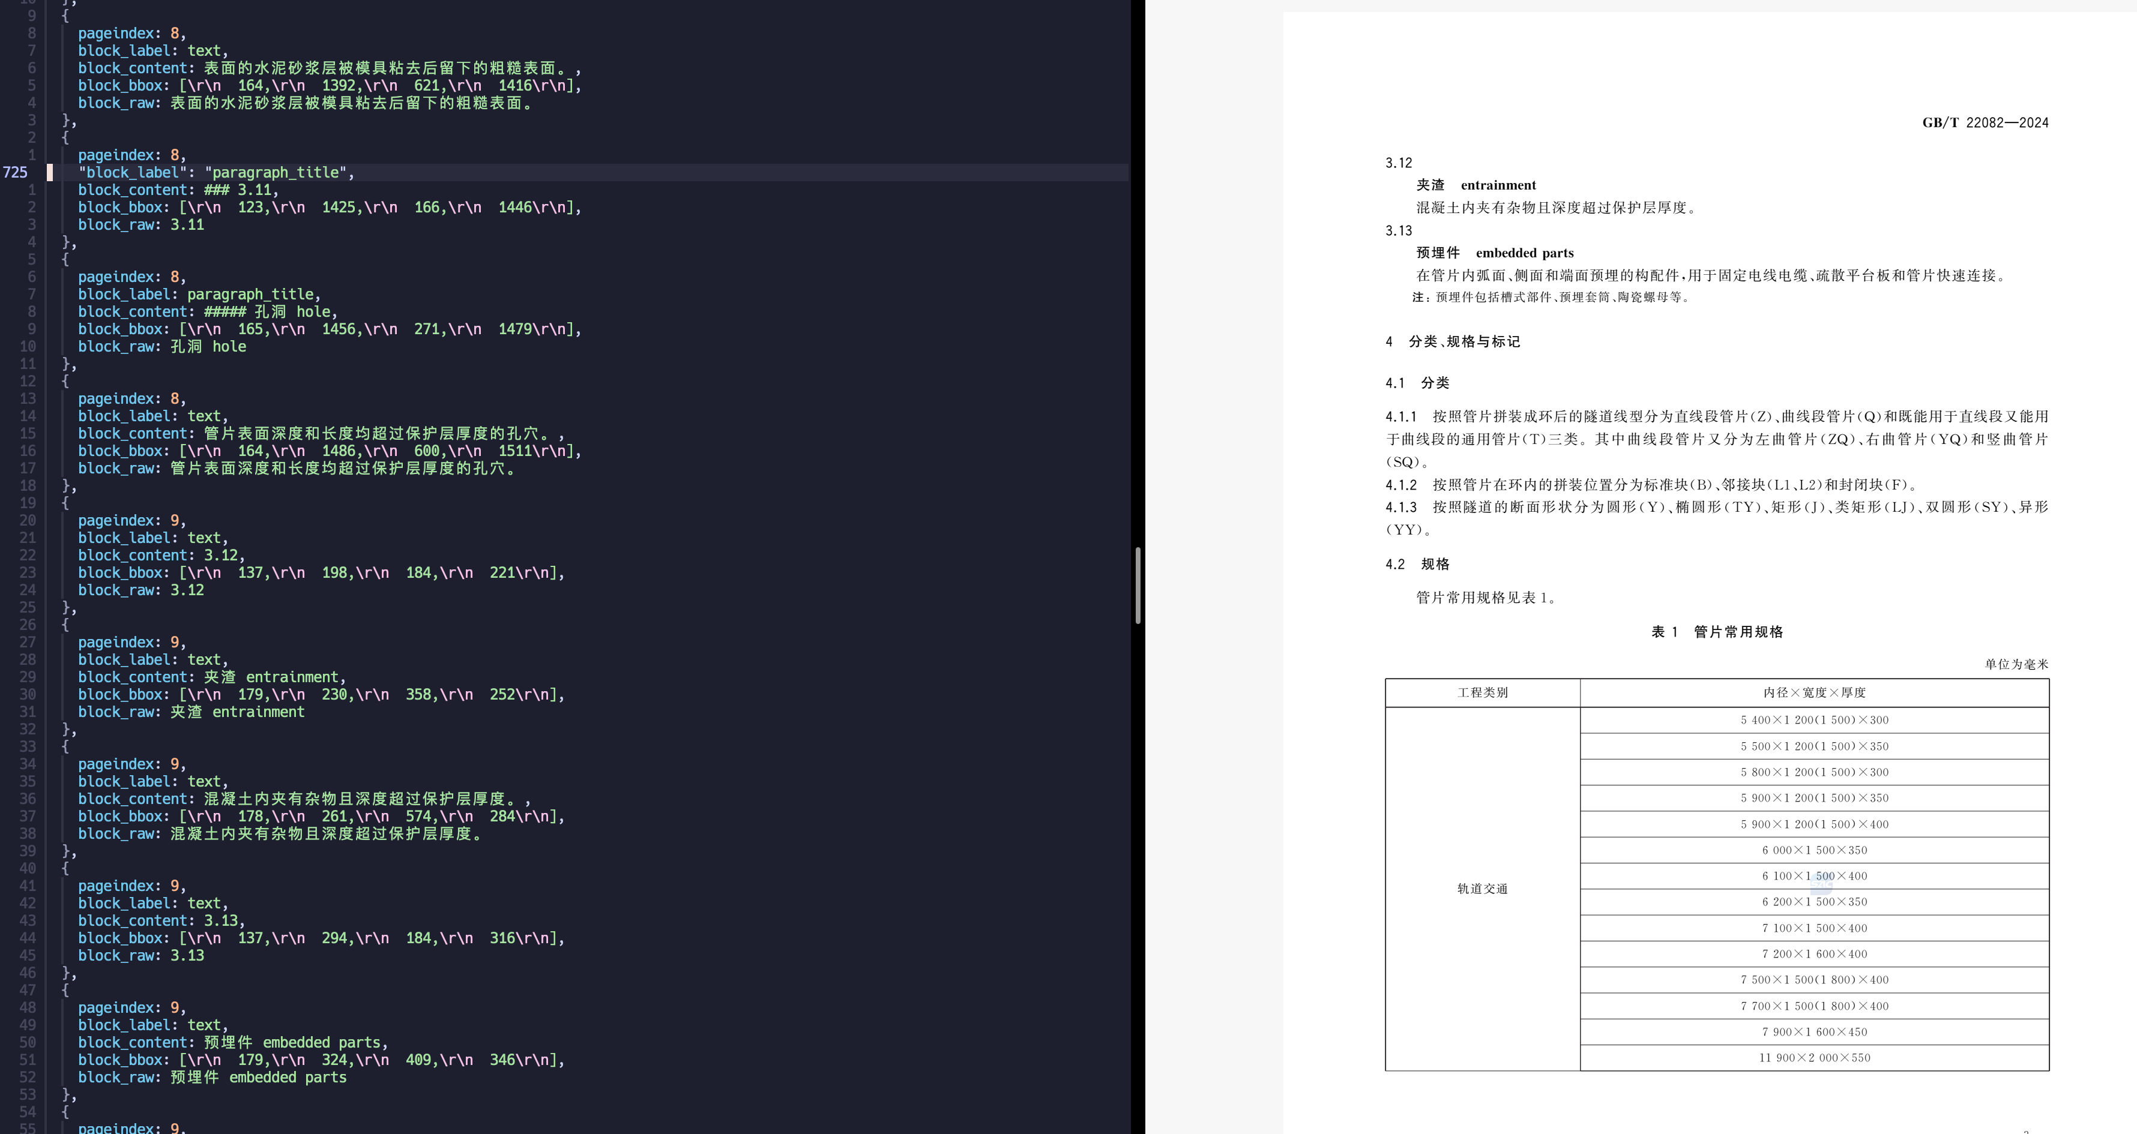
不够稳定，这一页识别标题不够理想

Slide 4
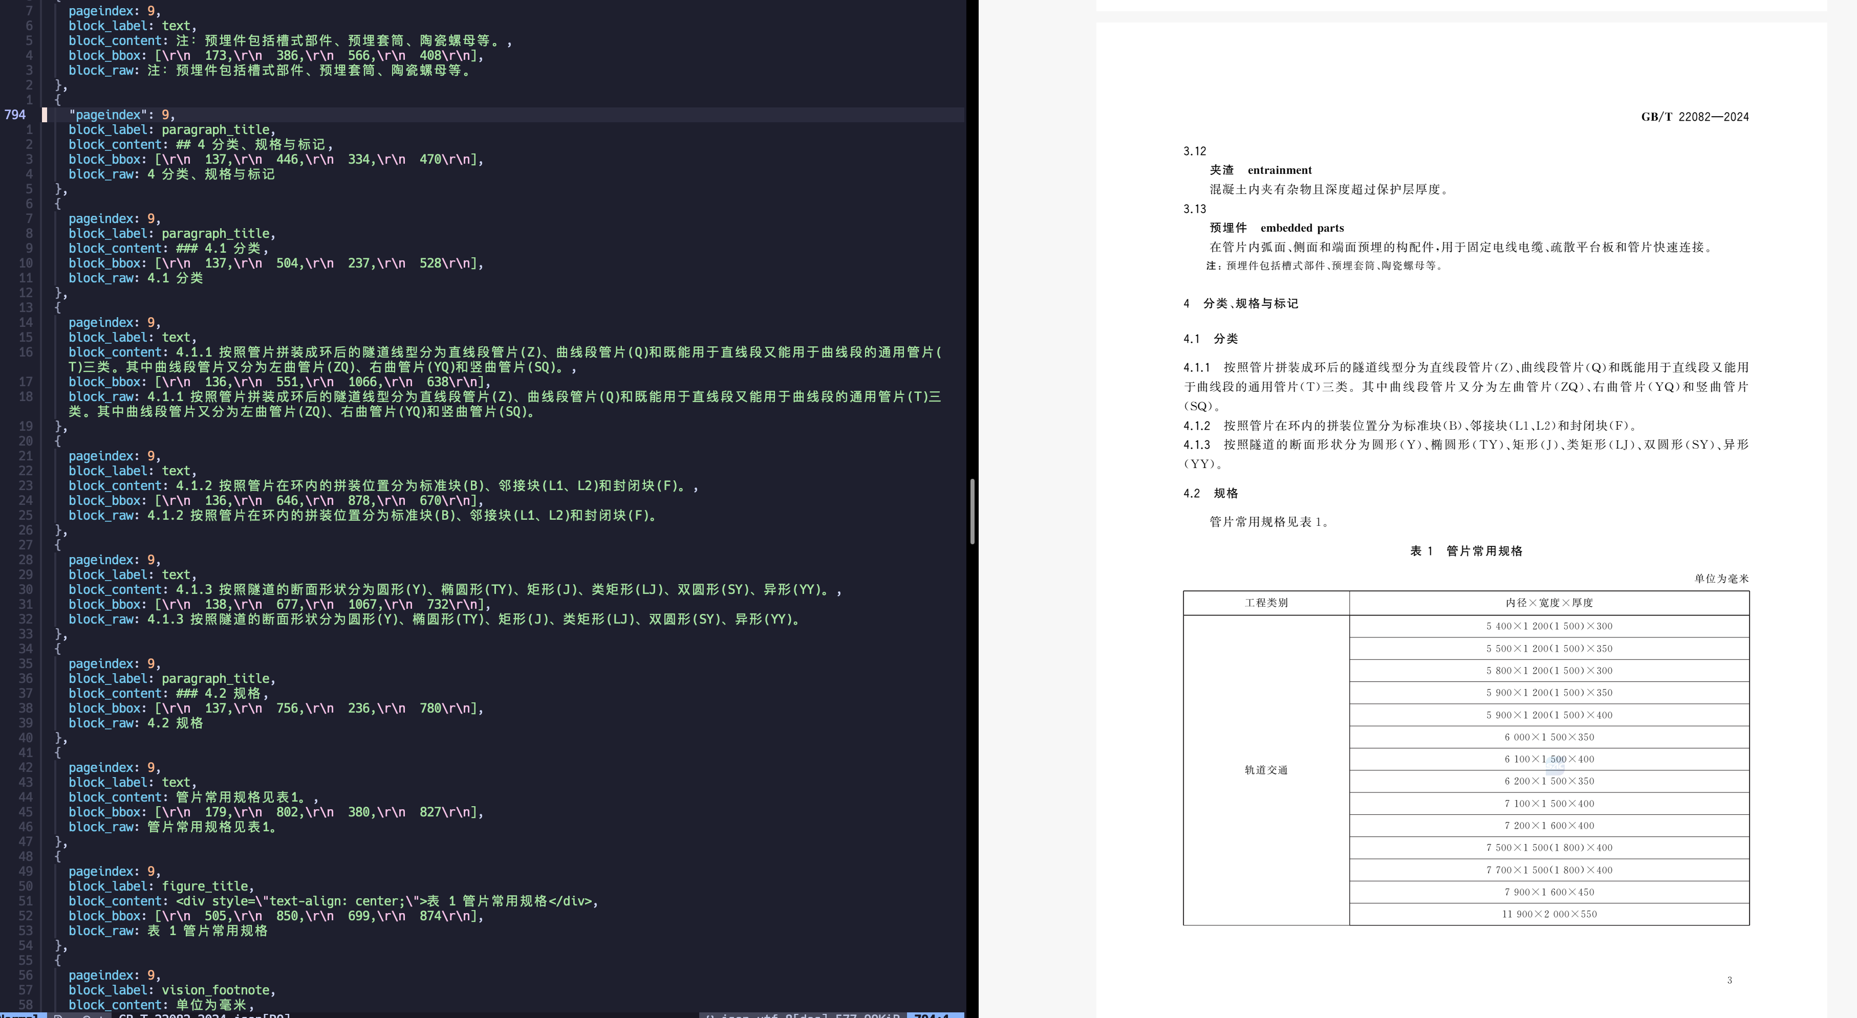
不够稳定，这一页识别标题不够理想

Slide 5
<table border=1 style='margin: auto; word-wrap: break-word;’>
<tr>
<td style='text-align: center; word-wrap: break-word;'>工程类别</td>
<td style='text-align: center; word-wrap: break-word;'>内径×宽度×厚度</td>
</tr>
<tr>
<td rowspan=\"14\">轨道交通</td>
<td style='text-align: center; word-wrap: break-word;'>5 400×1 200(1 500)×300</td>
</tr>
<tr>
<td style='text-align: center; word-wrap: break-word;'>5 500×1 200(1 500)×350</td>
</tr>
<tr>
<td style='text-align: center; word-wrap: break-word;'>5 800×1 200(1 500)×300</td>
</tr>
<tr>
<td style='text-align: center; word-wrap: break-word;'>5 900×1 200(1 500)×350</td>
</tr>
<tr>
<td style='text-align: center; word-wrap: break-word;'>5 900×1 200(1 500)×400</td>
</tr>
<tr>
<td style='text-align: center; word-wrap: break-word;'>6 000×1 500×350</td>
</tr>

Slide 6
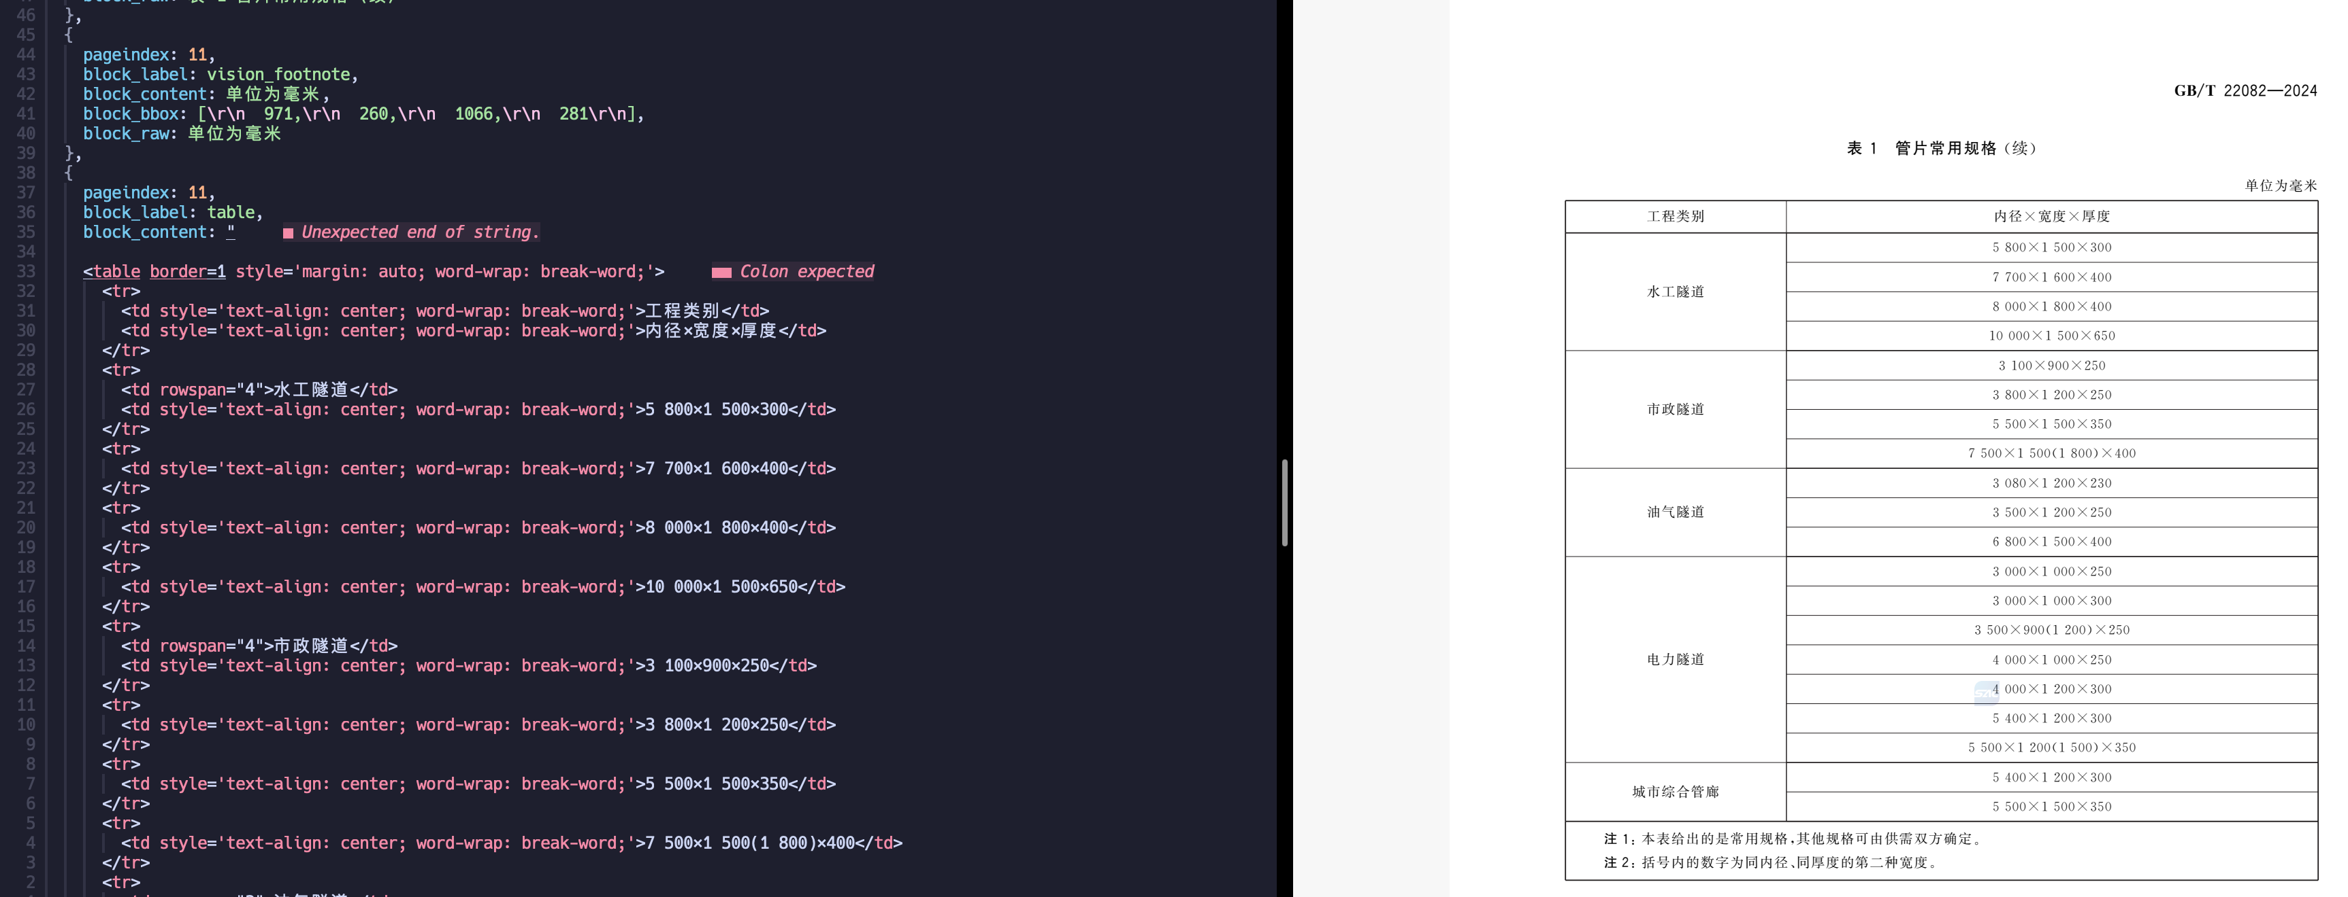

Slide 7
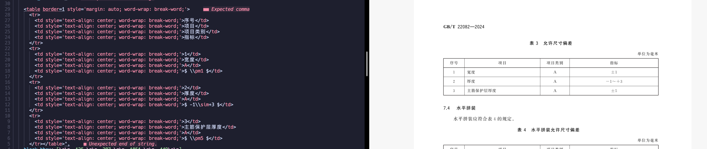

Slide 8
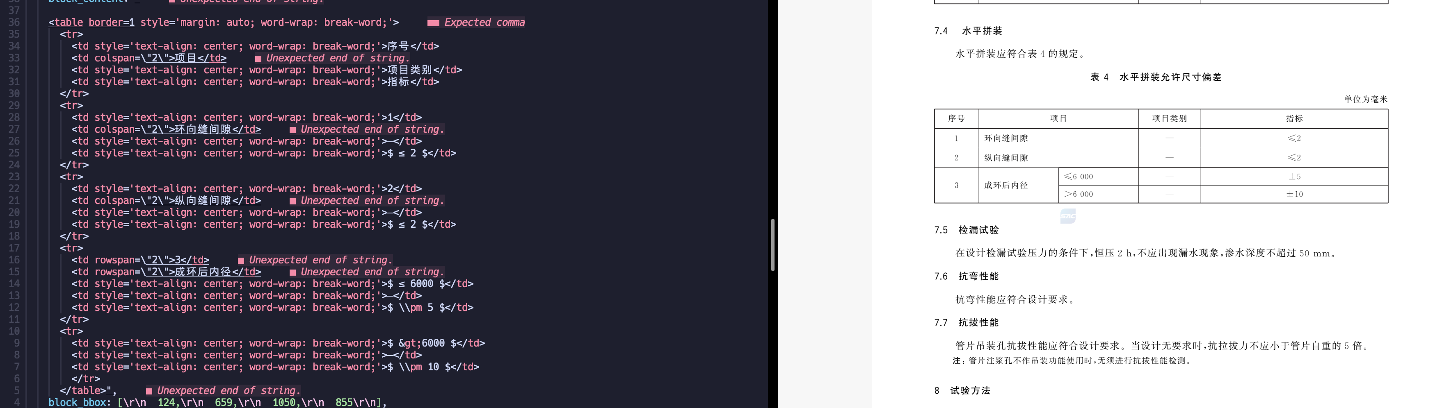

Slide 9
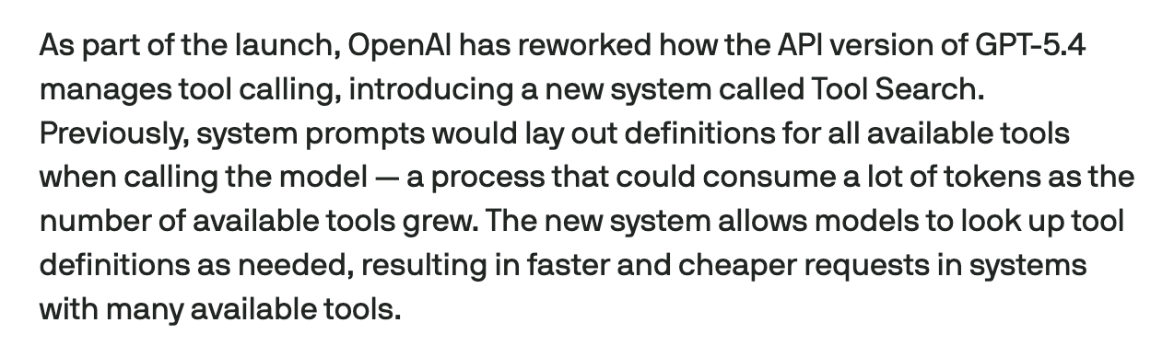
https://techcrunch.com/2026/03/05/openai-launches-gpt-5-4-with-pro-and-thinking-versions/

Slide 10


Slide 11
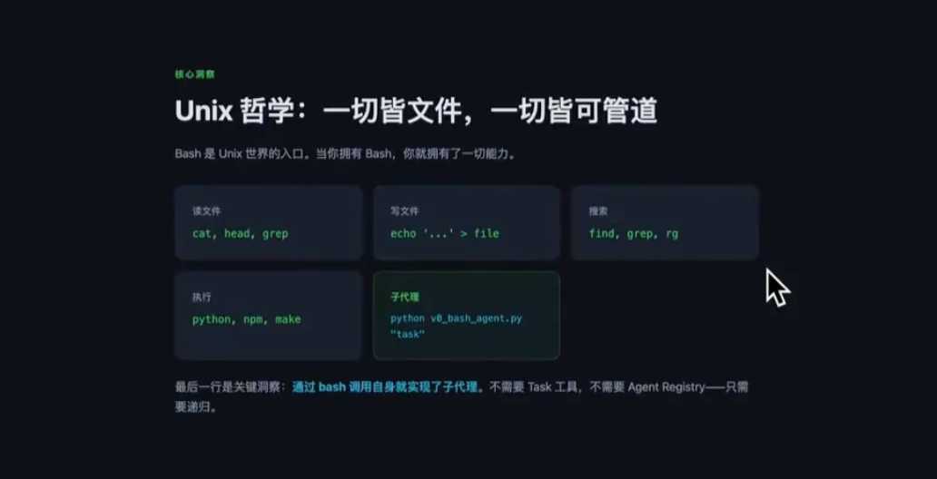

Slide 12
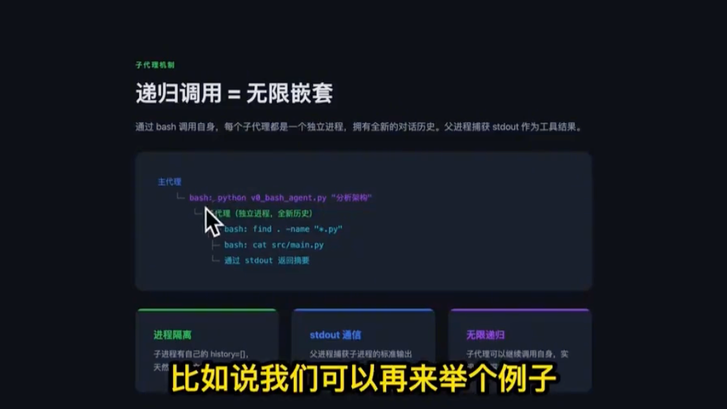

Slide 13
