Slide 1

Title Page
Cover Page
UFCFWQ-45-M
Interdisciplinary Group Project
An analysis on staff diversity in UK higher education institutions

Slide 2



Title Page
Proprietors
Team Members
Group 1
Mark
Group Leader
Akinlade
Group Secretary
Chidozie
Group moderator

Slide 3

Title Page
Proprietors
Introduction
Overview and Objective
Objectives
The rationale behind this research is to investigate staff diversity in the United Kingdom and its status quo implementing python and Tableau to draw hidden insights and patterns.
Diversity characteristics which includes ethnicity, disability age group and Gender will be considered to analyze their employment discrimination.

Slide 4
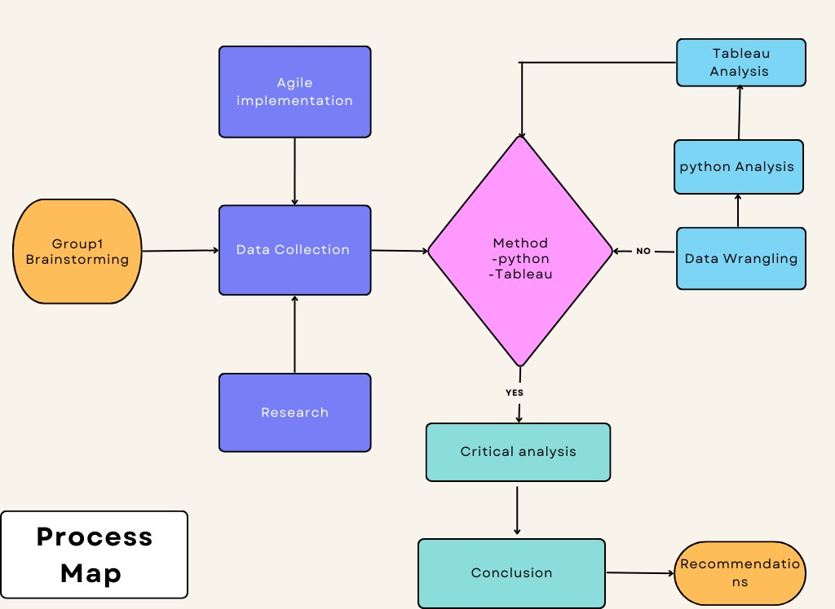
Title Page
Proprietors
Introduction
Process Map

Slide 5
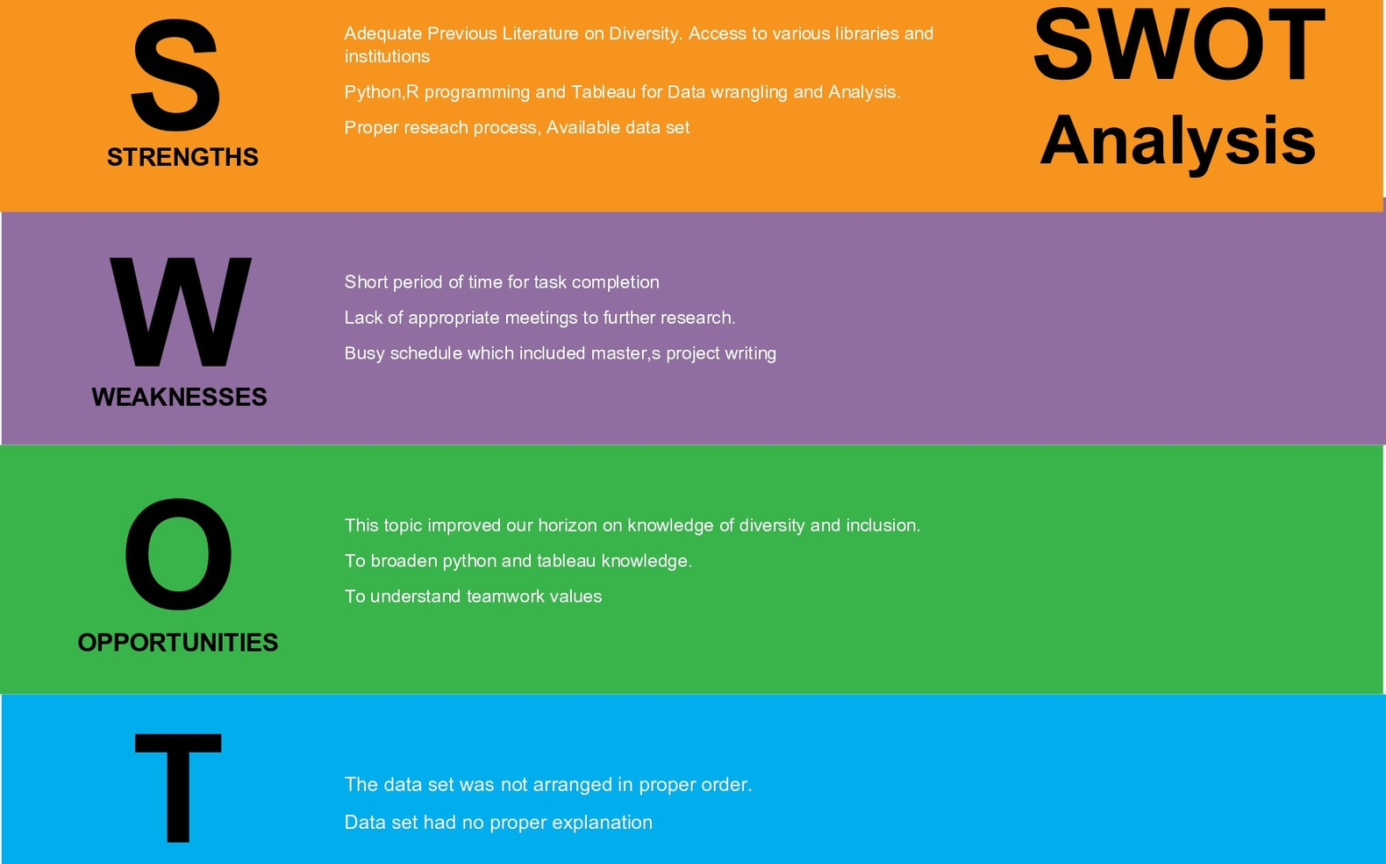
Title Page
Proprietors
Introduction
Swot analysis

Slide 6

Title Page
Proprietors
Introduction
Review of Literature
Methodology
Results
Conclusion
word cloud

Slide 7
Title Page
Proprietors
Introduction
Insert your topic here
Introduction
General Overview
Equality and diversity is a term used in the United Kingdom to define and champion equality, diversity and human rights as defining values of society. It promotes equality of opportunity for all, giving every individual the chance to achieve their potential, free from prejudice and discrimination. UK legislation requires public authorities to promote equality in everything that they do, also making sure that other organisations meet their legal duties to promote equality while also doing so themselves.

Slide 8

Title Page
Proprietors
Introduction
Background
History
In the UK under the Equality Act 2010 there are certain legal requirements under existing legislation to promote equality in the areas of nine protected characteristics. These are often collectively referred to as the general duties to promote equality.
As the independent advocate for equality and human rights in Britain, a Commission of Equality and Human Rights (EHRC) exists that aims to reduce inequality, eliminate discrimination, strengthen good relations between people and promote and protect human rights. EHRC has a duty to challenge prejudice and disadvantage and promote the importance of human rights, enforcing equality laws on age, disability, gender, gender reassignment, race, religion or belief and sexual orientation and encourage compliance with the Human Rights Act.

Slide 9
Title Page
Proprietors
Introduction
Review of Literature
Review of Literature
Review of Literature
The First Source
“Figures published by the Higher Education Statistics Agency record represents that black academics in elect staff classification of managers, directors, and senior officials are not present in 2015-2016 the third year subsequently this has occurred. 535 senior officials who declared their ethnicity and the white race claimed a lion share of 510, Asian recorded 15 in total and the remainder was 10 which was ‘other including mixed’.
A recorded number of 30 senior academics failed to record an ethnicity” (Richard Adams, 2017).

Slide 10
Title Page
Proprietors
Introduction
Review of Literature
Review of Literature
The Second Source
In recent times, observations have shown that the workforce of UK Higher Education has increasingly become diverse. From 2003 to 2020, the proportion of white staff has decreased from 91.4% to 84.6%, and the proportion of staff members from Black, Asian, and minority ethnic groups increased from 8.6% to 15.4%.(Richard Adams, 2017).

Slide 11
Title Page
Proprietors
Introduction
Review of Literature
Review of Literature
The Third Source
In the aspect of gender diversity, the increasing number of young women in the upper echelons of higher education in the United Kingdom has significantly increased. “Leaders in Higher Education 2016, benchmarks changes taking place in women’s representation in leadership roles in Higher Education Institutions (HEIs) in the UK.
The overall direction of change is positive but men still overwhelmingly dominate Chair and Vice Chancellor roles and are the vast majority of executives and academic heads” (Women count, 2016).
“The HESA Staff record changed in 2012/13 so that earlier definitions of Professor are not strictly comparable with recent data. However, in 2003/2004 only 15% of academic staff graded 'Professor' were female, and the trend shows this proportion increasing slowly over time” (HESA, 2015).

Slide 12
Title Page
Proprietors
Introduction
Review of Literature
Review of Literature
The Fourth Source
From the survey carried out, the response reflects insecurity across the sector as the respondents represented a range of academic and professional services positions in the institutions sampled: 28% Professional services, 10% Professors, 18% Senior Lecturers, 19% Lecturers, 14% Post-Doctoral or Research Fellows, and 10% Ph.D. Students.
30% agree with the statement ‘I might lose my job in the next 6 months, and 67% disagree with the statement ‘If I were to lose or quit my current job, it would be easy for me to find a job of similar salary’, ‘77 % of respondents have thought about leaving HE’, ‘29% say promotion criteria affect LGBT+ people negatively’, ‘57% have been promoted in their current workplace, however, more Lesbian and Gay respondents have been promoted than those who identify as Bisexual and those identifying their sexual orientation as other’ ( Trude Sundberg, 2021).

Slide 13

Title Page
Proprietors
Introduction
Review of Literature
Methodology
Insert your topic here
Quantitative Methodology
Data Pre
Data Analysis
Data collection
Processing
Implemented python Matplotlib and seaborn libraries for visualization and further visualizations implementing Tableau.
Data set was downloaded from HESA official website.
implemented Python for data wrangling.
Made use of pandsa and lumpy Libraries.

Slide 14

Title Page
Proprietors
Introduction
Review of Literature
Methodology
Insert your topic here
Data set Summary
The data sets which were csv files were downloaded from HESA website(https://www.hesa.ac.uk/data-and-analysis/staff/working-in-he/characteristics) and contains 4 data sets namely table-2.csv, table-27.csv, table-3.csv and table-4.csv.
Table-2 represents HE staff by HE provider and personal characteristics containing 7 different data sets showing different academic calendar year ranging from 2014/2015 to 2020/2021.
The table-2 consists of the HE provider column which gives detailed information institution name, country and region of HE provider. The contract marker column represents the academic or non- academic staff.
Each csv file is made up of 551,195 rows by 12 columns. The Category marker column is a mixture of ethnicity, age group, disability and sex.

Slide 15
Title Page
Proprietors
Introduction
Review of Literature
Methodology
Links to Code
Links to Code
Python code
https://gitlab.uwe.ac.uk/c2-uchendu/igp_data-files
Tableau public analysis
https://public.tableau.com/app/profile/mark.uchendu/viz/StaffdiversityinUk institutions-/Dashboard1

Slide 16

Title Page
Proprietors
Introduction
Review of Literature
Methodology
Results
Gender Diversity
Project Findings. Gender Diversity
Gender
More women are employed than men and are not underrepresented in the overall number of employed but are a bit underrepresented in senior roles.
They are well represented in permanent roles, fixed term roles and contract roles.
They are well represented in administrative and professional roles but are underrepresented in process, plant and machine operatives’ roles.
They hold more teaching than research roles and there is an increase trend in number of employed over the academic years.
Employment for the bisexuals was introduced in 2017/2018 and the trend shows an increasing pattern over the years. The race for majority of bisexuals are whites and mixed race and their national marker shows UK nationals have highest bisexuals.
They hold more teaching and academic roles, are more in full time employment, hold permanent professors and other senior academic roles.

Slide 17
Title Page
Proprietors
Introduction
Review of Literature
Methodology
Results
Ethnicity Diversion
Ethnicity Diversion
Black or Black British race has an increasing pattern on number of employed from 2014/15 to 2020/2021
consisting of Black males outnumbering Black Females.
They have more academic contracts and most of them are in professional occupations.
Whites has the highest employment in all ramifications.
More males are employed in the research department. There are 880 professors and 147,520 number of
employed. Less than 1% are professors or hold senior academic roles.
They are majorly hold contract roles The whites are the most employed and are employed more in senior roles and full-time employments followed by
Not Known Ethnicity which justifies a combination of unknown races.
The Chinese are next to the white and hold full time roles and are more employed than their Asian race.

Slide 18

Title Page
Proprietors
Introduction
Review of Literature
Methodology
Results
Disability Diversion
Dissability Diversion
People with Known disability are underrepresented in the employment numbers in general and No known Disability was employed far more than known disability. This stems from so many factors such as disability type and population of disable people as compared to people without disability. More than 70% of disabled people were offered permanent roles in almost an even spread of academic and non-
academic levels

Slide 19

Title Page
Proprietors
Introduction
Review of Literature
Methodology
Results
Age group
Age group
Permanent roles were offered more than contract roles which is a plus. 46-50 were the highest in number employed on permanent basis. The difference in Terms of employment distributed almost equally which is a plus.
Same amount of male and female professors, non-academic contracts and another senior academic contract.
66 and Over has the highest professors’ roles.
Professional occupations had the highest number of employed. Males had a higher number of employed in academic contract and Females had a higher number in Non-academic contracts.

Slide 20

Title Page
Proprietors
Introduction
Review of Literature
Methodology
Results
Conclusion
Insert your topic here
Recommendation
Detailed explanation should be given to each table of the diversity characteristics.
Definitions between definitions and variables within the diversity characteristics will endure effective data collection which will yield better results.
Further exploration on diversity of university graduates should be considered.
More employment allocations should be given to disabled people because there is a gap in the margin.
46-50 Age group had the highest margin in permanent roles and permanent should be offered more to younger people of 31-35 and 36-40 as they account for highest in number of employed.

Slide 21
Title Page
Proprietors
Introduction
Review of Literature
Methodology
Results
Conclusion
Recommendations
More employment allocation of Professor roles and other senior academic roles should be given to the younger age-group as they account for 0.3% of the total number of professors and 0.69% of other senior academic roles. More females should be considered for other senior roles and professor too.
Other Ethnicity should be allocated more senior academic and professor roles too as they are well underrepresented in this role.
Males should be considered for managerial roles to bridge the gap and females should be considered for the process, plant and machinery category.
More allocation should be given to people from other ethnic backgrounds as whites has majority of the employment.

Slide 22
Title Page
Proprietors
Introduction
Review of Literature
Methodology
Results
Conclusion
Recommendations
More employment allocation of Professor roles and other senior academic roles should be given to the younger age- group as they account for 0.3% of the total number of professors and 0.69% of other senior academic roles. More females should be considered for other senior roles and professor too.
Other Ethnicity should be allocated more senior academic and professor roles too as they are well underrepresented in this role.
Males should be considered for managerial roles to bridge the gap and females should be considered for the process, plant and machinery category.
More allocation should be given to people from other ethnic backgrounds as whites has majority of the employment.
The research departments have more males and More females should be encouraged to join the research departments
Further exploration on other diversity characteristics such as Gender reassignment, Marriage and civil partnership, Religion or Belief, Sexual orientation can be included in data collection for further data analysis and to enhance accuracy of results.

Slide 23

Title Page
Proprietors
Introduction
Review of Literature
Methodology
Results
Conclusion
References
Insert your topic here
References
Richard, A. (2017) Higher Education: British universities employ no black academics in top roles, figures show
The Guardian [online] 19 January. Available from: British universities employ no black academics in top roles, figures show | Higher education
| The Guardian [Accessed 4 July 2022].
Women count(2016) WOMEN COUNT: LEADERS IN HIGHER EDUCATION 2016
WomenCount[online] 10 January. Available from: WomenCount: Leaders in Higher Education 2016 (women-count.org)[Accessed 4 July 2022].
Advanced HE (2017) Disabled staff: Addressing barriers to career development and progression threat disabled staff with impairment.
Advanced HE [online] 19 January. Available from Disabled staff | Advance HE (advance-he.ac.uk) [Accessed 8 July 2022].
Khan, M.S., Lakha, F., Tan, M.M.J., Singh, S.R., Quek, R.Y.C., Han, E., Tan, S.M., Haldane, V., Gea-Sánchez, M. and Legido-Quigley, H. (2019). More talk than action: gender and ethnic diversity in leading public health universities. The Lancet, [online] 393(10171), pp.594–600. doi:10.1016/s0140-6736(18)32609-6.
Trude S.(2021) LGBT-HE: Challenging LGBTQ+ Exclusion in Higher Education
LGBT-HE[online] 4 May. Available from: Challenging LGBT+ exclusion in UK Higher Education - LGBT-HE (lgbt-highered.co.uk) [Accessed 4 July 2022].

