Slide 1
UseR STORIES

Slide 2




User STORIES summary
User Stories
Definition
Structure
Key Characteristics
Acceptance Criteria
Epics
Documentation
Creation Process
Let’s Get Practical (Exercise)
Now It’s Your Turn
Student Exercise

Slide 3
What is a user story?
A one or two sentence description, written from the viewpoint of the actor, describing what function is needed.
Describes an activity the user should be able to do.

Slide 4
What is a user story?
A one or two sentence description, written from the viewpoint of the actor, describing what function is needed.
Describes an activity the user should be able to do.
As a customer, I want to be able to purchase Udemy courses with a credit card, so it is convenient.

Slide 5
What is a user story?
A one or two sentence description, written from the viewpoint of the actor, describing what function is needed.
Describes an activity the user should be able to do.
As a customer, I want to be able to purchase Udemy courses with a credit card, so it is convenient.
As a sales manager, I should be able to run reports at anytime, so I can make adjustments to improve our sales numbers.

Slide 6
User story structure
As an <actor>,
I want to be able to <function>,
so that I can <business reason>
As an <actor>,
I should be able to <function>,
so that I can <business reason>
1
2

Slide 7
User story structure
As an <actor>,
I want to be able to <function>,
so that I can <business reason>
As a customer, I want to be able to purchase Udemy courses with a credit card, so that I can purchase courses conveniently.
As a sales manager,
I should be able to run reports at anytime,
so that I can make adjustments to improve our sales numbers.
As an <actor>,
I should be able to <function>,
so that I can <business reason>

Slide 8
Keys to a good user story
I N V E S T

Slide 9
Keys to a good user story
I N V E S T
: Independent - each story should stand alone : Negotiable - keep the stories nimble until just before implementation : Valuable - define features and function that provide value to the business : Estimatable – clear enough to enable a validate estimate : Small – small enough to be implemented in a single iteration : Testable – independently verifiable

Slide 10
Other User story examples
As a sales rep, I should be able to search for my customers by first and last name, so that I can access their details.
As a truck driver, I want to be able to have turn-by-turn navigation in my cab, so that I can get directions to my destination.
As a customer, I want to be able to reset my password via the internet, so that I can reset it without having call into the customer service line.
As a Human Resources professional, I want to be able to attach digital resumes to candidate profiles, so that I can access those resumes conveniently.

Slide 11
Other User story examples
As a sales rep, I should be able to search for my customers by first and last name, so that I can access their details.
As a truck driver, I want to be able to have turn-by-turn navigation in my cab, so that I can get directions to my destination.
As a customer, I want to be able to reset my password via the internet, so that I can reset it without having call into the customer service line.
As a Human Resources professional, I want to be able to attach digital resumes to candidate profiles, so that I can access those resumes conveniently.

Slide 12
Other User story examples
As a sales rep, I should be able to search for my customers by first and last name, so that I can access their details.
As a truck driver, I want to be able to have turn-by-turn navigation in my cab, so that I can get directions to my destination.
As a customer, I want to be able to reset my password via the internet, so that I can reset it without having call into the customer service line.
As a Human Resources professional, I want to be able to attach digital resumes to candidate profiles, so that I can access those resumes conveniently.

Slide 13
Other User story examples
As a sales rep, I should be able to search for my customers by first and last name, so that I can access their details.
As a truck driver, I want to be able to have turn-by-turn navigation in my cab, so that I can get directions to my destination.
As a customer, I want to be able to reset my password via the internet, so that I can reset it without having call into the customer service line.
As a Human Resources professional, I want to be able to attach digital resumes to candidate profiles, so that I can access those resumes conveniently.

Slide 14
Other User story examples
As a sales rep, I should be able to search for my customers by first and last name, so that I can access their details.
As a truck driver, I want to be able to have turn-by-turn navigation in my cab, so that I can get directions to my destination.
As a customer, I want to be able to reset my password via the internet, so that I can reset it without having call into the customer service line.
As a Human Resources professional, I want to be able to attach digital resumes to candidate profiles, so that I can access those resumes conveniently.

Slide 15
Acceptance Criteria
Provides details on what the solution needs to accomplish
Describes how the user story can be verified to be complete
User Story
Acceptance Criteria
Acceptance Criteria
Acceptance Criteria

Slide 16
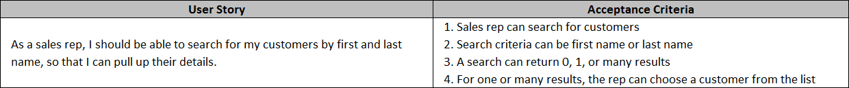
Acceptance Criteria
Provides details on what the solution needs to accomplish
Describes how the user story can be verified to be complete

Slide 17
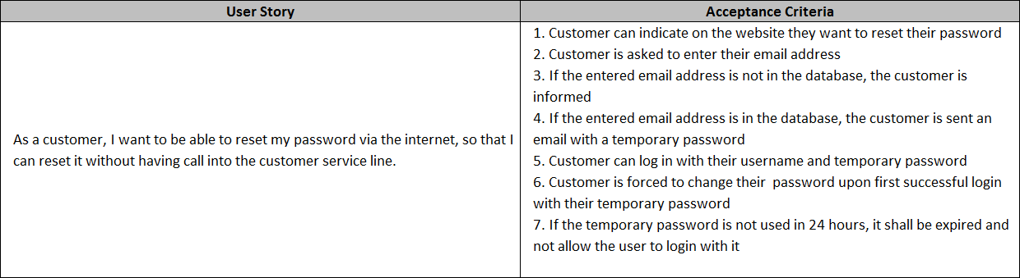
Acceptance Criteria
Provides details on what the solution needs to accomplish
Describes how the user story can be verified to be complete

Slide 18
Introduction to epics
Describes at a broader detail what the user will get from the product
Contain multiple user stories (usually 5-10)
Not all user stories need to be tied to an epic
EPIC
User Story
User Story
EPIC
User Story
User Story
User Story
User Story
User Story
User Story
User Story

Slide 19

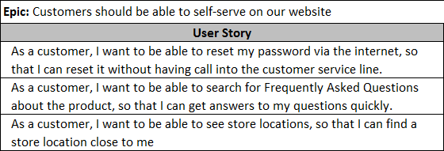
An epic example
(pun intended)

Slide 20
Documenting user stories

Slide 21
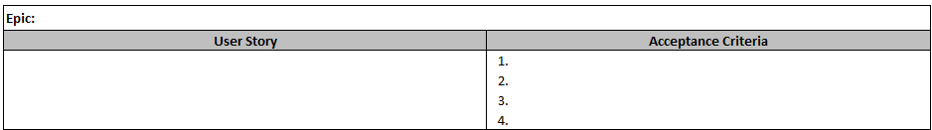
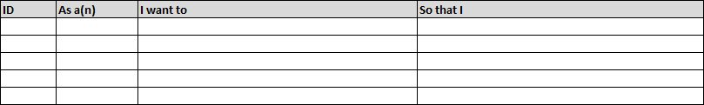
Documenting user stories (EXCEL)

Slide 22
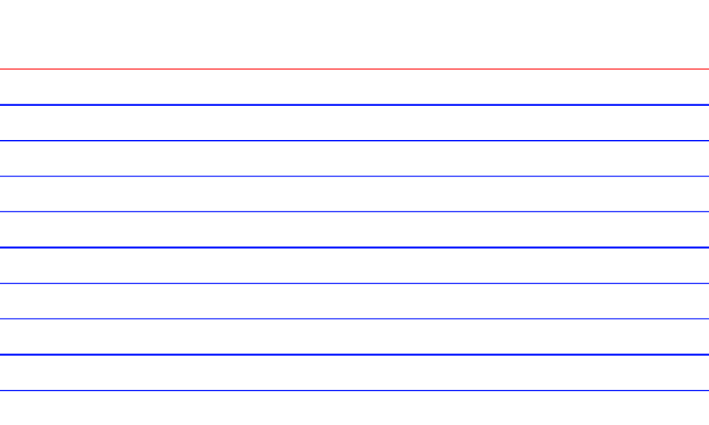
Documenting user stories (index card)
As an <actor>,
I want to be able to <function>,
so that I can <business reason>

Slide 23
User story creation process

Slide 24
User story creation process
Write the user story
Modify and massage the user story
Categorize in epics (as necessary)
Modify and massage the user story
Document acceptance criteria
Modify and massage the user story

Slide 25
Practical exercise

