Slide 1
The Registrar’s Problem
-based on conflicts number
Fall data
93.2%
Spring data
99%
Nov 11, 2019
Yichun Cao, Chen Fan

Slide 2
Algorithm
Conflict-driven
Algorithm
Create Lists
- Room, Courses, time, student lists
- Conflict list (Combination[Ca][Cb][conflict])
- Map of slots lists to assign courses
Remove students
- Remove overlapping courses for each student
- Remove students to fit room capacity
Prioritized Lottery
(Extension)
Create Objects
- Students: id, preference lists
- Courses: id, prof, length, subject, level
- Time: start, end, duration, days
- Room: id, capacity, subjects
Assign Times
&
Assign Rooms
Output schedule
Traverse course list and print everything
Flexible
(Extension)

Slide 3
Extension #1(Improvement on Algorithm)
General idea : minimize the total conflict between each course scheduled in one time slot
combination[COURSE A, COURSE B] returns the conflicts between course A and B
Instead of putting two courses with minimum conflict into one time slot
For each time slot, we calculate total conflict number when course A is put into that slot by adding conflict number with all scheduled courses in that slot
Put course A into the slot with minimum conflict number
Optimal might use Dynamic Programming

Slide 4
Assign Time
Map of Arrays of ArrayList
<Key, Value>
Map of Arrays of ArrayList to store courses into each time slot
PutFirst : separate courses with high conflict number into distinct slots
PutRest : After each time slot has at least one course, put the class with the least number of conflicts with all scheduled courses in the slot
Arraylists of Arraylists
Duration
Represents Time slots of D1
D1
D2
D3
...
T1 | T2 | T3 | ...
C1
C2
C3
...
…....
Courses to be scheduled in T1,T2,T3...

Slide 5
Extension #2(Assign time slots by duration)
Store duration of the class time into Course
Map<Integer, ArrayList<ArrayList<Course>>>
Integer: the duration
ArrayList<ArrayList<Course>> : time slots in this duration
ArrayList<Course>: stores the courses in one time slot
Put each course in time slots with required duration

Slide 6
Update Students
Extension #4 (lottery)
Extension #3
(Assign classrooms by Subject Building)
Assign Room
Assign biggest room to biggest course in each time slot
Check subject of each course and assign accordingly
Remove overlapping courses for each student
Remove students to fit room capacity
For each classrooms store all subjects that courses from those subjects can use this classroom
Assign largest course to a largest unscheduled room that can hold this course based on the subject.
Randomly generate Class Year for each student
For 300-level course, only lottery students that are not seniors out

Slide 7
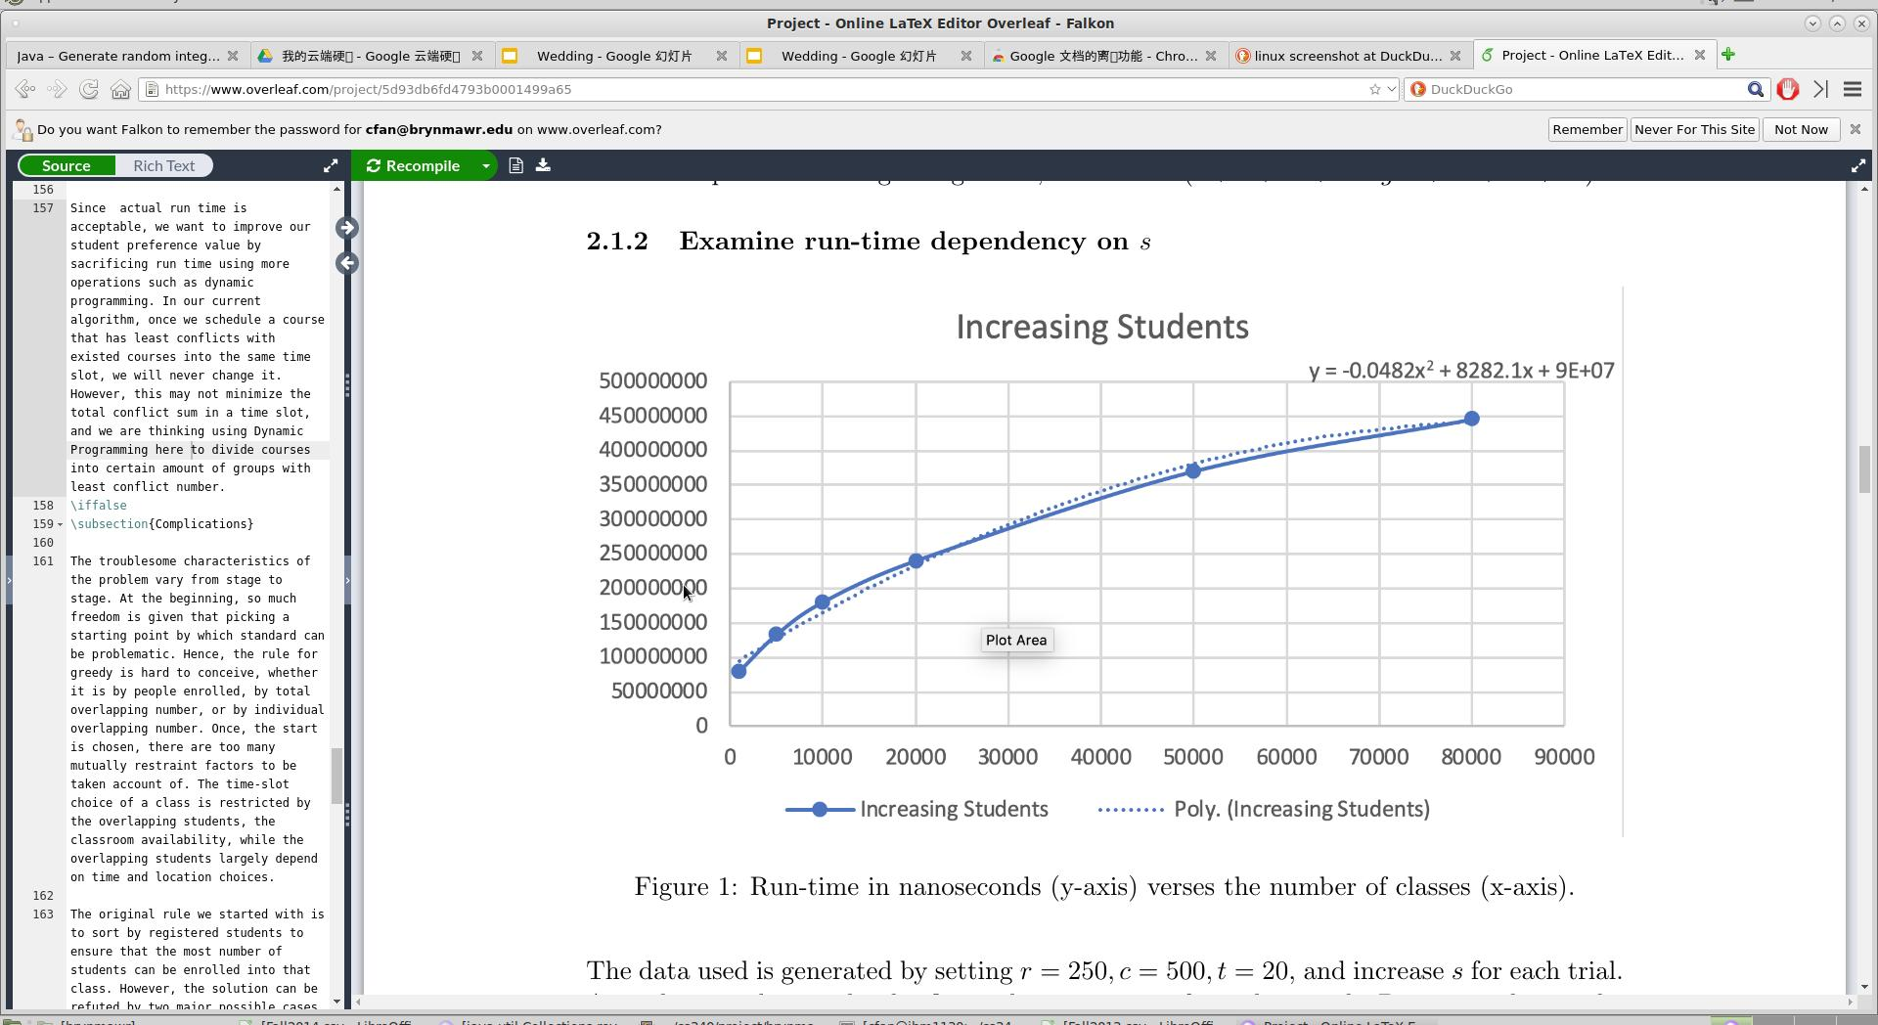
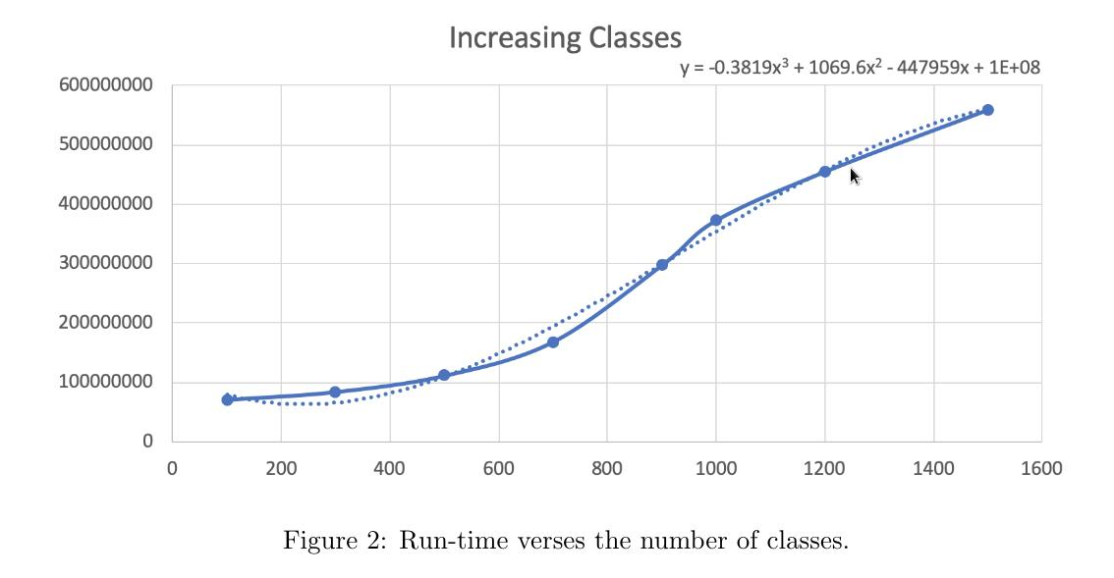

Run-time Analysis
Dependency On s
Dependency On c

Slide 8
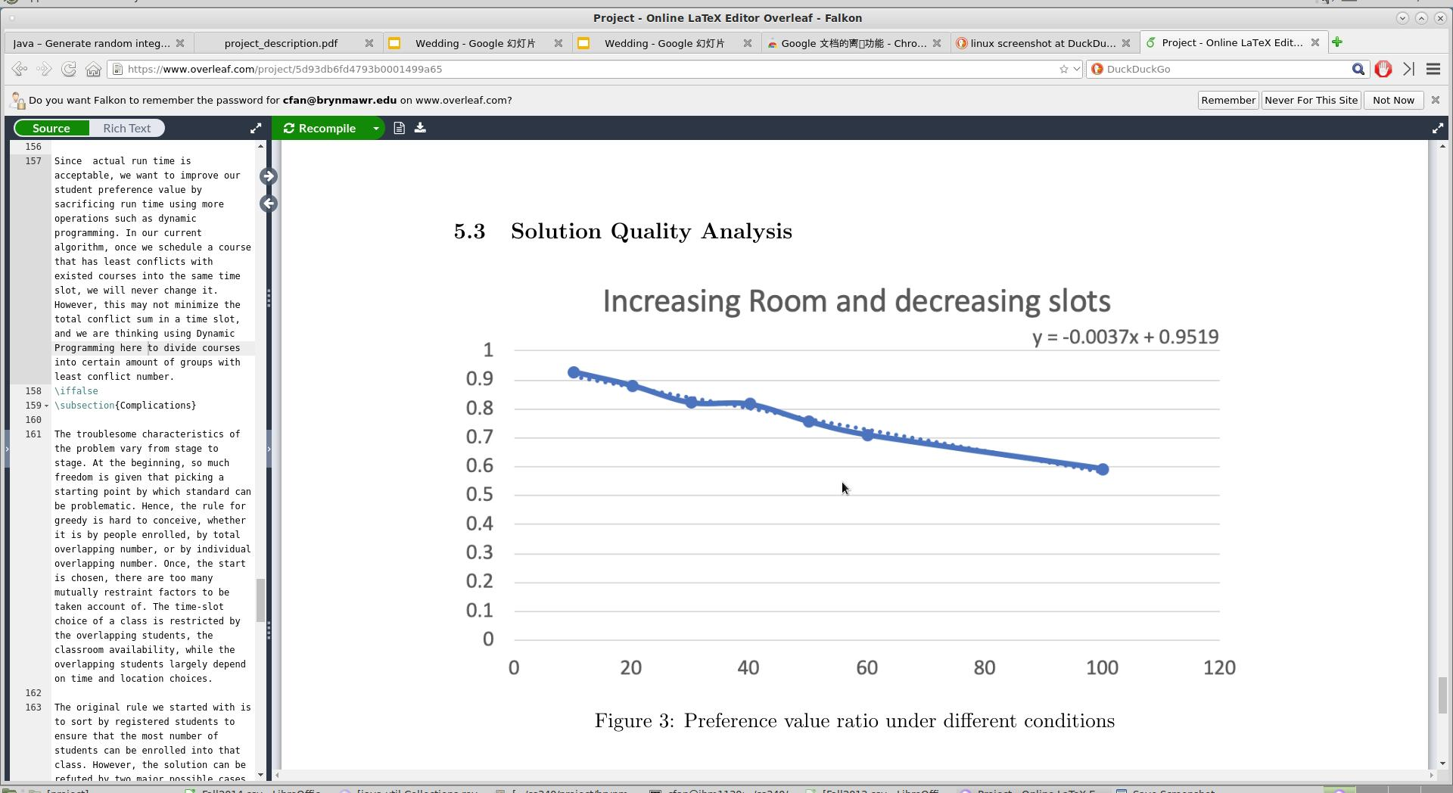
Solution Quality Analysis
On random input
On real data
Fall | 0.931 | 0.931 | 0.929 | 0.936 | Avg = 0.932
Spring | 0.99 | 0.992 | 0.993 | 0.982 | Avg = 0.99
Highest: Spring 2012(99.3%)
Lowest: Fall2004 (89.5%)
ESEM?
100 level intro?
Students tends to choose more course in Fall

Slide 9
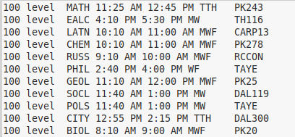
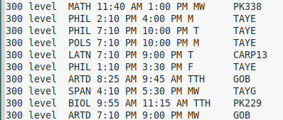
Close to Reality
Linear Alebra/Multi Calc
Intro Language Classes
Intro Humanity Classes
Real Analysis (Allowing overlaps with 100 Math course)
Typical 300-level humanity courses (meets once a week & really late)
Typical 300-level Science courses (meets twice a week & not so late)

Slide 10
ESEM TIME
2014 | 9:55AM - 11:15 AM TTH
2013 | 8:15AM - 9:45 AM TTH
2012 | 9:45AM - 11:15 AM TTH
2011 | 11:15AM - 12:45AM TTH
2010 | 4:00 PM - 5:30 PM TTH
2009 | 8:30 AM - 10:00 AM TTH
... | ...
Mostly on Tuesday-Thursday mornings
Not expected:
Most time slots have duration of 160
Reasons Speculated:
Data is extracted from real schedules
Results -> real schedule

