Slide 1
Submission #488
Model-Agnostic Online Certificate-Driven Calibration for Time Series Forecasting Under Distribution Shift
Chenfeng Huang, Zixuan Ma, George Michailidis
Department of Statistics and Data Science
Notes:
Hello everyone, I’m Chenfeng Huang from UCLA, Statistics and Data Science department. Here today, I’m presenting our paper Model-Agnostic Online Certificate-Driven Calibration for Time Series Forecasting Under Distribution Shift.

Slide 2
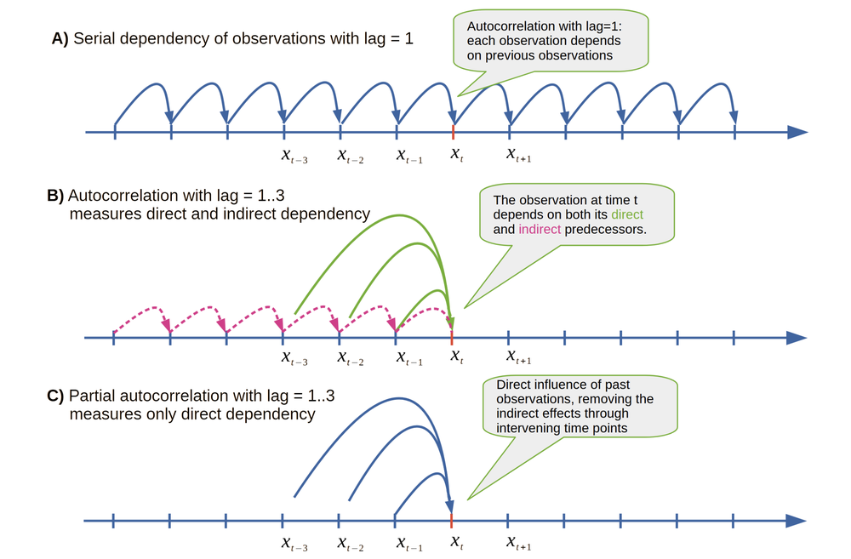
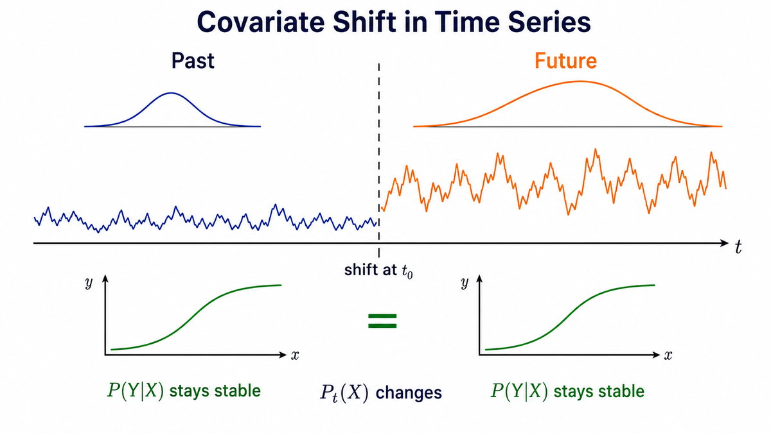
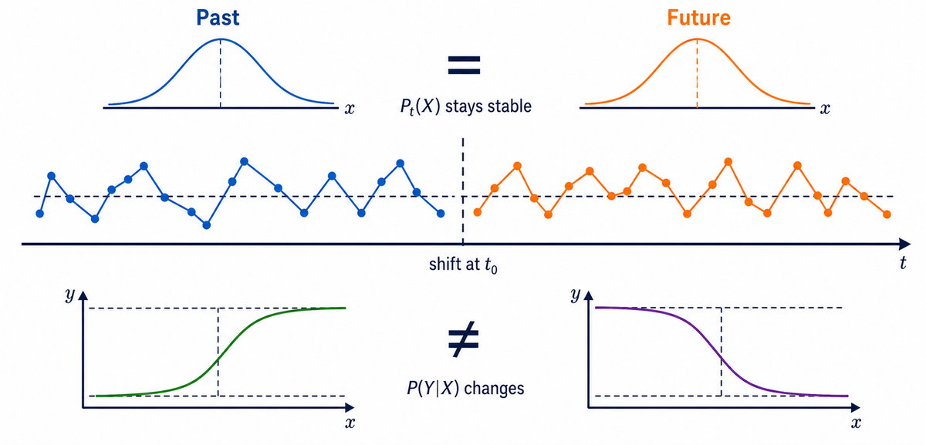
Motivation: Reliable forecasting under distribution shift
Forecasting models fail when deployment differs from training.
Three challenges occur simultaneously:
Temporal dependence + delayed feedback
Covariate shift
Concept shift
Goal: online calibration with provable reliability.
Notes:
Reliable forecasting under distribution shift requires forecasters to remain reliable when deployment dynamics differ from training conditions due to three challenges
The first would be the Covariate Shift:
Which is the input marginal distribution $P(X)$ evolves while the conditional predictive distribution $P(Y∣ X)$remains invariant. For example, it could be elicited by sensor replacement or changes in operating conditions.
The second would be the Concept shift:
Which would be the inverse way that conditional distribution changes while the input marginal remains stable. This corresponds to a fundamental shift in the data-generating mechanism, could be caused by factors like regime shift, or evolving dynamics changes
And also Temporal Dependence:
Time series observations are sequentially dependent, meaning that current and future values are influenced by past observations, trends, seasonality, and lagged effects. This makes OOD generalization harder because shifts can propagate over time and cause accumulated forecasting errors.
So our goal is to performance online calibration with provable reliability

Slide 3



Online calibration
1
3
Backbone predict
Calibrated predict
$${\hat{z}}_{t}$$
$$ŷₜ$$
5
4
t+1
Update
calibration module
Reveal ground truth
$$yₜ$$
repeat
Notes:
And let me explain what is online calibration and how it works.
Online calibration works in the following order:
Firstly we capture the backbone prediction, and we calibrate base on the predict. Then we have the access the ground truth label to update our calibration module, which avoid data leakage and strictly follow the causal order in reality that we can only access the ground truth after the prediction being made.

Slide 4
Why existing methods are insufficient?
SOLID (KDD 2024): Context retrieval with lightweight fine-tuning
OneNet (NIPS 2023): Online ensemble for tracking non-stationary drift
PROCEED (KDD 2025): Proactive adaptation via learned drift representations
Missing: certificate-driven online calibration for time series.
Notes:
However, we found existing online calibration frameworks are insufficient
SOLID: its performance depends on retrieving relevant context, however repeated fine-tuning may be unstable under noisy or sudden shifts.
OneNet: its Ensembling improves drift tracking but introduces additional model and update overhead, with limited protection against harmful adaptation.
PROCEED: Its adaptation relies on a learned drift representation, which may not transfer when deployment shifts differ substantially from training observations
These findings motivate us to propose a certificate-driven online calibration for time series

Slide 5
Key insight
Need a certificate that
remains valid under temporal dependence,
detects distribution shift before labels arrive,
regularizes online updates.
Notes:
Such certificate should suffice three challenges:
1. It should address temporal dependence,
2. it detect shift before label arrives to follow the causal order in reality.
3. It regularize the online updates to avoid overly aggressive calibration.

Slide 6
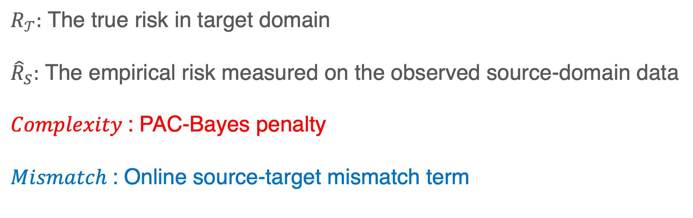
Why PAC-Bayes?
$$R_{𝒯}≤{\hat{R}}_{S}+Complexity+Mismatch$$
$R_{𝒯}:$ The true risk in target domain
${\hat{R}}_{S}:$ The empirical risk measured on the observed source-domain data
$Complexity$: PAC-Bayes penalty
$Mismatch$: Online source-target mismatch term
Notes:
The PAC-Bayes becomes an appealing candidate. It separate the source risk, complexity and source-target mismatch, which naturally becomes an optimization objective for conservative adaptation.
In the following slide, I will elaborate the details of the two essential component of PAC-Bayes bound, the complexity and mismatch term.

Slide 7
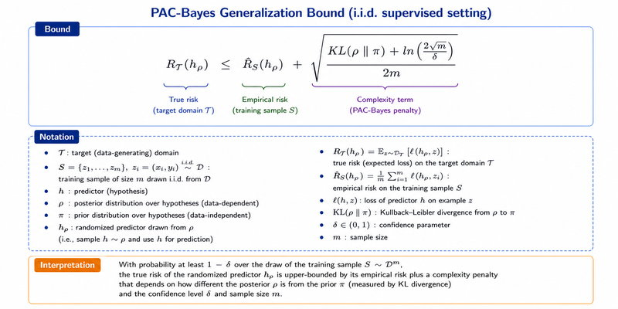

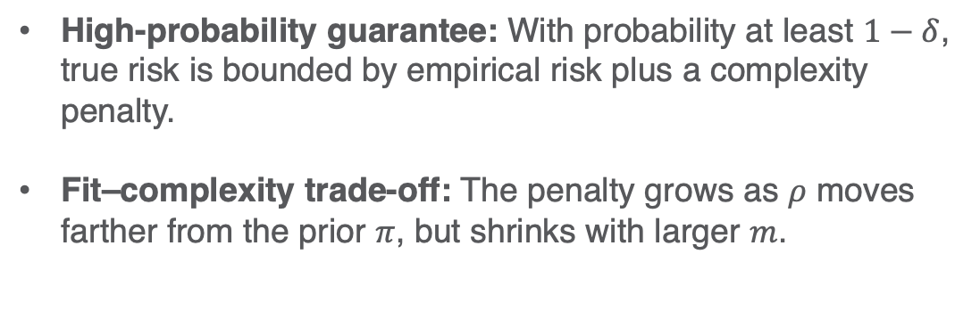
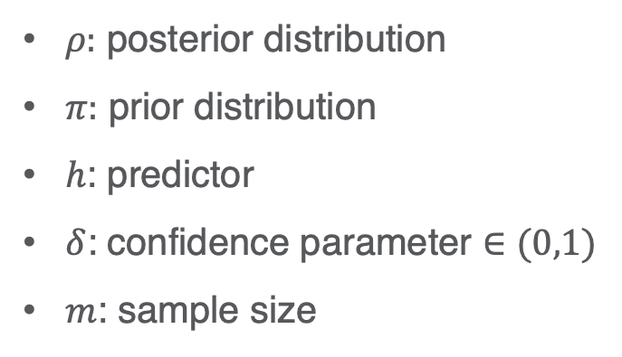
PAC-Bayes Complexity
$$R_{𝒯}(h_{ρ})≤{\hat{R}}_{S}\left(h_{ρ}\right)+\sqrt{\frac{\left(KL\left(ρ∥π\right) +ln\left(\frac{2\sqrt{m}}{δ}\right)\right)}{2m}}$$
$ρ:$ posterior distribution
$π:$ prior distribution
$h$: predictor
$δ$: confidence parameter $∈(0,1)$
$m$: sample size
High-probability guarantee: With probability at least $1−δ$, true risk is bounded by empirical risk plus a complexity penalty.
Fit–complexity trade-off: The penalty grows as $ρ$ moves farther from the prior $π$, but shrinks with larger $m$.
Assumption: Training sample S drawn i.i.d. from the same distribution
Notes:
The complexity term consists of the KL divergence between posterior and prior distribution, a confidence penalty, and a sample size scaling term
The certificate means with probability at least $1−$confidence parameter, the true risk of the randomized predictor $h_{ρ}$ is bounded by its empirical risk on the training sample plus a complexity penalty
This penalty increases when the posterior $ρ$ moves farther from the prior $π$, and decreases as the sample size $m$ grows. The bound therefore balances training fit against model complexity,
however, it assumes that the training data are drawn independently from the same distribution as the evaluated target domain.

Slide 8
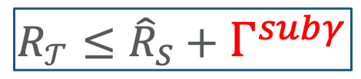
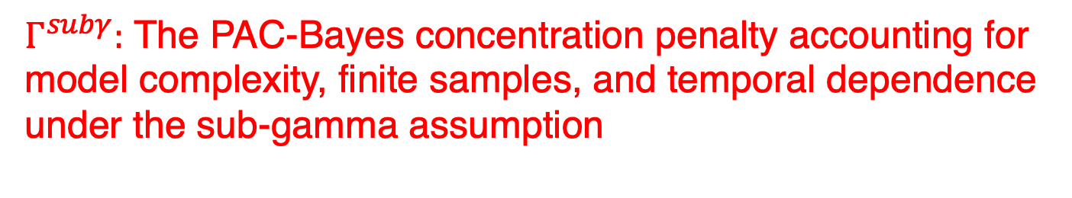
From classical PAC-Bayes to our setting
i.i.d. PAC-Bayes → fails for time series
Martingale concentration (sub-gamma)
⇓
Dependence-aware PAC-Bayes certificate
$$R_{𝒯}≤{\hat{R}}_{S}+Γ^{subγ}$$
$Γ^{subγ}:$ The PAC-Bayes concentration penalty accounting for model complexity, finite samples, and temporal dependence under the sub-gamma assumption
Notes:
So under the classical setting, the i.i.d. assumption failed under the context of time series. We therefore leverage martingale concentration with sub gamma assumption to construct a dependence-aware PAC-Bayes certificate by replacing the PAC-Bayes complexity term with sub-gamma martingale term.

Slide 9
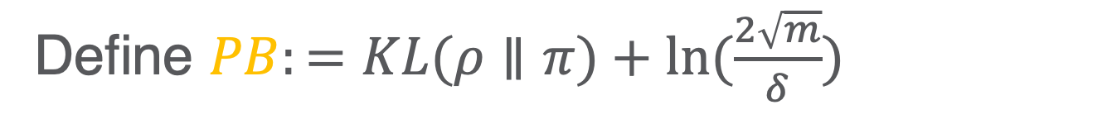
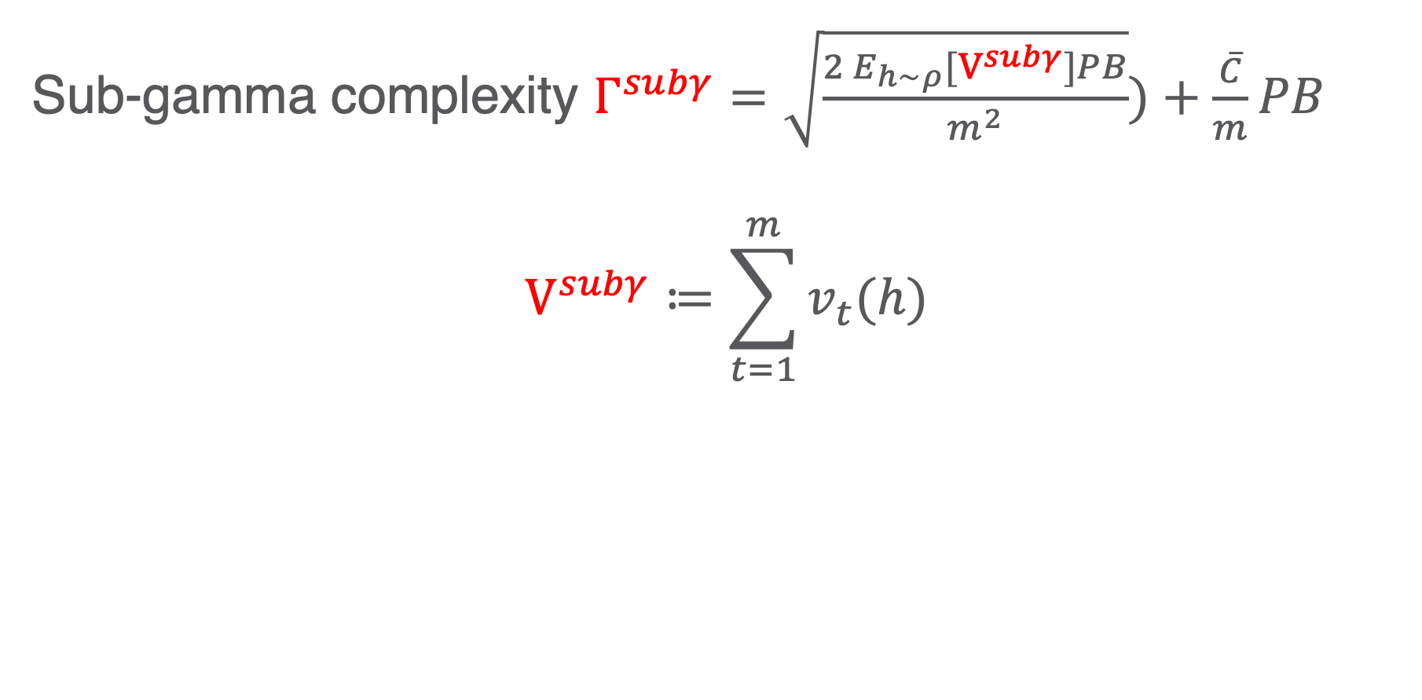
Martingale Concentration
Define $PB:=KL(ρ∥π)+ln⁡(\frac{2\sqrt{m}}{δ})$
Sub-gamma complexity $Γ^{subγ}=\sqrt{\frac{2 E_{h∼ρ}[V^{subγ}]PB}{m^{2}}})+\frac{\overline{C}}{m}PB$
$$V^{subγ}≔\sum_{t=1}^{m}{v_{t}(h)}$$
Notes:
Let define PB as the complexity component of the classical pac-bayes bound without the sample size scaling.
Martingale concentration yields a variance-adaptive PAC-Bayes penalty, the complexity $PB$ is scaled by the posterior-averaged cumulative conditional variance $V^{subγ}$ and tail scale $\overline{c}$, while decreasing as the sample size grows.
The sub-gamma assumption limits the magnitude and frequency of unexpected forecasting-error shocks, enabling reliable risk bounds under temporal dependence.

Slide 10

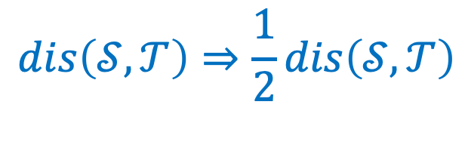
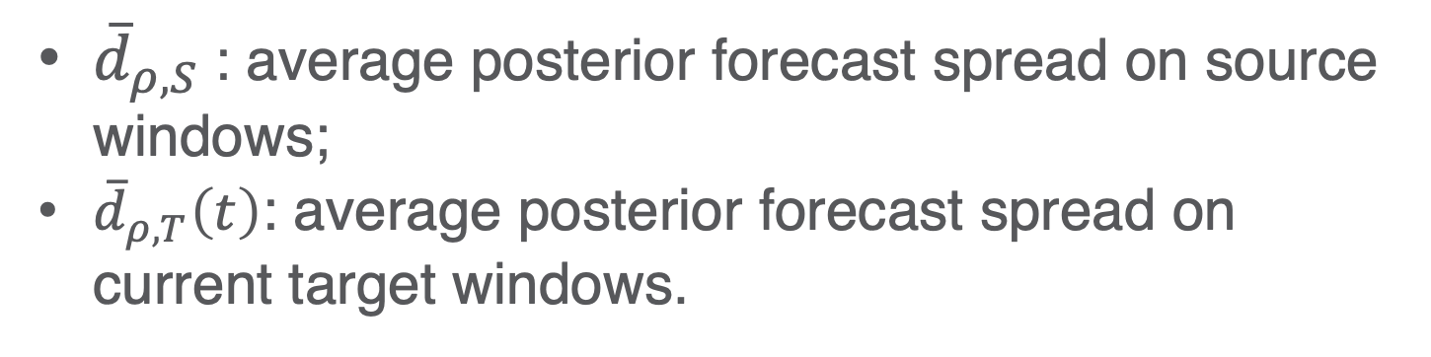
Mismatch
$$dis(𝒮,𝒯)=|{\overline{d}}_{ρ,S}−{\overline{d}}_{ρ,T}(t)|$$
${\overline{d}}_{ρ,S}$: average posterior forecast spread on source windows;
${\overline{d}}_{ρ,T}\left(t\right)$: average posterior forecast spread on current target windows.
$$dis\left(𝒮,𝒯\right)⇒\frac{1}{2}dis\left(𝒮,𝒯\right)$$
Notes:
The mismatch term is calculated from predictors from the posterior and examine how spread out their forecasts are. We compare the average posterior spread on source replay windows with the spread on the current target windows.
Since the mismatch is computed between two posterior predictors, while risk is defined for one predictor, so the pairwise disagreement contributes one half to the single-predictor risk.

Slide 11
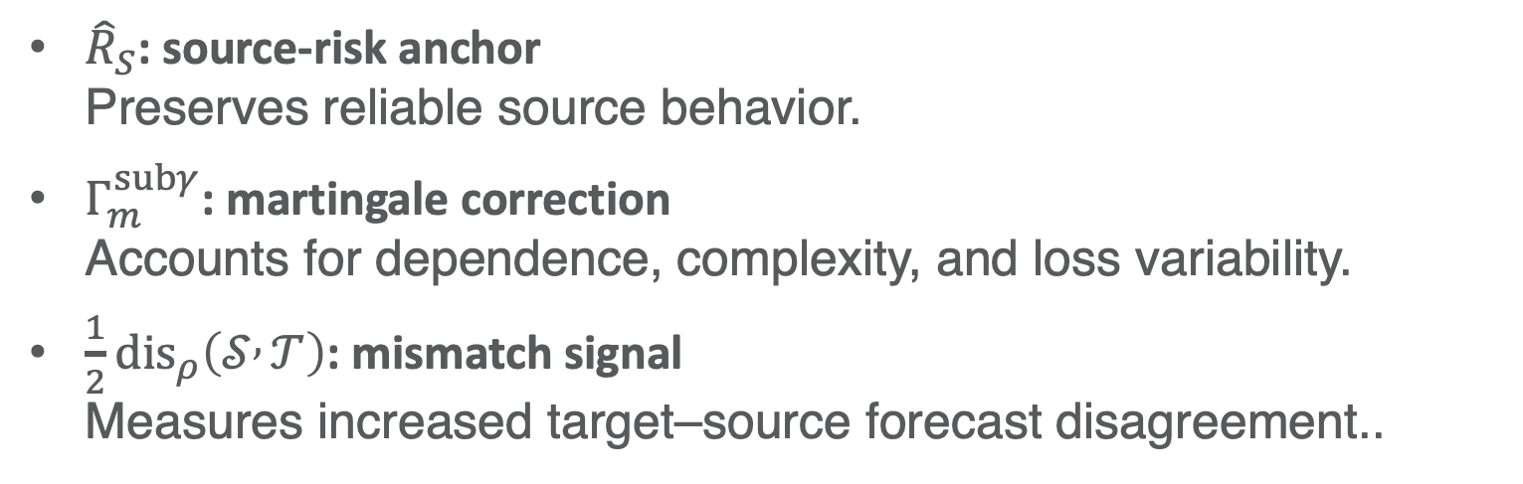
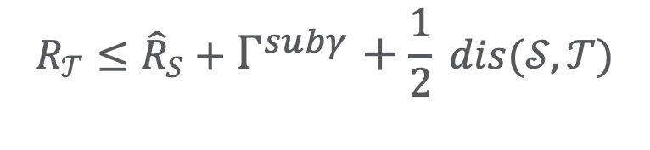
What does the certificate tell us?
$$R_{𝒯}≤{\hat{R}}_{S}+Γ^{subγ}+\frac{1}{2} dis(𝒮,𝒯)$$
${\hat{R}}_{S}$: source-risk anchor Preserves reliable source behavior.
$Γ_{m}^{subγ}$: martingale correction Accounts for dependence, complexity, and loss variability.
$\frac{1}{2}{dis}_{ρ}\left(𝒮 , 𝒯\right)$: mismatch signal Measures increased target–source forecast disagreement..
An interpretable online certificate for monitoring distribution shift and regularizing calibration.
Notes:
Finally, we have a certificate having a source risk that keeps the calibration close to reliable source behavior.
A martingale correction that accounts for temporal dependence, posterior complexity, and changing loss scale.
And a mismatch increases when posterior forecasts disagree more on target windows than on source windows
Together, they construct an interpretable online certificate for monitoring distribution shift and regularizing calibration.

Slide 12
Online martingale PAC-Bayes (OMPB)
Offline:
Train backbone
Initialize Bayesian head,
Online:
Predict,
Compute unlabeled shift certificate,
Observe delayed label,
Update only Bayesian head.
Notes:
Now let me introduce our major contribution, the online martingale pac-bayes framework, with abbreviation of OMPB. It includes the following essential components:
Frozen backbone, which preserves forecasting knowledge.
Lightweight Bayesian residual head, which provides tractable PAC-Bayes complexity with gating mechanism, which is safe fallback to backbone when it shows uncertain.
And Certificate regularizes updates to avoid overfitting on target labels.
The overall pipeline has two stages: in the offline stage, we train the backbone and initialize our Bayesian head. During the online stage, we make prediction, compute the certificate, and update Bayesian head given revealed target label.
(The Bayesian head is a probabilistic residual linear layer applied to the frozen backbone representation. Its correction weights W and biases b follow a diagonal Gaussian posterior, while a zero-centered isotropic Gaussian prior regularizes them toward small corrections. This Gaussian choice gives a closed-form KL-divergence term and supports efficient sampling through the reparameterization trick.
Each posterior sample produces a residual forecast correction, which is scaled by a learnable sigmoid gate and added to the original backbone prediction. After a target label is revealed, only the posterior mean, posterior variance, and gate are updated by minimizing the forecasting loss together with the PAC-Bayes complexity penalty. Posterior dispersion represents epistemic uncertainty, while the gate suppresses unreliable corrections and preserves the frozen backbone as a fallback.)

Slide 13
Experiments
Does OMPB improve OOD forecasting?
We test it on
Covariate shift
Train: ETTh1,
Test: ETTh1-ID, ETTh2-OOD
Concept shift
Train: ILI(Pre-COVID),
Test: ILI(Pre-COVID)-ID, ILI(COVID)-OOD
Covariate shift under spatial context
Train: WEATHER(Miami),
Test: WEATHER(Miami)-ID, WEATHER(Atlanta)-OOD_near, WEATHER(NYC)-OOD_far
Is it model agnostic?
We test it on backbones in TCN (CNN-based), Autoformer (Transformer-based), and GPT4TS (LLM-based)
Does each component matter?
We performed ablation on removing gate, removing PAC-Bayes complexity term in certificate, and disabling the online calibration with offline learning only.
Notes:
In the experiment, we attempt to answer the following questions:
Does OMPB improve OOD forecasting?
We therefore test on covariate shift using the energy field dataset ETTh, where ETTh1 and ETTh2 use the same hourly forecasting schema and variables, but they were collected from two different locations and under different operating conditions. Consequently, the input windows can have different load levels, temperature ranges, seasonal patterns, and marginal distributions, which is a typical case of covariate shift
For concept shift scenarios, we use a medical dataset ILI
In ILI dataset, the pandemic changed disease transmission, interventions, and healthcare behavior, so the relationship between recent illness history and future outcomes are fundamentally changes, which represents the concept shift.
Then we further test on covariate shift with increasing spatial shift severity, as the distance from Miami increase from Atlanta to New York city.
Then we testify whether our framework is model agnostic by testing it with representative time series forecasting backbone in convolutional neural network TCN, transformer-based approach Autoformer, and the latest large-language model-based approach, GPT4TS
Finally, we performance an ablation studies to verify the effectiveness of our gating mechanism, PAC-Bayes complexity, and online calibration schema.

Slide 14
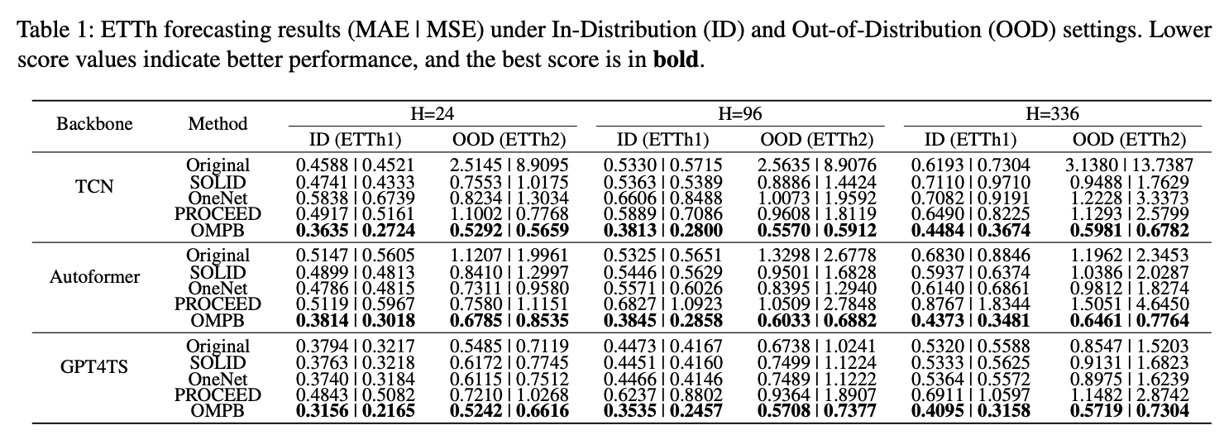
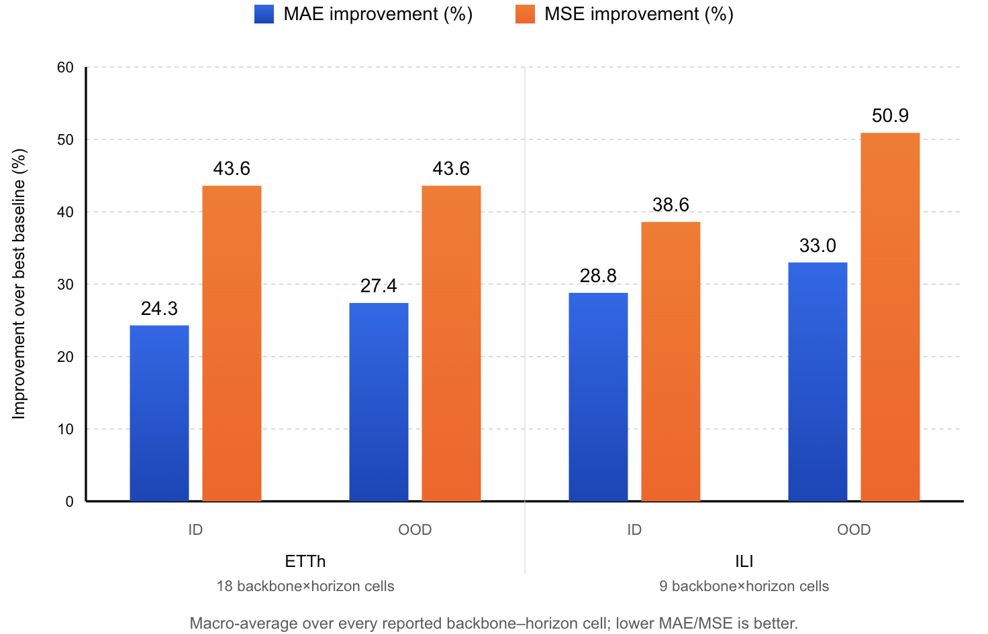
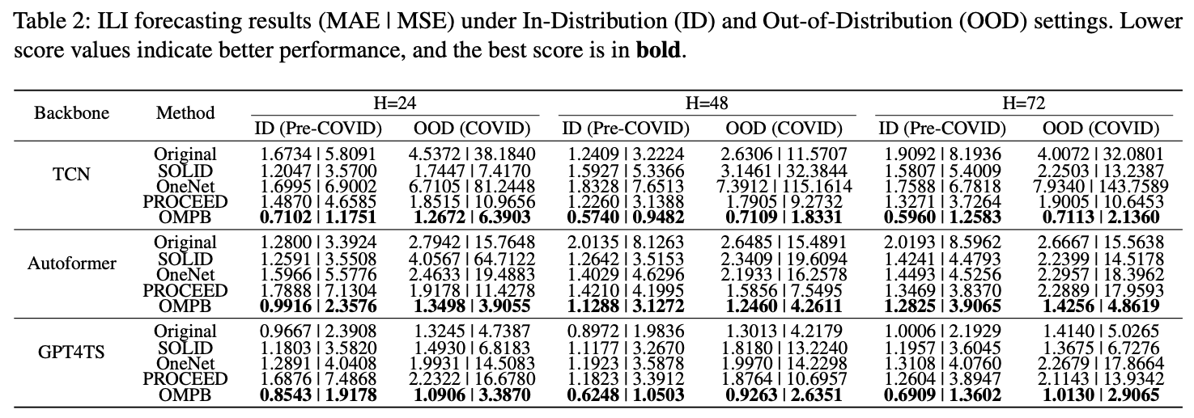
Performance Result for Electricity and Medical Dataset
Robust across shift types: OMPB remains effective under both covariate shift on ETTh and COVID-induced concept shift on ILI
No ID–OOD trade-off: OMPB provides strong OOD robustness without sacrificing ID forecasting accuracy.
Notes:
The results of ETTh and ILI verify OMPB framework effectiveness under both covariate and concept shift. The framework improves the performance in both in-distribution and out-of-distribution. Under more significant concept shift, the OOD improvement is more explicit compared with in-distribution performance, because backbone performance under such OOD scenario is much worse, which leaves more room of improvements. Also, among all baselines, we are only framework has no negative effect on the in-distribution performance.

Slide 15
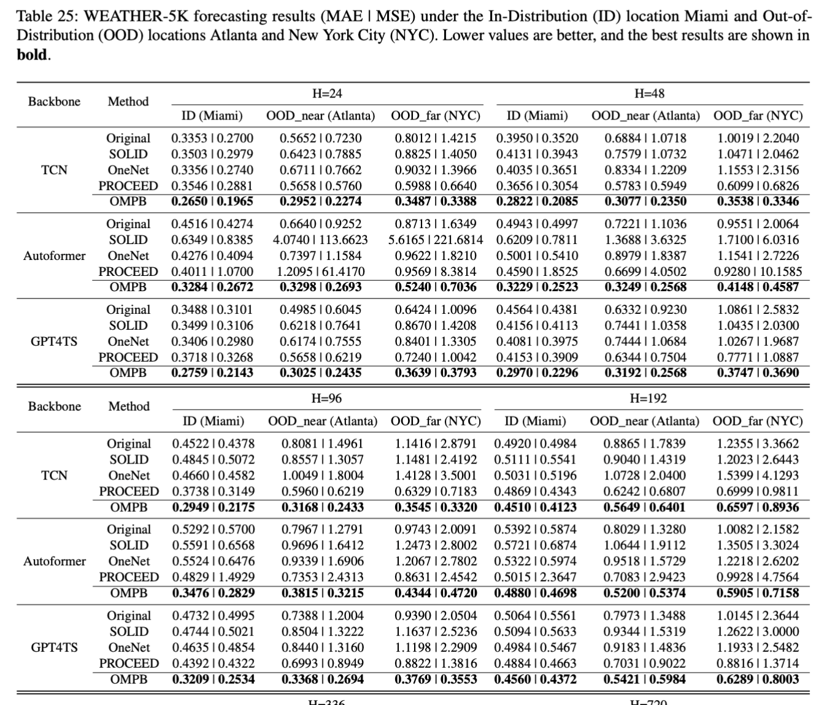
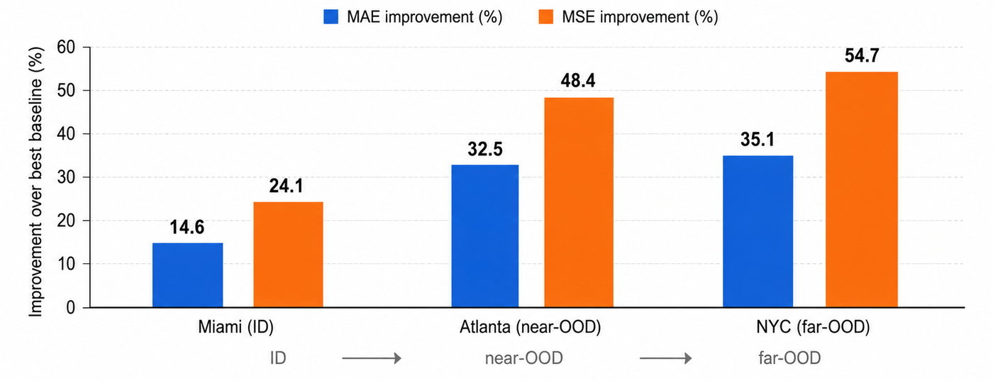
Performance Result for Weather dataset
Increasing spatial shift severity: The experiment evaluates forecasting at the ID location Miami, the near-OOD location Atlanta, and the far-OOD location New York City.
Larger gains under far-OOD shift: The advantage of OMPB becomes particularly clear in NYC, indicating stronger robustness as the target location becomes increasingly different from the source location.
Notes:
In the weather datasets, OMPB also shows consistent the largest improvement among all baselines. In case of the covariate shift with increasing spatial shift severity, our approach shows larger gains under farther OOD shifting, as the percentage of improvement is the largest in NYC testing set. It reflects the robustness of OMPB against increasingly different target domain from source domain.

Slide 16
Why does it work?
Certificate tracks shift
Upper panel — Certificate components: Source risk, martingale PAC-Bayes complexity, mismatch term, and i.i.d. PAC-Bayes complexity.
Middle panel — Shift severity: KS: largest source–target CDF gap. Wasserstein: amount of probability mass transported. JS: overall distribution-shape difference. RBF-MMD: multivariate and higher-order distribution mismatch.
Lower panel — Realized target error: Pre-calibration MAE and MSE observed after target outcomes are revealed.
Key finding: the certificate as an interpretable, shift-responsive risk signal rather than a purely heuristic regularizer.
Notes:
We further verify how certificate behave to verify how does it works exactly.
The upper panel plot the value of source risk, martingale pac-bayes complexity, mismatch term, and i.i.d pac bayes. You will found out that the i.i.d. pac bayes complexity is loser than the martingale one. This does not imply that every martingale bound is tighter than every i.i.d. bound; here the gain comes from the martingale variance-adaptive correction when the loss has low predictable variation.
The middle panel measures the distribution severity with four classical measurement, KS distance, Wassertein, JS divergence, and Radial Basis Function Maximum Mean Discrepancy.
The lower panel show the realized target error that is the uncalibrated prediction error.
All of them show similar patterns, so it testify that our certificate is not a heuristic regularizer but an interpretable bound on target risk that responses the distribution shift correspondingly.
(KS distance measures the largest difference between the source and target cumulative distributions.
Wasserstein measures how far the probability mass must be moved to transform the source distribution into the target distribution.
JS Divergence measures the overall difference in distributional shape while remaining symmetric and finite.
Radial Basis Function Maximum Mean Discrepancy (RBF-MMD) detects differences in means, variances, dependence patterns, and other higher-order distributional properties.)

Slide 17
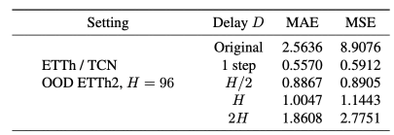
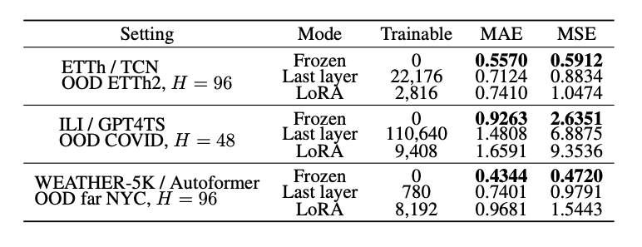
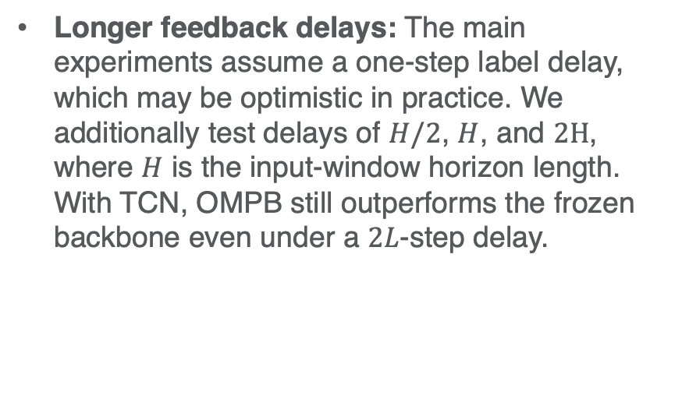
Why does it work?
Feedback-delay analysis
Longer feedback delays: The main experiments assume a one-step label delay, which may be optimistic in practice. We additionally test delays of $H/2$, $H$, and $2H$, where $H$ is the input-window horizon length. With TCN, OMPB still outperforms the frozen backbone even under a $2L$-step delay.
Frozen backbone vs LoRA
More adaptation is not always better: Unfreezing the last layer or applying LoRA increases online trainable capacity but consistently worsens MAE/MSE. Under delayed and potentially stale supervision, the lightweight gated Bayesian head provides more stable adaptation
Notes:
In our main experiment, we assume the delay feedback of target label is 1 timestep, it could optimistic in real-world scenario since we might not able to get the ground-truth label immediately after prediction, so we test our framework with longer delay in half of input window size, a full windows and even a double window size. Under the context of TCN as backbone, the OOD performance of double window size delay is still better than the pure backbone prediction.
Besides, we further address the concern on the expressivity of Bayesian layer by introducing more trainable parameters by unfrozen the last-layer and LoRA-style online update. They both degrade MAE/MSE, suggesting that extra online flexibility can be harmful under delayed supervision context.

Slide 18
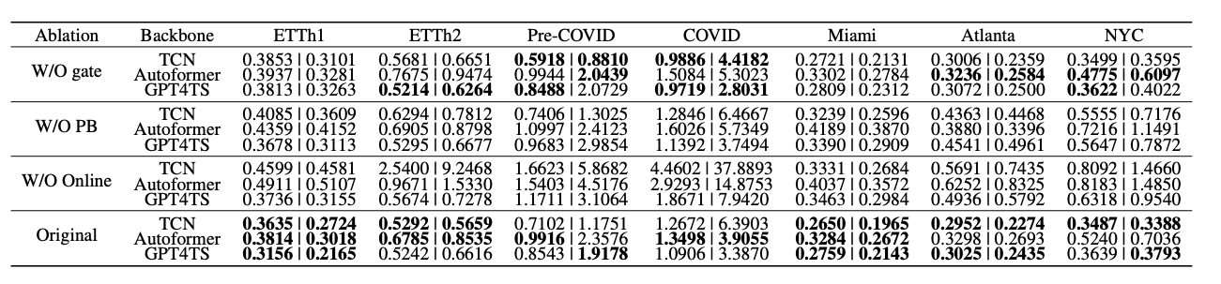
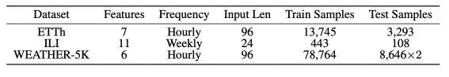
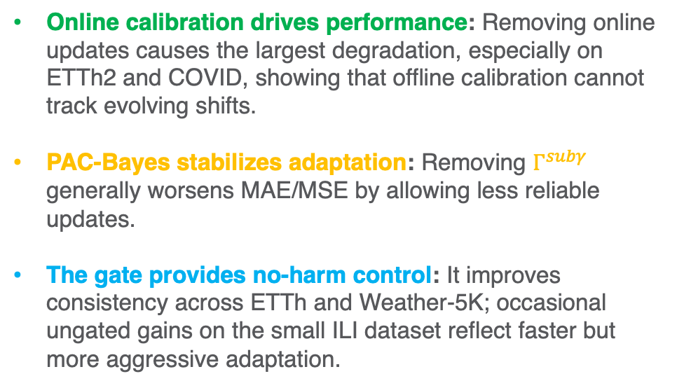
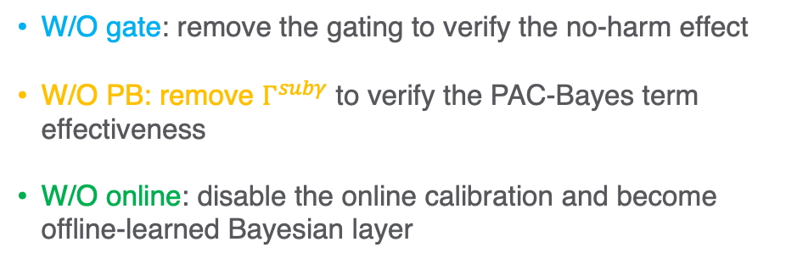
Ablation studies
W/O gate: remove the gating to verify the no-harm effect
W/O PB: remove $Γ^{subγ}$ to verify the PAC-Bayes term effectiveness
W/O online: disable the online calibration and become offline-learned Bayesian layer
Online calibration drives performance: Removing online updates causes the largest degradation, especially on ETTh2 and COVID, showing that offline calibration cannot track evolving shifts.
PAC-Bayes stabilizes adaptation: Removing $Γ^{subγ}$ generally worsens MAE/MSE by allowing less reliable updates.
The gate provides no-harm control: It improves consistency across ETTh and Weather-5K; occasional ungated gains on the small ILI dataset reflect faster but more aggressive adaptation.
Notes:
We performed three kinds of ablations: we removed the gating mechanism to verify the no-harm effect, and we remove the pac-bayes term to verify its effectiveness. Then we disable the online calibration enforce the framework as offline-learned Bayesian layer.
Online calibration is the main performance driver: This is expected because offline training has access only to ETTh1, so the resulting PAC-Bayes certificate cannot account for the ETTh2 shift. Only during the online stage, with ETTh2 are revealed, OMPB can estimate accountable certificate between source and target domain.
And PAC-Bayes term performs the role of stabilizing the calibration.
The gating mechanism show benefits in ETTh and Weather dataset whose sample size is much larger, while it shows negative impact on ILI datasets, implying with limited samples, more aggressive calibration may yield better performance.

Slide 19
Takeaways
First martingale PAC-Bayes online calibration framework for time-series OOD.
Valid certificates under temporal dependence.
Consistent gains across TCN, Autoformer, GPT4TS under covariate and concept shift.
Notes:
Finally, the major contributions can be summarize as following,
OMPB is the first martingale PAC-Bayes online calibration framework for time-series OOD generalization, whose certificate remains valid under temporal dependence. It shows consistent gains across TCN, Autoformer, and GPT4TS under both covariate and concept shift.

Slide 20
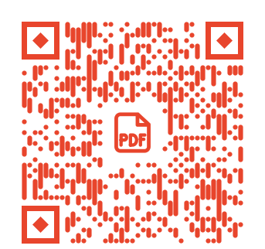
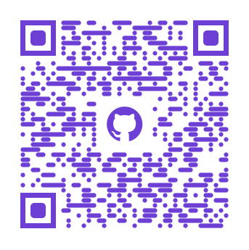
Paper
Code

