Slide 1
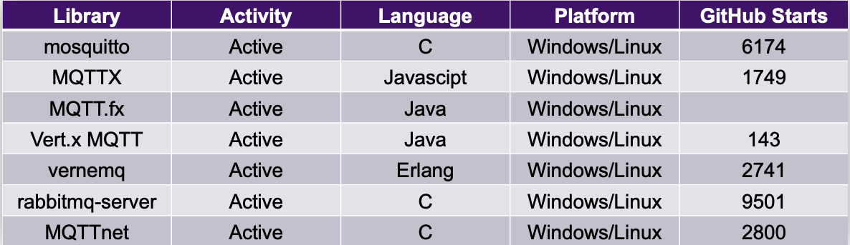
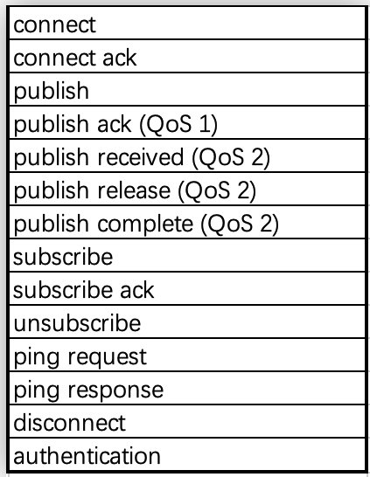
Analysing IoT Protocol Implementation based on Fuzzing
Fengyu Chen & Guangdong Bai
BACKGROUND
As IoT becomes popular in many domains, the security of IoT protocol has become an important research topic. IoT protocols include application-layer protocols like CoAP and MQTT and communication-layer protocols like Bluetooth and Zigbee. These protocols may be implemented differently by various manufacturers, who may realize their own requirements in the implementations. Nonetheless, failing to follow the protocols’ official specifications may introduce bugs and potential security problems. In this project, our goal is to analyze IoT protocol implementations using a fuzzing framework.
Fuzzing has shown its effectiveness in analyzing binaries, OS kernels, and many other programs, but has not been widely used in analyzing IoT protocols, due to some non-trivial IoT-specific challenges. Our fuzzing framework is proposed to bridge this gap. We take discrepancies and rules from RFCs as the oracles of our testing to address the ineffectiveness of crash-based oracle that current fuzzing techniques heavily rely on. We will apply our methodology to analyze several implementations of MQTT.
METHODS
Our project consists of four stages.
RFC parse
Manually read the RFC file, MQTT Version 5.0 OASIS Standard, and extract the functions that the MQTT implementation needs to provide and the regulations that need to be followed.
Test Cases Generation
Based on the functional information we got from RFC, reproduced them on different MQTT implementations and used Wireshark to capture packets. These packets are seeds for mutation.
Fuzzing
Mutated the pcap file we got from the test cases and sent them to the different MQTT brokers de and used Wireshark to capture the result.
Result analysis
The results obtained from fuzzing are analyzed using the rule information obtained from the RFC. In addition to comparing the differences between them and the RFC, compare the differences between the different implementations.
RESULTS
MQTT Implementations
We have chosen the following MQTT implementations as objects. Some of them only provide clients or servers individually, but they are all active.
MQTT Actions
We did fuzzing the following actions.
Abnormal behavior
The currently supported version numbers of MQTT are 3.1, 3.1.1, and 5.0. In the test, it was found that even unrecognized version numbers can still be successfully connected.
CONCLUSIONS
Summary
We analyzes multiple implementations of MQTT. Some unusual behavior was found. Some of the challenges faced in this project. Because we read the RFCs manually, we cannot guarantee that our test cases cover all functionality, and when analyzing test results, there may be misunderstandings. Even so, the abnormal behavior of the MQTT implementation can still be found using this method.
Future work
There are many IoT protocols, corresponding to many RFCs. As IoT develops, we cannot deny that more IoT protocols may appear in the future. In order to better use fuzzing to analyze IoT protocol implementations, we need an automated tool to help us read RFC. At present, NLP technology is expected to solve this problem.
REFERENCES
[1] “Mqtt: The standard for iot messaging” https://mqtt.org, 2021, accesse.
[2] “MQTT Version 5.0 OASIS Standard” https://docs.oasis-open.org, 2019, accesse.

