Slide 1

the problem
ArcBBQ

Slide 2



Team Members
Joey Lee
GIS
Karie Huang
GIS
Zhengcong Yin
Developer

Slide 3
Mental H
An event based public mental health monitoring platform

Slide 4
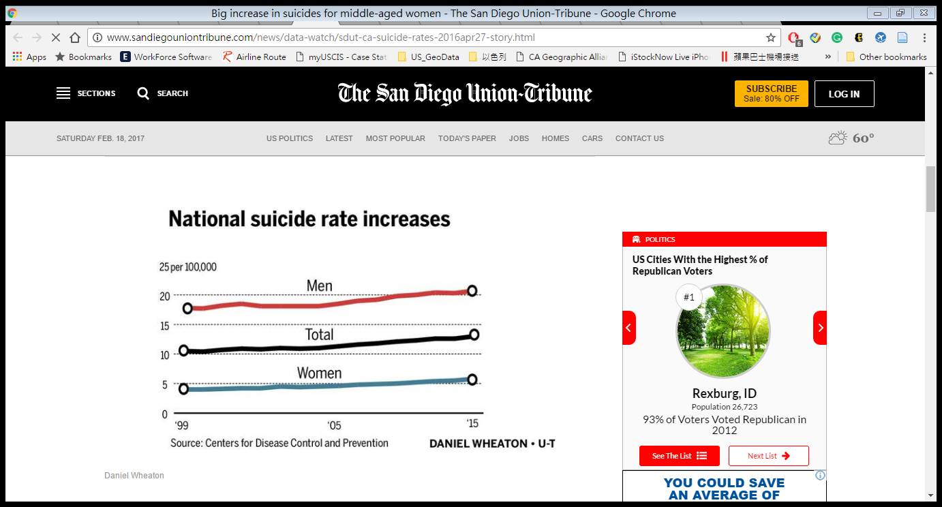
Why Mental health?
Human life is priceless

Slide 5
Mental H
An event based public mental health monitoring dashboard

Slide 6
Why Dashboard
Target user: Government
Mission: For better help,
for more support
Government
community
Individual
collect
support
integrate

Slide 7
How – can we collect the data ?
Data | URL
Suicide Death 2010-2013 (livewell) | Livewell http://www.livewellsd.org/
Self Inflicted Hospitalization 2010-2013 (livewell) | Livewell http://www.livewellsd.org/
Chronic Alcohol Hospitalization 2010-2013 (livewell) | Livewell http://www.livewellsd.org/
Anxiety Hospitalization 2010-2013 (livewell) | Livewell http://www.livewellsd.org/
Mood Disorders Hospitalization 2010-2013 (livewell) | Livewell http://www.livewellsd.org/
Healthcare Facility Locations (California Health and Human Services Open Data Portal) | California Health and Human Services Open Data Portal https://chhs.data.ca.gov/
Twitter | Twitter API

Slide 8
How – does it work?
Community members
Crunch tweets
Mental Health Data
Mental H
dashboard
Mental Health Patterns
POI (hospitals/tweets)
Leaflet
Sentiment analysis

Slide 9
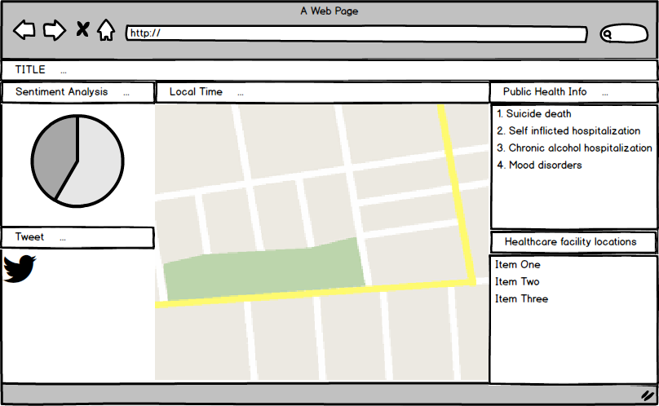
How – does it look like ?
Show the rate of positive words and negative words
Show the mental health information in the selected area
Tweets input: input helping tweets
Show the locations of hospital in the selected area

Slide 10
How – do you feel like it?
Suggestion? sdsumentalh@gmail.com

