Slide 1
Data set
The data set we worked with was chosen from the smart cities domain, specifically it is about traffic accidents in Madrid in 2018.
Data structure
We took the data set from the web page of the Ayuntamiento de Madrid, explicitly we sought the information in the portal de datos abiertos del Ayuntamiento de Madrid.
Feature | Type
Fecha | Date
Rango_horario | String
Dia_semana | String
Distrito | Text
Lugar accidente | Text
N° | Int
N° parte | String
CPFA Granizo | String
CPFA Hielo | String
CPFA Lluvia | String
CPFA Niebla | String
CPFA Seco | String
CPFA Nieve | String
CPSV Mojada | String
CPSV Aceite | String
License analysis
CPSV Barro | String
CPSV Grava Suelta | String
CPSV Hielo | String
CPSV Seca Y Limpia | String
Nº VICTIMAS | Int
TIPO ACCIDENTE | String
Tipo Vehiculo | String
TIPO PERSONA | String
SEXO | String
LESIVIDAD | String
Tramo Edad | String
Right holder - Editor:
Ayuntamiento de Madrid
Responsable Unit:
Dirección General de la Policía Municipal
License
https://datos.madrid.es/egob/catalogo/aviso-legal
In resume we can use the information for commercial or noncommercial purposes.
Origen de los datos: Ayuntamiento de Madrid

Slide 2
Resource name strategy
Taking into account the guideline from the "Ready 4 smart cities" document, we defined our resource name strategy as follow:
Domain for the URIs: since we are working with a topic of smart cities, we are going to use their URIs domain (http://smartcity.linkeddata.es/), for educational purpose.
Path for the URIs.: in this case, we will add a subfolder to set that our ontology model and data refers to our project, accidents of traffic in Madrid. http://smartcity.linkeddata.es/trafficAccidentsInMadrid/ontology#
Pattern for ontology classes and properties in the ontology, as well as for individuals:
Ontology model classes: http://smartcity.linkeddata.es/trafficAccidentsInMadrid/ontology#<className>
Ontology model properties: http://smartcity.linkeddata.es/trafficAccidentsInMadrid/ontology#<propertyName>
Instances: http://smartcity.linkeddata.es/trafficAccidentsInMadrid/resource/<className>#<identifier>.

Slide 3
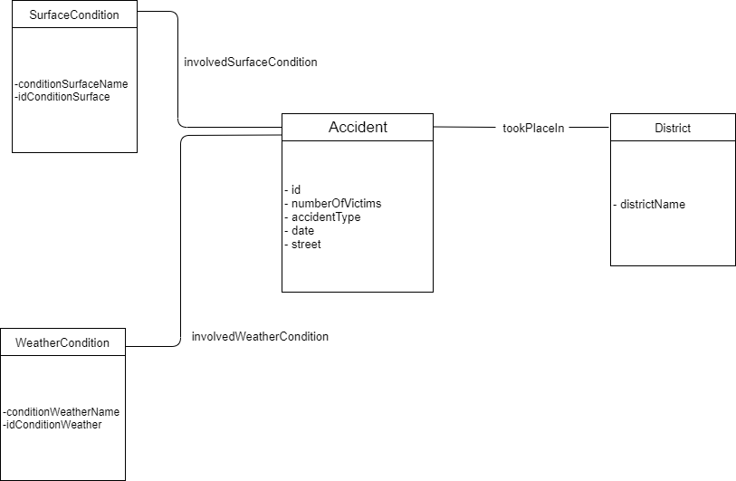
Ontology

Slide 4
Data Transformation with OpenRefine
Converted date fields to DateTime
Changed all “?” to the correct letter
Trimmed all values in all cells.
Removed all columns pertaining to the persons and vehicles involved.
Removed all repeating rows (the repeating rows mainly pertained to the persons involved in the accident).
Split STREET column to 2 columns: STREETS_1, STREETS_2
Created new columns: weatherCondition and surfaceCondition.
Populated weatherCondition with weather conditions.
Populated surfaceCondition with surface conditions.
Fixed all values:
Did facets to ensure all values are uniform.
Reconciled the column District with wikiData.
Added a column based on the reconciled (District) column to show the District’s wiki URI.

Slide 5
RDF skeleton
Base URI: http://smartcity.linkeddata.es/trafficAccidentsInMadrid/ontology#
To generate our RDF with the 4 classes defined on the ontology:
- Accident
- WeatherCondition
- SurfaceCondition
- District
We are reusing class District from:
http://vocab.linkeddata.es/datosabiertos/def/sector-publico/territorio#
We are reusing class Accident:
http://vocab.datex.org/terms#

Slide 6
Class Accident:
The URI define for class accident is ID column.
Data properties from this classes are:
* numberOfVictims , declared as an integer and assigned to NO_OF_VICTIMS column.
* accidentType, declares as string and assigned to EVENT_TYPE column.
* dateTime, declares as Date/time and assigned to RANGE_DATE_START column.
* streetName, declares as string and assigned to columns STREETS_1, STREETS_2 column.
Object Properties from this classes are:
* tookPlaceIn, define as an URI and assigned to md5 value from DISTRICT column.
* involvedSurfaceCondition, define as an URI and assigned to the md5 from value in SurfaceCondition column.
* involvedWeatherCondition, define as an URI and assigned to WeatherContidionID column

Slide 7
Classes
District: The URI define for class district is ID column.
Data properties :
districtName, declared as string, and associated to District column.
WeatherCondition : The URI define for class WeatherCondition is WeatherConditionID column.
Data properties :
weatherConditionName, declared as string, and associated to weatherCondition column
SurfaceCondition : The URI define for class SurfaceCondition is md5 value from surfaceCondition column.
Data properties :
weatherConditionName, declared as string, and associated to weatherCondition column

Slide 8
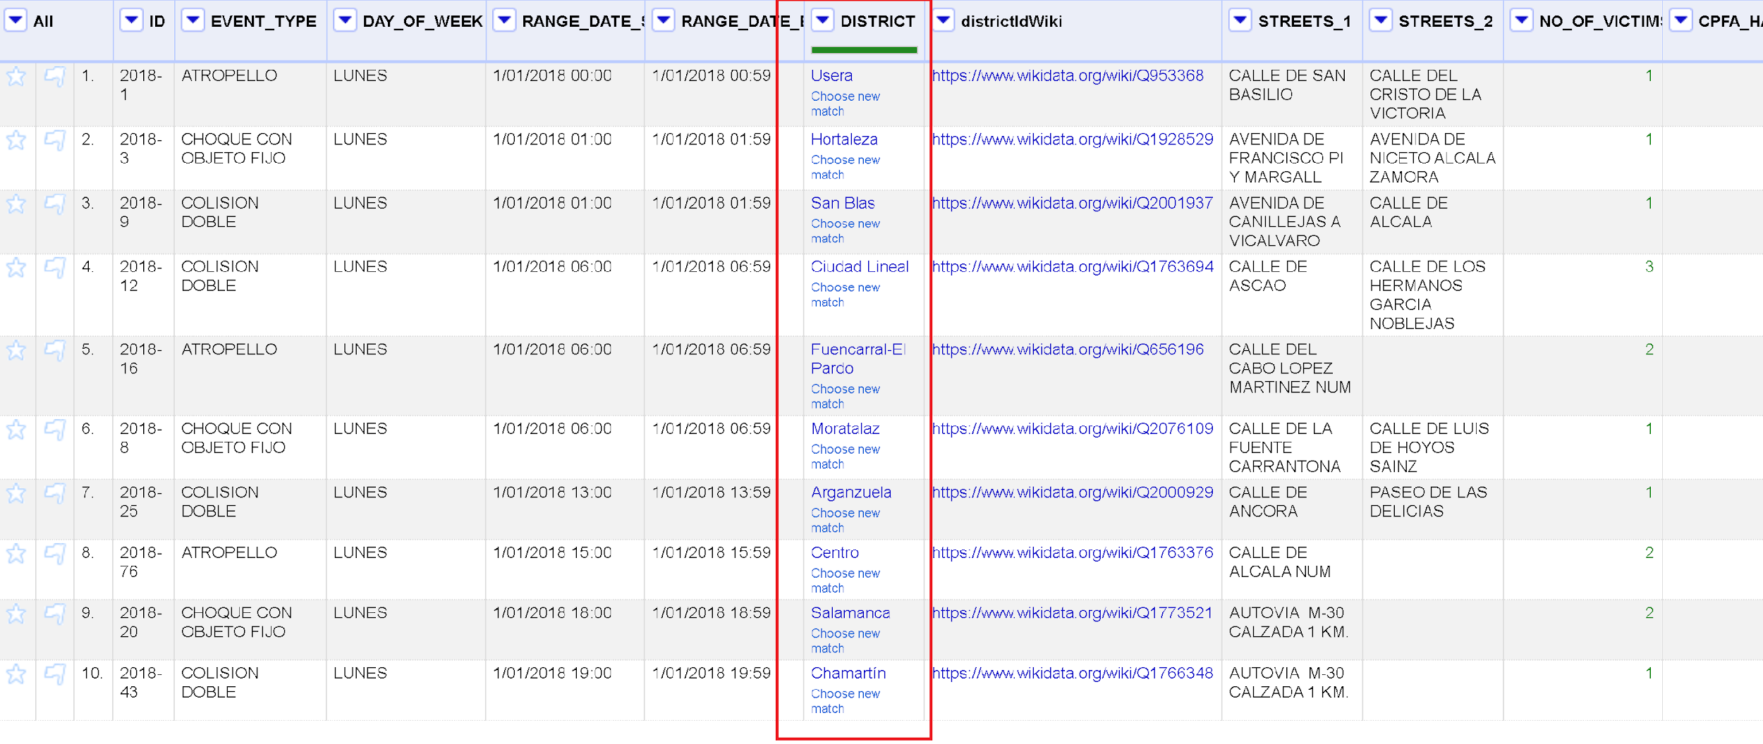
Reconciliation
Reconciliation was made against www.wikidata.org
We reconciliated the DISTRICT column with a match of 100% to entities from distric of madrid

Slide 9
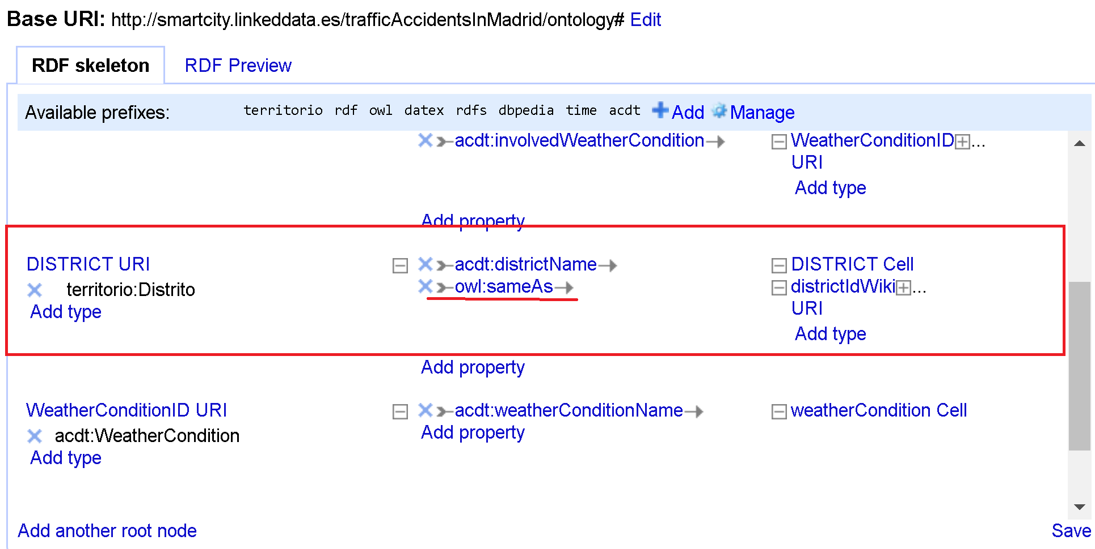
Linked Data
We created a new column with the name districIdWiki based on the values from the District column, already reconciliated with the GREL expression:
"https://www.wikidata.org/wiki/”+cell.recon.match.id
Also in our RDF, for the class district we define a property as owl:sameAS associated to the districIdWiki

Slide 10
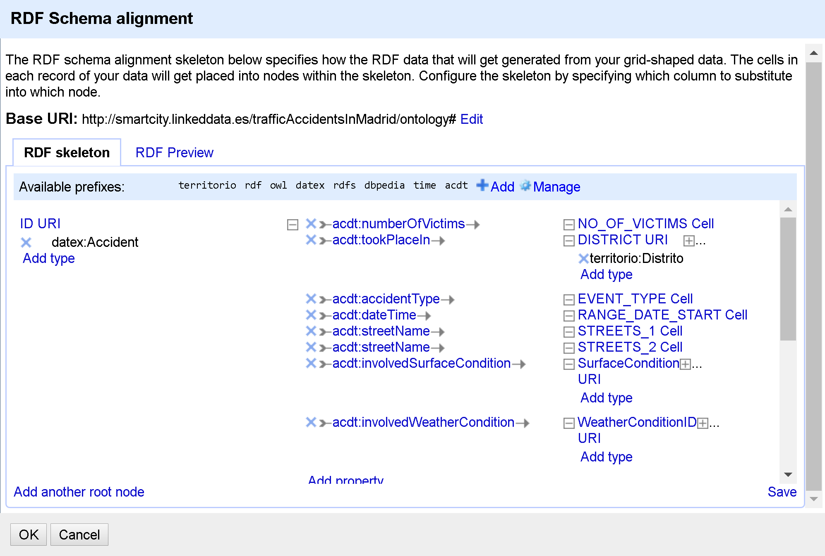
Final RDF

Slide 11
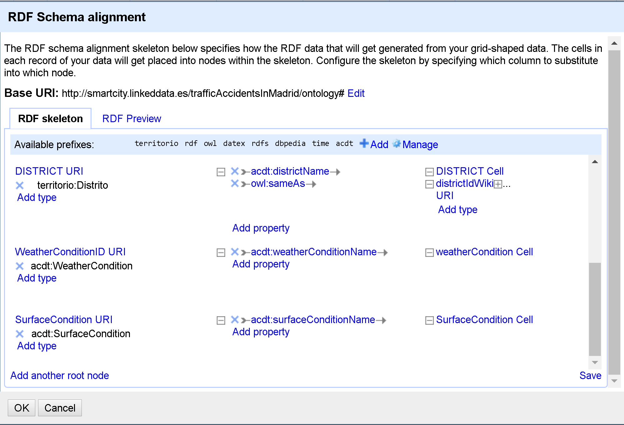
Final RDF

Slide 12
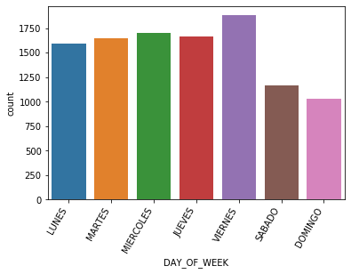
Which Day Of The Week Had The Most Number Of Accidents?

Slide 13
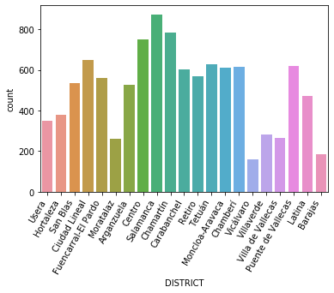
Which District Had The Most Number Of Accidents?

Slide 14
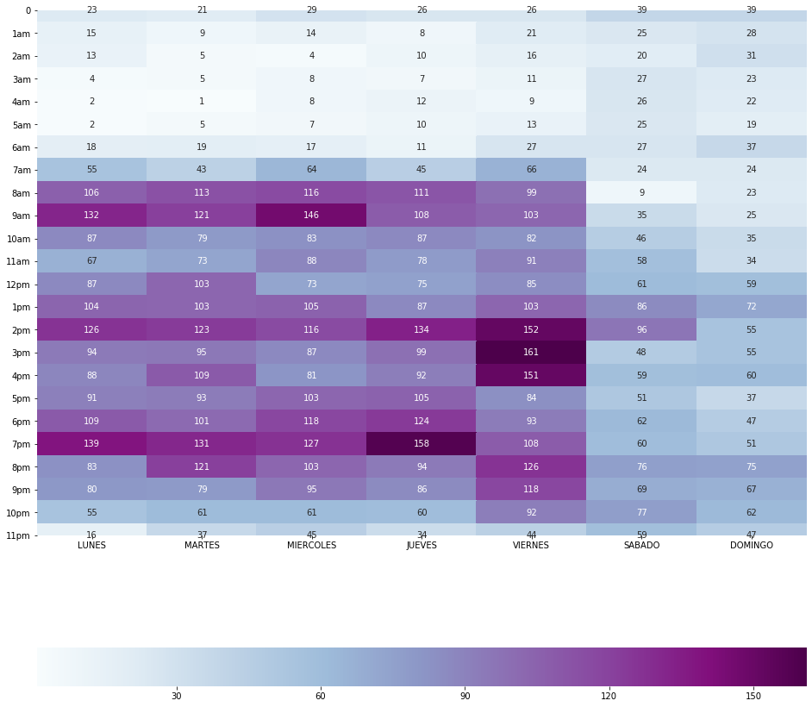
Which Time Of Day Had The Most Number Of Accidents?

Slide 15
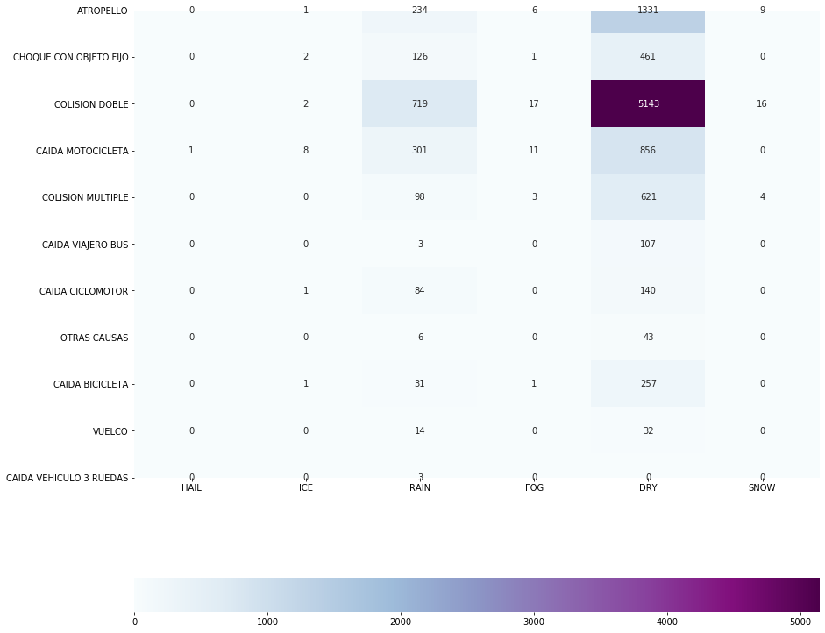
Which Weather Condition Caused The Most Number Of Accidents?

Slide 16
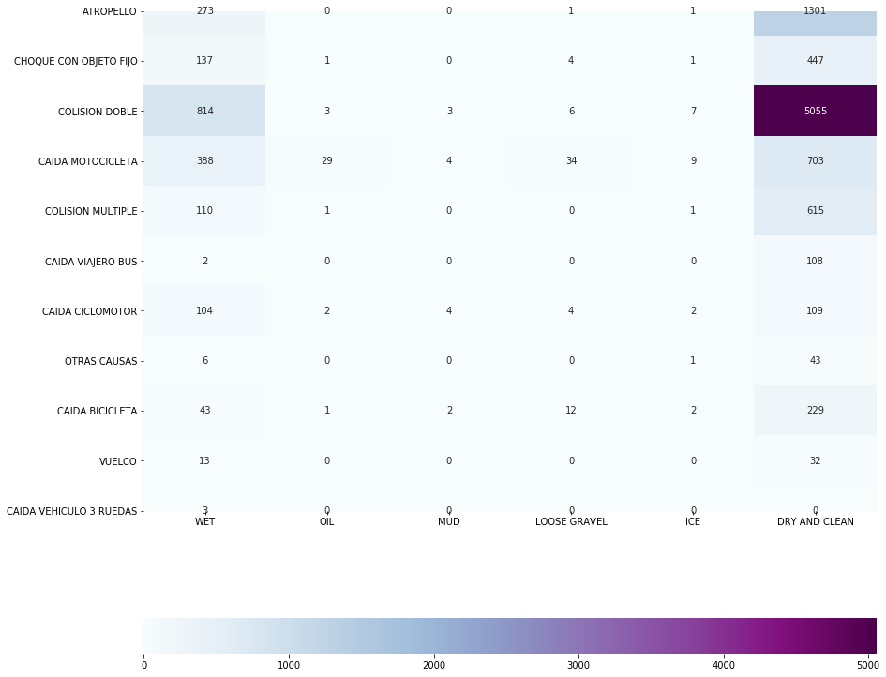
Which Surface Condition Caused The Most Number Of Accidents?

Slide 17
TRAFFIC ACCIDENT PREDICTOR
CONCEPT:
Live prediction of traffic accident risks using Machine Learning and Google Maps
Traffic accidents are a major cause of death globally. A system that can predict the occurrence of traffic accidents or accident-prone areas can potentially save lives.
OBJECTIVE:
Create an API that can interface with popular map systems. These map systems can then be capable of the following on top of their usual use:
Identify areas along the route that are particularly accident prone within the current time window.

Slide 18
DEVELOPMENT STEPS
Data Collection
Data Processing
Negative Sampling
Exploration and Observation
Supervised Learning

Slide 19
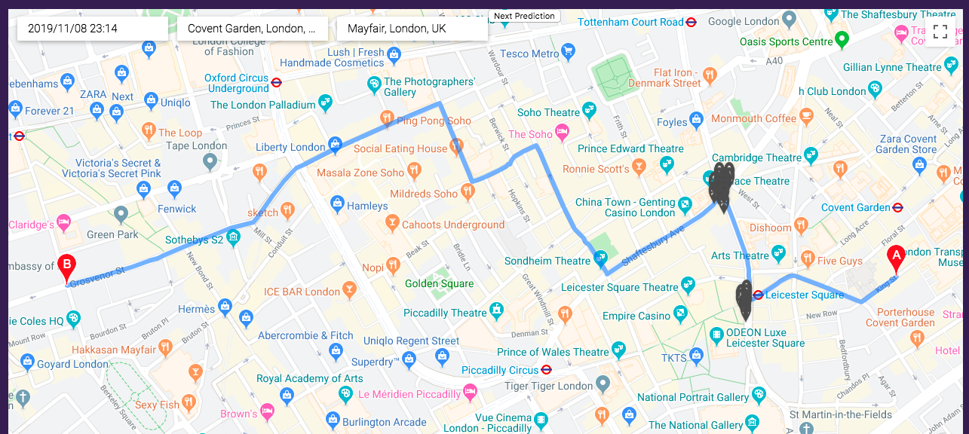
OUTPUT GOAL

