Slide 1
Traffic accidents on Leeds Council
Banks Raymond, Briwa Houda, Hängul Emre, Nugra Hugo

Slide 2

And after a Virtual Knowledge graph?
An analysis of the extracted data

Slide 3
Our refining process
Initial state
Result
Casualty data
Environmental data
Latitude and Longitude
One cell for Datetime
4 vehicle types
Street name
City
Postal Code
Casualty data
Environmental data
Northing, easting
Time and date separated
Very different vehicle types

Slide 4
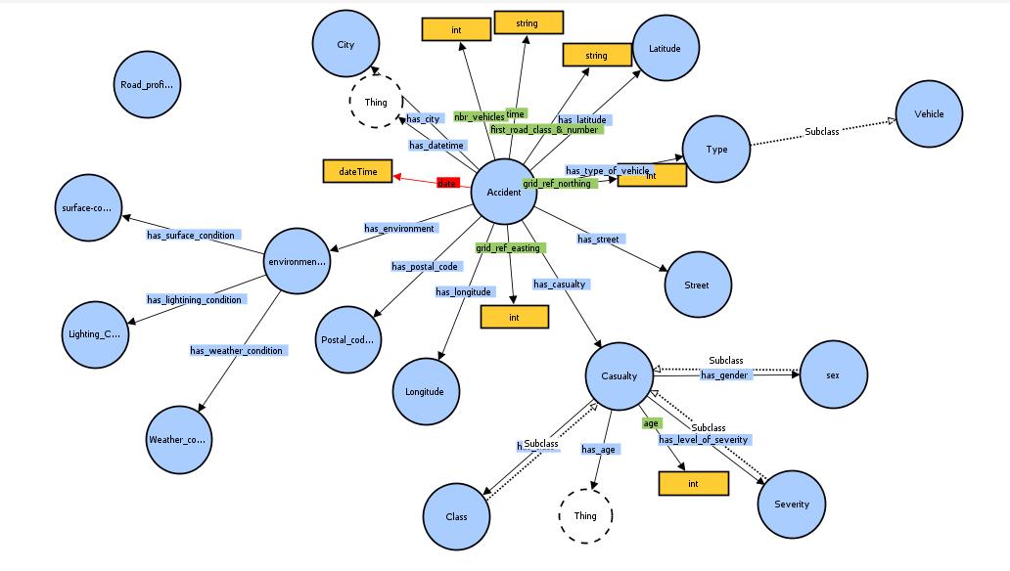
Our Ontology

Slide 5

And what to do with our refined data?
An analysis done by a team of data scientists on the domain on Smart cities

Slide 6

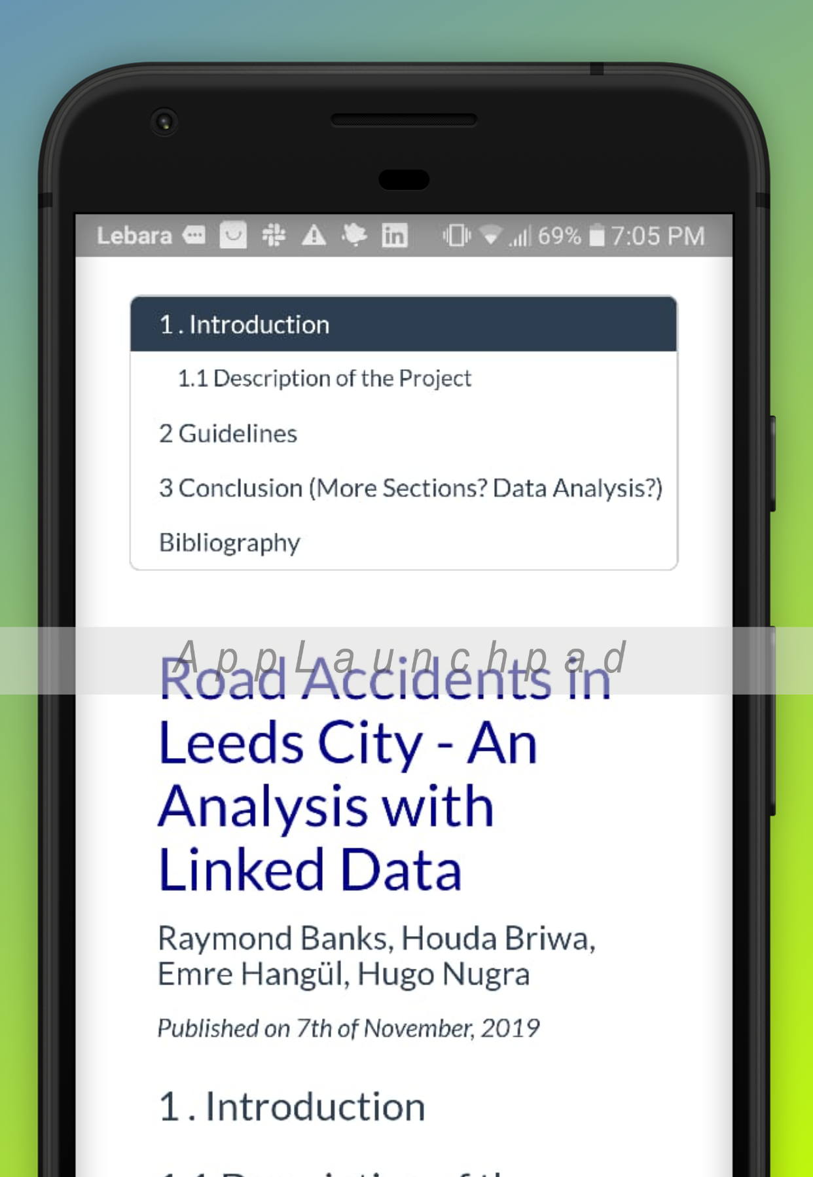


Leeds roads accidents
Ingresa un texto.
An analysis of traffic accidents on Leeds city
Mobile app
Website

Slide 7
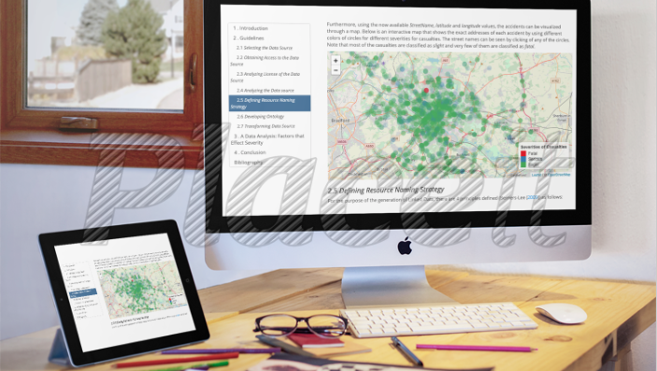
http://leedsroadaccident.com/
https://expo.io/artifacts/b32e6977-9bf0-4e41-bb11-e734ae4121ee

Slide 8
Communication
Template
Resource to AI

Slide 9


