Slide 1
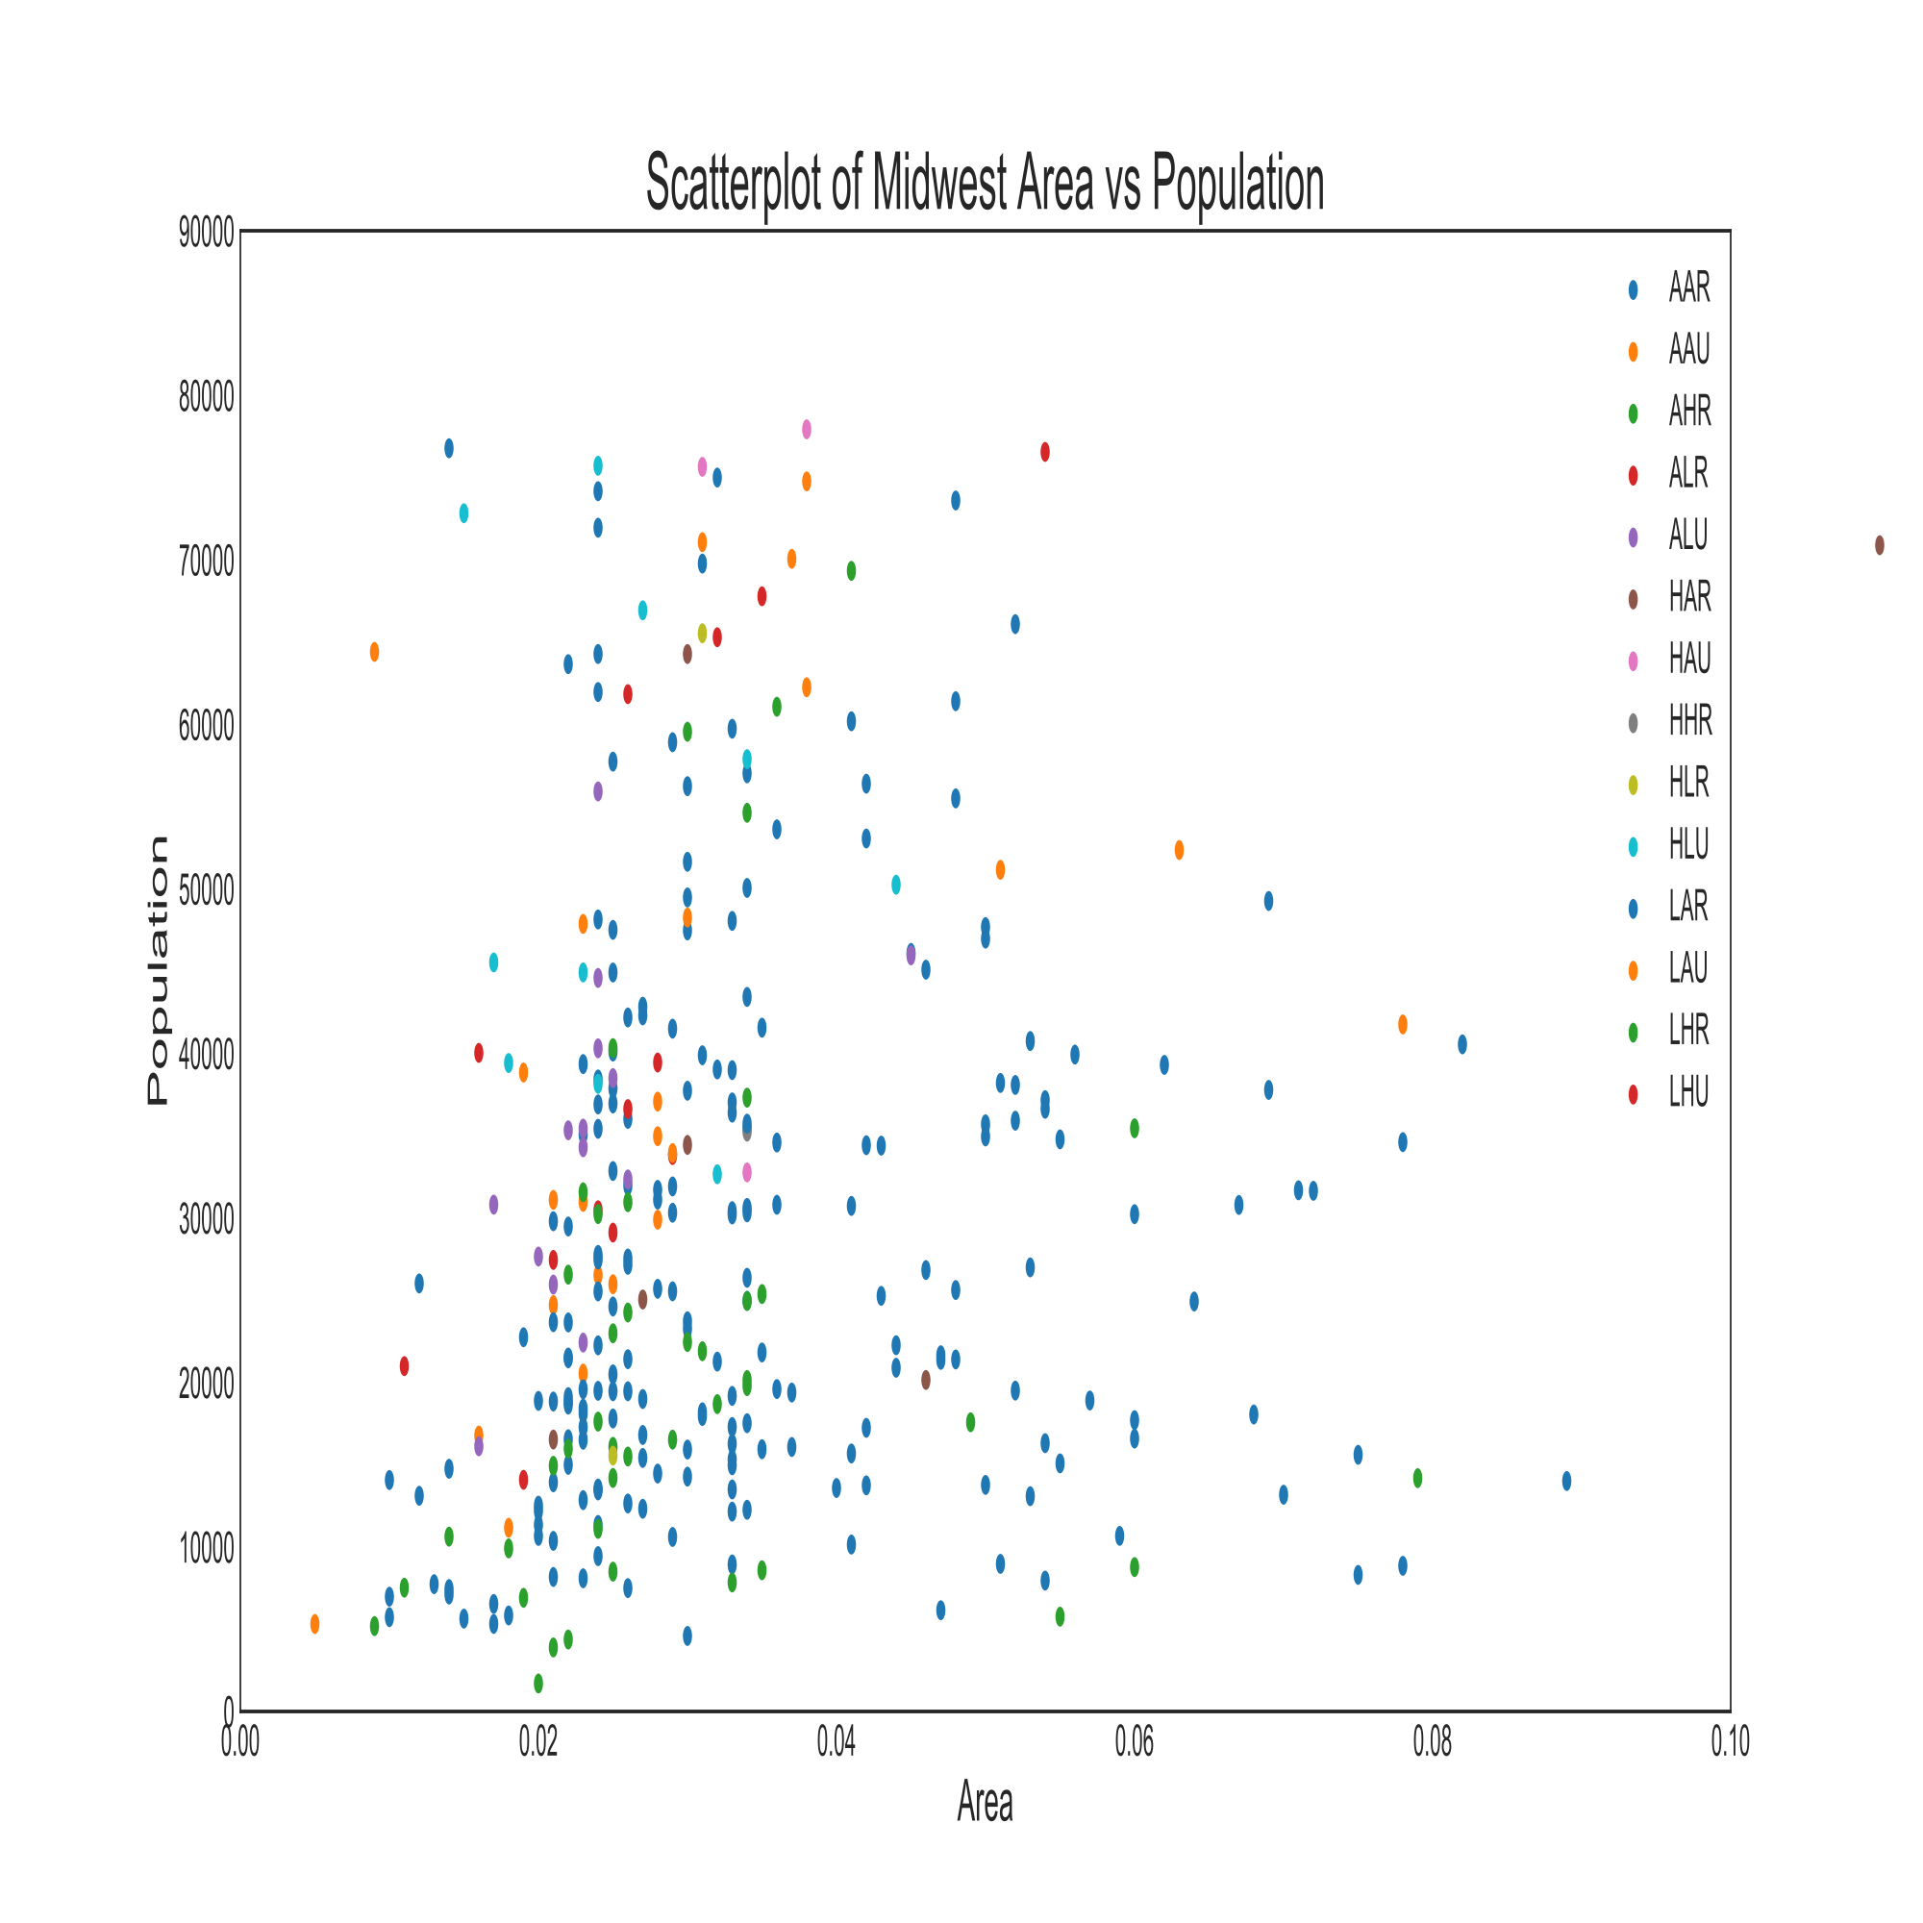
关联——散点图（Scatter plot）
代 码
#Import dataset
import numpy as np
import pandas as pd
import matplotlib.pyplot as plt
midwest = pd.read_csv("https://raw.githubusercontent.com/selva86/datasets/master/midwest_filter.csv")
categories = np.unique(midwest['category'])
colors = [plt.cm.tab10(i/float(len(categories)-1)) for i in range(len(categories))]
# Draw Plot for Each Category
plt.figure(figsize=(16, 10), dpi= 80, facecolor='w', edgecolor='k')
for i, category in enumerate(categories): plt.scatter('area', 'poptotal',
data=midwest.loc[midwest.category==category, :], s=20, cmap=colors[i], label=str(category))
# Decorations
plt.gca().set(xlim=(0.0, 0.1), ylim=(0, 90000),xlabel='Area', ylabel='Population')
plt.xticks(fontsize=12); plt.yticks(fontsize=12)
plt.title("Scatterplot of Midwest Area vs Population", fontsize=22)
plt.legend(fontsize=12)
plt.show()

Slide 2
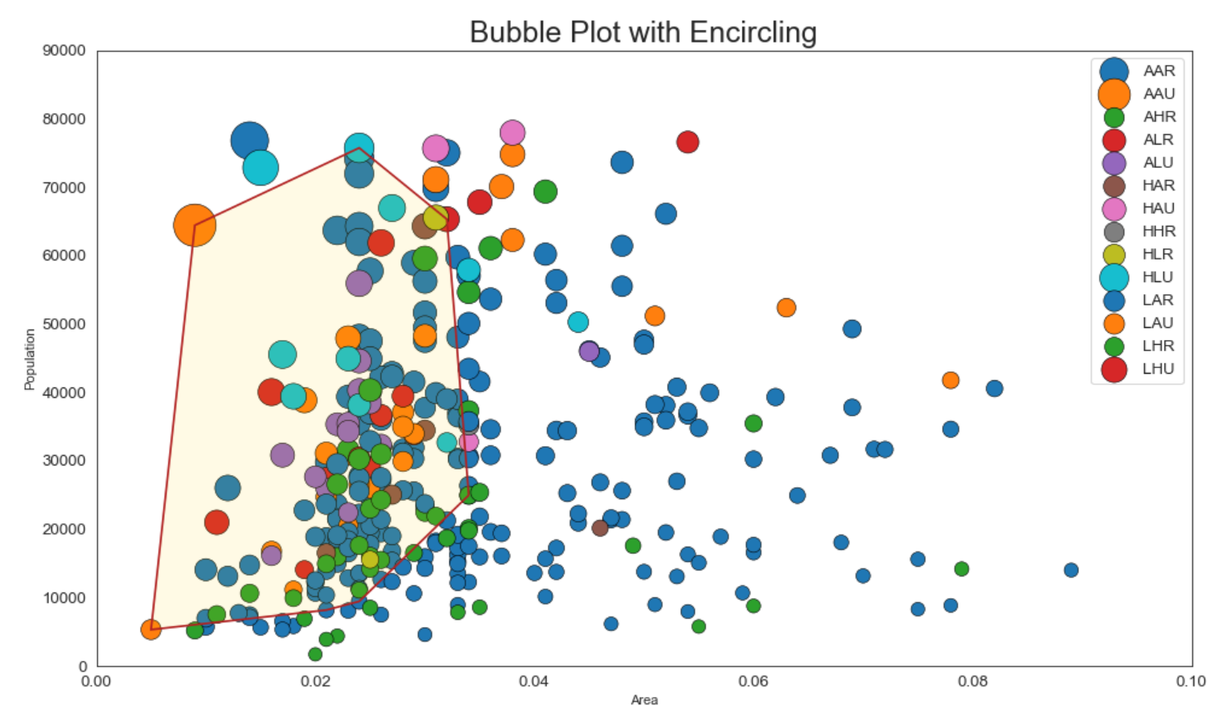
关联——散点图（Scatter plot）
代 码
详细见备注
Notes:
#Import dataset
import numpy as np
import pandas as pd
import matplotlib.pyplot as plt
import seaborn as sns
#带边界的气泡图
from scipy.spatial import ConvexHull
import warnings; warnings.simplefilter('ignore')
sns.set_style("white")
# Step 1: Prepare Data
midwest = pd.read_csv("https://raw.githubusercontent.com/selva86/datasets/master/midwest_filter.csv")
# As many colors as there are unique midwest['category']
categories = np.unique(midwest['category'])
colors = [plt.cm.tab10(i/float(len(categories)-1)) for i in range(len(categories))]
# Step 2: Draw Scatterplot with unique color for each category
fig = plt.figure(figsize=(16, 10), dpi= 80, facecolor='w', edgecolor='k')
for i, category in enumerate(categories):
plt.scatter('area', 'poptotal', data=midwest.loc[midwest.category==category, :],
s='dot_size', cmap=colors[i], label=str(category), edgecolors='black', linewidths=.5)
# "c=" 修改为 "cmap="，Python数据之道 备注
# Step 3: Encircling
# https://stackoverflow.com/questions/44575681/how-do-i-encircle-different-data-sets-in-scatter-plot
def encircle(x,y, ax=None, **kw):
if not ax: ax=plt.gca()
p = np.c_[x,y]
hull = ConvexHull(p)
poly = plt.Polygon(p[hull.vertices,:], **kw)
ax.add_patch(poly)
# Select data to be encircled
midwest_encircle_data = midwest.loc[midwest.state=='IN', :]
# Draw polygon surrounding vertices
encircle(midwest_encircle_data.area, midwest_encircle_data.poptotal, ec="k", fc="gold", alpha=0.1)
encircle(midwest_encircle_data.area, midwest_encircle_data.poptotal, ec="firebrick", fc="none", linewidth=1.5)
# Step 4: Decorations
plt.gca().set(xlim=(0.0, 0.1), ylim=(0, 90000),
xlabel='Area', ylabel='Population')
plt.xticks(fontsize=12); plt.yticks(fontsize=12)
plt.title("Bubble Plot with Encircling", fontsize=22)
plt.legend(fontsize=12)
plt.show()

Slide 3
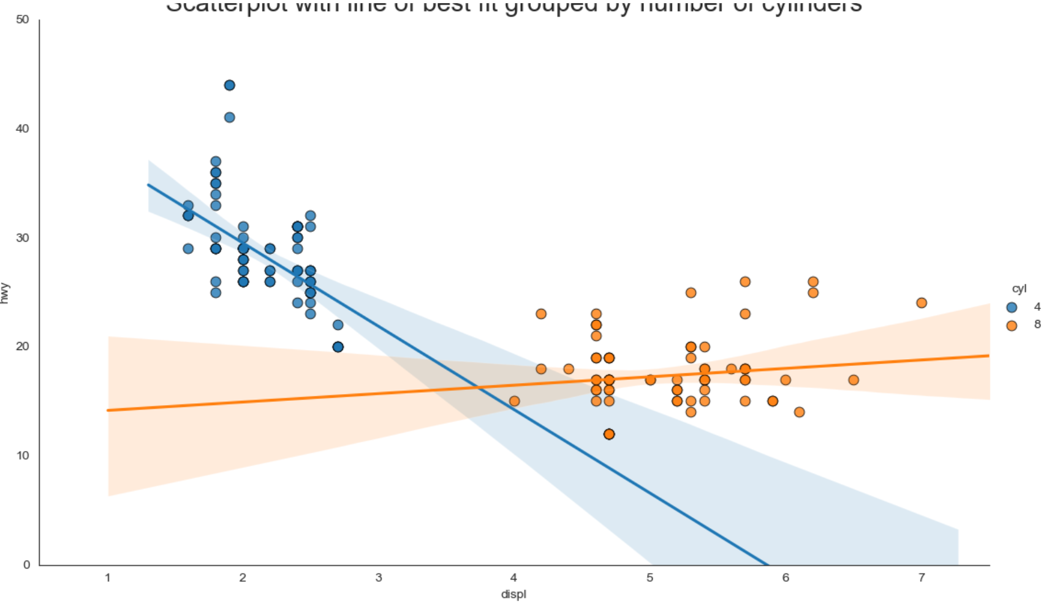
关联——散点图（Scatter plot）
代 码
import pandas as pd
import matplotlib.pyplot as plt
import seaborn as sns
# Import Data
df = pd.read_csv("https://raw.githubusercontent.com/selva86/datasets/master/mpg_ggplot2.csv")
df_select = df.loc[df.cyl.isin([4,8]), :]
# Plot
sns.set_style("white")
gridobj = sns.lmplot(x="displ", y="hwy", hue="cyl", data=df_select, height=7, aspect=1.6, robust=True, palette='tab10', scatter_kws=dict(s=60, linewidths=.7, edgecolors='black'))
# Decorations
gridobj.set(xlim=(0.5, 7.5), ylim=(0, 50))
plt.title("Scatterplot with line of best fit grouped by number of cylinders", fontsize=20)
plt.show()

Slide 4
关联——散点图（Scatter plot）
代 码
#Import dataset
import numpy as np
import pandas as pd
import matplotlib.pyplot as plt
midwest = pd.read_csv("https://raw.githubusercontent.com/selva86/datasets/master/midwest_filter.csv")
categories = np.unique(midwest['category'])
colors = [plt.cm.tab10(i/float(len(categories)-1)) for i in range(len(categories))]
# Draw Plot for Each Category
plt.figure(figsize=(16, 10), dpi= 80, facecolor='w', edgecolor='k')
for i, category in enumerate(categories): plt.scatter('area', 'poptotal',
data=midwest.loc[midwest.category==category, :], s=20, cmap=colors[i], label=str(category))
# Decorations
plt.gca().set(xlim=(0.0, 0.1), ylim=(0, 90000),xlabel='Area', ylabel='Population')
plt.xticks(fontsize=12); plt.yticks(fontsize=12)
plt.title("Scatterplot of Midwest Area vs Population", fontsize=22)
plt.legend(fontsize=12)
plt.show()

Slide 5
关联——散点图（Scatter plot）
代 码
#Import dataset
import numpy as np
import pandas as pd
import matplotlib.pyplot as plt
midwest = pd.read_csv("https://raw.githubusercontent.com/selva86/datasets/master/midwest_filter.csv")
categories = np.unique(midwest['category'])
colors = [plt.cm.tab10(i/float(len(categories)-1)) for i in range(len(categories))]
# Draw Plot for Each Category
plt.figure(figsize=(16, 10), dpi= 80, facecolor='w', edgecolor='k')
for i, category in enumerate(categories): plt.scatter('area', 'poptotal',
data=midwest.loc[midwest.category==category, :], s=20, cmap=colors[i], label=str(category))
# Decorations
plt.gca().set(xlim=(0.0, 0.1), ylim=(0, 90000),xlabel='Area', ylabel='Population')
plt.xticks(fontsize=12); plt.yticks(fontsize=12)
plt.title("Scatterplot of Midwest Area vs Population", fontsize=22)
plt.legend(fontsize=12)
plt.show()

