Slide 1
Data Quality of Generative Images for Object Detection
Presenter: Jingcheng Qian 1640690
Notes:
Good afternoon everyone. My name is Jingcheng Qian, and today I’ll be presenting my research titled *“Data Quality of Generative Images for Object Detection.”*
This study lies at the intersection of computer vision and generative AI. It explores a practical question: whether AI-generated images can genuinely support the training of visual recognition systems, especially in cases where real data is scarce or costly to collect.

Slide 2
Background
Data Bottleneck
costly annotation
data-hungry detectors
Limits of Augmentation
pixel transforms only
no new scenes
Notes:
Object detection is fundamental in applications like autonomous driving, robotics, and security. Yet, these systems are highly data-hungry — they rely on large numbers of labeled images, where each object must be carefully annotated with bounding boxes and class names.

Slide 3
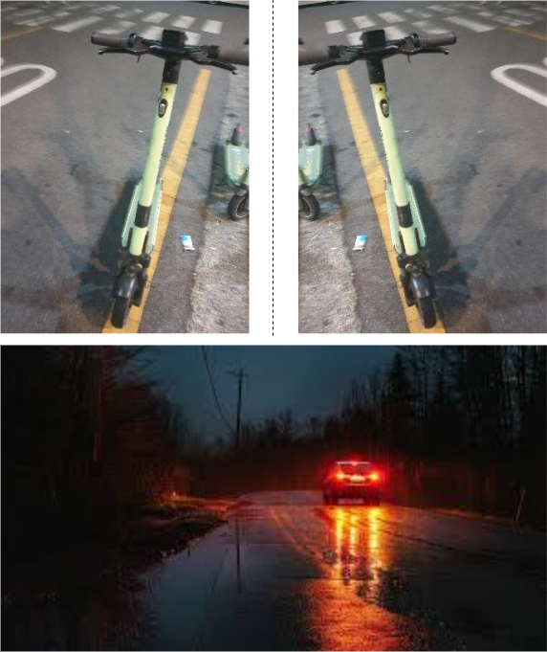
Background
Data Bottleneck
costly annotation
data-hungry detectors
Limits of Augmentation
pixel transforms only
no new scenes
Long-Tail Challenge
rare events, harsh conditions
safety-critical domains
Figure 1: Traditional methods (rotate, flip,…) cannot create unseen events.
Notes:
Traditional data augmentation methods like rotation and flipping can improve generalization, but they only modify existing pixels. They cannot create new events, unseen scenes, or rare situations. In real-world datasets, some events occur often, like clear daytime driving, while rare but safety-critical ones — such as rainstorms, fog, or an ambulance on the road — are underrepresented. This imbalance is known as the long-tail problem.
When models are trained mostly on common cases, they struggle in rare conditions, which can directly affect performance and safety. Generative synthesis provides an opportunity to address this by producing diverse, rare, and challenging scenarios that help balance the dataset.

Slide 4
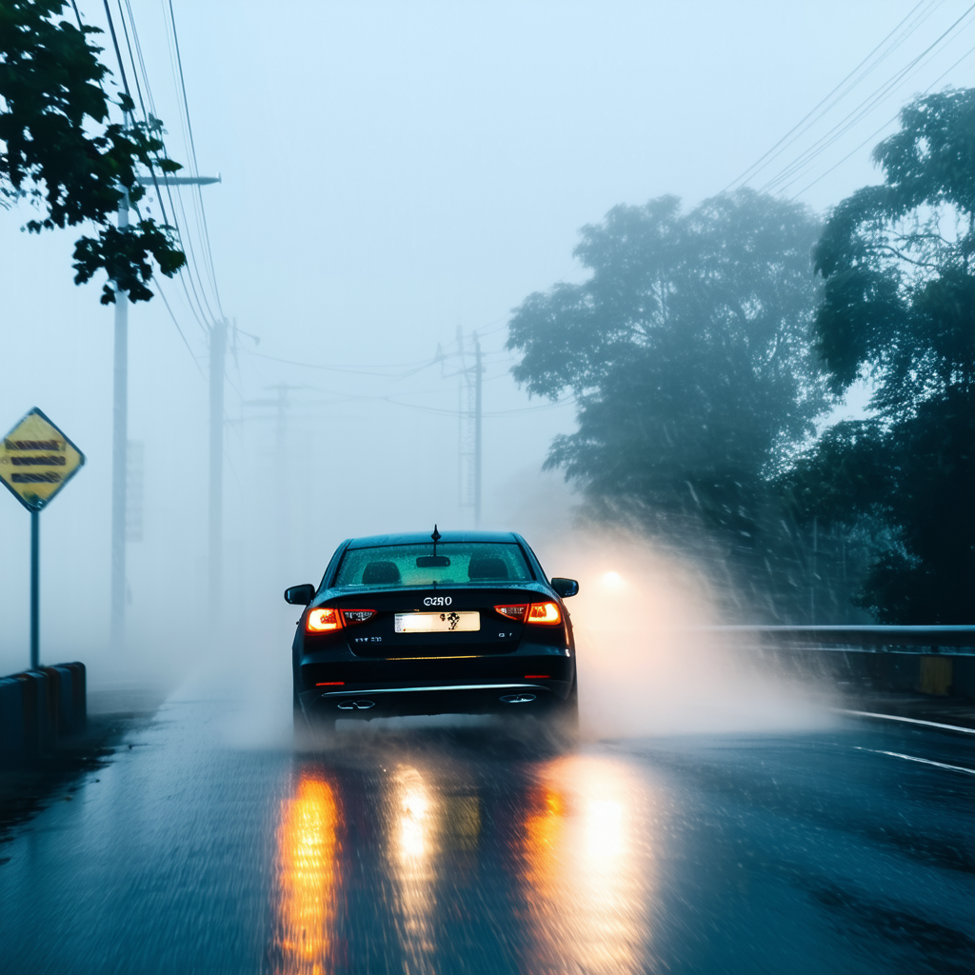
Background
Data Bottleneck
costly annotation
data-hungry detectors
Limits of Augmentation
pixel transforms only
no new scenes
Long-Tail Challenge
rare events, harsh conditions
safety-critical domains
Generative Models
Bridge between real and synthetic data
Figure 1: Traditional methods (rotate, flip,…) cannot create unseen events.
Figure 2: Image generated by prompt ‘a car in foggy weather’ using SD3.5-Large.
Notes:
Recent advances in generative AI, especially diffusion models, have opened a new path for data generation. These models learn from large image datasets and can create realistic new scenes from simple text prompts or structural inputs.
This makes them a practical way to expand training data in domains where real images are limited. The question is whether these generated images can actually improve detection performance, not just look realistic.

Slide 5
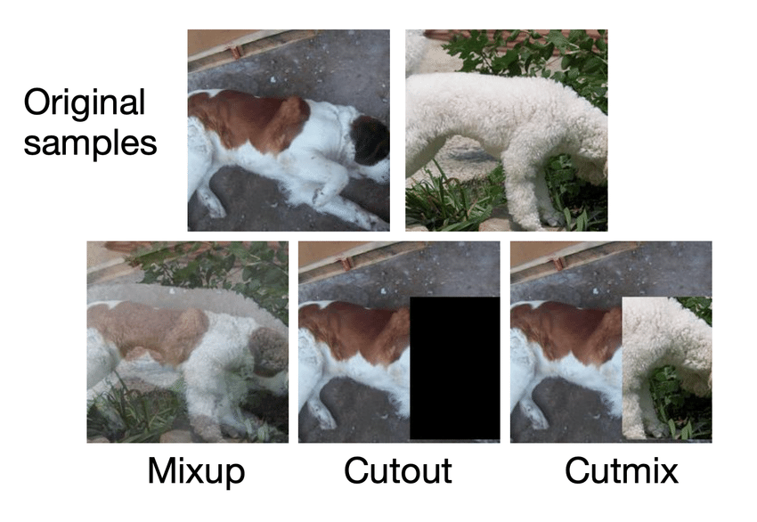
Motivation: Previous Work
Traditional Augmentation
rotate, crop, or mix
can’t generate unseen scenes
Notes:
Previous research explored several approaches. Traditional augmentation methods like MixUp, CutMix, or Copy-Paste improve diversity but are limited to pixel-level operations — they don’t introduce new object relationships or unseen scene layouts.

Slide 6
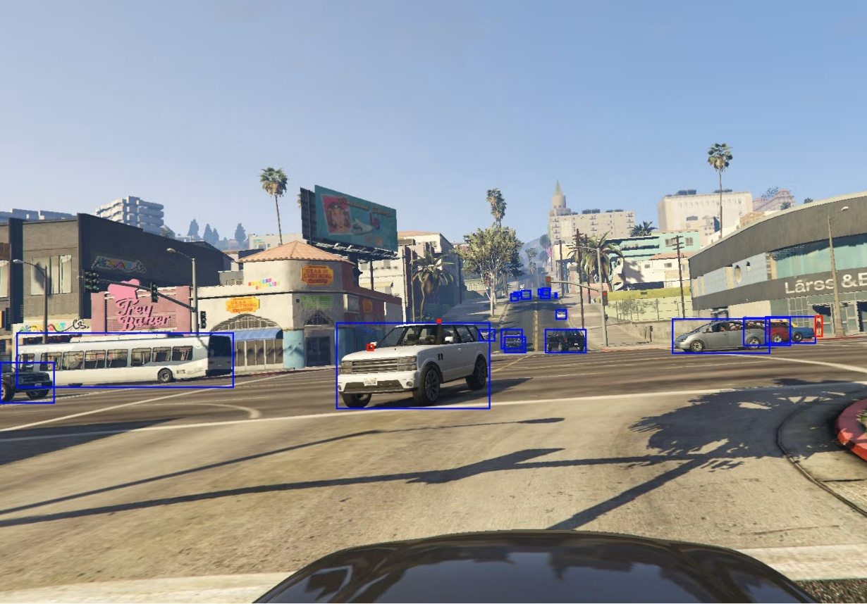
Motivation: Previous Work
Traditional Augmentation
rotate, crop, or mix
can’t generate unseen scenes
Simulation
GTA-V/CARLA can render labeled scenes
look artificial and unrealistic
Notes:
Simulation-based datasets, such as those from GTA-V or CARLA, can render labeled images automatically, but they often look artificial, lacking the realism of natural lighting and textures.

Slide 7
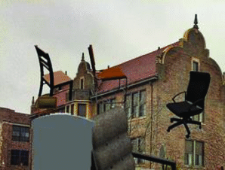
Motivation: Previous Work
Traditional Augmentation
rotate, crop, or mix
can’t generate unseen scenes
Simulation
GTA-V/CARLA can render labeled scenes
look artificial and unrealistic
Domain Adaptation
converts synthetic to realistic images
domain gap remains
Notes:
Domain adaptation techniques aim to reduce the visual gap between synthetic and real data, yet the differences in texture and style often remain noticeable.
While these methods have made progress, they all share a common limitation — they can’t fully capture the richness and diversity of real-world scenes. This is where modern generative models start to make a difference.

Slide 8
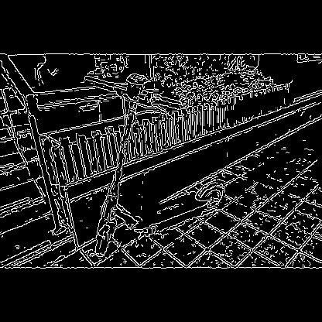
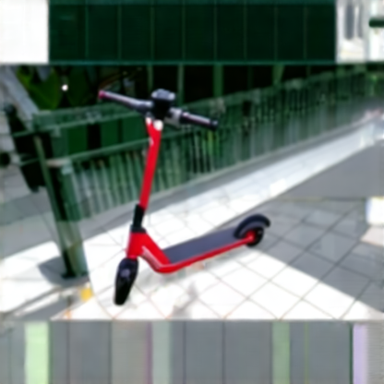
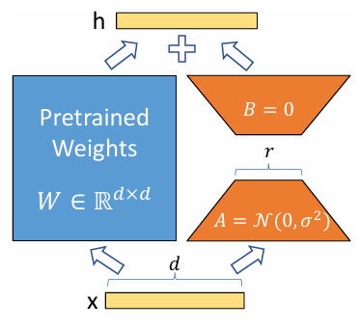
Motivation: Advances in Generative Models
Controlnet
structural information
respect the original layout
Figure 3: LoRA’s reparametrization, which only trains A and B.
Figure 3: Canny map controlnet example
Notes:
Diffusion models have recently surpassed GANs and VAEs in both image quality and controllability. A major innovation is *controllable generation* — the ability to guide how and where objects appear within a scene.
ControlNet enables structural guidance by taking inputs such as edge maps, depth maps, or segmentation layouts, helping the model maintain spatial accuracy and label consistency.

Slide 9
Motivation: Advances in Generative Models
Controlnet
structural information
respect the original layout
LoRA (Low-Rank Adaptation)
lightweight tuning method
adapt to a new domain
Figure 3: Canny map controlnet example
Figure 4: LoRA’s reparametrization, which only trains A and B.
Notes:
Another important component is Low-Rank Adaptation. Originally developed for large language models, LoRA was designed to fine-tune massive networks efficiently by updating only a small number of parameters instead of retraining the entire model. This idea has since been successfully transferred to diffusion models, allowing them to adapt quickly to new visual domains.
Despite these advances, there is still no systematic study on how elements like ControlNet and LoRA jointly influence the quality of generated data and their actual benefit for object detection tasks.

Slide 10
Research Objectives
Quantify domain gap (real vs synthetic)
Evaluate cross-domain robustness
Assess realism & annotation consistency
Provide best practices for generative data use
Identify the contribution of individual components through ablation studies
Notes:
Building on these ideas, this research focuses on four main objectives.
**quantify the domain gap** between real and synthetic data using multiple visual and semantic metrics.
**evaluate cross-domain robustness**, examining how well models trained with generative data perform when applied to real-world images.
**assess the realism and annotation consistency** of generated samples, ensuring they are both visually convincing and semantically accurate.
**develop best practices** for using generative data effectively in object detection training pipelines.
And additionally, **Identify the contribution of individual components** in the generative augmentation pipeline through **ablation studies**.

Slide 11
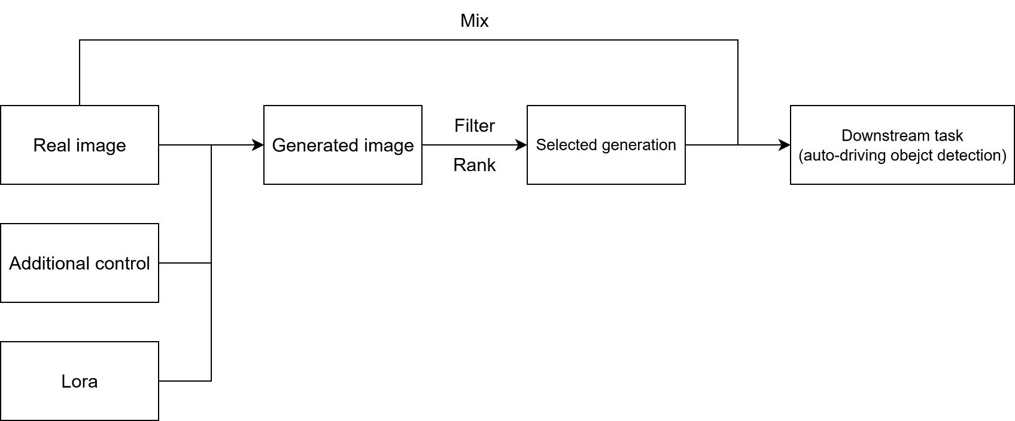
Research Framework
A closed-loop research framework includes:
Controlled data generation
Quality filtering
Detector training
Multi-level evaluation
Figure 5: Pipeline of the closed-loop research framework.
Notes:
The research follows a four-stage framework: **generation**, **filtering**, **training**, and **evaluation**.
In the generation stage, diffusion models enhanced with ControlNet and LoRA are used to produce controllable and adaptive synthetic data. The filtering stage then selects high-quality samples using perceptual and semantic metrics such as **CLIP**, which measures image–text alignment, and **DINOv2**, which captures semantic similarity between visual features.
Training proceeds with different ratios of real and synthetic data, while the evaluation stage measures both visual quality and detection performance. The feedback from each stage is used to refine the generation process, ensuring that improvements are measurable and consistently validated.

Slide 12
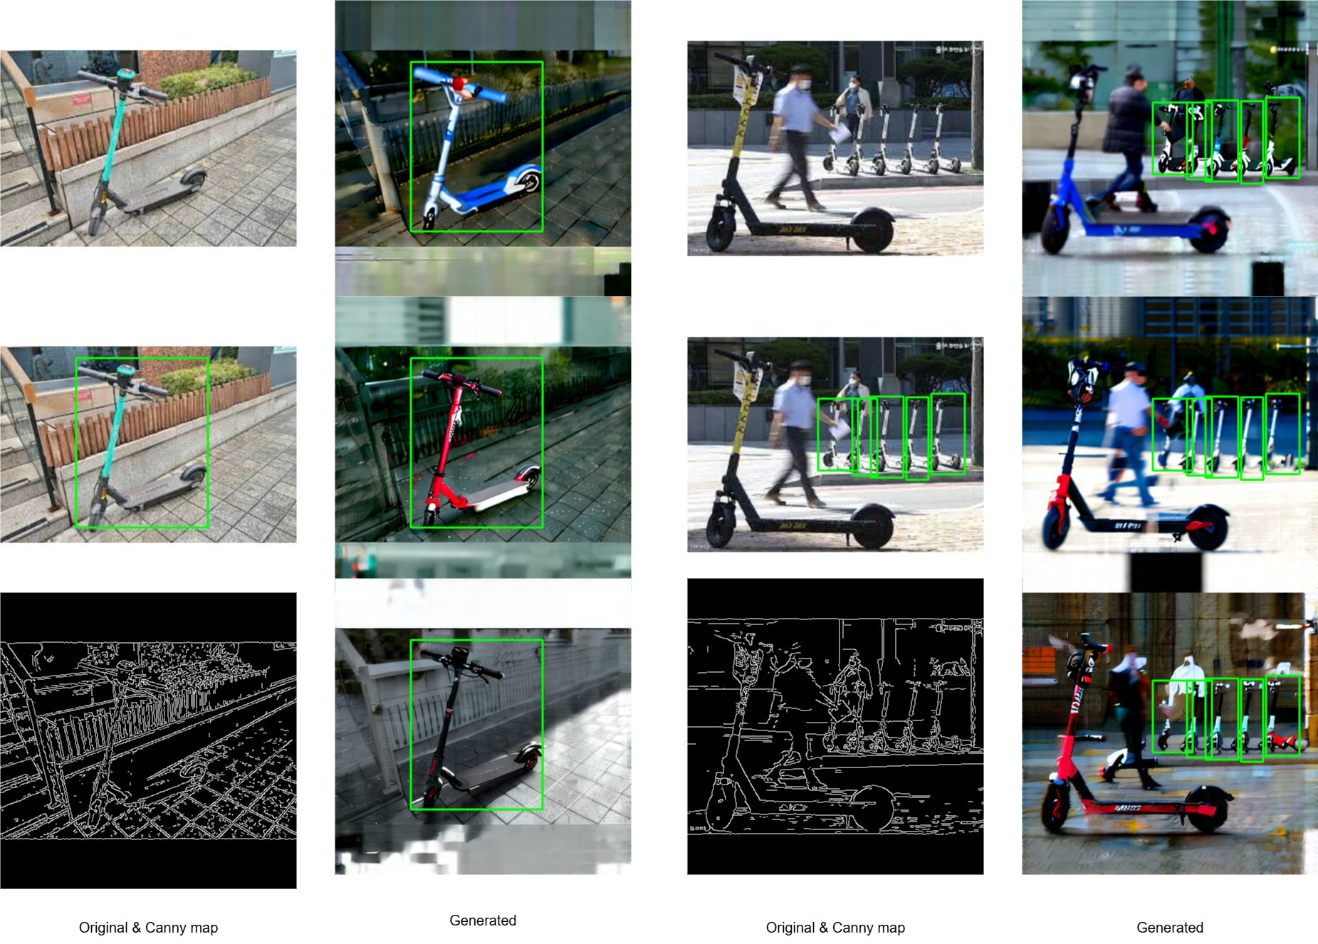
Methodology: Generation Pipeline
Framework: ComfyUI
modular, node-based workflow
flexible combination & reproducibility
Core Models: Stable Diffusion, FLUX
Structural Control: ControlNet
visual prior conditioning
ensures spatial and label consistency
Lightweight Adaptation: LoRA
efficient domain fine-tuning
improves realism without full retraining
Figure 6: Current ComfyUI workflow using SD3.5 and canny controlnet generation.
Notes:
The generation pipeline is implemented using ComfyUI, a modular and node-based workflow system that supports flexible and reproducible design.
We start with an **original image**, which is first converted into a **Canny edge map**.
That edge map is then fed into **ControlNet**, guiding the diffusion model to generate a new image that keeps the same structure and layout.
Next, **LoRA** helps adapt the model to different domains — for example, turning a daytime highway scene into a realistic nighttime or foggy version — without the need for full retraining.
Finally, we **reuse the original bounding-box annotations** and apply them directly to the generated image.
This way, we can automatically create realistic and well-labeled data at scale, greatly reducing the need for manual labeling.
Together, these steps make the pipeline both flexible and efficient for object detection training.

Slide 13
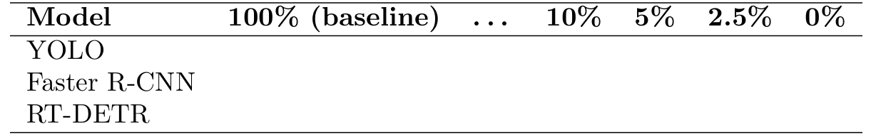
Methodology: Downstream Task
Detection Models: YOLO, RT-DETR
balance between accuracy and real-time efficiency
Training Strategy
mixed ratios of real & synthetic data
Objective
quantify value of generative data
identify optimal balance for cost-effective training
Table 1: Planned training configurations with different real–synthetic data ratios.
Notes:
After generating the synthetic dataset, we move to the downstream task.
Here, I focus on two representative object detectors: **YOLO** and **RT-DETR**. These models strike a balance between accuracy and real-time efficiency, making them suitable for practical applications like autonomous driving.
The **training strategy** involves mixing real and synthetic data in different ratios — from entirely real to heavily synthetic — to explore how generative data contributes under various levels of data scarcity.
The main **objective** of this stage is to quantify the value of synthetic data and identify the most cost-effective balance between real and generated samples. This helps determine how much real data can be replaced without significant performance loss.

Slide 14
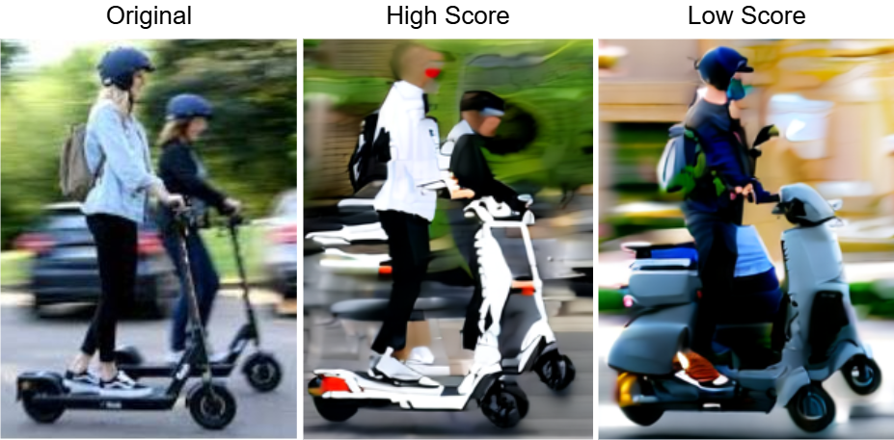
Evaluation
Downstream Performance
mAP, AP50
task-oriented measure
Perceptual Quality
FID, IS
fidelity & diversity
Semantic Consistency
CLIP / DINOv2 Score
alignment with labels
Human Evaluation
subjective realism & annotation faithfulness
complements automated metrics
Figure 7: Higher CLIP/DINOv2 scores indicate stronger semantic faithfulness.
Notes:
After training, the models are evaluated through multiple perspectives to understand both task performance and data quality.
For **downstream performance**, I use standard object detection metrics such as *mean Average Precision (mAP)* and *AP50*, which directly measure how well the model detects and localizes objects. These are task-oriented indicators that reflect real-world performance.
Next, **perceptual quality** is assessed using *FID* and *IS* scores to evaluate the fidelity and diversity of the generated images. Lower FID and higher IS values indicate more realistic and varied results.
To measure **semantic consistency**, I use *CLIP* and *DINOv2* similarity scores, which capture how well the image content aligns with its intended labels or descriptions.
*(Here on the slide, you can see examples of generated images with different semantic scores. Images with higher CLIP and DINOv2 scores appear more faithful to the intended object or scene.)*
Finally, **human evaluation** complements these automated metrics. Participants rate the realism and annotation accuracy of generated samples, providing qualitative insights that pure numerical scores may miss.
Together, these layers of evaluation reveal how visual quality relates to real detection performance, offering a comprehensive understanding of data usefulness.

Slide 15
Expected Contributions
Clarify the domain gap between real and synthetic data and quantify its impact on object detection accuracy.
Demonstrate the transferability of detectors trained on synthetic data to real-world environments.
Establish evaluation criteria connecting image diversity, realism, and annotation consistency to detection performance.
Formulate practical guidelines for integrating generative data into object detection training pipelines.
Notes:
*(slight pause, smile)*
To wrap up today’s presentation, I’d like to highlight the **key contributions** of this research.
*(short pause)*
**First**, it aims to **clarify the domain gap** between real and synthetic data — and **quantify** how that gap actually impacts object detection accuracy.
*(beat)*
**Second**, it will **demonstrate the transferability** of detectors trained with synthetic data. In other words, we’ll see **how well these models perform** when applied to **real-world conditions**, especially in those *rare or adverse scenarios* where real data is hard to collect.
*(slight shift in tone)*
**Third**, the study will **establish evaluation criteria** that link **image diversity, realism, and annotation consistency** to downstream detection performance. This combines both **traditional metrics**, and **semantic verifiers**, giving us a *fuller picture* of data quality.
*(pause, slightly more animated)*
And **finally**, it will **formulate practical guidelines** for integrating generative data into detection pipelines — identifying what really matters, from **prompt design** and **structural control**, to **fine-tuning** and **post-processing**.
*(gentle close)*
Together, these efforts aim to **bridge the gap** between **generative modeling** and **applied computer vision**, offering both **empirical evidence** and **actionable methods** for making synthetic data truly useful in practice.
*(pause, nod)*
Thank you.

Slide 16
Reference
H. Fang, B. Han, S. Zhang, S. Zhou, C. Hu and W. -M. Ye, "Data Augmentation for Object Detection via Controllable Diffusion Models," 2024 IEEE/CVF Winter Conference on Applications of Computer Vision (WACV), Waikoloa, HI, USA, 2024, pp. 1246-1255, doi: 10.1109/WACV57701.2024.00129.
L. Zhang, A. Rao and M. Agrawala, "Adding Conditional Control to Text-to-Image Diffusion Models," 2023 IEEE/CVF International Conference on Computer Vision (ICCV), Paris, France, 2023, pp. 3813-3824, doi: 10.1109/ICCV51070.2023.00355.
Hu, E.J., Shen, Y., Wallis, P., Allen-Zhu, Z., Li, Y., Wang, S., Wang, L. and Chen, W., 2022. Lora: Low-rank adaptation of large language models. ICLR, 1(2), p.3.
Nowruzi, Farzan Erlik, et al. "How much real data do we actually need: Analyzing object detection performance using synthetic and real data." arXiv preprint arXiv:1907.07061 (2019).

Slide 17
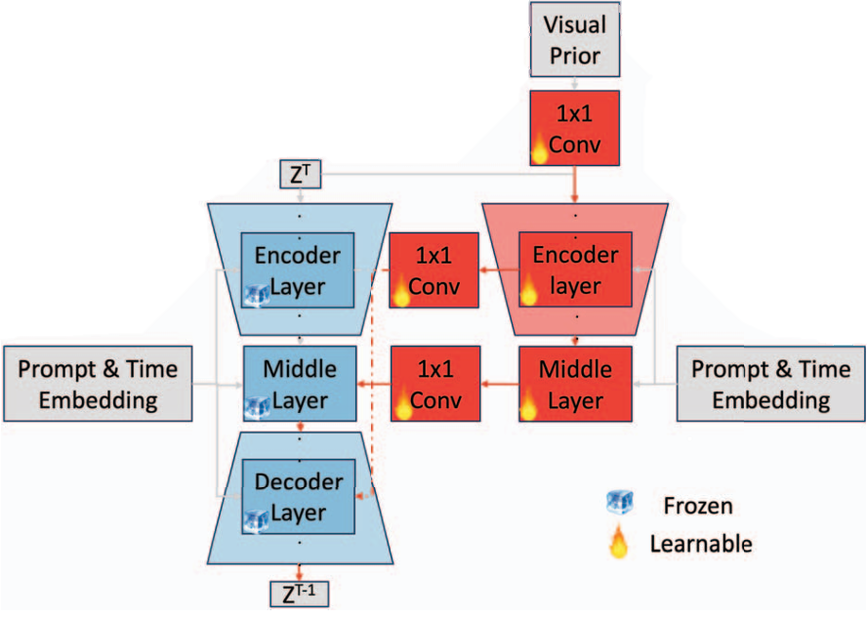
Appendix
Figure: Structure of the controllable diffusion model.

