Slide 1
Data Quality of Generative Images for Object Detection, Real vs Generated
Presenter: Jingcheng Qian
Supervised by: Dr. Mansooreh Zahedi, Dr. Christoph Treude, Brian Du
In collaboration with Swordfish Computing
Notes:
Good afternoon everyone. My name is Jingcheng Qian, and today I’ll be presenting my research on “Data Quality of Generative Images for Object Detection.”

Slide 2
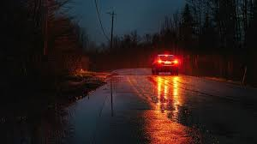
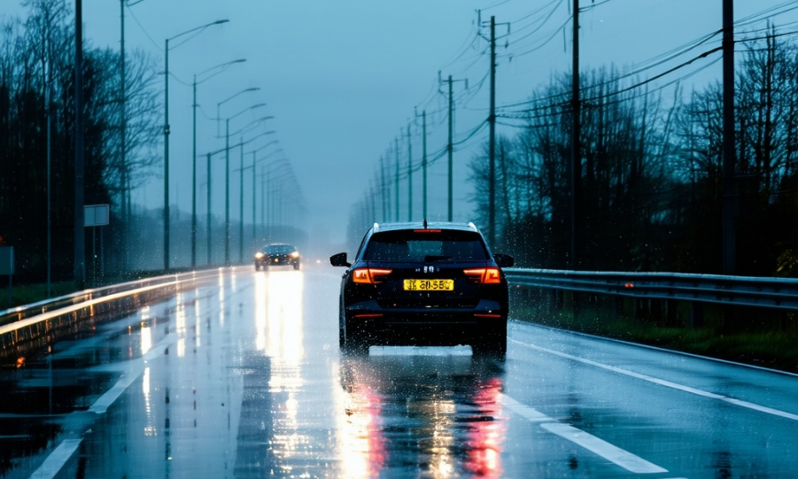
Introduction
Data Challenge → Modern object detection relies on large, labeled datasets.
→ But collecting diverse real-world scenes is costly, time-consuming, and often fails to cover rare or new cases.
Generative AI Opportunity
→ Diffusion models can generate realistic and diverse synthetic scenes, enriching data when real samples are limited^{[1]}.
However, their quality and effectiveness for detection remain uncertain.
Research: How AI-generated data improve accuracy and under what conditions.
Figure 1: Top: Real scene — a car on wet road at dusk.
Bottom: Generated scene — “a car on wet road at dusk” via Stable Diffusion^{[2]}
[1] Dhariwal & Nichol, Diffusion Models Beat GANs on Image Synthesis, NIPS 2021.
[2] Rombach, R. et al., High-Resolution Image Synthesis with Latent Diffusion Models, CVPR 2022.
Notes:
In the past decade, object detection has become powerful and easy to use. Thanks to open-source models and affordable hardware, almost anyone can train a detector even on a laptop.
But what really limits progress today is still data, not the model. In academia, we usually focus on improving architectures using large, public datasets. But in the industry, it’s a very different story — companies often need to detect uncommon or new types of objects, and they usually have very limited labeled data to work with.
That’s where Generative AI comes in. Diffusion models can now create realistic and diverse AI-generated scenes, offering a way to expand datasets when real samples are limited.
(In the figure here — the top shows a real photo captured at dusk, and the bottom is a diffusion-generated version — similar scene, but created entirely from text.)
However, the quality and usefulness of such data for detection are still uncertain.
So, in collaboration with Swordfish Computing, this research explores how generated data improve accuracy and under what conditions.

Slide 3
Outline
Introduction
Background
Data Bottleneck
Current Methods
Controllable Diffusion Models
Research Objective
Research Framework
Methodology
Dataset
Generation Pipeline
Downstream Tasks
Evaluation & Metrics
Notes:
So, here’s the outline for today’s talk.
I’ll start with some background — what’s the key data challenge and why it matters.
Then I’ll briefly go over current methods and their limitations.
After that, I’ll introduce controllable diffusion models and discuss the main research objective and tasks.
Finally, I’ll explain the overall framework, including the methodology, dataset, generation pipeline, and how we evaluate the results.

Slide 4
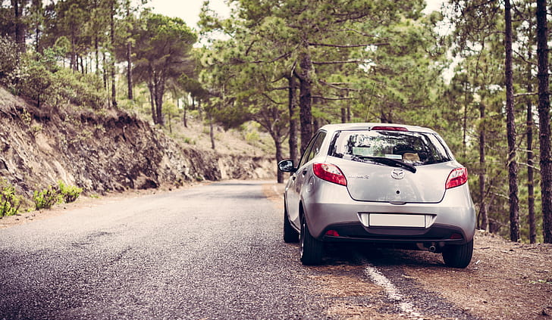
Background: Data Bottleneck
Modern object detection models are data-hungry — they rely on large, labeled datasets.
Long-tail Problem
→ Real datasets are also imbalanced — common cases dominate, while rare but critical ones are underrepresented.
Consequence
→ models struggle in unseen or rare scenarios, limiting real-world robustness.
Figure 2: Comparison between common and rare scenarios: Top: Frequent clear-day driving scene (well represented in datasets); Bottom: Rare foggy scene (underrepresented long-tail case).
Notes:
Modern object detection systems are extremely data-hungry — they require massive amounts of well-labeled images. But in practice, collecting and annotating diverse real-world scenes is both expensive and time-consuming. Even after all that effort, datasets are often unbalanced. Common situations, like clear daytime driving, appear in abundance, while rare but safety-critical ones — such as fog, night, or emergencies — are scarce. This imbalance, known as the long-tail problem, creates a major data bottleneck. As a result, models perform well on frequent cases but struggle to generalize to rare or unseen scenarios.

Slide 5
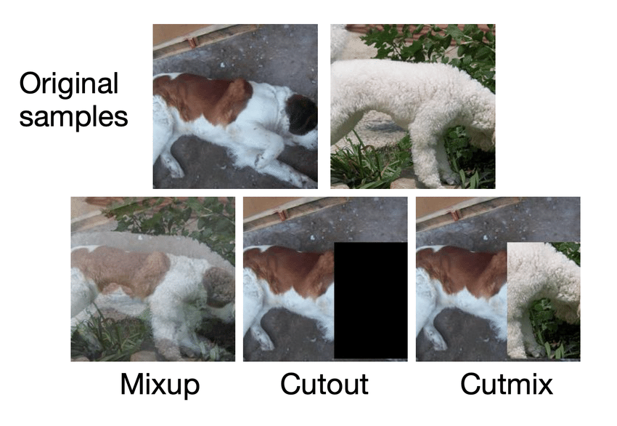
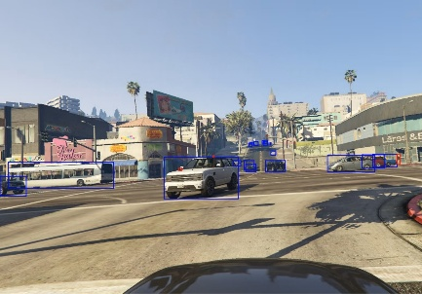
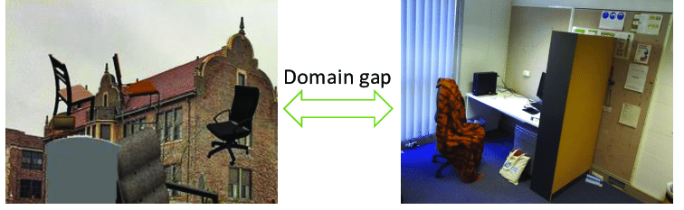
Background: Current Methods
Traditional Augmentation → Simple pixel-level transforms such as rotation, cropping, or mixing. → Cons: cannot create new or unseen scenes.
Simulation → Platforms like GTA-V or CARLA can render labeled images automatically. → Cons: often look artificial and unrealistic.
Domain Adaptation → Converts synthetic images into more realistic styles. → Cons: the domain gap between synthetic and real data remains.
Figure 3: Top-left: Traditional augmentation method (Mix^{[3]}). Top-right: Simulation engines generate labeled synthetic scenes^{[4]}. Bottom: Domain adaptation narrows the visual gap between synthetic and real images, yet a clear domain gap remains^{[5]}.
[3] Yun, S. et al., CutMix: Regularization Strategy to Train Strong Classifiers with Localizable Features, ICCV 2019.
[4] Richter, S. R. et al., Playing for Data: Ground Truth from Computer Games, ECCV 2016.
[5] Laga et al., A Survey on Deep Learning Techniques for Stereo-Based Depth Estimation, IEEE TPAMI, 2022.
Notes:
Researchers have explored several methods to overcome the data bottleneck.
(These three figures show examples of the methods)
First, traditional augmentation techniques like rotation, cropping, or pixel mixing can slightly improve diversity, but they only modify existing images and can’t create new or unseen scenes.
Second, simulation-based datasets, like GTA-V, automatically generate labeled scenes at scale. However, these images often appear too clean or artificial, lacking the natural lighting and textures of real photos.
Finally, domain adaptation techniques try to make generated images look more realistic by transferring styles, but some visual inconsistencies always remain.
Despite these efforts, there’s still a clear gap between generated and real data. This is where modern generative models start to make a difference.

Slide 6
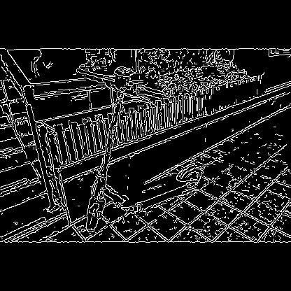
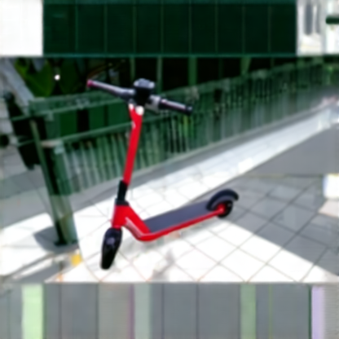
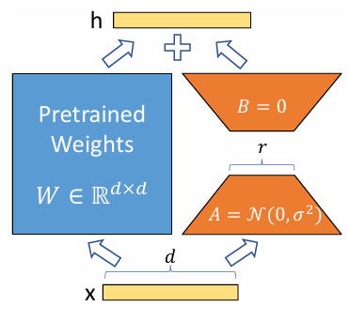
Background: Controllable Diffusion Models
Diffusion Models → Generate realistic, diverse images beyond existing data. → Shift from modifying pixels to creating new events.
ControlNet^{[6]} → Injects structural information such as edges and depth. → Ensures generated images respect the original layout and spatial consistency.
LoRA^{[7]} (Low-Rank Adaptation) → A lightweight tuning method that adapts diffusion models to new domains. → Enables fast, efficient fine-tuning for specific conditions (e.g., fog, night).
Figure 4: Structural Control with ControlNet. Edge maps guide generation while preserving spatial layout.
Figure 5: Lightweight Domain Adaptation with LoRA. Fine-tunes diffusion models efficiently to adapt to new visual domains.
[6] Zhang, L., Rao, A., & Agrawala, M., Adding Conditional Control to Text-to-Image Diffusion Models, ICCV 2023.
[7] Hu, E. J. et al., LoRA: Low-Rank Adaptation of Large Language Models, ICLR 2022.
Notes:
Recent advances in diffusion models have opened a new path for data generation.
Unlike traditional augmentation, these models can actually create new and realistic scenes, instead of simply transforming existing pixels.
ControlNet plays a key role by adding structure — like edges, depth maps, or segmentation layouts — so that the generated images maintain accurate spatial relationships and respect the original layout.
Low-Rank Adaptation, Originally developed for large language models, LoRA was designed to fine-tune massive networks efficiently by updating only a small number of parameters instead of retraining the entire model. This idea has since been successfully transferred to diffusion models, allowing them to adapt quickly to new visual domains. For instance, converting daytime scenes into foggy or nighttime environments — without full retraining.
Together, these components make diffusion models both controllable and adaptable.

Slide 7
Research Objective
Research Objective: Evaluate the effectiveness and reliability of synthetic data in object detection.
Research Tasks:
Quantify the domain gap between real and synthetic data
Evaluate cross-domain robustness
Assess realism and annotation consistency
Provide best practices for generative data use
Identify component contributions via ablation studies
Notes:
Building on these ideas, this research aims to evaluate the effectiveness and reliability of generated data in object detection.
To achieve this goal, the study focuses on several key tasks:
quantify the domain gap between real and generated data using multiple visual and semantic metrics.
evaluate cross-domain robustness, examining how well models trained with generative data perform when applied to real-world images.
assess the realism and annotation consistency of generated samples, ensuring they are both visually convincing and semantically accurate.
develop best practices for using generative data effectively in object detection training pipelines.
And additionally, Identify the contribution of individual components in the generative augmentation pipeline through **ablation studies**.

Slide 8
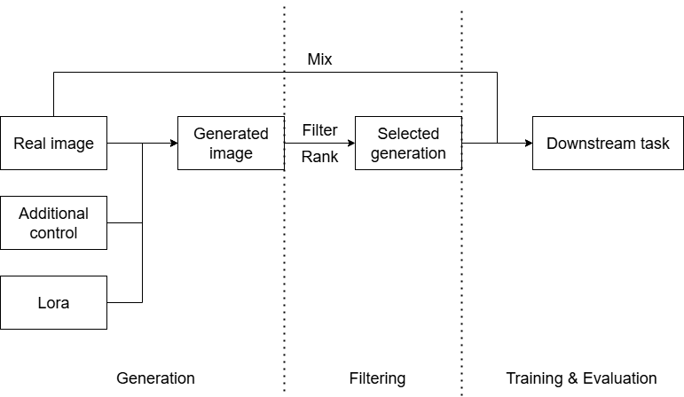
Research Framework
A closed-loop research framework includes:
Controlled data generation
Quality filtering
Detector training
Multi-level evaluation
Figure 6: Pipeline of the closed-loop research framework.
Notes:
The research follows a four-stage framework: generation, filtering, training, and evaluation. (Figure 6 shows the pipeline of our closed-loop research framework)
In the generation stage, diffusion models enhanced with ControlNet and LoRA are used to produce controllable and adaptive generated data. The filtering stage then selects high-quality samples using visual and semantic metrics.
Training proceeds with different ratios of real and generated data, then we evaluate both the visual quality and the detection performance. The feedback from each stage is used to refine the generation process, so that improvements are measurable and repeatable.

Slide 9
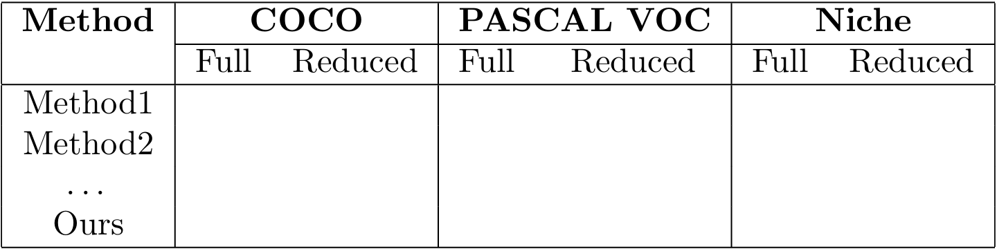
Methodology: Dataset
Dataset Strategy：Validate pipeline on standard benchmarks, then test on niche, domain-specific datasets.
Benchmarks
→ COCO^{[8]} and PASCAL VOC^{[9]}.
→ Use both full sets and reduced subsets to simulate limited data.
Niche & Real-world Datasets
→ Autonomous driving datasets (e.g., from Roboflow, Kaggle) — rare categories & adverse conditions.
→ LoRA fine-tuning on small real-world image sets for realistic textures & lighting.
Table 1: Comparison of different methods across benchmark and niche datasets.
[8] Lin et al., Microsoft COCO: Common Objects in Context, ECCV 2014.
[9] Everingham et al., The PASCAL Visual Object Classes (VOC) Challenge, IJCV 2010.
Notes:
For the dataset setup, we follow a staged strategy.
We begin with benchmark datasets like COCO and PASCAL VOC to validate the pipeline. To simulate real-world data shortage, we also use reduced subsets with only a few dozen images per class.
Then, we move to **niche datasets** from domains like self-driving, focusing on rare objects and difficult conditions. We also fine-tune the diffusion model using LoRA on small real-world image sets to better capture realistic lighting and textures.
This setup lets us compare performance under both rich and limited data conditions, showing how well the generative augmentation adapts to different domains.

Slide 10
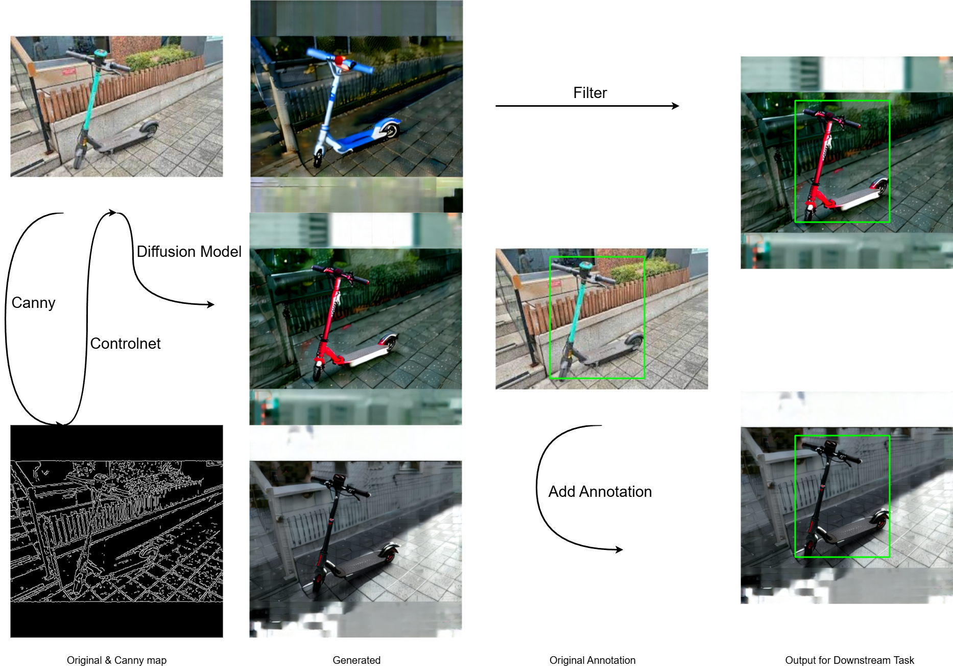
Methodology: Generation Pipeline
Framework: ComfyUI
modular, node-based workflow
flexible combination & reproducibility
Core Models: Stable Diffusion, FLUX
Structural Control: ControlNet
visual prior conditioning
ensures spatial and label consistency
Lightweight Adaptation: LoRA
efficient domain fine-tuning
improves realism without full retraining
Figure 7: Current ComfyUI workflow using SD3.5 and canny controlnet generation.
Notes:
The generation pipeline is developed using ComfyUI, a modular and node-based workflow system that’s flexible and easy to reproduce.
(Here you can see one of our preliminary experimental results. It’s built in ComfyUI and uses Stable Diffusion 3.5 together with the Canny ControlNet to guide the generation process.)
Using a generation example, we start with an original image, which is first converted into a Canny edge map.
That edge map is then fed into ControlNet, guiding the model to make a new image with the same layout.
Next, LoRA helps adapt the model to different domains.
Finally, we reuse the original bounding boxes directly.
This pipeline automatically produces realistic, well-labeled images at scale — greatly reducing manual labeling.

Slide 11
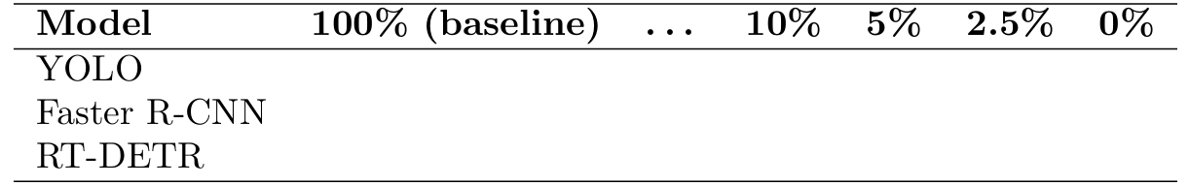
Methodology: Downstream Task
Detection Models: YOLO, Faster R-CNN, RT-DETR
balance between accuracy and real-time efficiency
Training Strategy
mixed ratios of real & synthetic data
Objective
quantify value of generative data
identify optimal balance for cost-effective training
Table 2: Planned training configurations with different real–synthetic data ratios.
Notes:
After generating the generated dataset, we move to the downstream task.
Here, I focus on some representative object detectors: YOLO =Faster R-CNN, RT-DETR. These models balance accuracy and real-time efficiency, making them suitable for practical applications like self-driving.
The training strategy involves mixing real and generated data in different ratios — from entirely real to heavily generated — to explore how generative data contributes under various levels of limited data.
The main objective of this stage is to quantify the value of generated data and identify the most cost-effective balance between real and generated samples. This helps determine how much real data can be replaced without significant performance loss.

Slide 12
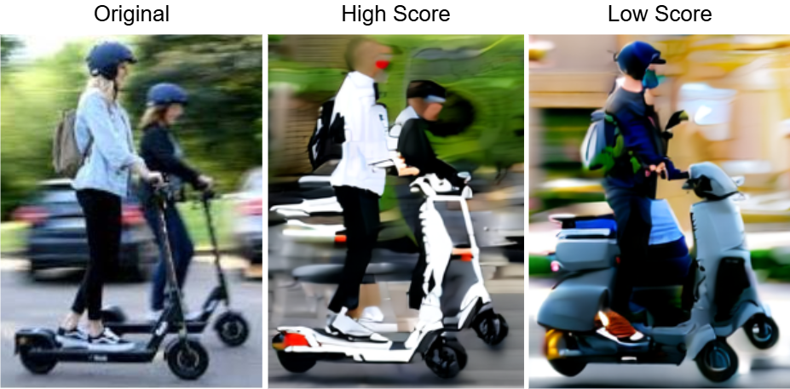
Evaluation & Metrics
Downstream Performance
mAP, AP50
task-oriented measure
Perceptual Quality
FID, IS
fidelity & diversity
Semantic Consistency
CLIP^{[10]} / DINOv2^{[11]} Score
alignment with labels
Human Evaluation
subjective realism & annotation faithfulness
complements automated metrics
Figure 8: Higher CLIP/DINOv2 scores indicate stronger semantic faithfulness.
[10] Radford, A. et al., Learning Transferable Visual Models from Natural Language Supervision, ICML 2021.
[11] Oquab, M. et al., DINOv2: Learning Robust Visual Features without Supervision, TMLR 2024.
Notes:
After training, the models are evaluated through multiple perspectives to understand both task performance and data quality.
For detection performance, I use standard object detection metrics such as mean Average Precision (mAP) and AP50, which directly measure how well the model finds and locates objects. These are task-oriented indicators that reflect real-world performance.
Next, perceptual quality is assessed using FID and IS scores to evaluate the fidelity and diversity of the generated images. Lower FID and higher IS values indicate more realistic and varied results.
To measure semantic consistency, I use CLIP and DINOv2 similarity scores to capture how well an image’s content aligns with its intended labels or descriptions. Specifically, **CLIP** measures image–text alignment, while **DINOv2** captures semantic similarity between visual features.
(Here on the slide, you can see examples of generated images with different semantic scores. Images with higher scores appear more faithful to the intended object.)
Finally, human evaluation complements these automated metrics. Human reviewers rate the realism and annotation accuracy of generated samples, providing human insights that pure numerical scores may miss. This way, we can confirm whether improvements shown by numbers actually make sense in practice.
Together, these layers of evaluation reveal how visual quality relates to real detection performance, offering a comprehensive understanding of data usefulness.
Answer: The meaning of human evaluation?
Human evaluation helps us check what automated metrics can’t capture — mainly how realistic and correctly labeled the generated images are.
It provides a human perspective on visual quality and consistency.
This way, we can confirm whether improvements shown by numbers actually make sense in practice.

Slide 13
Q & A
Thanks for listening!

Slide 14
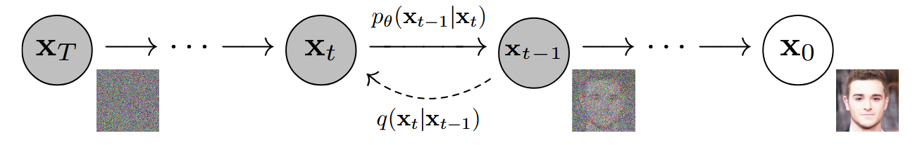
Appendix: Diffusion Model
A diffusion model gradually transforms random noise into a realistic image through a learned denoising process, essentially “drawing” an image step by step.
Figure: Structure of the diffusion model.
Notes:
A diffusion model gradually transforms random noise into a realistic image through a learned denoising process, essentially “drawing” an image step by step.

Slide 15
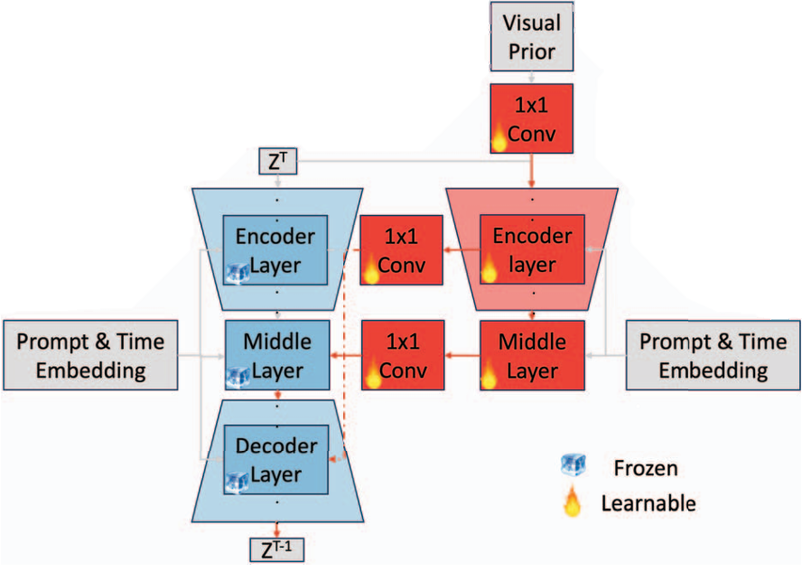
Appendix: Controlnet Structure
Figure: Structure of the controllable diffusion model.

Slide 16
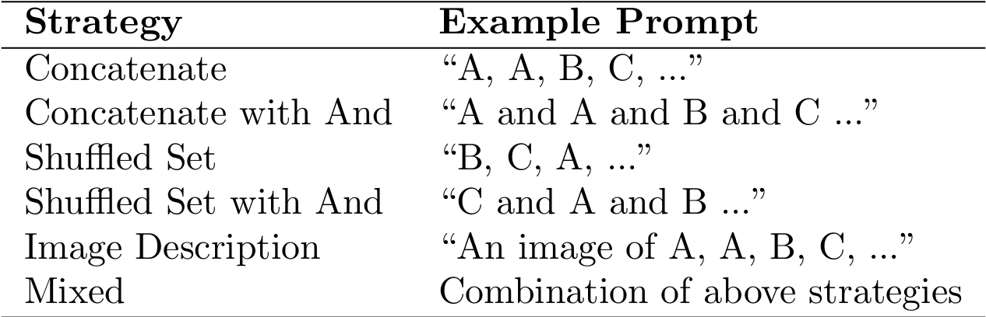
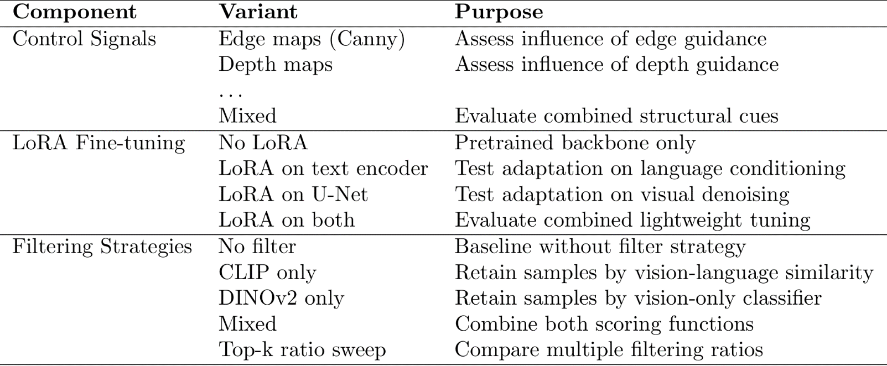
Appendix: Ablation Study
Table 3: Planned prompt construction strategies.
Table 4: Planned ablation experiments on major components of the generation pipeline.

Slide 17
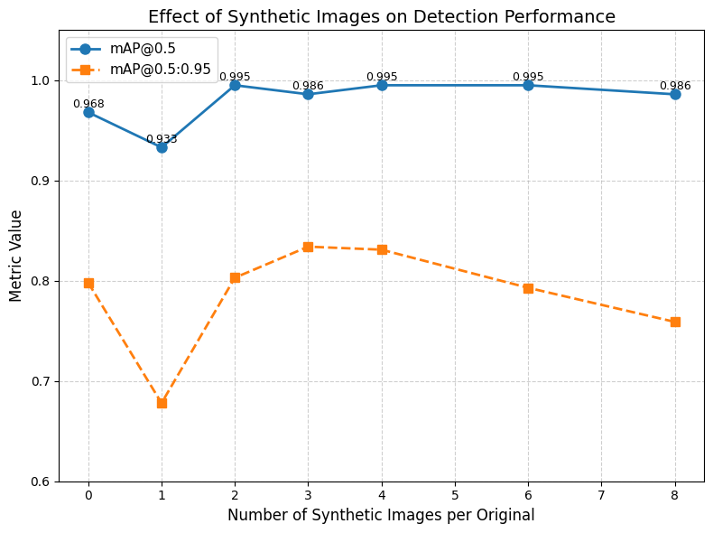
Appendix: Preliminary Result
Model: YOLOv8s
Dataset division: 70% for training, 20% for validation, and 10% for testing (excluding synthetic images).
top-k (0-8) filter synthetic images
retaining about half of the synthetic images improves the model’s performance.

