Slide 1
AV UI Demo

Slide 2
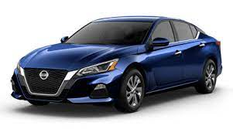

Architecture Diagram
Web server
backend
MQTT server
Car Agent
ROS

Slide 3
Tech Stack
Web UI: ReactJS
Backend: NestJS
Database: PostGres
MQTT
Car Agent app: Python, ROS

Slide 4
Deployment
Azure
http://20.163.8.20/
20.163.10.111
Web Server
backend
MQTT server
Car Agent
ROS
Notes:
all component are deployed under Docker containers. Easy to migrate from dev to prod

Slide 5
Next Steps
UI functions allow a user to pull code or executable files of ros nodes to a selected car
From web UI, user can define a sequence for each car and store it to database
Auto update new versions of car agent application on cars

