Slide 1
Quickstart Guide

Slide 2
Preparation
Download car agent application Nissan_AV_Agent-0.0.1.AppImage from this repository
Url: ssh://stash.ail-sv.com/nrc/nrc_av_ui.git
Branch: feature/FY22_SV_Dev
Folder: release
Pull ROS workspace or catkin project to car agent machine. Assume this machine was installed ROS libraries and can execute ROS core and nodes.

Slide 3
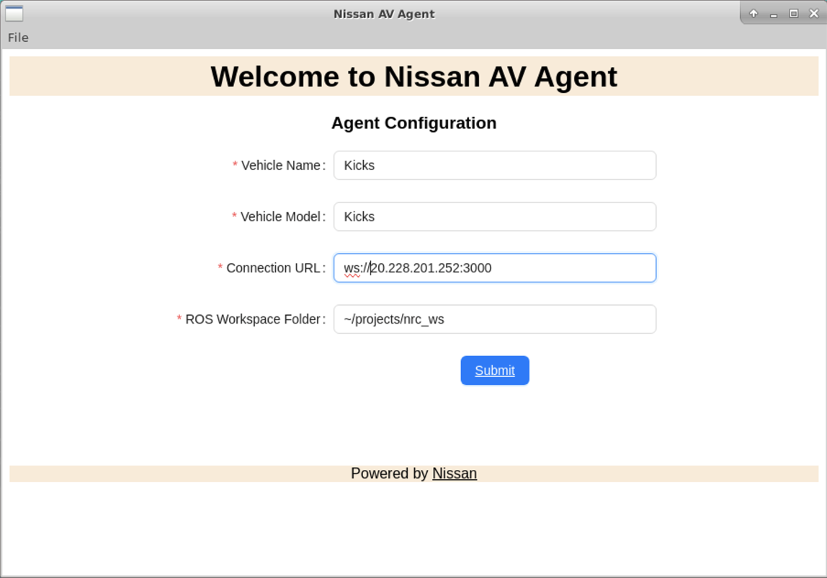
Launch Car Agent App
Run the file in Terminal window on Ubuntu: Nissan_AV_Agent-0.0.1.AppImage
Enter Parameters on UI:
Vehicle name & model: any
Connection URL: ws://20.228.201.252:3000
ROS Workspace Folder: folder path to ROS compiled workspace
Click ‘Submit’ to register car to the cloud system on Azure
This manual step is required for the 1st time of registration. Next time, when we start the app, it automatically connects to server

Slide 4
Car Agent UI after Submit
This screen is after clicking ‘submit’. We need to access Azure server to approve this registration

Slide 5
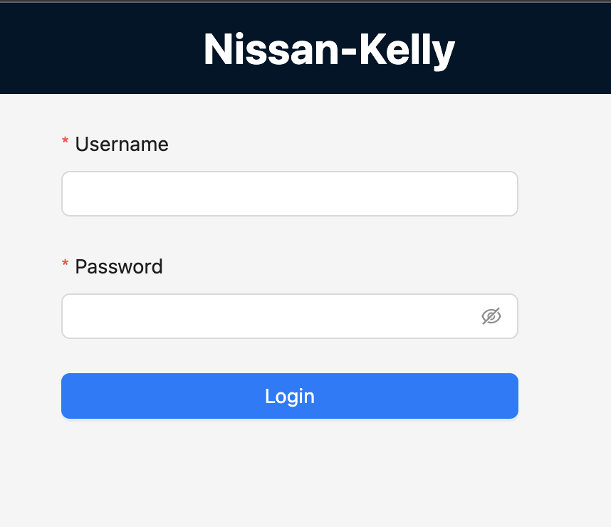
Register Car - Login Web Server
Access http://20.228.201.252 on browser
Login the UI with user: admin, password: nissan!@#123

Slide 6
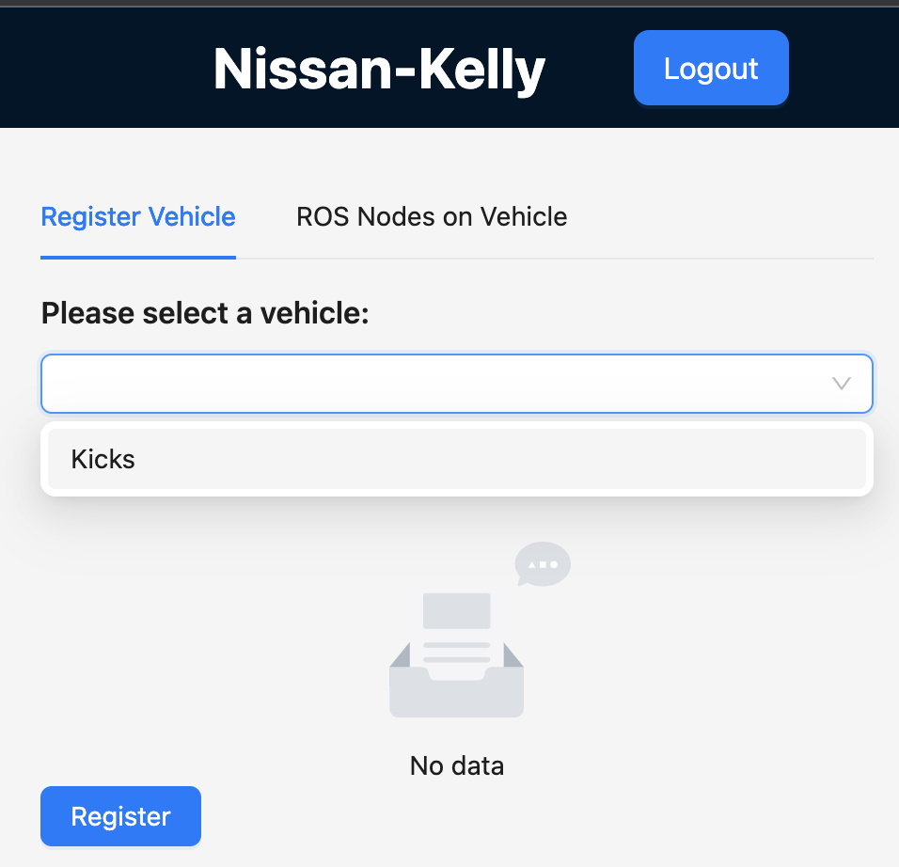
Register Car
After log in the web UI,
Select the car. Unregistered cars will be shown in a list
Click ‘Register’ to approve the registration.

Slide 7
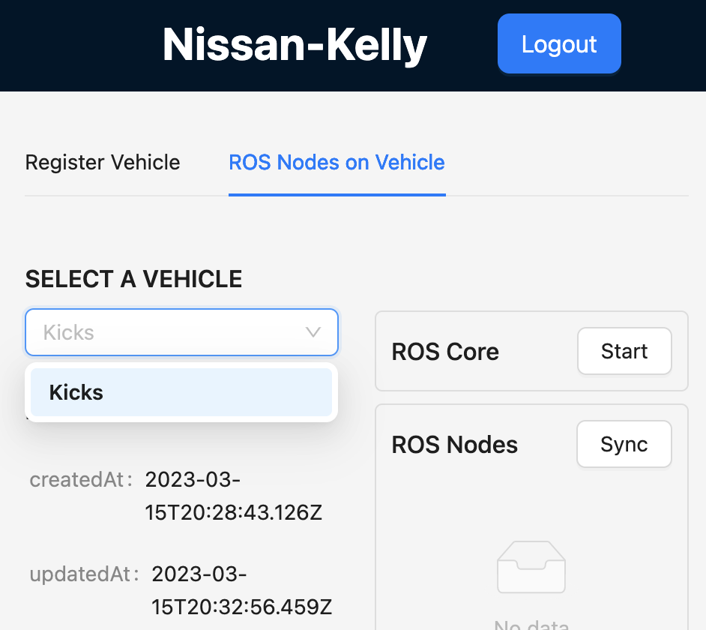
Start ROS Core and Nodes (1)
Click ‘ROS Nodes on Vehicle’
Select a registered online car
Click ‘Start’ ROS Core
Click ‘Sync’ to get ROS nodes installed and compiled on car. (details in the next slide)

Slide 8
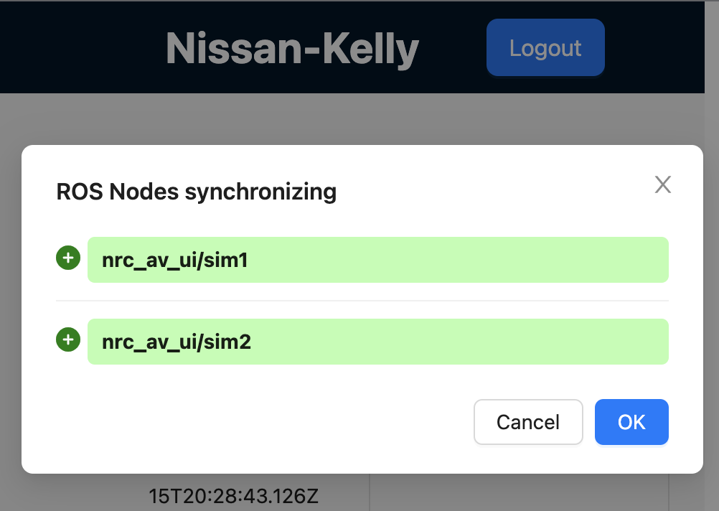
Start ROS Core and Nodes (2)
User needs to sync up ROS nodes when there’re changes in ROS nodes on car. This process is to automatically scan ROS nodes on car in workspace folder (at slide #3)
This screen will shown new added nodes, and removed nodes.
Click ‘OK’ to update ROS nodes of a car in database.

Slide 9
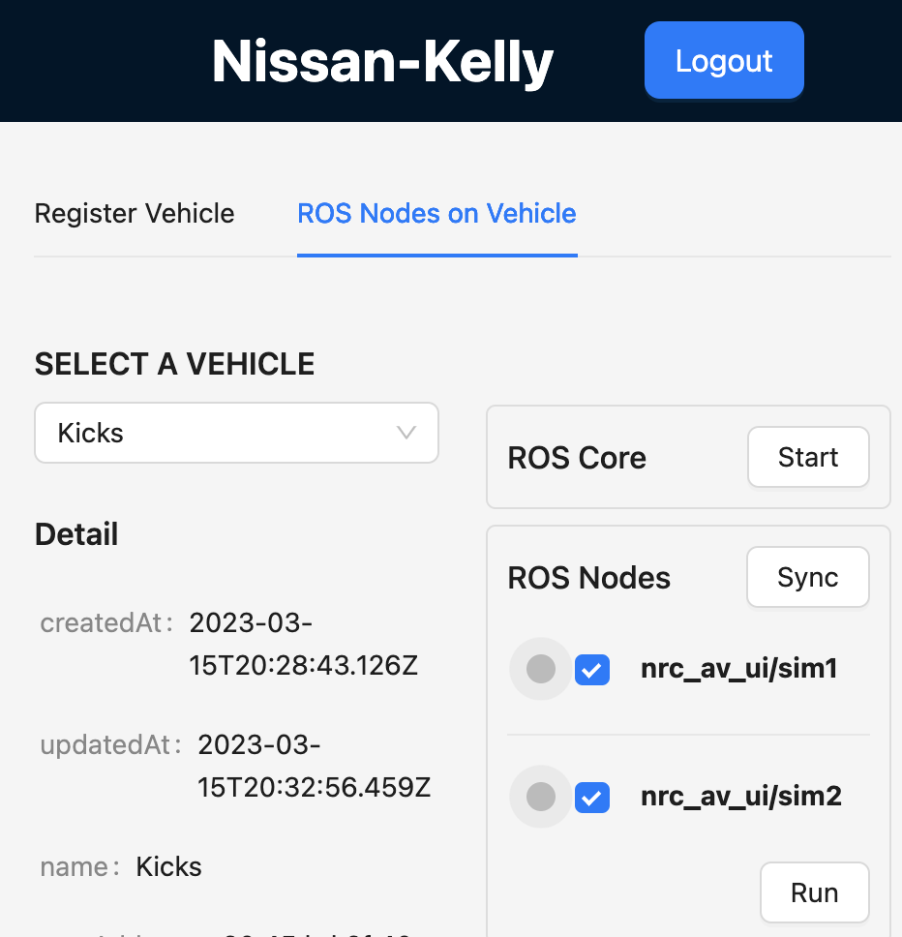
Start ROS Core and Nodes (3)
Select ROS nodes
Click ‘Run’

Slide 10
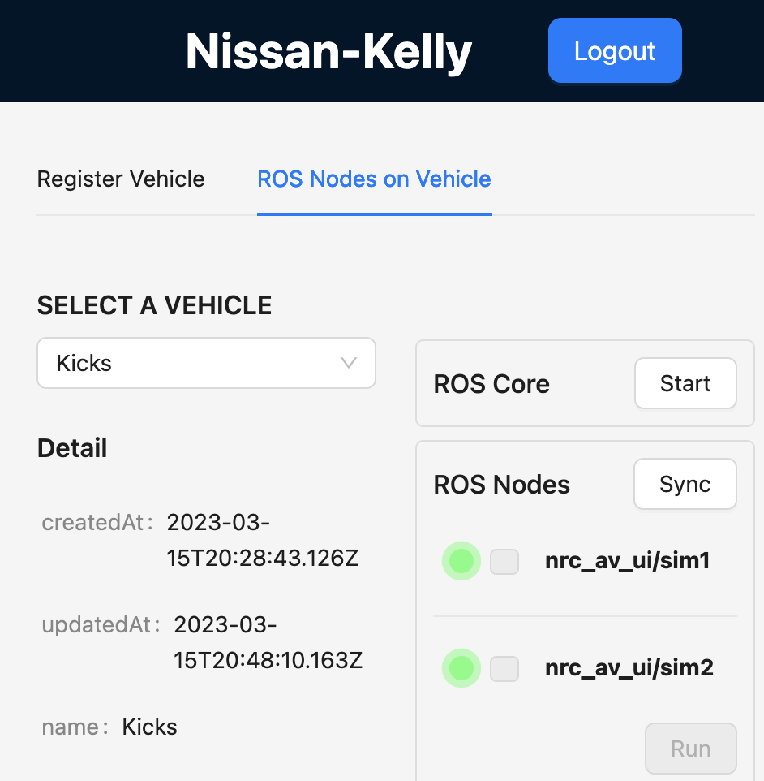
Health Check
User can see status of ROS nodes
Green: Running
Red: Stopped. User can select to run it.

