Slide 1
Tank Battle
B05901016 王珽
B05901064 林承德
B05901185 戴慕潔

Slide 2
Outline
Game Rules
Game Structure
Display
Game State
Tank & Shell
Demo

Slide 3
Game Rules
1

Slide 4
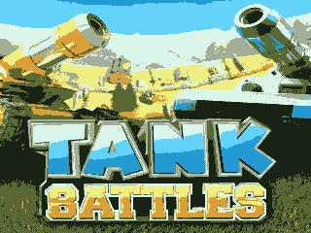
START
Place your screenshot here
Press left together to start

Slide 5
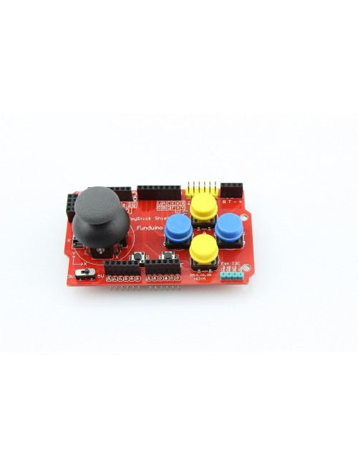
Joystick
↑
←
→
↓
Moving direction
fire

Slide 6
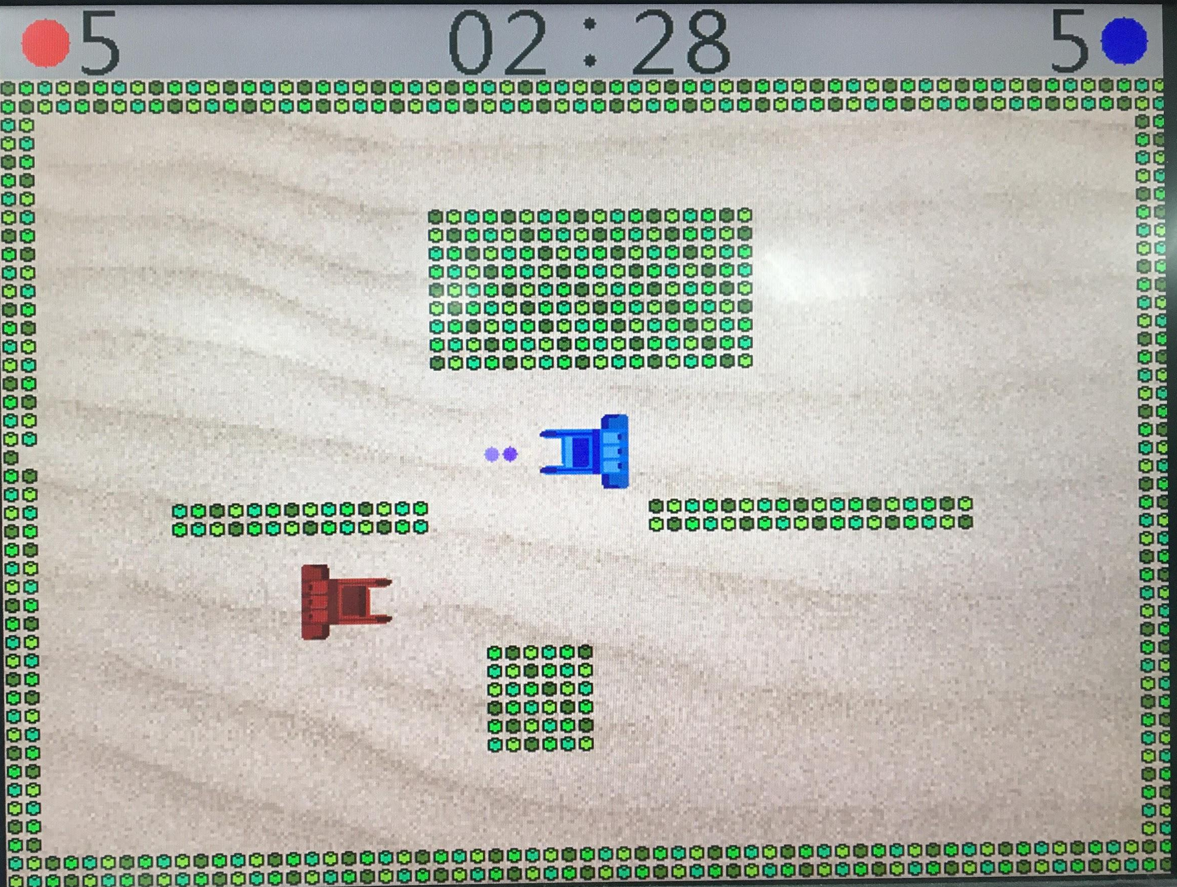
time
How many lives do you left?
Player 1
Player 2
Random map
(8 in total)
The wall can be hit through if you hit more than 3 times

Slide 7
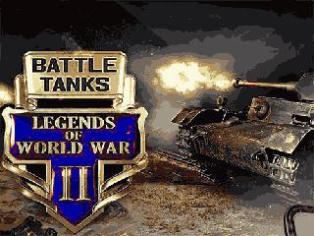
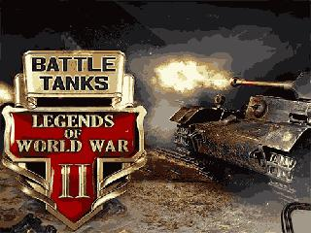
END
Place your screenshot here
Press left together to start the next game

Slide 8
Game Structures
2

Slide 9
DISPLAY
VGA : 640 x 480 resolution with frequency 60Hz
The resolution of Image is 320 x 240
We divided the screen to 64 x 48 grids
Top 4 rows : Status bar
Tank : 5 x 5 grids
Shell : 1 x 1 grid
Wall : 1 x 1 grid

Slide 10
DISPLAY
K-means Clustering
k-means clustering aims to partition n observations into k clusters
We use k = 8 or 16 in this case
Reduce bits per pixel from 24 to 3 or 4.

Slide 11

DISPLAY
Change color
(implement on FPGA)
Origin Image
Resize to 320x240
K-means with k=16

Slide 12
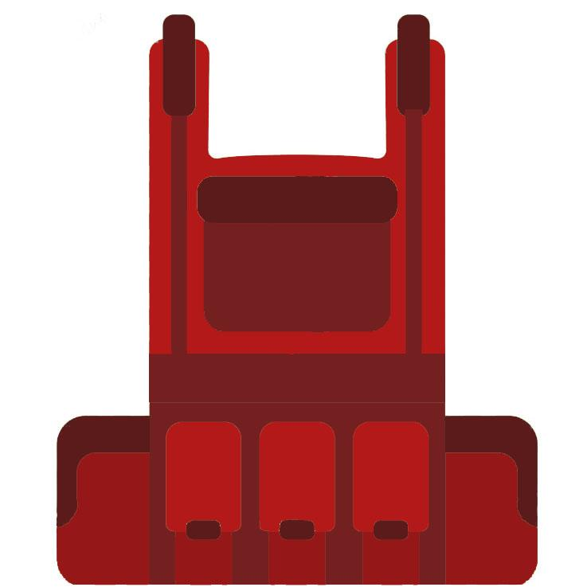






DISPLAY
Remove watermark
Coloring
Crop
Resize 50x50
K-means, k=8

Slide 13
Game States
START
Press left together
Press left together
END
GAME
Implement the collision cases:
Shell hits the wall
Tank hits the wall
Shell hits the other tank
Tank hits the other tank
One of the tank is hit by shell

Slide 14
Tank & Shell
Position
X-position
Y-position
Speed
Tank: Change position once every four frames
Shell: Change position once every 400000 cycles

Slide 15
Demo
3

Slide 16
Thanks!

